Slide 1

“Digital marketing is the act of promoting products and services through digital channels, such as social media, SEO, email, and mobile apps. Any form of marketing that involves electronic devices is considered digital marketing.
It can be done online and offline; in fact, both kinds are important for a well-rounded digital marketing strategy.”
(Patel, 2022)
Notes:
全局英文字体：Arial
全局中文字体：微软雅黑
无用到特殊字体，建议使用微软OFFICE2013或2016演示，效果更佳
感谢你的购买
更多作品，请访问作者主页，为你职场助力。
售后服务QQ：835692134

Slide 2
PLT also often uses brand influencers to get its name out there on social media. Most of these influencers are known worldwide, with the brand working with Instagram stars including Kourtney Kardashian from ‘Keeping Up with The Kardashians’ and Molly-Mae Hague from ‘Love Island’. (Noye, 2022)
I think they do skim over customer acquisition, and do not personalise or target different emails to different groups, which could benefit them if they decide to do this in the future. (Stokes, 2018)
We’re currently integrating a new CRM system. It's used to manage the data for various customer touchpoints in one place, and the subsequent communications, through a variety of different channels, such as email, SMS, push notifications etc. This will allow us to communicate with our customer base more efficiently, bring them more relevant offers and information at the time it suits them best. (Lavey, 2021)
“The first thing I thought when I saw the virtual model was that it was going to negatively impact their sales. (Faulkner, 2022)

Slide 3

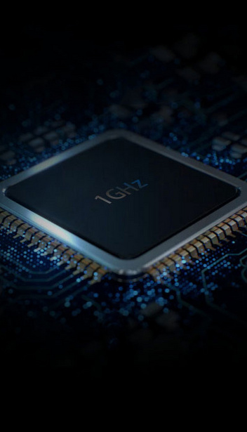
Reference List
Faulkner, A. (2022) Prettylittlething's virtual model slammed as "tone deaf" by customers, Glasgow Standard. Available at: https://glasgowstandard.com/2022/02/07/virtual-model-plt/ (Accessed: December 13, 2022).
Lavey, K. (2021) Prettylittlething's transformation into a big ecommerce name, Drapers. Available at: https://www.drapersonline.com/insight/how-prettylittlething-turned-a-small-ecommerce-business-into-a-global-household-name (Accessed: December 13, 2022).
Noye, M. (2022) How Prettylittlething has adapted with audience, Harvey &amp; Hugo. Available at: https://www.harveyandhugo.com/how-prettylittlething-has-adapted-to-keep-up-with-its-audience/ (Accessed: December 13, 2022).
Patel, N. (2022) What is Digital Marketing?, Neil Patel. Available at: https://neilpatel.com/what-is-digital-marketing/ (Accessed: December 13, 2022).
Stokes, K. (2018) Pretty little thing – a critical evaluation of a marketing email, digitalmarketing. Available at: https://blogs.brighton.ac.uk/kirastokes/2018/11/26/pretty-little-thing-a-critical-evaluation-of-a-marketing-email/ (Accessed: December 13, 2022).

