Slide 1
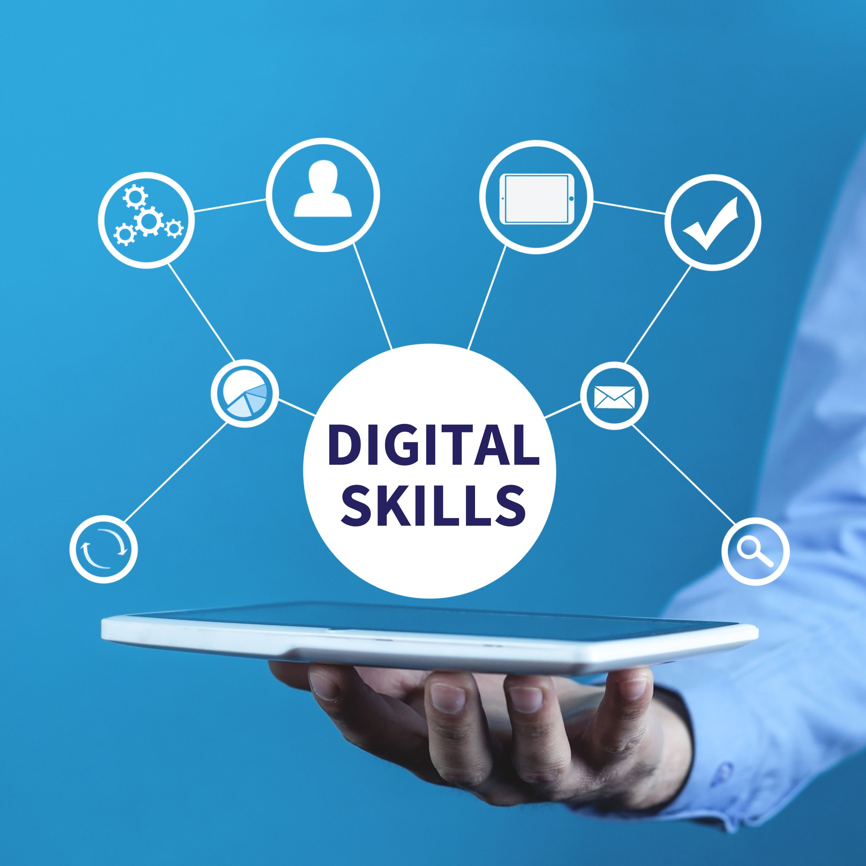
The University of Wales Trinity Saint David
Digital skills and research methods(Lchs4007_birm)
Component 1
Group presentation
Presented by:
Group B
Sabrina Rose 2511942
Tramaine Dorane Graham 2513703
Emmanuel Oppong 2435925
Olabisi Gbadebo Arekemase 2506007
Lecturer: Masud Siddiqui
Presented: 13th October 2025

Slide 2
Speaker plan
Topic | Answered by
The benefits and limitations of MS Excel | Sabrina Rose 2511942
Benefits and limitations of MS teams | Tramaine Dorane Graham 2513703
Impact of limited digital skills | Emmanuel Oppong 2435925
Checklist for digital safety practices | Olabisi Gbadebo Arekemase 2506007

Slide 3

Introduction
Definition of digital skills
Why are they needed in a care home setting?
What will we be discussing today?

Slide 4

What are the benefits of using Ms Excel?
Simple and easy to use. Basic training, if necessary (NHS,2023)
Clear layout and legible
Can be used for various tasks within the company
Saves time instead of writing, less chance of human error
Secure storage of information
Improves quality by enhancing safety and enabling more ‘responsive’ care. (cambridge.org, 2023)

Slide 5
What are the limitations of using Ms Excel?
Staff being digitally incompetent
Internet stability to support use (.GOV, 2023)

Slide 6
Summary
Struggles faced with research
How can I overcome them?
Overall summary of the use of MS Excel in the sunrise care home.
Thank you for listening, if there are any questions I would be happy to answer as it could assist with future research.
I will now hand over to my classmate Tramaine Graham, who will answer the next question.

Slide 7
Reference list:
NHS England, 'Health England', www.England.nhs.uk/longread/digital-skills-health-informatics-competency-standards-frameworks-and-tools-for-healthcare-professionals/ version 1.2,(Dated 26/05/2023), Date sourced 21/09/2025
(Image), 'Step2Skills' www.events.hertfordshire/step2skills/2324-digital-skills-for-work-copy (Date sourced 21/09/2025)
.GOV 2023, Digital working in adult social care: What good looks like www.gov.uk/government/publications/digital-working-in-adult-social-care-what-good-looks-like/digital-working-in-adult-social-care-what-good-looks-like-for-local-authorities-and-care-providers (Date accessed 29/09/2025)
Cambridge.org, Technology and homecare in the UK: Policy, storylines and practice | Journal of Social Policy https://www.cambridge.org/core/journals/journal-of-social-policy/article/technology-and-homecare-in-the-uk-policy-storylines-and-practice/DA9669E0025249E9FF14873F8490F6BDD (Date accessed 03/10/2025)

Slide 8
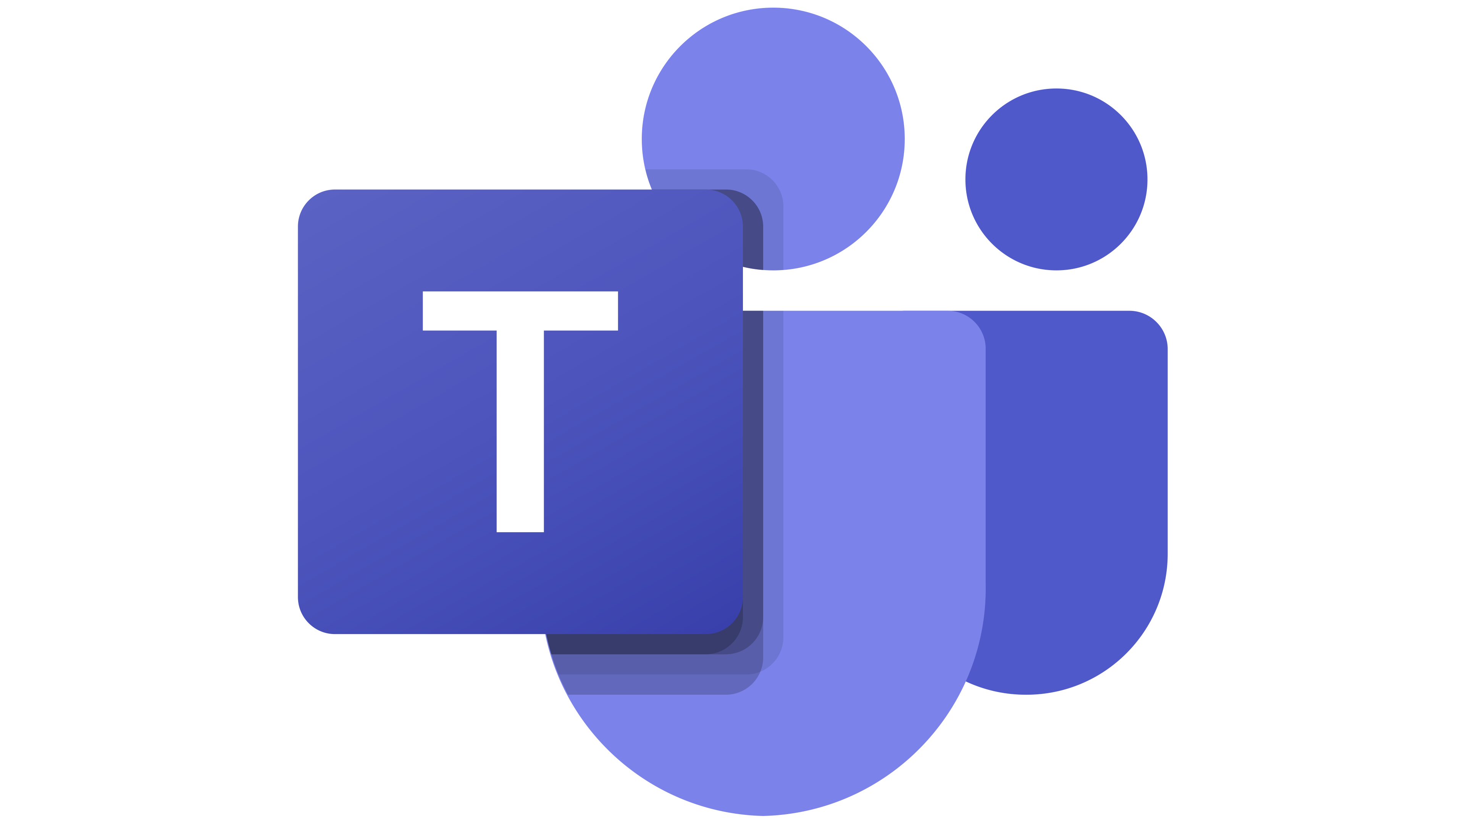
How using Microsoft Teams, can be used in Sunrise Care Home.
Presented by Tramaine Graham

Slide 9
Introduction
Today I will present on Microsoft Teams- otherwise known as (MS Teams). What are its benefits and limitation within the Sunrise Care Home.
I will provide a brief overview about what Microsoft Teams is, highlighting some of its key features and explaining what each different features offers.

Slide 10

What is Microsoft Teams
Is a real-time app within Microsoft 365 that facilitates one-on-one chats, group conversations, voice and video calls, and virtual meetings and features like screen sharing and whiteboards.
It offers a collaborative platform for companies to communicate, share files, conduct rich online meetings, and manage tasks efficiently. Its extensive web conferencing integrates virous Microsoft 355 tools to boost productivity.
The platform also supports teamwork through channels, both with and without Microsoft 365 apps, along with customizable notifications and sharing options to manage information effectively.
Sanders, C. (2021-23) Chicago: American Bar Association; GP solo p.55-58

Slide 11
The Features In Microsoft Teams
File Sharing
Screen Sharing
Security
Video Conferencing
Teams
Calling
Conversation Threads
External Collaboration
Meeting Join
Reduced Email
Slash Commands
Secure Collaboration
Group Chats
Immersive Reader
Integrations
Microsoft 365 Intergration
Teams Chat Notification
Video Meetings
Advanced Metting Capabilities
Together Mode
AI Tools
Channels
Chats

Slide 12
Examples of how some of the features can be used.
Chat: will engage in individual or group conversation with media support, including gifts, stickers and flies.
Meetings: You can schedule and conduct virtual meetings with the options for audio, video, screen sharing, and presentation with tools like – PowerPoint live and Microsoft white board.
Live Events& Webinars: Is for larger audience, host large- scale events or webinars with dedicated features for attendees and presenters.
Together Mode: Experience meetings in a virtual and digitize shared space, making interactions feel more engaging and interactive.
Channels: Is useful for organising conversations and work around specific projects or teams, keeping everyone on the same page.
File Sharing: seamlessly share and real time collaboration on documents and files within the chats, channels and team meeting recordings.

Slide 13

The Benefits and Limitations using Ms Teams in Sunrise Care Home.
Benefits
The implementations of Ms Teams can be useful and beneficial at Sunrise care home, can greatly enhance communication and facilitating efficient, reliable transfer and documents and files.
It is helpful for the organisation to host large meetings with multiple participants and can schedule and undertake various methods of communication, while offering flexibility and scalability for collaboration with employees and other team members.
The platform consolidates communication and teamwork in a single app, seamlessly integrates
with Microsoft 365 tools, and includes strong security features, making it a highly suitable choice for Sunrise care home.

Slide 14

The Benefits and Limitations of Using MS Teams in Sunrise Care Home
Limitations
A rule of circumstances may arise with restrictions or problematic servers.
A steep learning curve and an overwhelming interface pose challenges for new users.
There are notable performance issues,, such as slowness, high resource usage, and unreliable message delivery, notification and syncing.
Additional drawbacks include poor external user access, file management challenges, limited channels, and susceptibility to internet interference.
When you use Teams as Part of a larger Microsoft 365suite, many of the features it offers become redundant, and the solution loses some of its overall value.

Slide 15
CONCLUSION
MS Teams was introduced in March 2017.
Microsoft Teams is designed for people and organisations with busy schedules who cannot meet in person. The platform has proven to be a practical alternative for establishing a virtual and audio process that is not only efficient and reliable but also increases collaboration between employers, employees and companies.
The primary goal is to ensure that accurate and timely communication is provided and can facilitate a wide range of options on one application.

Slide 16
REFRENCES
aztechIT (2024) Benefits of Microsoft Teams for Small Business & Enterprise. Available at: https://www.aztechit.co.uk/blog/microsoft-teams-benefits#:~:text (Accessed: 10 October 2025)
CloudTech24 What are the Benefits of Using Microsoft Teams in 2024? Available at: https://cloudtech24.com/2024/01/benefits-of-microsoft-teams/ (Accessed: 10 October 2025)
Jotform (2025) The pros and cons of Microsoft Teams. Available at: https://www.jotform.com/blog/microsoft-teams-pros-and-cons/ (Accessed: 10 October 2025)

Slide 17

DIGITAL LITERACY
ITS IMPORTANCE, IMPACTS AND HOW IT IS MANIFESTED

Slide 18
DIGITAL LITERACY
Digital literacy according to UNESCO institute for statistics(2018) is "the mean to understand basic skills or ability to use computer confidently, safely and effectively, including the ability to use office software such as word processors, email and presentation software". In sunrise care home digital literacy include being aware of the privacy/regulatory obligations and recognising cyber risks, and the ability to practically use devices and software to interpret digital records, to follow digital procedure and to adapt when system change.
Limited digital literacy among the staff of Sunrise can cause concrete risks to residents' safety and quality of care, and can also slow the flow of work, generate gaps in communications, and gives extra workload of the staffs who are digitally confident.

Slide 19

THE IMPACT OF LIMITED DIGITAL LITERACY ON CARE DELIVERY.
•One of the major impacts limited digital literacy have on the residents of Sunrise care home is medication and clinical errors. This is because, when staffs cannot confidently enter or retrieve digital medication charts of patients, it can result in multiple doses or missed doses, and it also makes cross check.
•Another impacts limited digital literacy have on the residents and staff of Sunrise care home is that it slows down/ cause a delay in clinical decision making and response time. When the up-to-date records of a patient is digitally entered and a staff cannot access it quickly, it can cause harm to residents who are in critical situation.
Limited digital literacy ln care delivery waste staff time and inefficiency. Working manually take time away from direct care; most studies report that staff spend too much time on administrative tasks
Lower quality of person-centred. If a staff at Sunrise care home can't make use of the tools that compile data, plans for caring become less-evidence based and making chages nearly impossible.

Slide 20
IMPACT ON COMMUNICATION.
Missed handovers and fragmented information flow is an impact limited digital literacy have on the staff of Sunrise care room. Digital handovers such as Teams messages, shared shift notes makes it possible for a staff on a different shift know what went on with the residents during their absent and this can only be possible depending on staff knowing and checking how to use these channels. Due to limited digital literacy among staff, some important information and updates will be missed which can cause harm to the residents.
Another impact is the gaps in family communication. Residents in the care home are other people's family who have become the responsibility of the staff, so the family outside the care home needs to know the wellbeing of the residents.
Another impact limited digital literacy have on sunrise care home is the increase reliance on telephone or face to face communication which is not always possible.
Breakdown of multidisciplinary collaboration is also an impact limited digital literacy have on sunrise care home. Staffs low confidence in digital literacy reduces effective participation in multidisciplinary discussions and delays referrals.

Slide 21
IMPACT ON TEAMWORK AND WORKFORCE WELLBEING
Unequal workload and digital burden. In the sense that, staff with digital know how will pick up extra administration work and will be shifted around during work to help other colleagues this will increase their workload and make them resent work. Thus, because they are doing too much job for less pay.
Another impact limited digital literacy have on teamwork is the problem with retention and training. When new systems are introduced without adequate support, staffs feel overwhelmed and are mostly scared to make mistakes. For instance, a carer in sunrise might accidentally delete an important note or struggle to guide an electronic medication chart, they will lose their confident and not try to use the digital chart if their mistake is not guided but rather criticised. “Digital change fails when end-users do not feel competent, confident or supported”.(Greenhalgh,2017).
Inter-professional friction:
Lower staff morale and resistnce to technology.
inter

Slide 22
References
UNESCO Institute for Statistics (2018) A global framework of reference on digital literacy skills for indicator 4.4.2. Montreal: UNESCO Institute for Statistics. Available at: https://uis.unesco.org (Accessed: 5 October 2025).
Greenhalgh, T., Wherton, J., Papoutsi, C., Lynch, J. and Hughes, G. (2017) Journal of Medical Internet Research, 19(11), e367. Available at: https://www.jmir.org/2017/11/e367/ (Accessed: 10 October 2025).

Slide 23

Digital Safety Practices in Sunrise Care Home.

Slide 24
INTRODUCTION
Today I will be presenting about the Digital Safety and Practices. Covering secure logins, email safety, and safe document and storage.
By Olabisi Gbadebo Arekemase

Slide 25
Benefits:
Protects resident privacy and dignity
Ensures sensitive, personal and medical information remains confidential
Prevent unauthorised access to resident’s health records, photos or communications
Supports safe and effective care delivery

Slide 26
limitations
Limited staff digital skills and awareness
Cost and resource constraints
Dependence of technology
Resistance to change, some staff or residents may prefer traditional (paper-based) methods
Balancing privacy with accessibility
Third party risks

Slide 27
Checklist
Data protection & confidentiality. For example, all resident's records are stored digitally that are encrypted and password protected.
Access to care records is restricted to authorised personal only.
Staff use individual login credential.
Device and network security .
Password protection and Authentication.
Email and communication safety.
Incident management.

Slide 28
Conclusion
Digital safety in Sunrise Care Home summarises that residents personal and health information, staff data, and organisations system are protected from misuse, loss, or cyber threats.
This checklist outline the key areas and is equipped with advanced monitoring and the Maintenace of good digital practice.
In summary effective digital safety in a Sunrise care home protects resident's privacy, ensures compliance with data protection laws, efficient care delivery.

Slide 29
REFRENCES
Care Quality Commission (2023) How we regulate Guidance on data Security and information Governance in Care Services, London: CQC Available at: https://www.cqc.org.uk (Accessed 8 October 2025)
Department of Health and Social Care (2023) Data Security and Protection Toolkit Guidance, London DHSE Available at: https://www.dsptoolkit.nhs.uk (Accessed 8 October 2025)
NHS Digital (2023) Dat Security Standards for Health and Social Care Leads: NHS digital Available at: https://digital.nhs.uk/data-security (Accessed 8 October 2025)

