Slide 1
Luke Morgan
Arcade flying game.

Slide 2
Initial Idea and inspiration.
My initial Idea was a simple WW2 game.
Played the board game scythe and loved the art style.
Looked into it a bit more and started to research the artist and inspirations.

Slide 3
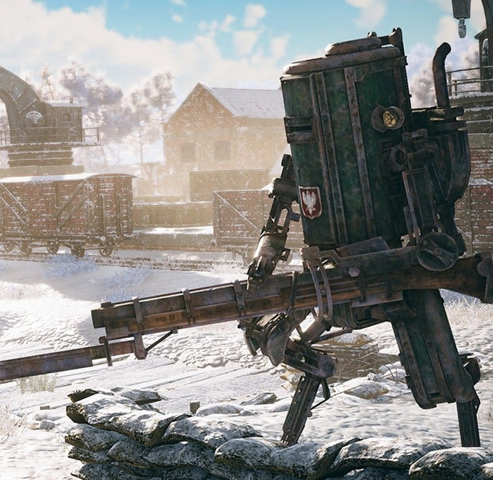
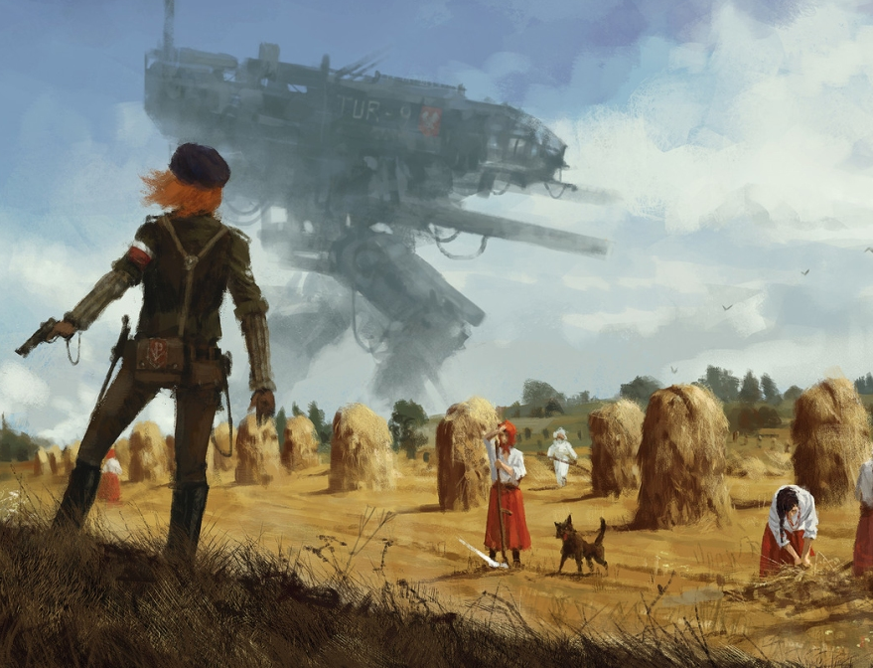
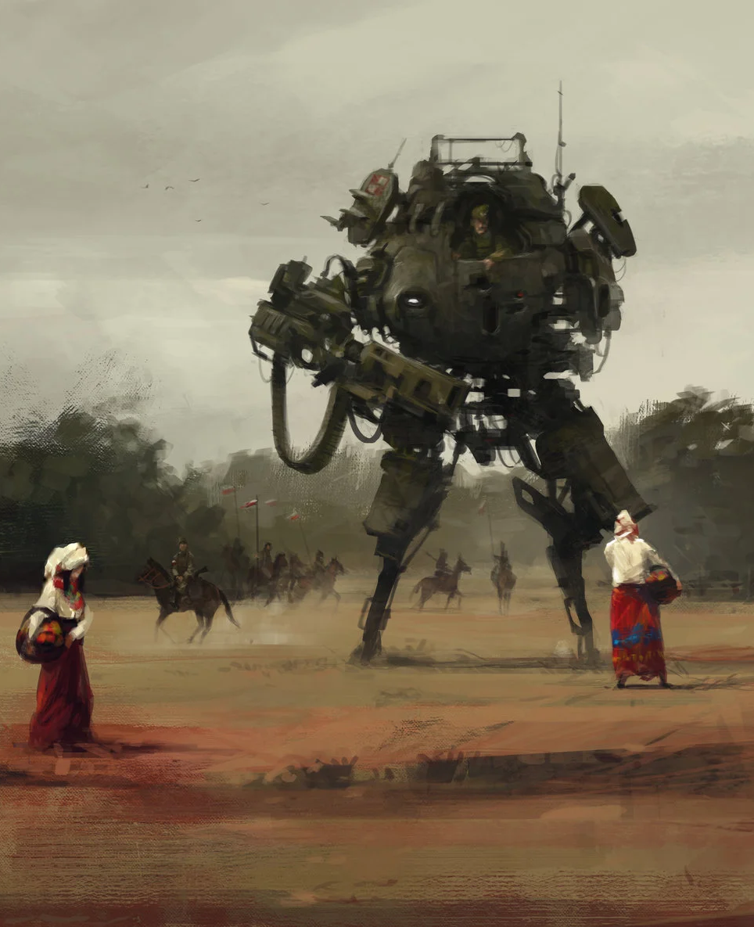
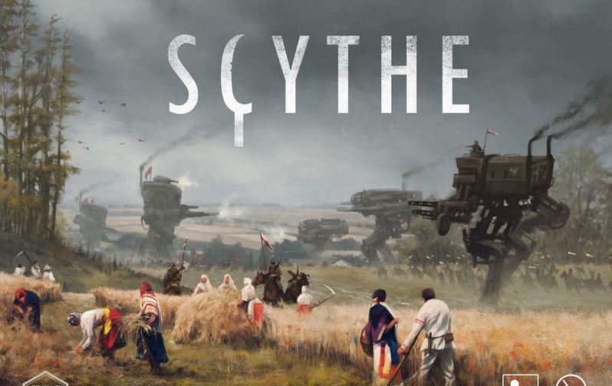
Inspirations and research.
I did some research in to the board game Scythe[1] and the digital game Iron harvest[2]. The artist Jakub Rozalski who Created artwork for both.
I had a look at his Art station[3] page and looked at how he made his artwork.
This helped to inform me on methods of creating my own designs.

Slide 4
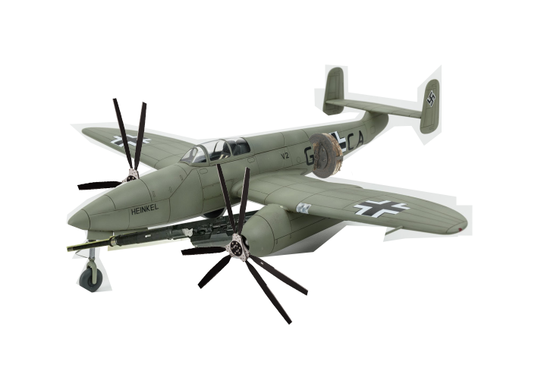
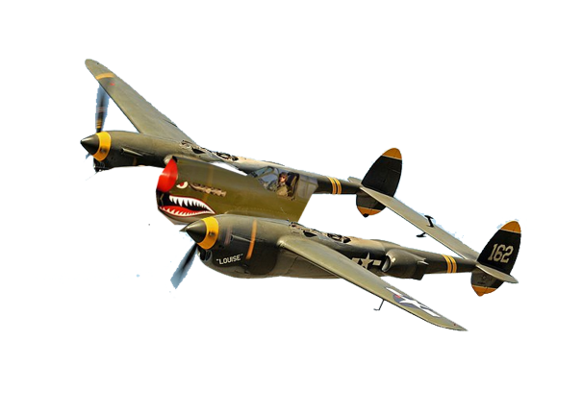
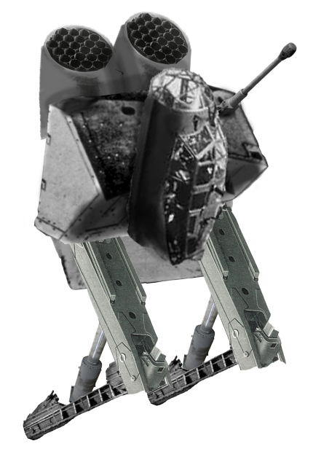
Photo bashing.
To come up with the designs for the Air craft I made some designs on photoshop by bashing loads of images together. Mostly from WW2 and WW1

Slide 5
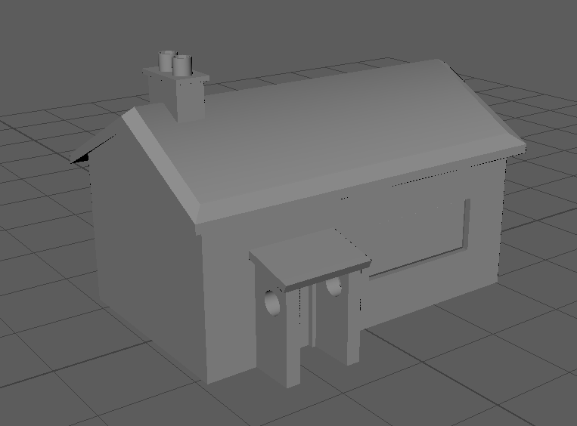
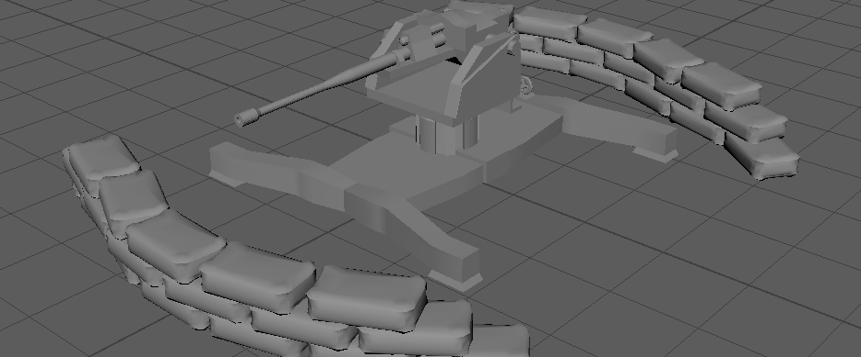
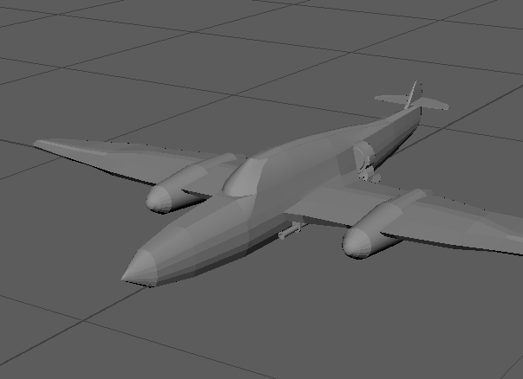
Modelling
I used Maya to model in as it is the software, I am most familiar with.

Slide 6
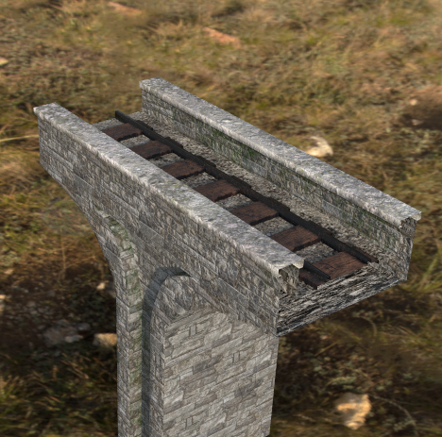
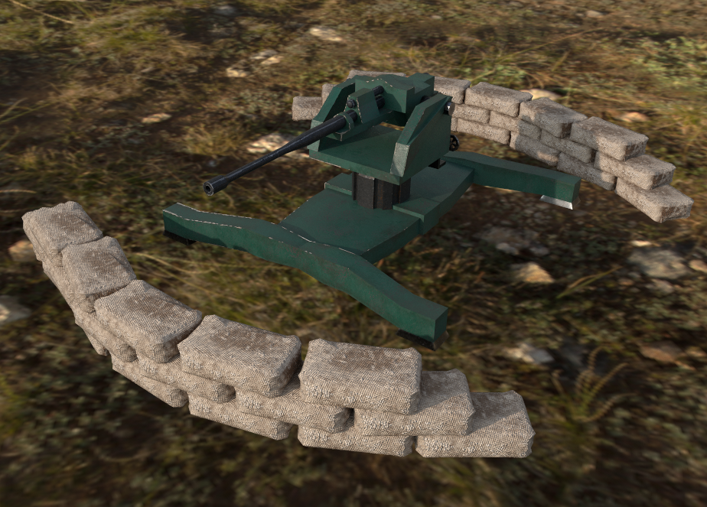
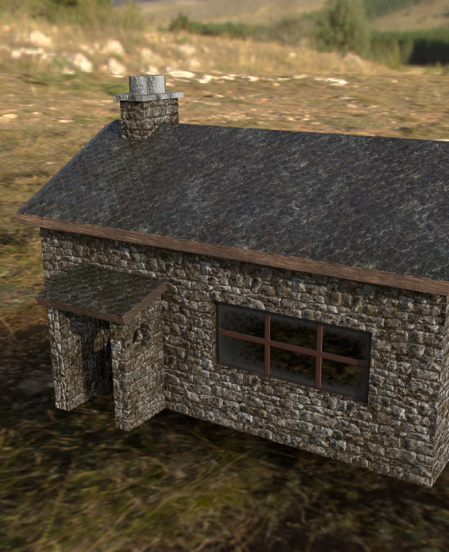
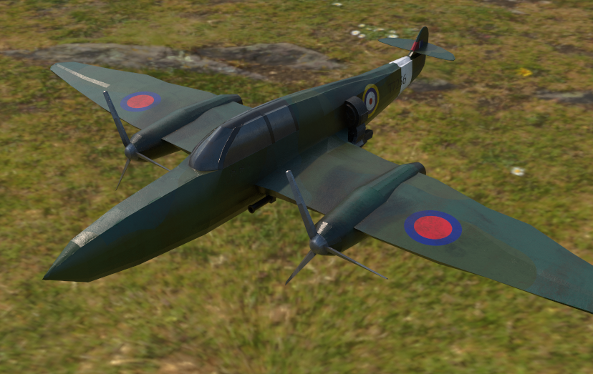
Texturing
I am extremely pleased with the textures I made for these model and honestly think they are some of the best I've made. I used Adobe Substance painter to create the textures.

Slide 7
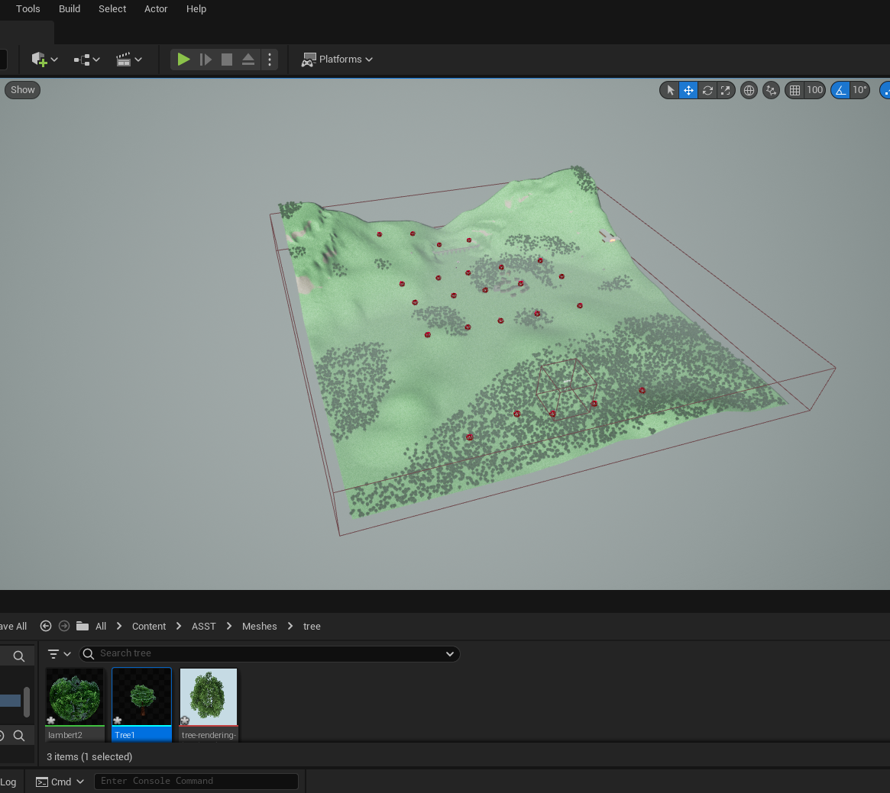
Unreal Engine
This is probably the most time I've spent on a project in Unreal
I learnt a lot about it other the course of the project

Slide 8


Problems that occurred
One of the biggest issues was using the foliage brush to create trees
Below is the frame rate with and without the trees on screen.
I found out this issue was because all the trees were classified as actors.
I fixed the issue by changing all of the trees from actors to standard meshes.

Slide 9

Questions

Slide 10
References
[1] Scythe.[Boardgame], USA: Stonemaier games, 2016
[2] Iron Harvest.[software], Austria: KING Art, 2020
[3] J. Rozalski, “Artstation - Jakub Rozalski,” Art Station. [Online]. Available: https://www.artstation.com/jakubrozalski. [Accessed: 30-April-2023].

