Slide 1
M O D U L E L C H S 7 0 0 9 · P O P U L A T I O N H E A L T H A N D D I G I T A L H E A L T H P R O M O T I O N
GROUP MEMBER 1 · JUSTIFICATION
Justification
Why this target group, why this problem, and why our response
STUDENT NAME
STUDENT ID
MD Rimon Miah
2509982
LECTURER
ASSIGNMENT
Dr Ping Wu
Component 3 – Group Project Presentation
SCREEN ADDICTION · DIGITAL HEALTH PROMOTION
4

Slide 2
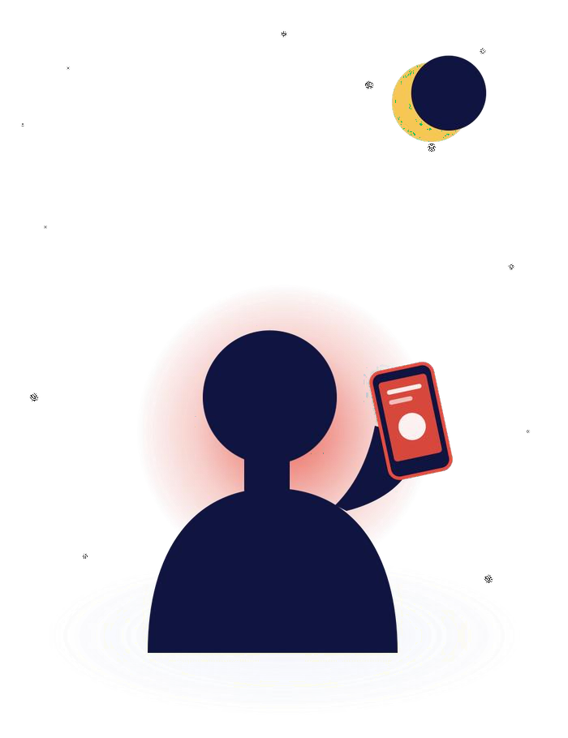
Digital Technology Overuse and Screen Addiction
M O D U L E L C H S 7 0 0 9 · P O P U L A T I O N H E A L T H A N D D I G I T A L H E A L T H P R O M O T I O N
A school-based digital health promotion intervention for adolescents
T A R G E T G R O U P
Adolescents aged 13–18
S E T T I N G
UK secondary schools
P U B L I C H E A L T H P R O B L E M
Excessive recreational screen time
GROUP PROJECT · COMPONENT 3 PRESENTATION
SCREEN ADDICTION · DIGITAL HEALTH PROMOTION

Slide 3




Activity: Aim & Content
A S A G R O U P · O U R A C T I V I T Y
What we are delivering, and why it is designed this way
AIM
To decrease excessive recreation screen time and enhance digital wellbeing of school-aged adolescents using a structured evidence-based self-monitoring programme.
CONTENT — HOW THE ACTIVITY RUNS
School sign-up & orientation
Daily self-monitoring
Weekly wellbeing dashboard
Gamified healthy-use rewards
All students are registered via form time and a brief introduction during form time.
Students record screen time and are gently nudged, not warned, in-app.
A personal database is shared with student and reviewed weekly.
Small in-app rewards are earned through streaks for sleeping, studying offline.
SCREEN ADDICTION · DIGITAL HEALTH PROMOTION

Slide 4
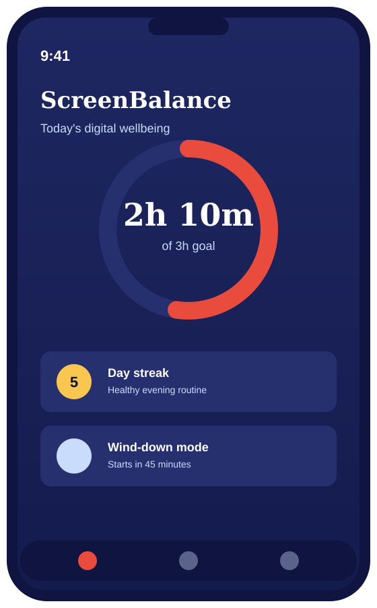


The Technology: ScreenBalance App
A S A G R O U P · O U R T E C H N O L O G Y
A gamified, self-monitoring digital-wellbeing app for schools
Screen-time tracking
Automatically tracks daily recreational screen use and shows progress toward a healthy goal.
Gentle nudges, not warnings
Gives positive supportive reminders without blocking or punishing use.
Gamified rewards
In-app rewards are earned after a period of consecutive good sleep, study, and screen-free behaviors.
Weekly wellbeing dashboard
A weekly overview provided to the student as a primary focus rather than to parents/staff.
Built-in data privacy
Screen-time data is securely kept and only accessed for a student's own goals.
Built on validated self-monitoring behaviour-change techniques
SCREEN ADDICTION · DIGITAL HEALTH PROMOTION

Slide 5
Why This Target Group?
J U S T I F I C A T I O N
Adolescents aged 13–18, in school settings
52%
81%
2–3 hrs
rise in UK children's screen time between 2020–2022
of adolescents (12–17) exceed 2 hours of daily screen time
max. daily leisure screen time recommended for ages 13–18
UK Education Committee, 2024
Zhou et al., 2025
Swedish Public Health Agency, 2024
Target group rationale: Adolescent access to the internet and digital media crystallizes during the critical period of the teenage years and is provided equally at school, which may be the sole place where some adolescents can access health information otherwise.
SCREEN ADDICTION · DIGITAL HEALTH PROMOTION

Slide 6



Why Schools as the Setting?
J U S T I F I C A T I O N
The practical case for delivering this intervention in school
Universal reach
Equitable access
Trusted, supervised setting
Consistent delivery
All youth are in school, irrespective of family income or parental involvement.
Attains learners who are not likely to access health or wellbeing services.
Wellbeing is already included in the PSHE curriculum, providing an existing platform upon which to develop.
A whole year group is reached at the same time using the same programme, to the same standard.
SCREEN ADDICTION · DIGITAL HEALTH PROMOTION

Slide 7


What the Evidence Shows: Mental Health
J U S T I F I C A T I O N
National guidelines and recent research linking screen overuse to mental health harms
Sleep displacement drives depression
In a 12-month longitudinal study of 4,810 Swedish children aged 12–16, sleep quality, duration, and timing were each independently associated with increased depression symptoms as a result of screen time.
Social media linked to poorer mental health
A study of 413 adolescents aged 12 to 15 in the Bradford area of England revealed that their daily use of social media was linked to poorer mental health.
Hökby et al., 2025
Pickavance et al., 2026
SCREEN ADDICTION · DIGITAL HEALTH PROMOTION

Slide 8


What the Evidence Shows: Physical Health
J U S T I F I C A T I O N
The same overuse pattern also affects the body, not only the mind
Systematic review of reviews: moderate-to-strong evidence links screen time to obesity, poorer diet, and reduced quality of life in children and adolescents.
British Psychological Society, 2026
Obesity & poor diet
Lower levels of physical activity and changes to usual eating hours have been associated with increases in weight and eating poorly.
Reduced quality of life
In all of the studies reviewed, an increase in screen time was found to be correlated with a decrease in overall well-being scores.
SCREEN ADDICTION · DIGITAL HEALTH PROMOTION

Slide 9




Consequences of Not Addressing This Problem
J U S T I F I C A T I O N
If adolescent screen overuse is left unaddressed in schools
Rising anxiety & depression
Chronic sleep deprivation
Obesity & poor dietary habits
Falling academic performance
Social isolation & weaker peer bonds
Left unmanaged, these harms compound over adolescence and carry into adulthood — making early, school-based intervention essential.
SCREEN ADDICTION · DIGITAL HEALTH PROMOTION

Slide 10

Our Response
J U S T I F I C A T I O N
A school-based digital health promotion intervention
ScreenBalance App
A self-monitoring, gamified digital-wellbeing app through the school's digital health programme.
Monitors screen time and provides gentle reminders Recognizes healthy-use streaks (sleep, study, offline time) Weekly dashboard shared with the student, not parents.
SCREEN ADDICTION · DIGITAL HEALTH PROMOTION

Slide 11
Why This Intervention?
J U S T I F I C A T I O N
Three reasons ScreenBalance is the right response for our target group
Evidence-based
Designed around self-monitoring behaviour-change strategies that have been proven to decrease excessive screen time.
Reaches every student
Delivered in-school, without relying on parental
resources and engagement.
Protects, doesn't punish
Encourages healthy digital habits, not a blanket
ban more sustainable in the long-term.
SCREEN ADDICTION · DIGITAL HEALTH PROMOTION

Slide 12


In Summary
J U S T I F I C A T I O N · S U M M A R Y
Our target group are adolescents in UK schools (aged 13 to 18), which we have selected due to their size and their access to the school.
Recent research and national guidelines have attributed this overuse to mental and physical harms which, if untreated, may be cumulative.
Our solution, ScreenBalance, is evidence-based, reaches all students, and establishes habits, not penalties.
Next: Group Member 2 will present the Application — the planning model used to deliver this intervention in schools.
SCREEN ADDICTION · DIGITAL HEALTH PROMOTION

Slide 13



Group Member 1
Our Response
ScreenBalance App
A self-monitoring, gamified digital-wellbeing app delivered
through the school's digital health programme.
Tracks daily screen time and sends gentle nudges
Rewards healthy-use streaks covering sleep, study and offline time
Weekly dashboard shared with the student, not just parents
Why This Intervention
Evidence-based
Built on self-monitoring behaviour-change techniques shown to reduce excess screen use.
Reaches every student
Delivered in-school, so it does not depend on parental resources or engagement.
Protects, does not punish
Builds healthy digital habits instead of a blanket ban, which is more sustainable long term.
University of Wales Trinity Saint David
Transforming Education. Transforming Lives.

Slide 14
PROGRAMME: MSC PUBLIC HEALTH AND SOCIAL CARE IN PRACTICE
MODULE LCHS7009 · POPULATION HEALTH AND DIGITAL HEALTH PROMOTION
Digital Technology Overuse and Screen Addiction
ScreenBalance: A School-Based Digital Wellbeing Intervention for Adolescents
GROUP MEMBER 2 · APPLICATION
STUDENT NAME
STUDENT ID
Pinkalben Macwan
2518469
LECTURER
ASSIGNMENT
Dr Ping Wu
Component 3, Group Project Presentation
University of Wales Trinity Saint David

Slide 15

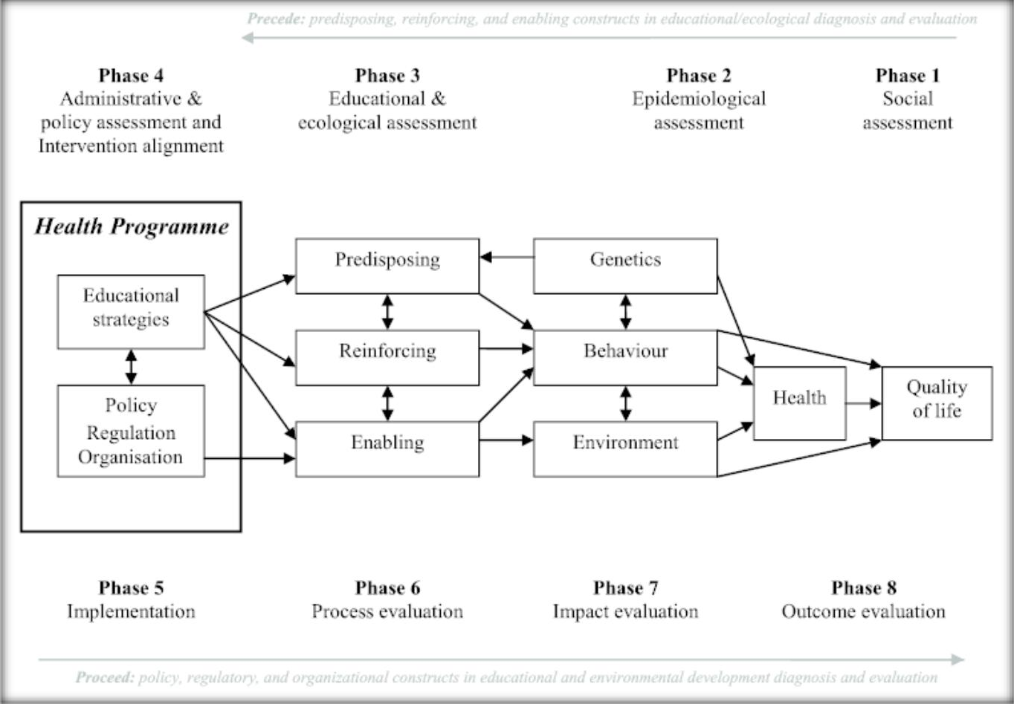
TITLE/INTRODUCTION
Excessive screen time like 7-9 hours negatively affects students' mental health, academic performance and overall wellbeing.
This presentation utilises ScreenSmart, a digital health promotion program, that helps promote more healthy technology habits using personalised digital wellbeing plans
Digital health promotion is a power that supports individuals using evidence-based technology.
Source: As inspired by (Crosby and Noar, 2011a)

Slide 16
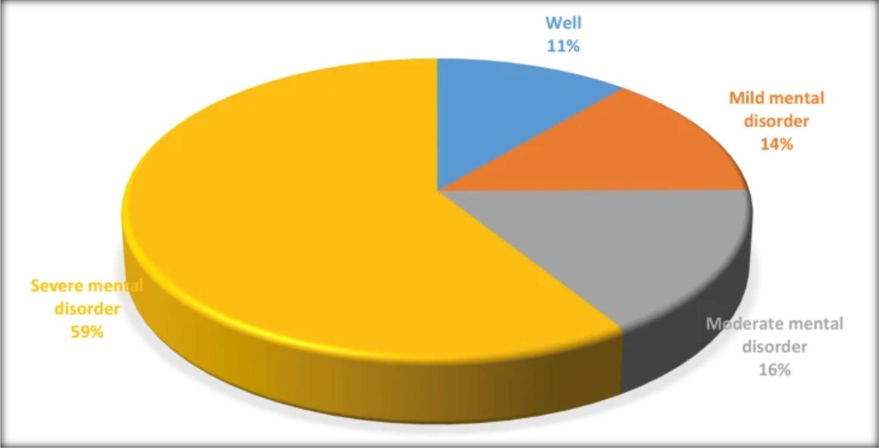
AIM OF THE ACTIVITY
Recent research has found that 59% of all university students are overly using their smartphones on a daily basis.
In the Health Belief Model, it is first the awareness of their vulnerability and the intensity of excessive screen use that influences students to take more healthy habits (Alyafei and Carr, 2024).
Health promotion strategies aimed at the entire population can help enhance wellbeing in the long-term.
Source: Abuhamdah and Naser, 2023

Slide 17
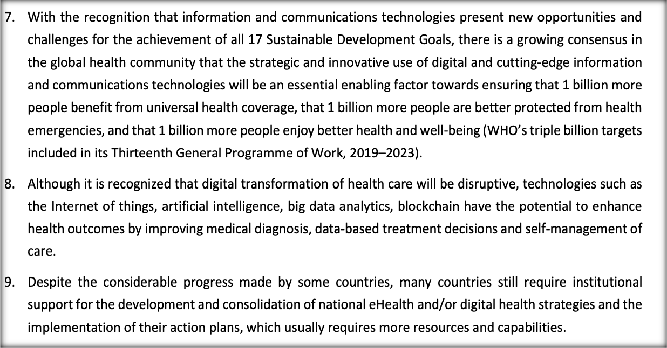
DIGITAL HEALTH TECHNOLOGY
ScreenSmart is a fictional digital wellbeing app created to assist university students in controlling the amount of time spent on screens.
According to the World Health Organization, more than one billion individuals in the world are benefiting through digital health technologies (WHO, 2024).
The Learning Health System constantly optimises the performance of interventions based on the analysis of anonymity among users.
Source: WHO, 2024

Slide 18
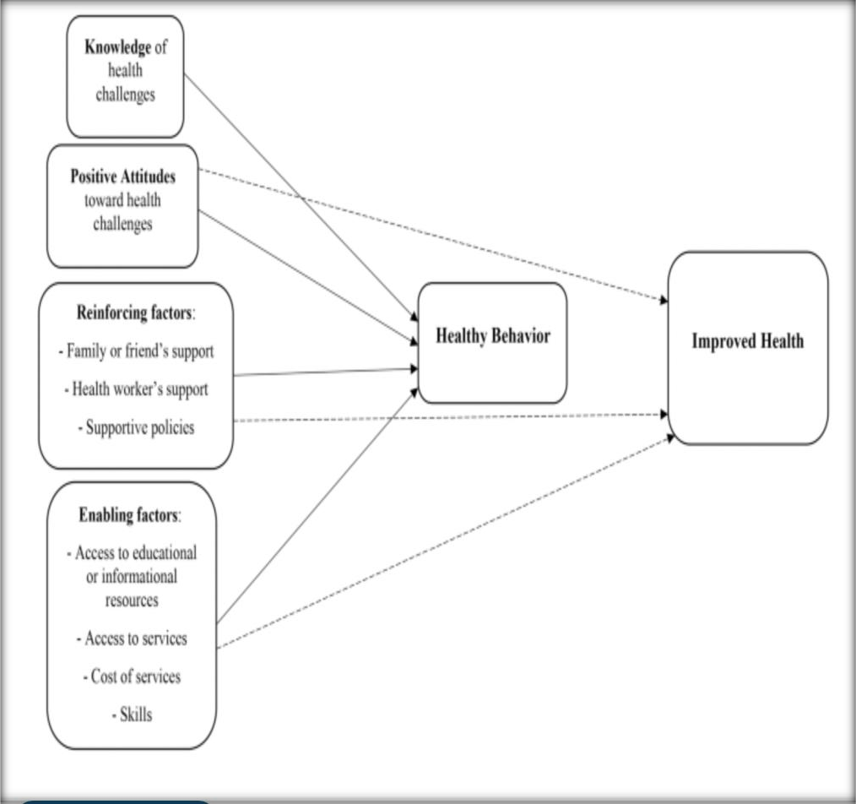
Planning Model
PRECEDE-PROCEED Model
The PRECEDE-PROCEED Model is a comprehensive model in formulating, implementing and reviewing health promotion interventions
Health Belief Model (HBM) adds to the PRECEDE by showing how the perceived susceptibility, severity, benefits and barriers affect student desirability to reduce screen time (Cai, van Berlo and Nguyen, 2026).
The Learning Health System (LHS) is a system that constantly evaluates the results of interventions in order to enhance their effectiveness.
Source: Khademi and Kaveh, 2025

Slide 19
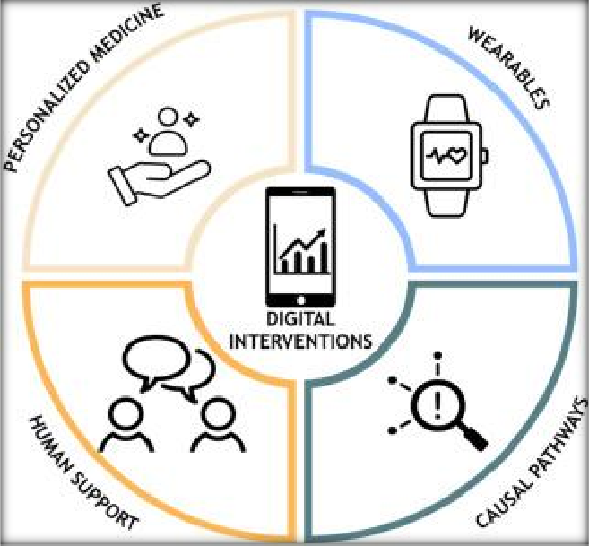
PRECEDE PHASE 1
Social Assessment
The initial stage of PRECEDE is a phase aimed at comprehending how the excessive use of digital technology affects quality of life and daily experiences of students.
Studies claim that about three in five university students have their problematic smartphone usage, which predisposes them to stress, loneliness, loss of focus and deteriorating grades (Nguyen et al., 2026).
The use of online questionnaires, focus groups and interviews also
collects information on the priorities of students and their perceived
challenges to determine what they deem important (AbouZahr and Boerma, 2005).
Source: Singla, 2024

Slide 20
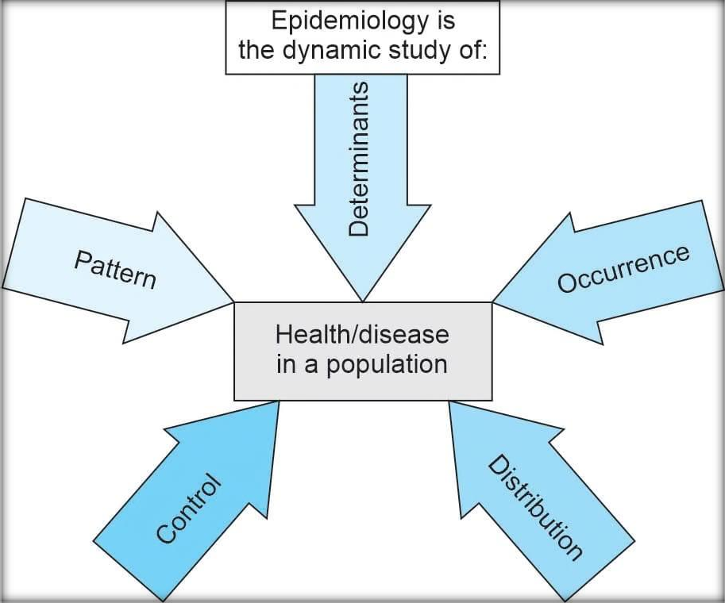
PRECEDE PHASES 2 & 3
Epidemiological, Behavioural and Environmental
Assessment
The epidemiological, behavioural and environmental analysis determines the main factors that lead to excessive screen use among university students.
The health outcomes consist of a digital addiction, anxiety, depression, obesity, straining of the eyes and a lifetime sleep disturbance.
Digital health technologies have already proved to be
valuable in behaviour monitoring and preventing chronic disease (Kampmeijer et al., 2016).
Source: Malhotra, 2026

Slide 21
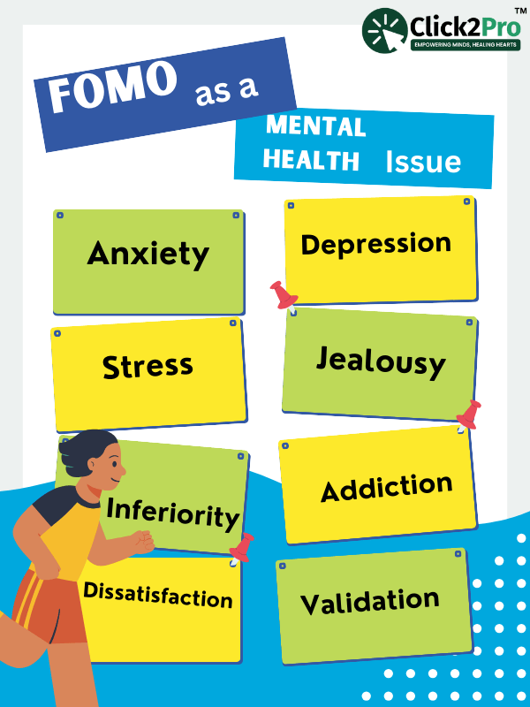
PRECEDE PHASES 4 & 5
Educational, Ecological and Administrative Assessment
The ecological and administrative assessment, one educational, determines the factors that affect the willingness of the students to embrace healthier digital behaviours.
Enabling factors encompass digital literacy programmes,
wellbeing applications and university counselling services.
The concerns of ethics governance and sustainable digital health implementation are still vital in ensuring trust.
Source: Click2Pro, 2024

Slide 22
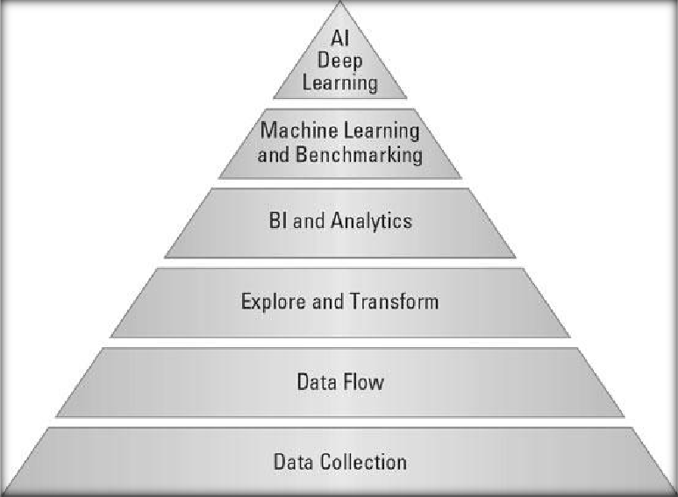
PROCEED PHASE
Delivering the Digital Intervention
The ScreenSmart application is rolled out to all campuses of universities in the PROCEED stage to promote healthier digital behaviors among students.
The application offers screen time management per day, personalised feedback, weekly targets, focus time, sleep notifications, behavioural nudges and constant progress track.
the Learning Health System (LHS) gathers the anonymised user information to measure the results of interventions and ameliorate subsequent recommendations (Bitar and Alismail, 2021).
Source: Zachary Jarvinen, 2020

Slide 23
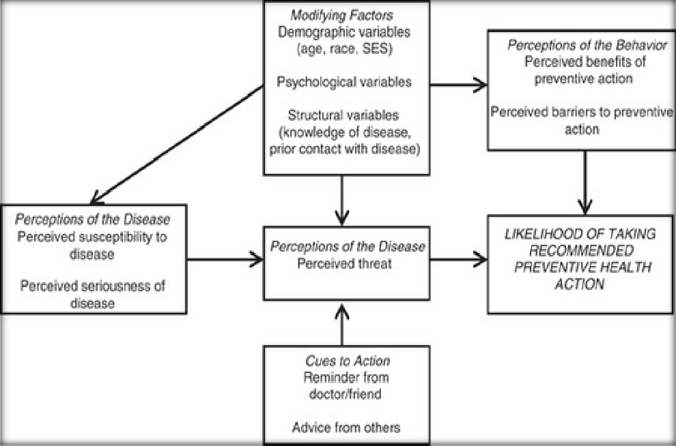
BEHAVIOUR CHANGE TECHNIQUES USED
The behaviour change techniques are pivotal towards making sure that screen time reductions are not merely short-term fixes but long-term behaviour modification.
ScreenSmart integrates self-observation, customised goal-setting, reflection diaries, weekly progress reports, the behavioural reinforcement and motivational messages to support healthy digital habits.
To prove the efficacy of digital health interventions, rigorous evaluation is needed (Murray et al., 2016).
Source: Tanner-Smith and Brown, 2020

Slide 24
IMPLEMENTATION PLAN
Timeline | Activity | Purpose
Week 1 | Recruit students | Enrol eligible participants and obtain informed consent.
Week 2 | Baseline assessment | Measure initial screen time, physical activity, and wellbeing indicators.
Weeks 3–10 | Use ScreenSmart | Participants engage with the intervention through daily tracking, educational content, and behaviour change activities.
Weekly (Weeks 3–10) | Challenges and reminders | Deliver motivational challenges, progress feedback, and reminder notifications to encourage continued participation.
Week 10 | Final assessment | Collect post-intervention data and compare outcomes with baseline measurements.
Week 12 | Evaluation report | Analyse findings, evaluate intervention effectiveness, and prepare the final project report.
The implementation plan is based on a systematic plan of 12 weeks to provide a systematized delivery and assessment of the ScreenSmart intervention.
The Learning Health System (LHS) constantly examines data on participants in order to enhance the effectiveness of interventions.
the Sub-discipline Hierarchy Model on AI customises the recommendations in relation to personal behavioural patterns (O'Neil, 2019).
Source: Self-developed

Slide 25
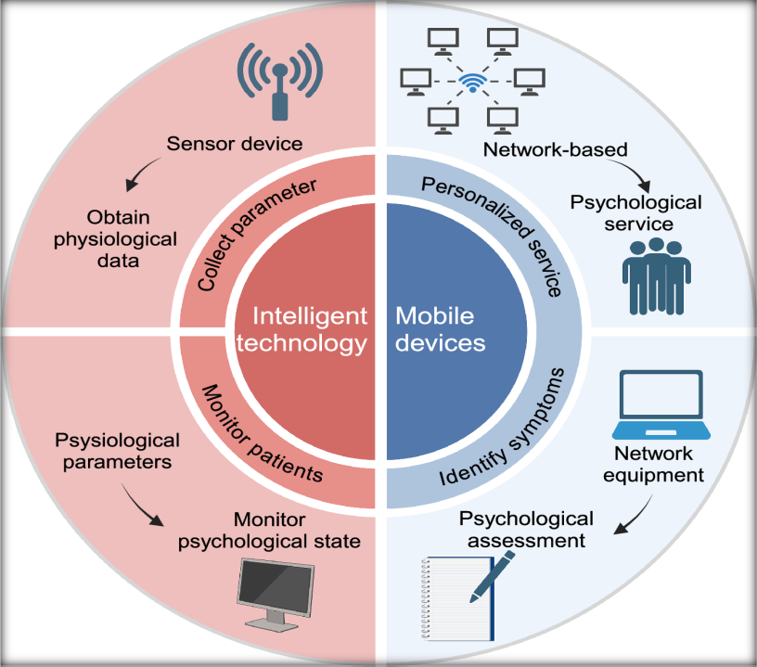
EVALUATION
Through evaluation, one would know that the intended
health promotion effects of the ScreenSmart.
Research indicates that digital health interventions have the potential to enhance wellbeing or self-management and long-term health outcomes by improving adherence to healthy behaviour by 20-30% (Lu et al., 2025).
The government has indicated that digital health technologies should be carefully assessed to be effective, safe and deliver value.
Source: (Lin et al., 2026)

Slide 26
Screen overuse is a
ScreenSmart intervention illustrates the use of
critical community health
issue posing an
unhealthy impact on the
digital health
mental health and
technologies to
academic performance
promote healthier
KEY TAKE-HOME MESSAGES
and general livelihood of the students. .
usage of
technology..
PRECEDE-
PROCEED Model offers the planning model, the Health
Belief provides power
Model
extra
to
behavioural motivation (Crosby and Noar, 2011b).
Source: Self-developed

Slide 27
ScreenSmart
Intelligent suggestions
intervention offers a
and self-observations as
multi-faceted approach to using screens in digital health promotion to counteract overactive
well as continuous
review mechanisms
produced by AI will
screen use among
promote more healthy online behaviour .
students of universities.
CONCLUSION
The effectiveness of the intervention is further enhanced by ethical implementation, privacy protection and continuous quality improvement (Kreps, 2014).
Source: Self-developed

Slide 28


Digital Technology Overuse and Screen Addiction
L CH S 7009
Population Health and
Digital Health Promotion
A school-based digital detox and wellbeing intervention
for adolescents, delivered with counsellor support
Component 3
Group Project Presentation
Md Shamim Osman
Student number 250396
Target group & setting
Adolescents (ages 13–17) in a UK secondary school setting
Public health problem
Excessive recreational screen use and problematic digital technology use among
adolescents
University of Wales Trinity Saint David

Slide 29

Group Member 3
Key Stakeholders (1 of 2)
Excessive social media and screen use among adolescents has been linked to a range of harms, including poor sleep, low mood and other psychological difficulties (Bozzola et al., 2022), so school pastoral leads, teachers and school counsellors would need to take joint ownership of the programme, since the intervention is built directly around the support counsellors provide.
Parents and carers should be involved from the outset. Interventions that actively include parents have been shown to produce considerably larger reductions in problematic digital technology use than those that do not (Žmavc et al., 2025), so their engagement is not just helpful but central to how well the programme works.
University of Wales Trinity Saint David
Transforming Education. Transforming Lives.

Slide 30
Group Member 3
Key Stakeholders (2 of 2)
External services such as CAMHS or educational psychology provide a referral route for students whose needs go beyond what a school can offer alone, while IT and data protection staff would need to assess the app before rollout. Wider policy stakeholders, such as local public health commissioners, also have a role in ensuring interventions like this are properly resourced and evaluated (Lopez-Fernandez and Kuss, 2020).
Given that digital addiction is estimated to affect around a quarter of young people globally (Meng et al., 2022), multi-behaviour school eHealth programmes such as Australia's Health4Life show that interventions of this kind can be delivered successfully at scale when schools are properly supported (Champion et al., 2023).
University of Wales Trinity Saint David
Transforming Education. Transforming Lives.

Slide 31
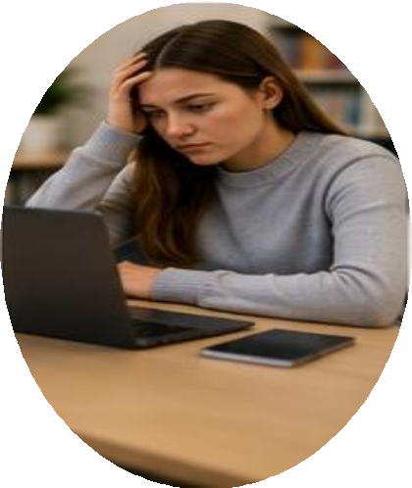
Group Member 3
Barriers to Implementation (1 of 2)
Many schools struggle to release staff time for training, and programmes led internally by school staff without adequate preparation tend to be less effective at reducing
problematic use than those led by external specialists (Žmavc et al., 2025).
Some students may be reluctant to engage with a tool that is visibly linked to the counselling service, out of concern about being seen to need support or being stigmatised by peers. The exclusivity of school-based mental health programmes has similarly been identified as a barrier to engagement elsewhere (Brown et al., 2023).
University of Wales Trinity Saint David
Transforming Education. Transforming Lives.

Slide 32

Group Member 3
Barriers to Implementation (2 of 2)
Digital wellbeing initiatives often compete with an already full curriculum and tight budgets, making it difficult for schools to protect the time and resources the programme needs in order to embed properly rather than being trialled briefly and dropped.
School-based interventions are considerably more effective at reducing problematic use than at reducing screen time itself (Žmavc et al., 2025). Sustaining engagement once the novelty wears off is a further challenge (Beames et al., 2023).
University of Wales Trinity Saint David
Transforming Education. Transforming Lives.

Slide 33

Group Member 3
Legal and Ethical Issues (1 of 2)
As most secondary school students are under 16, the app would need to satisfy UK GDPR Article 8, which generally requires parental consent before a child's data can be processed, although the Data Protection Act 2018 lowers this age of consent to 13 in the UK context (Nottingham, Stockman and Burke, 2022, and Data Protection Act 2018).
Wellbeing and counselling records count as special category data, meaning an explicit lawful basis would be needed under the UK General Data Protection Regulation (Arts. 6 and 9), rather than the general public task basis schools already use for routine learner data.
University of Wales Trinity Saint David
Transforming Education. Transforming Lives.

Slide 34

Group Member 3
Legal and Ethical Issues (2 of 2)
Data minimisation would need to be built in from the outset, in line with the ICO's Age Appropriate Design Code, which sets standards for default privacy settings in services likely to be accessed by children (Information Commissioner's Office, 2020), alongside safeguarding protocols for sharing any disclosure of risk with the counsellor and, where necessary, with parents.
Not all students have equal access to a personal device or reliable data, so the school would need to consider how equity of access is maintained if the app becomes central to the intervention.
University of Wales Trinity Saint David
Transforming Education. Transforming Lives.

Slide 35
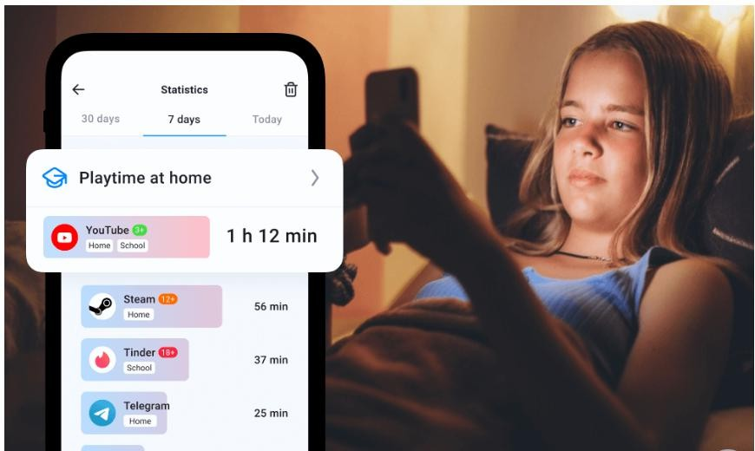
PROGRAMME: MSC PUBLIC HEALTH AND SOCIAL CARE IN PRACTICE
MODULE LCHS7009 · POPULATION HEALTH AND DIGITAL HEALTH PROMOTION
Digital Technology Overuse and Screen Addiction
ScreenBalance: A School-Based Digital Wellbeing Intervention for Adolescents
GROUP MEMBER 4 · BENEFITS
STUDENT NAME
STUDENT ID
Nidhi
2527220
LECTURER
ASSIGNMENT
Dr Ping Wu
Component 3, Group Project Presentation
University of Wales Trinity Saint David

Slide 36
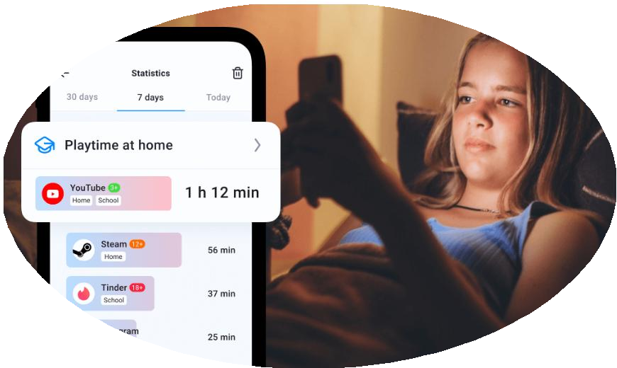
Group Member 4
Potential Benefits of ScreenBalance
ScreenBalance promotes healthier and more controlled digital habits among adolescents.
Self-monitoring increases students' awareness of their daily screen-use behaviour
(Vosloo, 2026).
Gamified rewards can motivate sustained participation and positive behaviour change (Liverpool et al., 2025).
School delivery provides accessible digital-wellbeing support across the student
population (Sengupta, 2025).
Digital interventions can improve accessibility and acceptability of youth support services (Liverpool et al., 2025).
Clearer way to monitor screen time on Android (Source: Vosloo, 2026)
University of Wales Trinity Saint David
Transforming Education. Transforming Lives.

Slide 37
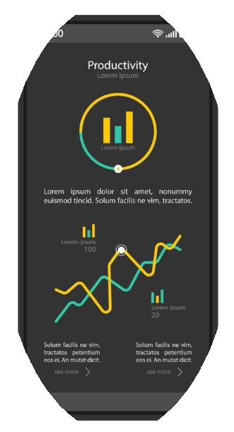
Group Member 4
Benefits for Healthy Screen-Time Behaviour
Daily tracking helps students recognise patterns of excessive digital technology use (Eezy LLC, 2026).
Personalised nudges can encourage timely breaks from prolonged recreational screen use
(Singh, 2025).
Goal setting allows adolescents to establish realistic and achievable screen-time targets (Sengupta, 2025).
Healthy-use streaks reinforce positive habits through immediate motivational feedback (Eezy
LLC, 2026).
Behaviour tracking and tailored feedback can strengthen youth engagement with health interventions, an approach already demonstrated in behaviourally informed self-monitoring apps (Smith et al., 2022).
Smartphone dashboard mock-up (Source: Eezy LLC, 2026)
University of Wales Trinity Saint David
Transforming Education. Transforming Lives.

Slide 38
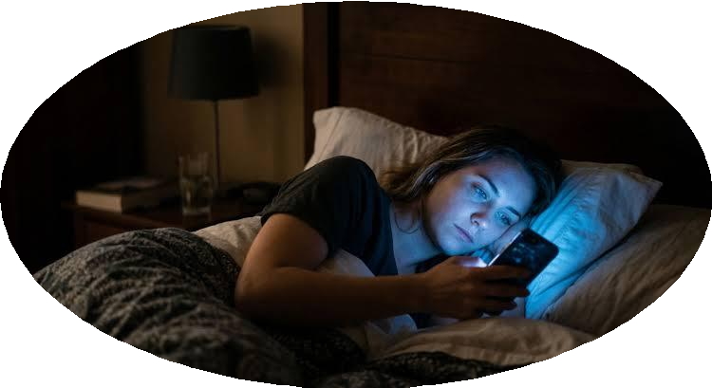
Group Member 4
Benefits for Mental Health and Sleep
Reducing excessive screen exposure may support better sleep duration and timing (Eye Solutions, 2023).
Improved sleep habits may reduce risks associated with adolescent depressive
symptoms (Hökby et al., 2025).
Structured offline periods may encourage healthier emotional and psychological recovery (Eye Solutions, 2023).
Screen awareness can reduce problematic patterns associated with intensive
social media use.
Screen-related sleep disruption is itself associated with increased depressive symptoms in adolescents (Hökby et al., 2025).
Late-night smartphone use and disrupted sleep (Source: Eye Solutions, 2023)
University of Wales Trinity Saint David
Transforming Education. Transforming Lives.

Slide 39
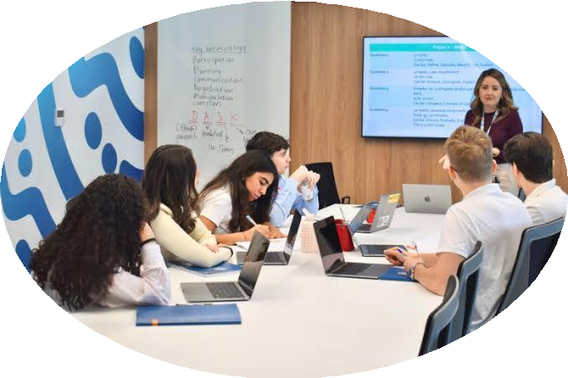
Group Member 4
Educational and Social Benefits
Reduced classroom phone distraction may improve students' attention and learning engagement (Torres et al., 2024).
Planned offline periods can increase opportunities for face-to-face peer
interaction (Sengupta, 2025).
Healthier digital routines may help students balance study, recreation and social activities (Torres et al., 2024).
School-wide participation can establish positive social norms around responsible
technology use.
Balanced screen use alongside socialisation and physical activity is recommended for older children (UK Parliament Education Committee, 2024).
Digital-wellbeing classroom session (Source: Sengupta, 2025)
University of Wales Trinity Saint David
Transforming Education. Transforming Lives.

Slide 40
Group Member 4
Implications for Policy
ScreenBalance could complement existing school policies restricting inappropriate mobile-phone use.
Schools could introduce measurable digital-wellbeing targets within wider wellbeing policies (Department for
Education, 2024).
Anonymous aggregate data could help schools evaluate digital-health promotion strategies.
Policies should balance screen reduction with beneficial educational uses of technology (Department for
Education, 2024).
Intervention implementation must take into account privacy, protection and proper governance of student data (UK Parliament, 2023).
University of Wales Trinity Saint David
Transforming Education. Transforming Lives.

Slide 41
Group Member 4
Implications for Education
Digital wellbeing education can teach students responsible and purposeful technology use (Hökby et al., 2025).
ScreenBalance data can support classroom discussions about healthy digital behaviours (Singh, 2025).
Teachers can also support goal setting and self-regulation principles (UK Parliament, 2023).
Parents could receive guidance supporting consistent healthy screen routines outside school (Singh, 2025).
Staff training would support safe, consistent and effective implementation across schools (Liverpool et al., 2025).
University of Wales Trinity Saint David
Transforming Education. Transforming Lives.

Slide 42
References
Beames, J.R., Werner-Seidler, A., Hodgins, M., Brown, L., Fujimoto, H., Bartholomew, A., Maston, K., Huckvale, K., Zbukvic, I., Torok, M., Christensen, H., Batterham, P.J., Calear, A.L., Lingam, R. and Boydell, K.M. (2023) 'Implementing a digital depression prevention program in Australian secondary schools: cross-sectional qualitative study', JMIR Pediatrics and Parenting, 6, e42349.
Bozzola, E., Spina, G., Agostiniani, R., Barni, S., Russo, R., Scarpato, E., Di Mauro, A., Di Stefano, A.V., Caruso, C., Corsello, G. and Staiano, A. (2022) 'The use of social media in children and adolescents: scoping review on the potential risks', International Journal of Environmental Research and Public Health, 19(16), 9960.
British Psychological Society (2026) Early years screen time and usage: BPS response to DfE consultation. Leicester: BPS.
Brown, G.K., Owens, J., Richards, C., Di Folco, S. and Schwannauer, M. (2023) 'Facilitators and barriers to the implementation of a school-based intervention for anxiety', Child Psychiatry & Human Development.
Champion, K.E., Newton, N.C., Gardner, L.A., Chapman, C., Thornton, L., Slade, T. and Mewton, L. (2023) 'Health4Life eHealth intervention to modify multiple lifestyle risk behaviours among adolescent students in Australia: a cluster-randomised controlled trial', The Lancet Digital Health, 5(5), pp. e276-e287.
Data Protection Act 2018 (c. 12). London: The Stationery Office.
Department for Education (2024) Government launches crackdown on mobile phones in schools.
London: GOV.UK.
Eezy LLC (2026) Smartphone dashboard interface vector template. Online image. Vecteezy.
Eye Solutions (2023) How blue light from screens impacts sleep and vision. Online. Eye Solutions.
Hökby, S., Alvarsson, J., Westerlund, J., Carli, V., Hadlaczky, G. and Ong, S.K. (2025) 'Adolescents' screen time displaces multiple sleep pathways and elevates depressive symptoms over twelve months', PLOS Global Public Health, 5(4), e0004262.
Information Commissioner's Office (2020) Age Appropriate Design Code: A Code of Practice for
Online Services. Wilmslow: ICO.
Liverpool, S., Mc Donagh, C., Feather, J., Uzondu, C., Howarth, M., Bannerman, F., Kaehne, A., Foster, C. and Mateus, C. (2025) 'Updates on digital mental health interventions for children and young people: systematic overview of reviews', European Child & Adolescent Psychiatry, 34(10),
pp. 2961-2974.
Lopez-Fernandez, O. and Kuss, D.J. (2020) 'Preventing harmful internet use-related addiction problems in Europe: a literature review and policy options', International Journal of Environmental Research and Public Health, 17(11), 3797.

Slide 43
References
Meng, S-Q., Cheng, J-L., Li, Y-Y., Yang, X-Q., Zheng, J-W., Chang, X-W. and Shi, J. (2022) 'Global prevalence of digital addiction in general population: a systematic review and meta-analysis', Clinical Psychology Review, 92, 102128.
Michie, S., van Stralen, M.M. and West, R. (2011) 'The behaviour change wheel: a new method for characterising and designing behaviour change interventions', Implementation Science, 6, 42.
Nottingham, E., Stockman, C. and Burke, M. (2022) 'Education in a datafied world: balancing children's rights and school's responsibilities in the age of Covid 19', Computer Law & Security Review, 45, 105664.
Olson, J.A., Sandra, D., Chmoulevitch, D., Raz, A. and Veissière, S.P.L. (2021) A ten-step behavioural intervention to reduce screen time and problematic smartphone use. Preprint.
Pickavance, J., O'Nions, E., Hammad, M. et al. (2026) 'Adolescent social media use and its association with mental health: a cross-sectional study in Bradford, England', BMC Public Health, 26, 2212.
Sengupta, A. (2025) Wellbeing in a digital age: innovation and authentic intelligence. Online. Education UAE.
Singh, B.S. (2025) 'Breaking free: strategies for overcoming smartphone addiction', in Smartphone Addiction, Phone Snubbing, and Effects on Interpersonal Relationships and Mental Health, pp. 397-426.
Smith, R., Michalopoulou, M., Reid, H., Payne Riches, S., Wango, Y.N., Kenworthy, Y., Roman, C., Santos, M., Hirst, J.E. and Mackillop, L. (2022) 'Applying the behaviour change wheel to develop a smartphone application Stay-Active to increase physical activity in women with gestational diabetes', BMC Pregnancy and Childbirth, 22, 246.
Swedish Public Health Agency (2024) Recommendations on screen time and physical activity for
children and adolescents. Solna: Public Health Agency of Sweden.
Torres, R.L., Solivio, C.J., Torres, D.D. and Torres, S. (2024) 'Exploring the digital habits and lifestyles of high school students towards the development of a digital wellbeing framework', International Journal of Research and Scientific Innovation, 11(15), pp. 234-244.
UK General Data Protection Regulation (Retained EU Legislation, Regulation (EU) 2016/679), Arts. 6, 8 and 9.
UK Parliament Education Committee (2024) Screen time: impacts on education and wellbeing. London: House of Commons.
Vosloo, P. (2026) How parents can check kids' screen time on Android devices. Online. Findmykids.org.
Zhou, W.Y., Franzini, L. and Ahmed, G.K.R. (2025) 'The role of social support in mitigating the effects of increased screen time on adolescent mental health', PLOS Mental Health, 2(1).
Žmavc, M., Horvat, J., Židan, M. and Selak, Š. (2025) 'The effectiveness of school-based interventions to reduce problematic digital technology use and screen time: a systematic review and meta-analysis', Journal of Behavioral Addictions, 14(2), pp. 571-589.

