Slide 1
Digital skills and research methods BMSW 403
Student name: Laisvydas Zibalas
Student id: 2025317
Module code: BMSW 4003
Assignment section: Digital Skills And Research
Lecturer’s name: Jones Oluchukwu Mordi

Slide 2
INTRODUCTION
Research methods are mostly oriented with the knowledge that is required to bring about the entire prospect of the work that is being carry forwarded.
A digital research is important in order to highlight the prospects whether it be a book or any kind of educational theories that will bring about a proper examination which is required for people to incorporate with the knowledge regarding the scenario that will have to be tackled.
Through research one can easily bring for the prospect that is necessary to be covered and also understood.
Notes:
Research methods are mostly oriented with the knowledge that is required to bring about the entire prospect of the work that is being carry forwarded.
A digital research is important in order to highlight the prospects whether it be a book or any kind of educational theories that will bring about a proper examination which is required for people to incorporate with the knowledge regarding the scenario that will have to be tackled.
Through research one can easily bring for the prospect that is necessary to be covered and also understood.

Slide 3
Duckworth’s Grit
Duckworth Grit is written by the author Angela Duckworth.
This book will portray the circumstances that are in regard with passion as well as the goals that are separated for people who are moving ahead in terms of achieving things that are up to their conscious.
The book also explains a passion and perseverance that is depicted by the writer in order to portray circumstances that will fall in regard to studies which she has been into.
This entire report will portray the aspect that great is one of the most common factor that is usually seen in people that are more towards achieving things.
Notes:
Duckworth Grit is written by the author Angela duckworth. This book will portray the circumstances that are in regard with passion as well as the goals that are separated for people who are moving ahead in terms of achieving things that are up to their conscious. The book also explains a passion and perseverance that is depicted by the writer in order to portray circumstances that will fall in regard to studies which she has been into. This entire report will portray the aspect that great is one of the most common factor that is usually seen in people that are more towards achieving things. Everything that is in regard to the characters especially in terms of encouraging the situations that require positive attitude are being portrayed in this report. Also this book will explain the barriers to achievement and the kind of solutions that can be Incorporated.

Slide 4
DIKW RESEARCH
This particular research is more associated with the knowledge that is in regard to the book.
It is necessary to understand the prospect with which the writer is bringing forth the ideologies about goals and also the barriers that are required therefore it is essential that the book will have to be understood on various components.
The DIKW research will be constituted upon bringing the formulation that are in regard to data, information, knowledge and wisdom.
All these components are the essential ones while reading the book and also discuss in the prospects of goals and the interactions that are being carried forwarded.
Notes:
This particular research is more associated with the knowledge that is in regard to the book. It is necessary to understand the prospect with which the writer is bringing forth the ideologies about goals and also the barriers that are required therefore it is essential that the book will have to be understood on various components. The DIKW research will be constituted upon bringing the formulation that are in regard to data, information, knowledge and wisdom. All these components are the essential ones while reading the book and also discuss in the prospects of goals and the interactions that are being carried forwarded.

Slide 5
DATA: The data that is portrayed in this book is completely about the great which is one of the constituent that will enhance the probable aspect with which the people are moving ahead. In this regard the data is around for there are certain conditions in order to move ahead with achievements and also the various suggestions that are related to close circumstances that will bring about the entire life into an instance.
INFORMATION: The information that is given in the book will mostly related to the entire everyday circumstances that will be tackled by people in terms of education as well as in job roles. The kind of barriers that are usually faced by people on a regular basis are provided on an informative environment and the kind of strategies that will have to be implemented by dealing with the atrocities or the barriers that will fall in this regard are being portrayed.
Notes:
DATA: The data that is portrayed in this book is completely about the great which is one of the constituent that will enhance the probable aspect with which the people are moving ahead. In this regard the data is around for there are certain conditions in order to move ahead with achievements and also the various suggestions that are related to close circumstances that will bring about the entire life into an instance. The data that is also mentioned in this regard will be especially the measure of how far the highest situations are being tackled with regard to admission and job applications. A complete focus upon grit is being enhanced with variable measures and numerous environmental factors.
INFORMATION: The information that is given in the book will mostly related to the entire everyday circumstances that will be tackled by people in terms of education as well as in job roles. The kind of barriers that are usually faced by people on a regular basis are provided on an informative environment and the kind of strategies that will have to be implemented by dealing with the atrocities or the barriers that will fall in this regard are being portrayed.

Slide 6
KNOWLEDGE: People usually suffer from different kinds of atrocities while dealing with the goals and opportunities. This book will portray upon the circumstances that are necessary for people to stand firm with their ideologies and the decisions irrespective of how far the barriers will last.
WISDOM: the kind of wisdom that is in this regard as a limelight but is thrown to keep up the entire hard work that is necessary to move ahead fixing the goals. It is necessary to build one's own self in order to move ahead with the choices and that is the entire wisdom that will have to be fortified with regard to this book.
Notes:
KNOWLEDGE: People usually suffer from different kinds of atrocities while dealing with the goals and opportunities. This book will portray upon the circumstances that are necessary for people to stand firm with their ideologies and the decisions irrespective of how far the barriers will last. Complete knowledge regarding the understanding of pathway that is being taken while dealing with goals is being a put forth in this report. The book also describes up on the probable approaches like being consistent towards are dealing with mood swings is also being put forth in this book.
WISDOM: the kind of wisdom that is in this regard as a limelight but is thrown to keep up the entire hard work that is necessary to move ahead fixing the goals. It is necessary to build one's own self in order to move ahead with the choices and that is the entire wisdom that will have to be fortified with regard to this book. In this personification the writer also throws circumstances that are usually dealt by people all around and how far she has been able to overcome every struggle in a more consistent manner is being explain the Indus book.

Slide 7
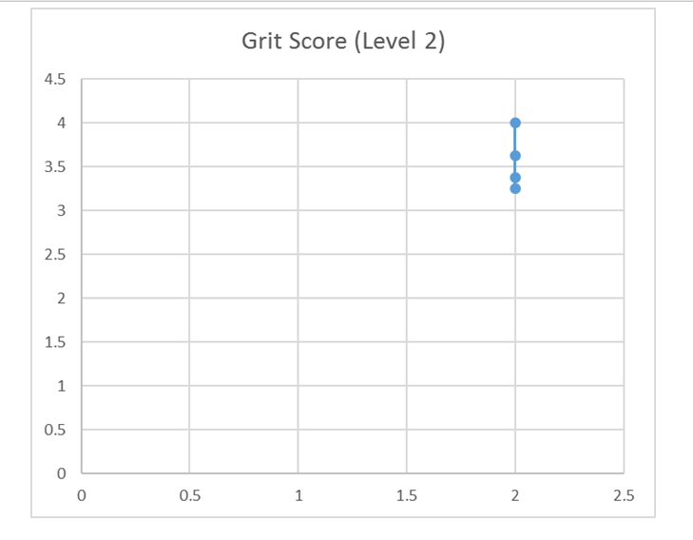
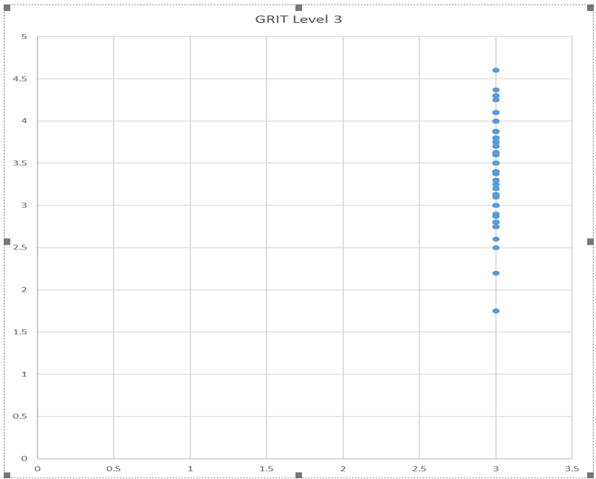
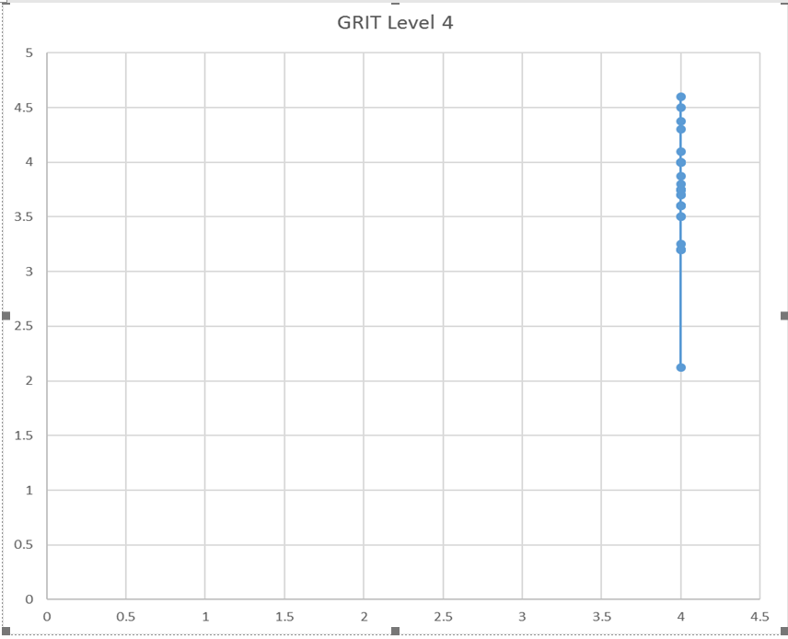
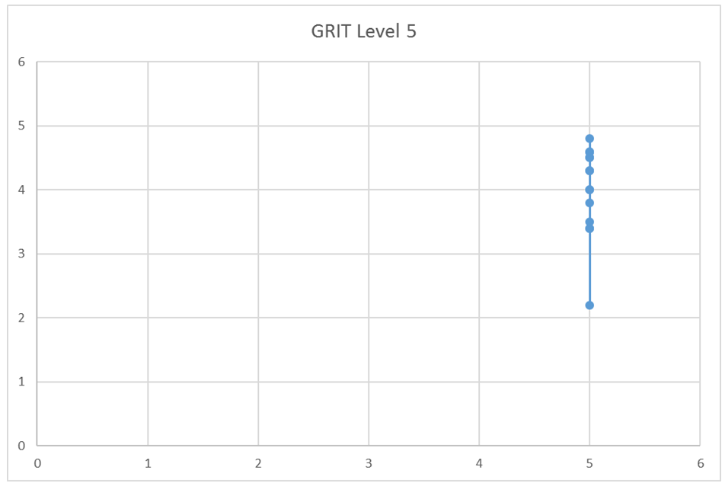
Notes:
The depicted prospect is the Grit score that is fortified at all levels. For the level two which is the first picture that is showing the score to be ranging between 3 to 4. For the level 3 of Grit the score is ranging between 2 to 5. The grit level 4 ranges between 2 to 5 and the grit level 5 ranges from 2 to 5.

Slide 8
CRAAP TEST
The CRAAP test is usually conducted in order to bring about the reliability and the definite information that is in regard to the work that is portrayed by the writer. It is not until when the sources of information is completely understood and also referred that it gets to be accepted by many people. In this regard the crap test will bring about the variations as well as the aim of that are in regard to the other along with the time of writing the book and the different sources that are involved in it.
Notes:
The CRAAP test is usually conducted in order to bring about the reliability and the definite information that is in regard to the work that is portrayed by the writer. It is not until when the sources of information is completely understood and also referred that it gets to be accepted by many people. In this regard the crap test will bring about the variations as well as the aim of that are in regard to the other along with the time of writing the book and the different sources that are involved in it.

Slide 9
CRAAP MODEL
CURRENCY : Duckworth's first book, Grit: The Power of Passion and Perseverance, was released in May 2016. It stayed on The New York Times bestseller list for 21 weeks. A review of the book in The New York Times called Duckworth "the psychologist who has made 'grit' the reigning buzzword in education-policy circles."
RELEVANCE: The intention to contribute to the well being of others.” To give back and spread your message. Purpose fuels longevity. The rest of the book discusses how to instill grit within an organization which was clearly written for the Blue-Chip CEOs and private school principals. However, there are many elements of Duckworth’s book meant for twentysomethings — worldly advice for her students navigating early careers.
AUTHORITY: Angela Duckworth is the world’s most prominent authority on “grit,” the much-touted ingredient in individual happiness. According to Duckworth, grit is “passion and continuous persistence implemented toward long-term accomplishment, with no regard for incentives or recognition along the way.”
Notes:
CURRENCY : Duckworth's first book, Grit: The Power of Passion and Perseverance, was released in May 2016. It stayed on The New York Times bestseller list for 21 weeks. A review of the book in The New York Times called Duckworth "the psychologist who has made 'grit' the reigning buzzword in education-policy circles."
RELEVANCE: The intention to contribute to the well being of others.” To give back and spread your message. Purpose fuels longevity. The rest of the book discusses how to instill grit within an organization which was clearly written for the Blue-Chip CEOs and private school principals. However, there are many elements of Duckworth’s book meant for twentysomethings — worldly advice for her students navigating early careers.
AUTHORITY: Angela Duckworth is the world’s most prominent authority on “grit,” the much-touted ingredient in individual happiness. According to Duckworth, grit is “passion and continuous persistence implemented toward long-term accomplishment, with no regard for incentives or recognition along the way.”

Slide 10
ACCURACY: The Grit Scale may seem superficial, but Duckworth maintains that it predicts with remarkable accuracy who will be able to persevere in the face of physical and psychological discomfort.
PURPOSE: To tell people about the use of grit. Specific purpose is to enlighten the listeners how Angela Lee Duckworth used the rhetorical situation of grit implementation in the society of education and managed to prove a new study.
Notes:
ACCURACY: The Grit Scale may seem superficial, but Duckworth maintains that it predicts with remarkable accuracy who will be able to persevere in the face of physical and psychological discomfort.
PURPOSE: To tell people about the use of grit. Specific purpose is to enlighten the listeners how Angela Lee Duckworth used the rhetorical situation of grit implementation in the society of education and managed to prove a new study.

Slide 11
CONCLUSION
The report concludes upon bringing about the complete knowledge regarding the book Duckworth Grit
The important hights of passion and perseverance are portrayed in this report.
Various formulations are enhanced to minimise the barriers to achieve goals .
Notes:
The report concludes upon bringing about the complete knowledge regarding the book Duckworth Grit
The important hights of passion and perseverance are portrayed in this report.
Various formulations are enhanced to minimise the barriers to achieve goals .

Slide 12
REFERENCES
Duckworth, 2016. Grit: The power of passion and perseverance (Vol. 234). New York, NY: Scribner.
Duckworth, and et.al 2009. Development and validation of the Short Grit Scale (GRIT–S). Journal of personality assessment. 91(2). pp.166-174.
Duckworth, 2019. Grit: Why passion and resilience are the secrets to success. NIDA Journal of Language and Communication. 24(35). pp.105-106.
Park and et.al, 2020. The development of grit and growth mindset during adolescence. Journal of Experimental Child Psychology. 198. p.104889.
Munro and et.al, 2019. Grit makes us unstoppable.

