Slide 1
EAEC6012C
Plentyndod cynnar: agweddau rhyngwladol
EAEC6012
Early childhood: international perspectives
Darlith 4
Lecture 4

Slide 2
Beth mae bywyd teuluol yn ei olygu i chi? What does family life mean to you?
Beth ydych chi’n ei werthfawrogi am fywyd teuluol?
Beth ydych chi’n meddwl mae plant yn ei werthfawrogi am fywyd teuluol?
Beth yw rôl teuluoedd?
What do you value about family life?
What do you think children value about family life?
What is the role of families?
Notes:
Ask students to consider their own families – there will be wide variations; this needs to be discussed sensitively as some students may not feel comfortable discussing their familiy situations. What does family mean to different people? Some will refer to having a sense of belonging, others to having someone who always looks out for you. Are there universally held values? Many parents query whether they are doing ‘ the right thing’. Do we allow children enough time to ‘be children’? Due to globalisation, in Western societies we live in an age of ‘advanced liberalism’: more laid back than it used to be?
Have hierarchical relationships disappeared? The father used to be the head of the household, how has this changed?
Are some Western children currently ‘containerised’?
Mae plentyn yn dibynnu ar oedolion i gael gofal ac amddiffyniad. A yw teulu yn meithrin anghenion, cyfleoedd a doniau plant a rhieni? A oes cysondeb gofal? A yw’r plentyn yn teimlo’n saff a diogel? A oes trefn sefydlog? A oes rheolau a therfynau clir? Dim rheolau = ansicrwydd/anhrefn
A child is dependent on adults for care and protection. Does a family nourish the needs, opportunities, talents of children and parents? Is there consistency of care? Does the child feel safe? secure? Is there a stable routine? Are there clear rules and boundaries? No rules=uncertainty/chaos.
Do students know the theory behind parenting styles? Laissez-faire? Autocratic? Democratic? Ask them for examples of each and the potential effects this has on children..

Slide 3
Trafodwch: Discuss:
Does dim modd gwahanu cysyniadau am y teulu, cymdeithasoli a phlentyndod oddi wrth ei gilydd.
Effeithiau diwylliannol?
The concepts of family, socialisation and childhood cannot be broken apart from each other.
Cultural effects?
Notes:
Crefydd – mewn rhai achosion mae plant yn cael eu magu i fod yn ufudd, i fod â pharch mawr at bobl hŷn – ydy hyn yn gyffredin nawr yng nghymdeithas y Gorllewin – sut mae hyn wedi newid dros amser? Unrhyw gapelwyr? Mae plant mewn eglwysi/capeli nawr yn gallu symud o gwmpas – does neb yn becso/mae capeli/eglwysi yn llawer llai ffurfiol – gwasanaethau teuluol, yn annog plant – yn y gorffennol gwyddai plant ei bod yn rhaid iddyn nhw eistedd yn llonydd/bod yn dawel (fel yn yr ysgol – ond newidiadau mawr wedi bod)
How powerful are families? Think of the word ‘morality’ What is/is not accepted. This varies according to culture and history. Views change over time.Religion – in some cases children are brought up to be obedient, to have high respect for elders – is this now common in Western society – how has it changed over time? Any chapel goers? Children in church now able to move around – no one minds/church much less formal – family services, encouraging children – in the past children knew they had to sit still/be quiet (the same as in school – vast changes).
What is the role of government in supporting families? Public policy? Maternity pay and leave? Paternity? How does this vary between countries? What affect could that have? They can do some research into this.
What is the role of government in supporting families? Public policy? Maternity pay and leave? Paternity? How does this vary between countries? What affect could that have?

Slide 4
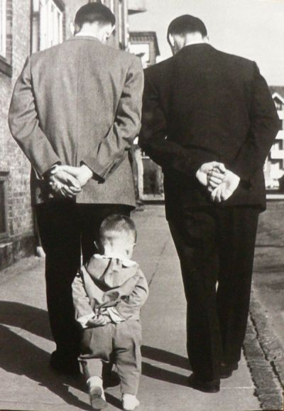
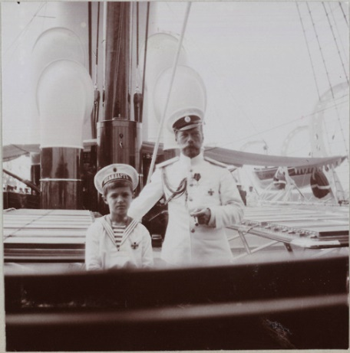
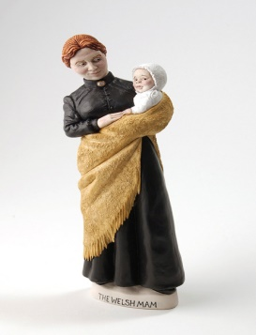
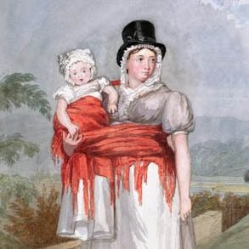
A yw mamau a thadau’n chwarae rolau gwahanol?
Do mothers and fathers play differing roles?
Yn hanesyddol rôl y tad oedd…..
Rôl y fam oedd……
A yw hyn wedi newid?
In history the role of the father was…..
The mother’s role was……
Has this changed?
Notes:
Worth discussing this for a while (but explaining that we cannot look at gender alone: there are so many variables eg number of children in the family could be considered eg the older daughter plays a role? Effects of cultural expectations? could class come in here? Do some children have ‘protected’ childhoods?). Care needed if the values of the home are very different to the values of the nurserty/school.
Pwy mewn teuluoedd sy’n trosglwyddo gwerthoedd moesol? Pwy yw’r ‘barnwr’ cyntaf, sy’n rhoi arweiniad rhag bod angen meddwl am heddlu/lys i gosbi troseddau. Pwy oedd/yw yr un sy’n ennill cyflog ac sy’n gofalu am y plant? Pwy yw’r un sy’n ‘normaleiddio’ ymddygiad plant?
Who in families transmits moral values? Who may be the first ‘judge’, giving guidance before any thought of police/court for misdoings. Who was/is breadwinner and childcarer? Who is the ‘normalising agent’ of children’s conduct?

Slide 5
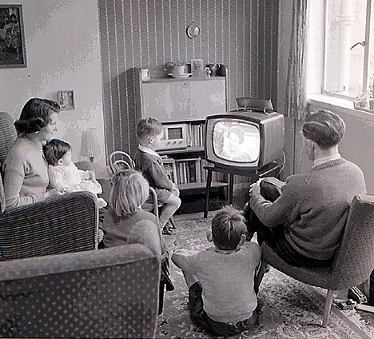
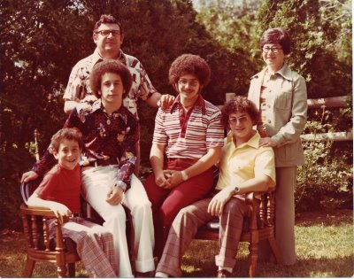
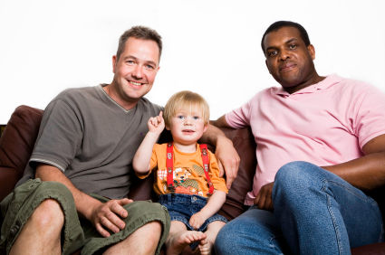
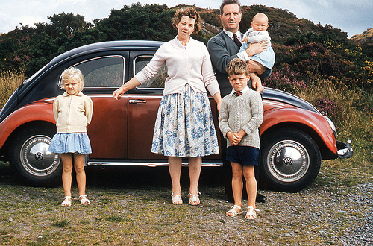
Beth sy’n achosi newid?
What causes change?
Sut mae teuluoedd wedi newid dros amser?
Mae newidiadau yn y teulu yn ganlyniad i newidiadau mewn cymdeithas - trafodwch.
A yw’r newidiadau wedi bod er gwell?
How have families changed over time?
Changes in the family are a result of changes in society – discuss.
Have the changes been for the better?
Notes:
Dewch o hyd i rywun a anwyd yn y 50au – gofynnwch iddyn nhw am eu gwerthoedd o ran magu plant – sut maen nhw’n wahanol i’ch gwerthoedd chi? Mae cyfansoddiad teulu wedi newid yn sylweddol dros y 30/40/50 mlynedd ddiwethaf. Amrywiaeth – ysgaru, gwahanu, cael partner newydd/ teuluoedd ailgyfansoddedig/dewis o gyfeiriadedd rhywiol/cydbwysedd grym yn symud rhwng dynion a menywod. Cynnydd enfawr mewn teuluoedd un rhiant (gyda menyw yn ben ar 92% o’r teuluoedd hynny). Nid yw plant sy’n cael eu geni y tu allan i briodas yn cael eu hynysu bellach (na’u mamau chwaith – newid mawr i 50 mlynedd yn ôl hyd yn oed?). Ydy plant yn teimlo’n fwy neu’n llai sefydlog nag o’r blaen?
Find someone born in the 50s – ask them about their values of bringing up children – how do they differ from yours? Family make up has significantly changed the over last 30/40/50 years. Diversity – divorce, separation, re-partnering/reconstituted families/choice of sexual orientation (‘normalisation’ in a very short amount of time)/shifting power balance between men and women. Huge increase in single parent families (92% being headed by a woman). Children born out of wedlock are no longer ostracised (neither are their mothers – a big change from even 50 years ago?). Might children feel more or less stable as they used to?
Do students know their neighbours?
Consider the international context here: are same sex relationships still illegal in some countries? What are the penalties? Was this the case in the UK just a few decades ago? Historical views in the UK regarding children born out of wedlock, just a few decades ago: mothers sent away, in secret to have babies; babies taken away from them: what effect could this have? Internationally, in some countries is it frowned upon to have an unmarried mother? What happens to them in some countries? Ostracised? Stoned?

Slide 6
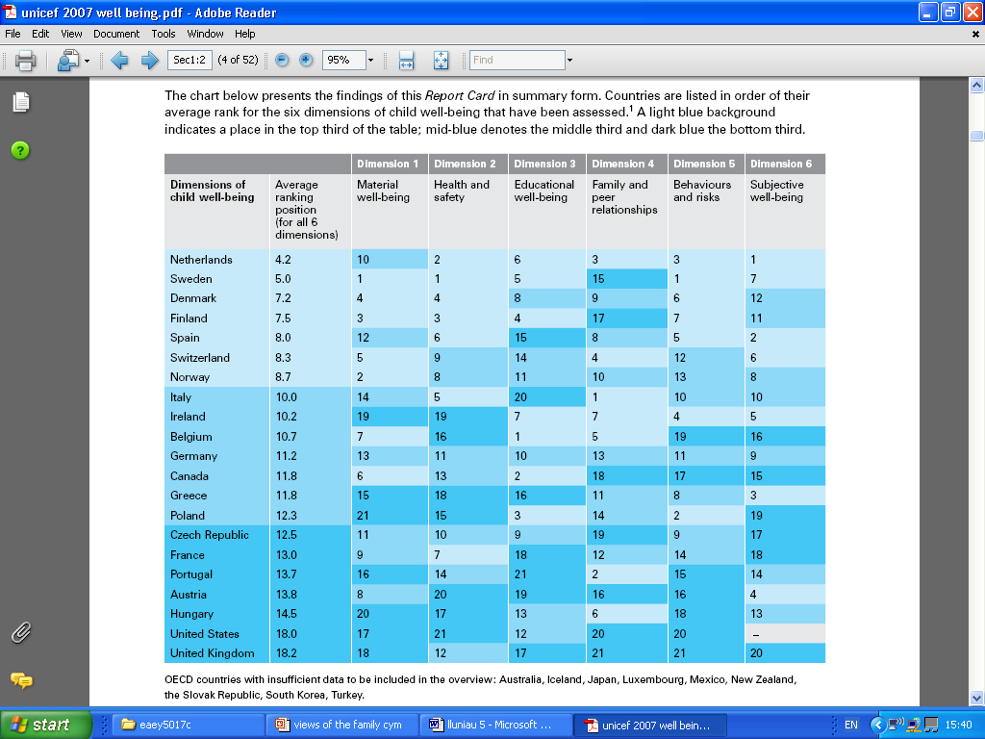
UNICEF an overview of child well being in rich countries 2010
Notes:
Unicef 2010 review of child well being in rich countries. There is a great deal of concern regarding the mental health of children. Are children happy? Overstressed? Why were children in the UK among the least happy? What should the Govt do to address this? What is ‘the politics of childhood?’ the politics of family life? What are organisations like Children in Wales doing to address this? Staff training to alert them to issues? Publishing reports? What about the role of local authorities? What does your ‘council’ do/provide in your area to support families?

Slide 7
Child well-being in the UK, Spain and Sweden – the role of inequality and materialism
‘Children in all three countries told us they wanted
time with their parents and families, good
relationships with their friends, and lots of stimulating things to do. In the UK, we found parents struggling to find time to be with their children, or to help them participate in sporting and creative activities.’
(Unicef, no date: no page)
Notes:
This is a quotation from the Unicef report – see the title above. This is on Moodle and is only available in English. They can use this report for their debate and essay but they will need to make sure that they refer to ‘family life’ in the debate and link the report to children’s lives for the essay.
Ask the students to consider why parents in the UK are having difficulty finding time for their families – long working hours, having to commute a long way to work, parents who are working away from home. Perhaps, not being able to afford to go on days out or to be able to pay for extra activities.

Slide 8
Child well-being in the UK, Spain and Sweden – the role of inequality and materialism
‘In comparing life in Spain, Sweden and the UK, we found that many children in the UK did not refer to material goods when asked what made them happy and also understood the principles of moderation in consumption. Yet parents seemed to feel compelled to purchase things for their children, often against their better judgment.’
(Unicef, no date: no page)
Notes:
Students to discuss in groups. Can they make links between this and changes to family circumstances. Do parents work long hours to buy the latest (generally very expensive) gadgets/toys for their children instead of spending time with their children?

Slide 9
Effeithiau daearyddol
Geographical effects
Pam mae teuluoedd yn symud i ardal arall?
Beth allai’r effeithiau fod?
A oes asiantaethau cymorth?
Why might families move area?
What might be the effects?
Are there support agencies?
Notes:
Start the discussion with a focus on Western issues (we have already discussed ‘globalisation’.)
Gobeithion am yrfa, gwell tai, gwell ysgolion. Effeithiau – colli cysylltiad gyda’u teulu estynedig/symud o’u ‘gwreiddiau’ – diffyg ymdeimlad o berthyn – hiraeth? Gall y berthynas rhwng tad-cu a mam-gu/yr wyrion wanhau? Strwythurau cymorth a strwythurau teuluol yn gwanhau. Beth os na allwch fforddio ymweld yn aml? Neb i ofalu am y plant – angen talu am ofal plant – sydd yn cynyddu’r angen i aros mewn swydd – cylch dieflig - hyd yn oed os ydych chi eisiau aros gartref gyda’ch babi, fedrwch chi ddim fforddio gwneud hynny – teimladau o euogrwydd? Drwgdybiaeth o ofalwyr plant? Canolfannau teuluoedd, canolfannau integredig, Dechrau’n Deg, addysg ran amser yn rhad ac am ddim yn 3 oed – mae’r Wladwriaeth yng Nghymru bellach yn darparu cymaint o gymorth i deuluoedd - yn y gorffennol y teulu estynedig oedd yn gwneud hyn.
Teuluoedd yn Gyntaf; Dechrau’n Deg, Homestart – cysylltiadau a pholisiau cyhoeddus.
Employment prospects, better housing, better schools. Effects – loss of contact with extended family/moving from ‘roots’ – lack of a feeling of belonging – hiraeth? Bond between grandparents/grandchildren can weaken? Weakening of support structures and family structures. What if you cannot afford to visit often? No one to mind the children – need to pay for childcare – increases need to stay in employment – vicious circle – even if you want to stay home with baby you can’t afford to – feelings of guilt? Mistrust in child carers? Family centres, integrated centres, Flying Start, free part-time schooling at 3 years – so much help now for families provided by the State in Wales, whereas in the past it was the extended family that did this. Note how public policy has changed over time in Western countries because extended families are not always present/available to support the care of children. Compare to many non-westernised countries. Families First, Flying Start, Homestart.

Slide 10
Tasg Task
Pairs/small groups
Discuss the subject on your card – you will need to take a positive of negative view
Consider both sides of the debate with the whole group
Parau/grwpiau bach
Trafodwch y testun ar y cerdyn – bydd eisiau cymryd agwedd positif neu negyddol
Ystyriwch 2 ochr y ddadl gyda’r grwp cyfan
Notes:
This will give them a chance to think about how a debate works. Put the students into random pairs (this will depend on the number in your cohort). Give each pair a card which will have a statement that they need to discuss. The card will note if they are to agree or disagree with the statement. Give them 5 minutes then bring each pair together with those who have the opposite side of the argument. Give them 5/10 minutes and ask each pair to share the differing viewpoints with the whole group. Lecturers to give some oral feedback (make it clear to the students that this is feedback –
Feedback might include – did everyone in the group contribute? How would they be able to support some of their comments? Were they listening to the others or interrupting? Were there others aspects/factors that they could have included? Did they use their time carefully when preparing or were they talking about other things? How could they structure the points so that the debate developed, was logical and flowed?
If you have some time left at the end of the lecture, ask them to go into their groups for the debate and do some planning – keep them in the room until the end of the lecture and go around the groups to see if they are on track and to give some pointers.

Slide 11
Tasg ymchwil Research task
Darganfyddwch sut mae Erthygl 8 ac erthygl 14 CCUHP (Confensiwn y Cenhedloedd Unedig ar Hawliau'r Plentyn) (1989) yn ymwneud â’r cysyniad o’r teulu.
Gwaith darllen ar Moodle e.e. Trask; King a Haugen; Levin: gweler hefyd y sleid nesaf.
Find out how Article 8 and article 14 of the UNCRC (1989) relate to the concept of the family.
Readings on Moodle e.g. Trask; King and Haugen; Levin: and see next slide.
Notes:
Other research: find out about the Family Law Act (do parents have total freedom in how they raise their children?); Laws change over time, in response to society/professional research/politics.
Levin: again care needed if students choose the Media module – avoid using the same info. For this module focus on relevant International comparators/links to /globalisation.

Slide 12
Cyfeirnodi a gwaith darllen
References and reading materials.
Clipart (images).
Kalliala. (2006). Play Culture in a Changing World. Berks: Open University Press.
King, L. and Haugen, K. (2013). ‘Today’s Families: Who are we and Why does it Matter?’. Exchange.
Trask, B. (2013). ‘Locating Multi-ethnic Families in a Globalising World’. Delaware: Family Relations.
Unicef. (2010). An overview of child well being in rich countries.
Unicef (no date). Child well-being in the UK, Spain and Sweden – the role of inequality and materialism.
Willan, J., Parker-Rees, R. and Savage, J. (eds), (2004) Early Childhood Studies. Exeter: Learning Matters.
Wright, H. (2015). The Child in Society. London: Sage. Pp. 50-57 and 102-110.

