Slide 1

Entrepreneurship and Starting a Small Business.

Slide 2
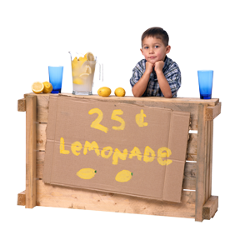
WHAT is ENTREPRENEURSHIP?
*
Entrepreneurship -- Accepting the risk of starting and running a business.
6-2
Notes:
See Learning Goal 1: Explain why people take the risks of entrepreneurship, list the attributes of successful entrepreneurs, and describe entrepreneurial teams, intrapreneurs, home-based and Web-based businesses.

Slide 3
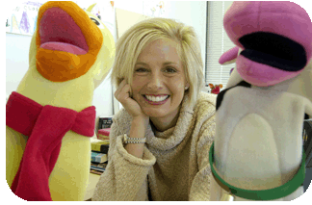
WHAT DOES IT TAKE to be an ENTREPRENEUR?
*
    Self-directed
    Self-nurturing
    Action-oriented
    Highly energetic
    Tolerant of uncertainty
6-3
Notes:
See Learning Goal 1: Explain why people take the risks of entrepreneurship, list the attributes of successful entrepreneurs, and describe entrepreneurial teams, intrapreneurs, home-based and Web-based businesses.

Slide 4
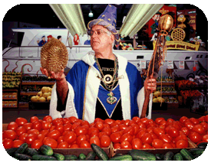
An IDEA is a
GOOD OPPORTUNITY IF…
*
  It fills customers’ needs.
  You have the skills and resources to start a business.
  You can sell the product or service at a reasonable price and still profit.
  You can get your product or service to customers before the window of opportunity closes.
  You can keep the business going.
6-4
Notes:
See Learning Goal 1: Explain why people take the risks of entrepreneurship, list the attributes of successful entrepreneurs, and describe entrepreneurial teams, intrapreneurs, home-based and Web-based businesses.

Slide 5

SOCIAL ENTREPRENEURSHIP:
RESPONSIBLE and PROFITABLE
(Thinking Green)
Gary Hirshberg of Stonyfield Yogurt wanted to run a profitable business that didn’t hurt the environment.
Stonyfield Yogurt is a 100% organic operation.
It’s green practices save the company millions of dollars each year.
After just 15 years, Stonyfield outsells Kraft Foods yogurt.
6-5
Notes:
See Learning Goal 1: Explain why people take the risks of entrepreneurship, list the attributes of successful entrepreneurs, and describe entrepreneurial teams, intrapreneurs, home-based and Web-based businesses.

Slide 6

ENTREPRENEURIAL TEAMS
  Entrepreneurial team -- A group of experienced people from different areas of business who join to form a managerial team with the skills to develop, make and market a new product.
      An entrepreneurial team (Steve Jobs, Steve Wozniak and Mike Markkula) was key to Apple’s success.
6-6
Notes:
See Learning Goal 1: Explain why people take the risks of entrepreneurship, list the attributes of successful entrepreneurs, and describe entrepreneurial teams, intrapreneurs, home-based and Web-based businesses.

Slide 7
MICROPRENEURS
  Micropreneur -- Entrepreneurs willing to accept the risk of starting and managing a business that remains small, lets them do the work they want to do, and offers a balanced lifestyle.
    Many micropreneurs are home-based business owners – writers, consultants, video producers, architects, bookkeepers, etc.
    Nearly 60% of home-based micropreneurs are men.
6-7
Notes:
See Learning Goal 1: Explain why people take the risks of entrepreneurship, list the attributes of successful entrepreneurs, and describe entrepreneurial teams, intrapreneurs, home-based and Web-based businesses.

Slide 8
HOME-BASED BUSINESS
GROWTH
*
Micropreneurs and Home-Based Businesses
*
LG1
    Computer technology has leveled the playing field.
    Corporate downsizing has led many to venture on their own.
    Social attitudes have changed.
    New tax laws have loosened restrictions on deducting expenses for home offices.
6-8
Notes:
See Learning Goal 1: Explain why people take the risks of entrepreneurship, list the attributes of successful entrepreneurs, and describe entrepreneurial teams, intrapreneurs, home-based and Web-based businesses.
In the United States home-based businesses have experienced growth due to a variety of reasons. One of the most important reasons for the growth in home-based businesses is that technology has made it easier for home-based businesses to compete against their larger competitors.

Slide 9

BENEFITS of HOME-BASED BUSINESSES
Ability to start your business immediately
Minimal startup capital needed
No rent or excessive set-up charges
Comfortable working conditions
Reduced wardrobe expenses
No commuting
Tax benefits
Elimination of office politics
Low risk for trial and error
Source: St. Louis Small Business Monthly, February, 2004.
6-9
Notes:
See Learning Goal 1: Explain why people take the risks of entrepreneurship, list the attributes of successful entrepreneurs, and describe entrepreneurial teams, intrapreneurs, home-based and Web-based businesses.
Ups of Home-Based Businesses
This slide walks students through some of the benefits of a home-based business.
Before showing this slide have students work alone, then with a partner, then with a group (doing all three will help promote discussion of students’ ideas) to see if they can come up with a list of positive characteristics of home-based businesses. Then reveal the slide and have students compare their lists to the slide.

Slide 10
DOWNSIDES of HOME-BASED BUSINESSES
*
Micropreneurs and Home-Based Businesses
*
LG1
Difficult to establish work habits
Limited support system
Isolation
Work space may be limited
Disruption of personal life
Clients may be uncomfortable coming to your home
Zoning restrictions
Success is based 100% on your efforts
Source: St. Louis Small Business Monthly, February, 2004.
6-10
Notes:
See Learning Goal 1: Explain why people take the risks of entrepreneurship, list the attributes of successful entrepreneurs, and describe entrepreneurial teams, intrapreneurs, home-based and Web-based businesses.
Downs of Home-Based Businesses
This slide walks students through some of the benefits of a home-based business.
Before showing this slide have students work alone, then with a partner, then with a group (doing all three will help promote discussion of students’ ideas) to see if they can come up with a list of disadvantages of home-based businesses. Then reveal the slide and have students compare their lists to the slide.

Slide 11

OUTSOURCING YOUR SMALL BUSINESS
(Reaching Beyond Our Borders)
*
*
The latest outsourcing trend is using the Internet to find affordable labor around the world.
Elance provides small businesses with a hub to find low-cost contractors.
Thanks to the inexpensive freelancers, Elance now has 48,500 clients, up 70% since 2007.
6-11
Notes:
See Learning Goal 1: Explain why people take the risks of entrepreneurship, list the attributes of successful entrepreneurs, and describe entrepreneurial teams, intrapreneurs, home-based and Web-based businesses.

Slide 12
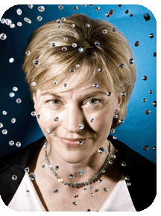
ONLINE BUSINESS
*
Web-Based Businesses
*
LG1
  Web-based businesses have more unique products than most brick and mortar stores.
  Online sales reached $165.9 billion in 2007, 8% of all retail sales.
  Affiliate Marketing -- An Internet-based marketing strategy in which a business rewards individuals or other businesses for each visitor or customer the affiliate sends to its website.
6-12
Notes:
See Learning Goal 1: Explain why people take the risks of entrepreneurship, list the attributes of successful entrepreneurs, and describe entrepreneurial teams, intrapreneurs, home-based and Web-based businesses.

Slide 13

INTRAPRENEURS
*
Entrepreneurship Within Firms
*
LG1
  Intrapreneur -- A creative person who works as an entrepreneur within a corporation.
  Intrapreneurs use a company’s existing resources to launch new products for the company.
    Art Fry of 3M developed Post-Its when he was trying to mark pages of his hymnal without damage.
6-13
Notes:
See Learning Goal 1: Explain why people take the risks of entrepreneurship, list the attributes of successful entrepreneurs, and describe entrepreneurial teams, intrapreneurs, home-based and Web-based businesses.
In order to develop new ideas engineers at Google are allowed to work on projects that interest them for up to twenty percent of the time at work. The idea is to support creative people and ideas in an effort to launch new products. This work can be more motivating than working on someone else’s ideas.

Slide 14
GOVERNMENT and ENTREPRENEURSHIP
*
Encouraging Entrepreneurship: What Government Can Do
*
LG1
Immigration Act passed in 1990 created a category of “investor visas” that encourage entrepreneurs to come to the U.S.
Enterprise Zones -- Specific geographic areas to which governments attract private business investment by offering lower taxes and other government support.
Incubators -- Offer new businesses low-cost offices with basic services.
6-14
Notes:
See Learning Goal 2: Discuss the importance of small business to the American economy and summarize the major causes of small-business failure.
Small-business is the economic engine of the United States economy. Due to the economic power of small-businesses the government has used “investor visas”, enterprise zones and business incubators to encourage entrepreneurship. A good website to further explore incubators is http://www.nbia.org/.

Slide 15

SMALL BUSINESSES
*
Small Versus
Big Business
*
LG2
  Small Business -- Independently owned and operated, not dominant in its field of operation and meets certain standards of size.
    Businesses are “small” in relationship to other businesses in their industries.
6-15
Notes:
See Learning Goal 2: Discuss the importance of small business to the American economy and summarize the major causes of small-business failure.

Slide 16
SMALL BUSINESS STATISTICS
*
Small Versus
Big Business
*
LG2
      There are 26.8 million small businesses in the U.S.
      Of all nonfarm business in the U.S., almost 97% are considered small.
      Small businesses account for over 50% of the GDP.
      Small businesses generate 60-80% of new jobs.
      About 80% of U.S. workers first jobs were in small business.
6-16
Notes:
See Learning Goal 2: Discuss the importance of small business to the American economy and summarize the major causes of small-business failure.
The power of small business is immense. Students are often shocked to see how small businesses contribute to the U.S. economy.

Slide 17
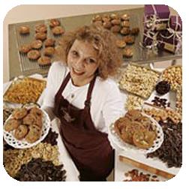
ADVANTAGES of SMALL OVER
BIG BUSINESS
*
Importance of Small Business
*
LG2
  More personal customer service.
  The ability to respond quickly to opportunities.
6-17
Notes:
See Learning Goal 2: Discuss the importance of small business to the American economy and summarize the major causes of small-business failure.

Slide 18

BUSINESS FAILURES are LOWER THAN the REPORTS BECAUSE…
*
Small Business Success & Failure
*
LG2
  Owner closing a business to start another is reported as a “failure.”
  Changing forms of ownership is reported as a “failure.”
  Retirement is reported as a “failure.”
6-18
Notes:
See Learning Goal 2: Discuss the importance of small business to the American economy and summarize the major causes of small-business failure.

Slide 19
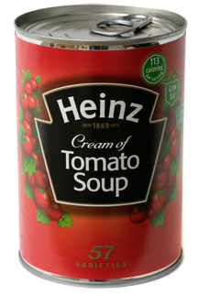
THEY DID WHAT?
Famous Business Failures
*
Small Business Success & Failure
*
LG2
Tommy Hilfiger – First store went bankrupt
Milton Hershey – First confectionary failed
H.J. Heinz – Company went bankrupt six years after start
Walt Disney – First film company went bankrupt
Henry Ford – First two car companies failed
L.L. Bean – Almost went bankrupt in first year
Source: World Features Syndicate, 2009.
6-19
Notes:
See Learning Goal 2: Discuss the importance of small business to the American economy and summarize the major causes of small-business failure.
They Did What?
Starting a successful new business is never easy and many famous entrepreneurs failed at their first and subsequent attempts.
Ask students: How can a business failure actually be a positive experience? (While failure is never a goal it often gives the entrepreneur an invaluable experience - old adage: Learn from your mistakes.)
Ask the student: If your first business failed, would you try again? Why or why not?
How can businesses survive such poor performances? (Determination and passion of the owners and founders plays a big role.)

Slide 20

MAJOR BUSINESS FUNCTIONS
*
Managing a Small Business
*
LG4
      Planning
      Financing
      Knowing customers
      Managing employees
      Keeping records
6-20
Notes:
See Learning Goal 4: Analyze what it takes to start and run a small business.
Starting a business is when the real work begins. It is important that entrepreneurs understand the major business functions such as planning, financing, understanding your customer, managing employees and keeping good records. Many entrepreneurs create business plans which may in part outline the major business functions.

Slide 21
BUSINESS PLANS
*
Begin with Planning
*
LG4
  Business Plan -- A detailed written statement that describes the nature of the business, the target market, the advantages the business will have over competition, and the resources and owners qualifications.
    A business plan forces potential owners to be specific about what they will offer.
    A business plan is mandatory for talking with bankers or investors.
6-21
Notes:
See Learning Goal 4: Analyze what it takes to start and run a small business.
The business plan is the entrepreneur’s road map to success. While a well designed business plan will not guarantee success the lack of one may surely lead to failure. To borrow money or to seek investors a business plan is a must.

Slide 22
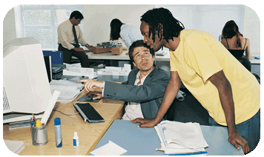
WRITING a BUSINESS PLAN
*
Writing a Business Plan
*
LG4
    A good plan takes a long time to prepare.
    A good executive summary catches interest and tempts potential investors to read on.
    Getting the plan into the right hands is almost as important as getting the right information in it.
6-22
Notes:
See Learning Goal 4: Analyze what it takes to start and run a small business.

Slide 23
A FAMILY AFFAIR
What to Consider Before Starting a Family Business
*
Writing a Business Plan
*
LG4
Clarify Expectations – What will each person contribute?
Discuss Work/Family Boundaries – What is the line that separates work from personal relationships?
Develop Good Communication – Agree about types of decisions you’ll make jointly and on own.
Clarify Long-Term Intentions – Discuss how long everyone will work full time and goals for the business.
Have an Escape Hatch – Have a Plan B.
Source: Business Week Small Biz, www.businessweek.com, February/March, 2008.
6-23
Notes:
See Learning Goal 4: Analyze what it takes to start and run a small business.
A Family Affair
This slide illustrates what needs to be considered before starting a business with family members.
Communication and the establishment of clear expectations are the keys to making a family business work.
To start a discussion in class about issues faced by family run businesses have students read the following article: http://www.postbulletin.com/newsmanager/templates/localnews_story.asp?z=7&a=399177
After reading the article ask students: Why do family businesses need extra care?

Slide 24

SOURCES of CAPITAL
*
Getting Money to Fund a Small Business
*
LG4
    Personal savings
    Relatives
    Former employers
    Banks & finance companies
    Government agencies
    Angel investors
    Venture capitalists -- Individuals or companies that invest in new businesses in exchange for partial ownership.
6-24
Notes:
See Learning Goal 4: Analyze what it takes to start and run a small business.
One reason that businesses fail is a lack of capital. Capital can come from internal sources (personal saving, employees etc.) or from external sources (relatives, banks and angel investors). One source of external funding is via venture capital. Venture capitalist are individuals or companies that invest in new businesses in exchange for a stake in ownership. Many well known businesses such as Google, Zappos and Apple received a first round of funding from venture capitalists.

Slide 25
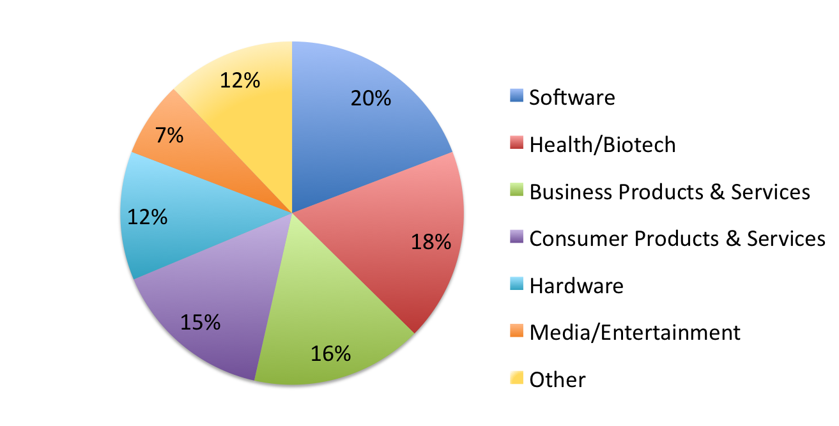
ANGELS ABOVE
Industry Sectors Favored by Angel Investors
*
Getting Money to Fund a Small Business
*
LG4
Source: CFO Magazine, www.cfo.com, September 2008.
6-25
Notes:
See Learning Goal 4: Analyze what it takes to start and run a small business.
Angels Above
Angel investors are private investors who invest in fast growing businesses before they go public.
This slide gives students insight into the industry sectors favored by angel investors.
Ask students: Why are software and health/biotech the top two industry sectors? (These two industry sectors offer the potential for fast growth which is very attractive to outside investors).

Slide 26
The SMALL BUSINESS ADMINISTRATION
*
The Small Business Administration
*
LG4
  Small Business Administration (SBA) -- A U.S. government agency that advises and assists small businesses by providing management training and financial advice.
    SBA started a microloan program in 1991 that provides very small loans to small business owners.
    Program judges worthiness on belief of the borrower’s integrity and soundness of their business ideas.
6-26
Notes:
See Learning Goal 4: Analyze what it takes to start and run a small business.
The importance of small business to the U.S. economy cannot be overstated. The Small Business Administration or SBA is the government agency that advises and assists small businesses with financial advice and management training. For more information on the SBA visit their website www.sba.gov.

Slide 27
Thank you.

