Slide 1
The role and importance of quality service, hospitality, and guest services within the hotel Industry
Hospitality and Guest Services BMIH4003
Lecturer: Charlotte Joyner
22/10/2023
Razvan Cristian Nicolae
Student ID:2222787
JW Marriott

Slide 2
Table of content
Introduction to JW Marriott....................................................................3
Identifying JW Marriott's Guest Demographics.....................................4
Nature, Scope, and Role of Guest Services and
Facilities.................................................................................................5
Guest Services and Facilities at JW Marriott.........................................6
Hospitality at JW Marriott.......................................................................7
JW Marriott's Personal Touch................................................................8
JW Marriott – Conclusion.......................................................................9

Slide 3

Introduction to JW Marriott
JW Marriott forms part of Marriott International's luxury portfolio, distinguished for its commitment to providing guests with orchestrated, nurturing experiences that cater to their well-being and enrich their lives. Founded in 1984, the brand embodies the personal passion of its namesake, J.W. Marriott, for gracious hospitality and genuine care (O'Fallon, M. J., & Rutherford, D. G., 2011). Renowned for its sophisticated design, exceptional craftsmanship, and dedicated service, JW Marriott creates a warm, authentic environment that allows guests to feel present in mind, nourished in body, and revitalized in spirit (Pizam, A., 2010).
(World Travel,2023)

Slide 4

Identifying JW Marriott's Guest Demographics
JW Marriott attracts affluent individuals, couples, and families seeking understated luxury and enriching experiences, along with business travelers desiring comfort and efficiency. Guests expect personalized, mindful services that enhance their well-being and cultural engagement, all delivered with an unobtrusive touch (Kucukusta, D., 2014; Lugosi, P., et al., 2009)
(Adannadill,2023)

Slide 5
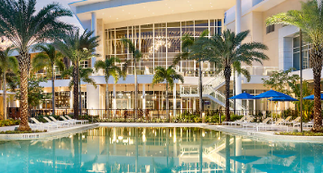
Nature, Scope, and Role of Guest Services and Facilities
Guest services and facilities in the hospitality industry are foundational to enhancing the overall guest experience, extending beyond mere accommodation to include diverse amenities such as wellness centres, gourmet dining, and personalized experiences (Barrows, C. W., & Powers, T., 2008). These services are crucial in meeting the varied needs of travellers, whether they're seeking relaxation, entertainment, business amenities, or cultural exploration. The scope of these offerings plays a vital role in positioning a hotel within the market, influencing guest satisfaction, loyalty, and the likelihood of personal recommendations (Torres, E. N., 2016).
(Americanexpress,2023)

Slide 6

Guest Services and Facilities at JW Marriott
Embodying this holistic approach, JW Marriott emphasizes well-being, with facilities offering spa services, fitness centres, and locally sourced restaurant menus. Their guest services include organized cultural events, mindfulness programs, and concierge services adept in personalizing guest experiences (O'Fallon, M. J., & Rutherford, D. G., 2011). This commitment not only reflects the brand’s dedication to guest comfort and satisfaction but also enhances its reputation as a destination that understands and caters to the nuanced needs of sophisticated guests (Pizam, A., 2010).
(Historichotels,2023)

Slide 7
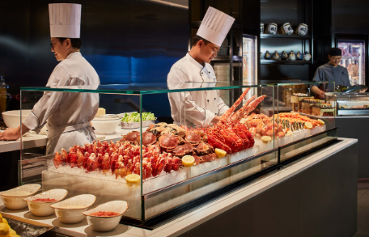
Hospitality at JW Marriott
JW Marriott's hospitality excels in crafting enriching, personalized guest experiences, focusing on well-being and relaxation (Pine & Gilmore, 1999). Their unique offerings, from yoga sessions to culinary workshops, not only meet but exceed guest expectations, fostering loyalty (O'Fallon & Rutherford, 2011).
(Nowtravelasia,2023)

Slide 8

JW Marriott's Personal Touch
A real-life example of JW Marriott's hospitality was demonstrated in Dubai, where staff organized a surprise desert dinner for a honeymooning couple, showcasing their commitment to creating unforgettable, heartfelt moments (Kandampully, J., Mok, C., & Sparks, B., 2001).
(Traveltriangle,2023)

Slide 9
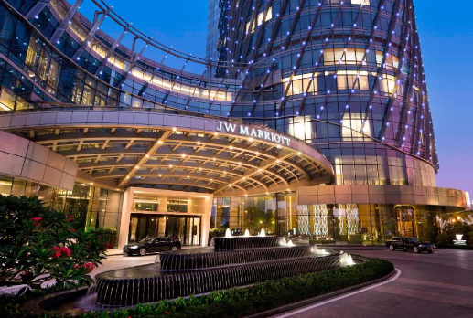
JW Marriott - Conclusion
JW Marriott stands out in the hospitality sector, delivering unique and memorable experiences that deeply resonate with guests. Their success hinges on personalized care and an unyielding commitment to guest satisfaction, setting a high standard in the luxury hotel industry (Pine & Gilmore, 1999; O'Fallon & Rutherford, 2011).
(Booking.,2023)

Slide 10
Reference
O'Fallon, M. J., & Rutherford, D. G. (2011). Hotel Management and Operations. John Wiley & Sons.
Pizam, A. (2010). International Encyclopedia of Hospitality Management. Butterworth-Heinemann.
Kucukusta, D. (2014). Luxury hoteliers' perspective on sustainable luxury hospitality. Journal of Tourism and Hospitality Management.
Lugosi, P., et al. (2009). Hospitality, culture and regeneration: Urban decay, entrepreneurship and the "ruin" bars of Budapest. Urban Studies.
Barrows, C. W., & Powers, T. (2008). Introduction to the Hospitality Industry. John Wiley & Sons.
Torres, E. N. (2016). Customer satisfaction and customer loyalty in the hotel industry. Handbook of Research on Customer Centricity and Service Management.
Pine, B.J., & Gilmore, J.H. (1999). The Experience Economy. Harvard Business Press.
O'Fallon, M.J., & Rutherford, D.G. (2011). Hotel Management and Operations. Wiley.
Kandampully, J., Mok, C., & Sparks, B. (2001). Service Quality Management in Hospitality. Haworth Hospitality Press.
Pine, B.J., & Gilmore, J.H. (1999). The Experience Economy. Harvard Business Press.

