Slide 1
LCBB5015
Principles of Marketing
Week 2
Marketing Concepts, Process and Strategies

Slide 2
Learning Objectives
To understand and analyse the various marketing orientations.
To determine the Ansoff Matrix and be able to apply the four growth strategies to a company.
To identify possible strengths, weaknesses, opportunities and threats of an organisation.

Slide 3
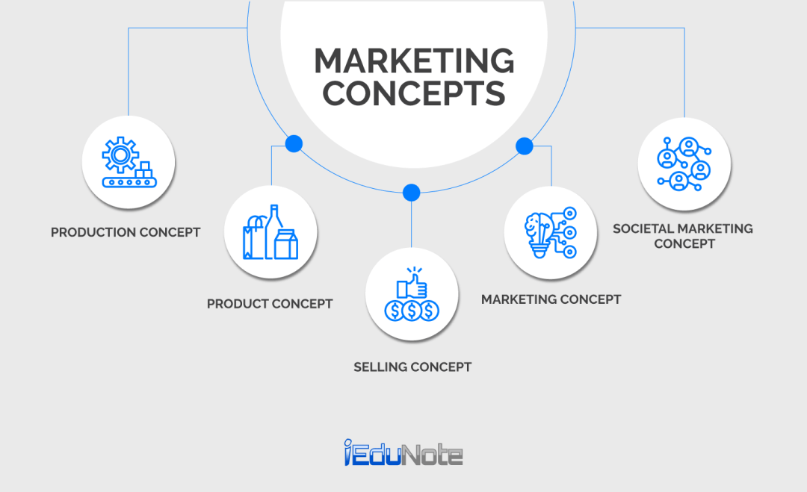
Five Marketing Concepts

Slide 4
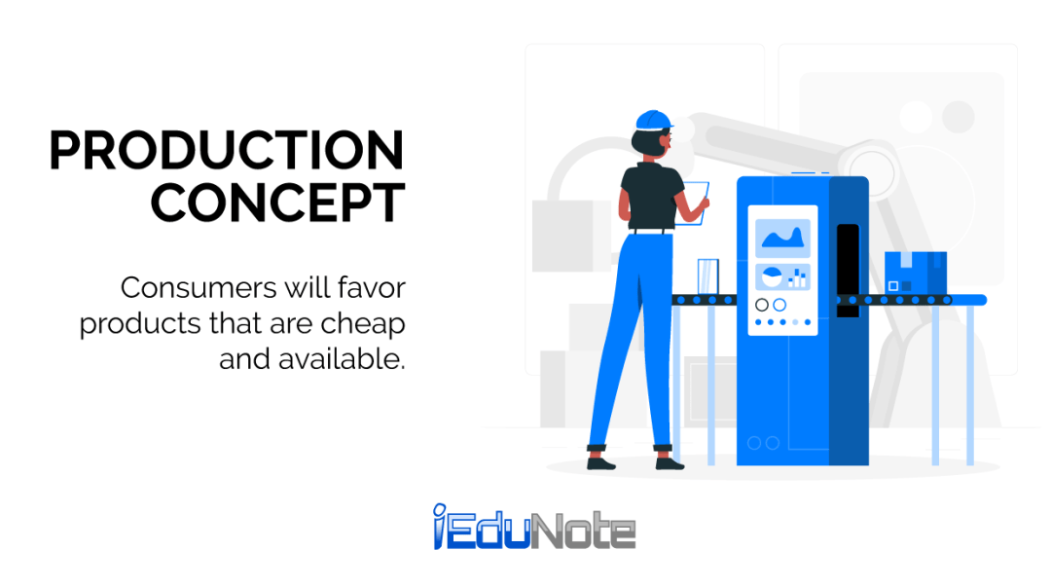
The Production Concept
The production concept holds that consumers will prefer products that are widely available and inexpensive.

Slide 5
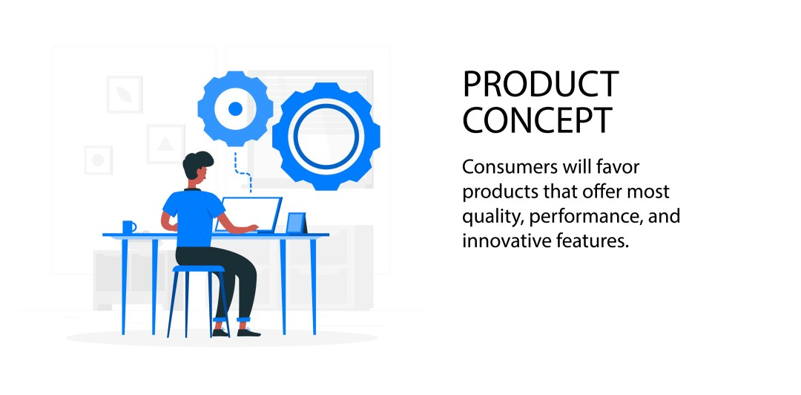
The Product Concept
The product concept holds that consumers will favour those products that offer the most quality, performance, or innovative features.

Slide 6
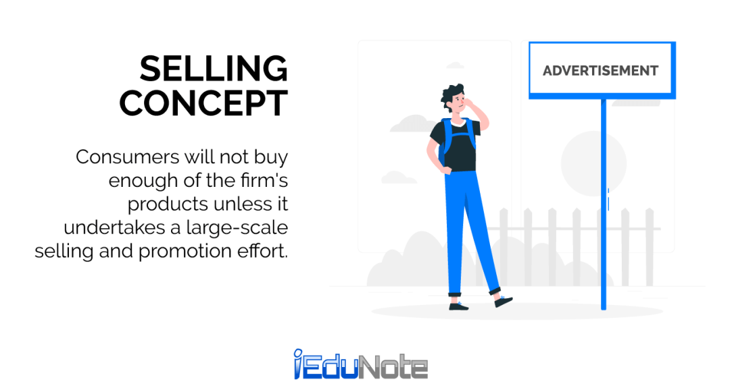
The Selling Concept
The selling concept holds that consumers and businesses, if left alone, will ordinarily not buy enough of the organisation’s products. The organisation must, therefore, undertake an aggressive selling and promotion effort.

Slide 7

The Marketing Concept
The marketing concept holds that the key to achieving its organisational goals, consists of the company being more effective than competitors in creating, delivering, and communicating customer value to its chosen target markets.

Slide 8
The Marketing Concept
The marketing concept rests on four pillars:
Target Market
Customer Needs
Integrated Marketing
Profitability

Slide 9
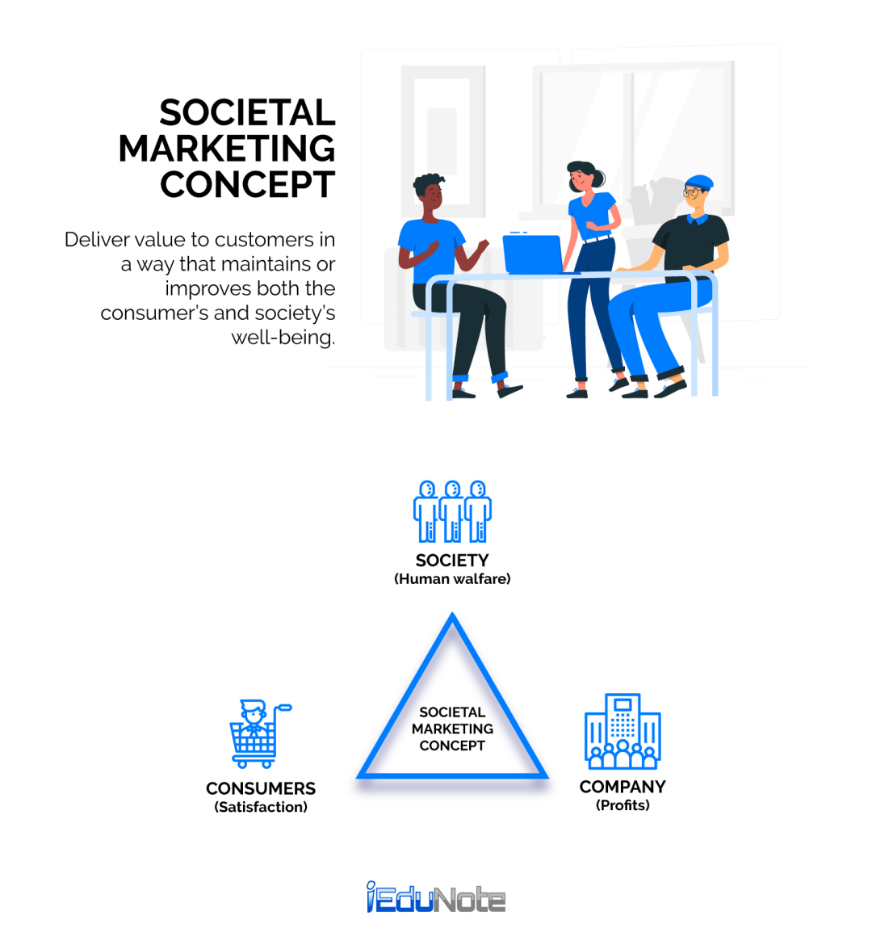
The Societal Marketing Concept
The societal marketing concept holds that the organisation’s task is to determine the needs, wants and interests of target markets and to deliver the desired satisfactions more effectively and efficiently than competitors in a way that preserves or enhances the consumer’s and the society’s well-being.

Slide 10
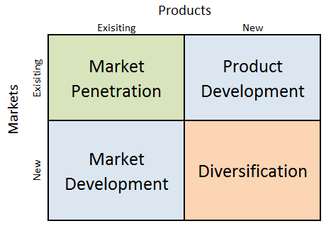
The Ansoff Matrix

Slide 11
Market Penetration
Existing product, existing market.
The company try to encourage their existing customers to buy more of the same product.
Relationship marketing and promotion can be used.

Slide 12
Product Development
Existing market, new product.
The company improve the quality or upgrade the technology of the existing product.

Slide 13
Market Development
New market, existing product.
The company make their product available in new, undiscovered countries.
The company find a new target market for an existing product.

Slide 14
Diversification
New market, new product.
The company produce products associated with a new industry.
There can be related or unrelated diversification.

Slide 15
Different Types of Diversification
Related (or concentric) diversification occurs when a firm internally develops or acquires another business that does not have products or customers in common with its current businesses but that might contribute to internal synergy through the sharing of production facilities, brand names, R&D know-how, or marketing and distribution skills.
An unrelated diversification involves two businesses that have no commonalities in products, customers, production facilities, or functional areas of expertise. Such diversification mostly occurs when a disproportionate number of a firm's current businesses face decline because of decreasing demand, increased competition, or product obsolescence.

Slide 16
Vertical Integration
Vertical integration is one way for companies to diversify.
Forward vertical integration occurs when a firm moves downstream in terms of the product flow, as when a manufacturer integrates by acquiring or launching a wholesale distributor or retail outlet.
Backward integration occurs when a firm moves upstream by acquiring a supplier.

Slide 17
SWOT Analysis
STRENGTHS
Strong brand name and good reputation.
Patent and copyright protection.
A large amount of financial resources.
A good relationship with suppliers and distributors.
The employees within the organisation.
Economies of scale and experience.

Slide 18
Weaknesses
The strengths can be reversed and become the weaknesses.
Failure to innovate.

Slide 19
Opportunities
Investment in research and development.
Competitor weaknesses.
New rules and regulations.
An unsatisfied customer need.

Slide 20
Threats
Changing customer needs and wants away from the company’s product/service.
Competitors and substitutes.
New rules and regulations.

Slide 21
Group Exercise
The Kelly Bottling Company, located in a large metropolitan area of some five million people, produced and marketed a line of carbonated beverages consisting mainly of flavoured soft drinks (not including colas), soda water and tonics. They were sold in different types of packages and sizes to a wide variety of retail accounts.
How might such a company expand its revenues by pursuing each of the different expansion strategies discussed in the Ansoff Matrix.

Slide 22
Summary
In this lecture we have analysed the various marketing orientations.
We have determined the Ansoff Matrix and have applied the four growth strategies to a company.
We have identified possible strengths, weaknesses, opportunities and threats of an organisation.

Slide 23
LCBB5015
Principles of Marketing
Week 2 Session 2
The Marketing Process

Slide 24
Learning Objectives
To identify and understand the stages in the marketing process.
To understand the stages in the marketing process in the context of a marketing plan.

Slide 25
The Marketing Process
Under the marketing concept, the company must find a way to identify and satisfy unfulfilled customer needs.
The process of doing so can be modelled in a sequence of steps: The Situational Analysis, Objectives, Strategies, Implementation and Control.

Slide 26
The Marketing Process
Situational Analysis
Objectives
Strategies
Implementation
Control
Notes:
Situation Analysis
The Situation Analysis is a thorough analysis undertaking by a company to discover the general position of a company within at a specific point in time. Its carried out by examining internal and external threats with the use of a strategy known as SWOT analysis as well as another strategy known as Portas 5 forces will be under taken
The

Slide 27
Situational Analysis
A situational analysis often is called the foundation of a marketing plan. A situational analysis includes a thorough examination of internal and external factors affecting a business. It creates an overview of the organisation that will lead to a better understanding of the factors that will influence its future.

Slide 28
Situational Analysis
Macro Environment
Porters 5 Forces Model
SWOT analysis

Slide 29
Situational Analysis
The Macro Environment
The major uncontrollable, external forces which influence a firm's decision making and have an impact upon its performance.

Slide 30
Situational Analysis
Porters 5 Forces Model
Michael E. Porter’s Five Forces framework is one of the most widely regarded business strategy tools. Born out of his work in 1979, this framework offers organisations a systematic approach to assessing their competitive environment and making strategic decisions that can influence their long-term success.

Slide 31
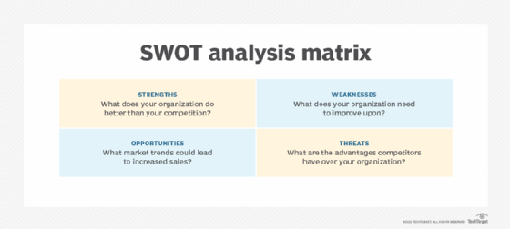
Situational Analysis
SWOT analysis
The primary goal of SWOT analysis is to increase awareness of the factors that go into making a business decision or establishing a business strategy. To do this, SWOT analyses the internal and external environment and the factors that can impact the viability of a decision.

Slide 32
Objectives
A specific result that a person or a company aims to achieve within a time frame and with available resources.

Slide 33
Strategy
A strategy is a general plan or set of plans intended to achieve something, especially over a long period.
Segmentation, targeting and positioning.
The marketing mix

Slide 34
Implementation
The process of putting a decision or plan into effect or execution.

Slide 35
Control
Set of practices and procedures employed by firms to monitor and regulate their marketing activities in achieving their marketing objectives and strategy.

Slide 36
Summary
In this lecture we have identified and determined the stages in the marketing process.
We have determined the stages in the marketing process in the context of a marketing plan.

Slide 37
References
John Gilbert Richardson, and Carolina Cooperative. Situational Analysis. Raleigh, N.C. Cooperative Extension Service, 2021.
Vanek, Michal. “Evaluation Methods of Swot Analysis .” GeoScience Engineering, vol. 58, no. 2, 1 June 2022, pp. 23–31.
Kotler, P., Armstrong, G. and Opresnik, M.O. (2018). Principles of marketing. 17th ed, global edition. Harlow: Pearson.
Hooley, G.J. & Nicoulaud, J.M. (2020). Marketing Strategy and Competitive Positioning. 7th ed. UK: Pearson Financial Times/Prentice Hall.

Slide 38
References
Hague, Paul. The Business Models Handbook : Templates, Theory and Case Studies. London, United Kingdom ; New York, Ny, Kogan Page Limited, 2019.
Jenkins, Abby. “How Does Vertical Integration Work?” Oracle NetSuite, 5 Jan. 2023, www.netsuite.com/portal/resource/articles/erp/vertical-integration.shtml.
Kotler, Philip, et al. Principles of Marketing. 8th ed., Harlow, Pearson, 2019.
“What Is Vertical Integration? Definition and Types - Business Jargons.” Business Jargons, 19 June 2017, businessjargons.com/vertical-integration.html.

