Slide 1
Management and decision making for your project

Slide 2
Catching up
The person who does not read has no advantage over the person who cannot read.
What did you read last week?
What will you read this week?

Slide 3
Outline
Ten minute writing
Reconnecting - drawing a vision
Considering vision and purpose
The leader and purpose
What is strategy?
Decision making
Evaluation

Slide 4
Ten minute writing
Your first task is to write for 10 uninterrupted minutes on the topic:
  My project is really important to me because..

Slide 5
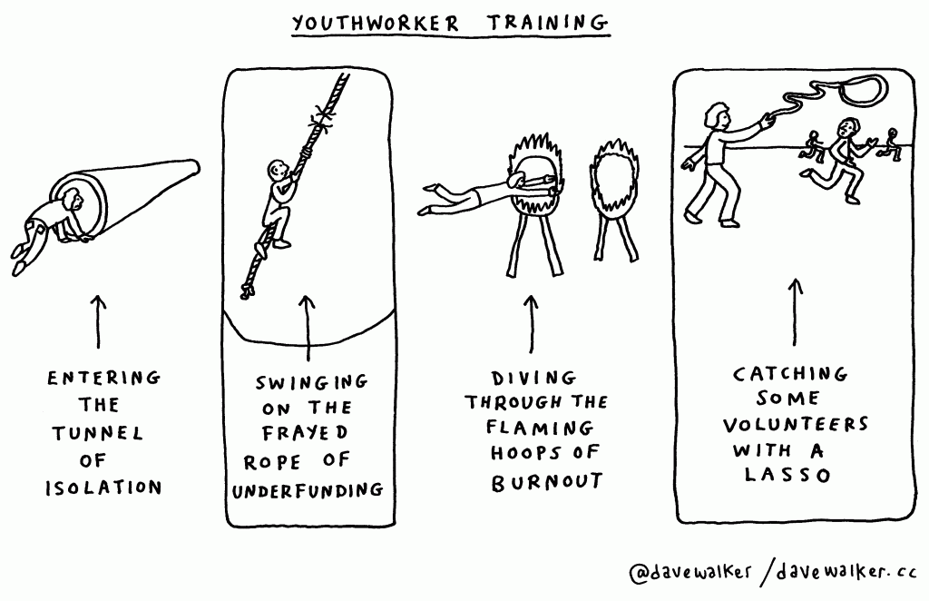
Drawing a vision
Take 5 minutes to draw a cartoon representing the vision of your business plan project.
Doesn’t need to be perfect
Isn’t a drawing competition
Is meant to make you think about your ideas and how they can be communicated..

Slide 6
Purpose
Youth work organisations have been regarded as woolly, well meaning organisations with a tendency to retreat to the moral and ethical high ground when faced with criticism.
To what extent should your project adopt or adapt one of the various purposes of youth work from the literature or develop its own ‘Statement of Purpose’ which is developed in house?

Slide 7
Should your business plan be strategic?
Strategic management is concerned with the formulation and implementation of strategy within organisations. Strategy combines:
  Awareness of the external environment
  Having a clear sense of purpose
  Developing the capacity to deliver
  Having the capacity for flexibility of action (effective plans to implement the strategy and the capacity to respond quickly to changes in the environment)

Slide 8
How does the Government think a business plan should look?
https://www.gov.uk/write-business-plan

Slide 9
Leadership and purpose
Purpose
or Mission
Aims
Objectives
(SMART)
Targets and action plans
Values
inform
Vision
What the world will be like if the mission is achieved and/or what the organisation will be like if the mission is achieved.
Question - How influential are the principles of youth work in ‘business planning?’
Adapted from Ford (2001)

Slide 10
Scanning the external environment
Purpose
Strategy, Policy
WG Policy, changes in external environment
Corporate Directors, Politicians, Trustees, Chief Executive.
Partners, peers, other departments, other organisations
Leader
Your staff: management team; full time, part time and casual
Young people
Citizens
Operational Delivery
Young people using the service
Adapted from Ford et. al. (2005)

Slide 11

3 Levels of Strategy – thinking ahead
Surface currents – easily detected, can be mapped and taken into account so as not to be pushed off course, these currents may change quite quickly
Ford et al, 2005: 61.

Slide 12

3 Levels of Strategy – thinking ahead
Underwater currents – harder to detect, usually slower moving, but very powerful. Not subject to rapid change.
Ford et al, 2005: 61.

Slide 13
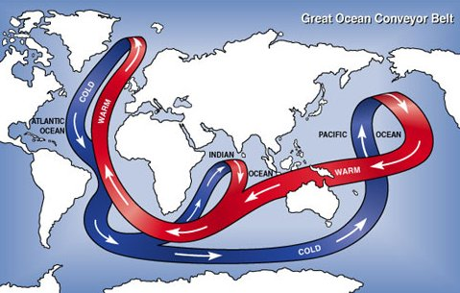
3 Levels of Strategy – thinking ahead
Deep ocean currents – very hard to detect, very slow to change but change in them can create a huge impact.
Ford et al, 2005: 61.

Slide 14

Task
Reflecting on a your youth work project, spend 10 minutes drawing a spider gram or a mind map with the organisation at the centre and factors/ individuals/organisations in the external environment which influence how you will develop the project.

Slide 15

Project Ideas
How can you develop your idea into a project?
  Young people
  Base
  Volunteers
  Paid Staff
  Transport
  Equipment
  Expertise
  Training
  Management

Slide 16
Stakeholder exercise
Taking the external influences you identified earlier, what do you think they understand to be the purpose of the organisation to be? Add your idea of purpose to your spider gram.
  What does this tell you about how your project can work with these potential influences?

Slide 17
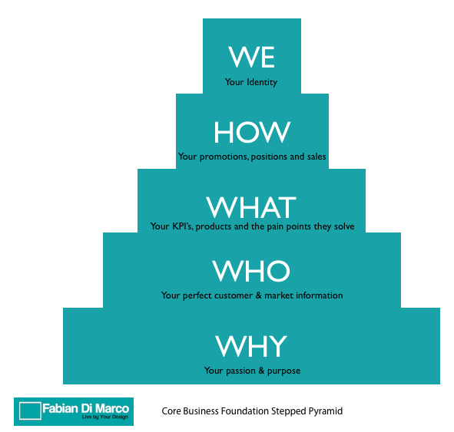
Two purposes
The notion of a primary purpose, linked to an organisation’s core business.
The notion of secondary purpose, linked to an organisation’s external influences.

Slide 18
Questions of purpose – ethics and morals
Mark Smith has pointed out that there is ‘a range of ideas about what the proper purpose of youth work might be. Such divergence is inevitable given the various interests involved.. Does it promote the welfare of individuals, serve to secure existing power relations, promote community or what?’ He then goes on to say that the concept of youth work is dynamic and constantly reinventing itself.
(Smith, 1988)

Slide 19
Making decisions
What questions should a project leader ask themselves (and others) when making sound decisions?
  Do we have clear purpose for our project?
  Do we know which young people we are providing the service to and why? (do we have good information on their needs/does our spending and activity reflect priority needs?)
  Do we have sufficient resources (finance, people, premises, equipment, etc.) to deliver the quality and quantity of services that will match our objectives?
  Is our approach to leadership and management appropriate for a small service or organisation working through a dispersed staff, in a wide variety of settings?
  Do we have adequate systems in place to record and measure the outcomes and impact of the service?
  Ford, 2005: 18

Slide 20
Approaches to thinking..
PMI
Cost/benefit
Six thinking hats
Mind mapping
Force field
McKinsey 7S
Pros and Cons
Reflection
Risk Assessment

Slide 21
Strategy - seeing the other side of the mountain
X
A
B
Y

Slide 22
Key points
Management models & self assessment
The importance of vision and purpose
Reading between the lines (principles)
Understanding the environment
Making time to think and reflect
Strategy needing to be plastic/elastic
Operational v strategic risk

Slide 23
Closing
We have covered a lot of ground today.
  What questions are arising for you from the lecture today?
  Off Course task is to read the paper on outcomes from the National Youth agency (available on Moodle).
  While your read and reflect, ask yourself some questions
    Is this information relevant to me in Wales?
    How does this relate to my project idea?
    How can I use this information to strengthen by business plan?
    Does the information on outcomes help my thinking about the SWOT analysis?

Slide 24
References
Audit Commission, Worth the Risk, London: Audit Commission, 2001
Dalrymple J, and Burke B, Anti-Oppressive Practice Social Care and the Law, Buckingham, OUP, 2001,
Ford K, Improving Youth Work Management, Leicester: FPM, 2001.
Ford K, Hunter R, Merton B, and Waller D, LEADING AND MANAGING YOUTH WORK AND SERVICES FOR YOUNG PEOPLE, Leicester: NYA, 2005.
Smith M, Developing Youth Work. Informal education, mutual aid and popular practice, Milton Keynes: Open University Press, 1988. http://www.infed.org/archives/developing_youth_work/dyw6.htm [16.03.10]

