Slide 1
Student Name: Fakhra Mumtaz
Student Number: 2420441
Module Code: LCHS32009_BRIM
Module Tile: Professional Development Within Health and Social Care
Lecturer Name: Vivan Osuchukwn
Assignment Title: Self-Awareness Presentation Component 1 Assessment

Slide 2
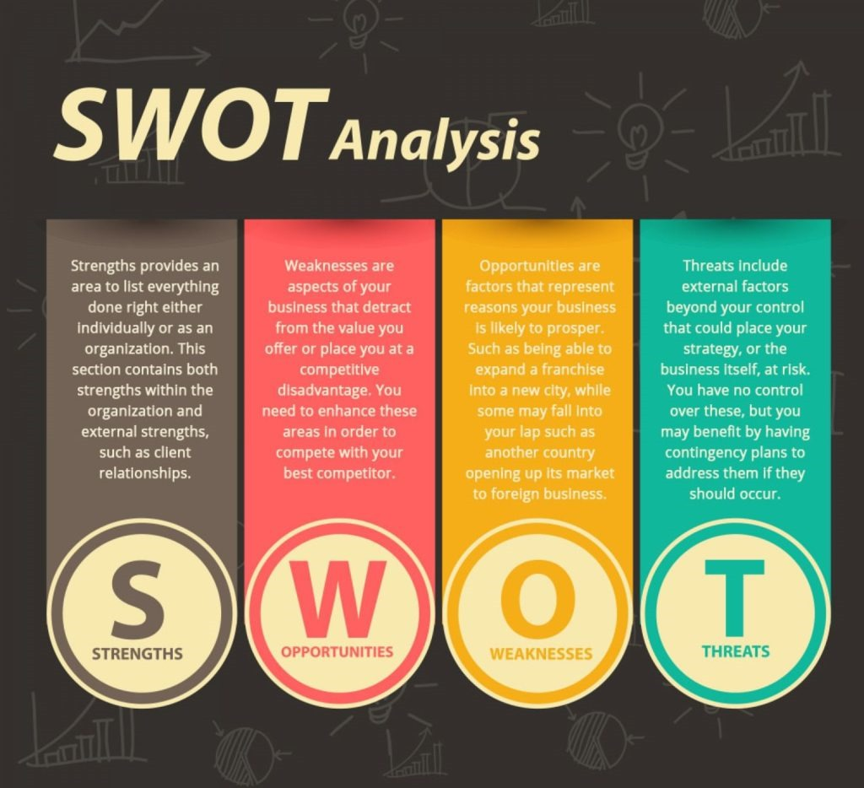
Introduction
Today, I am going to speak about my personal SWOT analysis. This will help me plan my professional development within the UK Health and Social Care Sector.
It is a framework used for strategic and planning in different projects or personal development.
A SWOT analysis helps organizations or individually understand their internal capabilities and external environment through organizations or individual can improve performance, reduce risk and take advantages of opportunities.

Slide 3

Strengths Weaknesses
Good communication
Sensitive and caring
Reliable team player
Punctual and responsible
Problem solving
Being positive
Lack of practical experience
Time management
Focus only on one task
Gat nervous under pressure (Skills for Care, 2024).

Slide 4
Opportunities Threats
Work placement modules
Online training courses
Volunteer roles in the community (National Health Service, 2023).
High competition for jobs
Being flexible
Different mental approach

Slide 5
Overcoming weaknesses
1.Weakness: Lack of Experience and Nervousness.
Solution: I will use my strength as a Reliable Team Player to secure a volunteer role at a local care home. This practical experience will build my confidence and reduce my nerves.
2. Leveraging Opportunities
Opportunities: Work Placement Module.
Solution:I will use my strength in Empathy and Care to make a positive impression. By focusing on good care, I can get a good reference and build my professional network.
3. Minimizing Threats
Threat: High Competition for Jobs.
Solution: I will use my good communication skill to talk to my tutors and careers advisors. Their guidance, combined with extra training from my opportunities, will help my CV out-standing.

Slide 6
References
Skills for Care (2024) Values. Available at: https://www.skillsforcare.org.uk/.
National Health Service (NHS) (2023) The NHS Constitution for England. Available at: https://www.england.nhs.uk/wp-content/uploads/2023/01/B1728-the-nhs-constitution-for-england-v14.pdf.
Photo SWOT link: https://andrewcussons.actioncoach.co.uk/s-w-o-t-analysis-for-personal-development/
Photo Animated link: https://www.vecteezy.com/vector-art/20977531-woman-with-victory-triumph-emotion-successful-female-character

