Slide 1
Student Name: JESSICA DUDUSOVA
Student ID: 2509008
Tutors: Annamarie Dufficy & Anita Nan
Assessment: Component 1 – Individual Presentation

Slide 2
Presentation Overview & Basil's
Bakery Context
What I will cover today
﻿﻿1.﻿Key issues affecting sales performance
﻿﻿2.PESTEL analysis of external factors
﻿﻿﻿3.Fishbone cause-and-effect analysis
﻿﻿﻿4.Summary of key findings
Backgrounds of the business
Independent artisan bakery in Coventry retail park established in 2015
Uses high-quality organic ingredients, serves shoppers, retail, office and warehouse staff
Challenge: Sales 25% below 2019
levels since 2023; no recovery despite restrictions ending
﻿﻿Customers have requested delivery and pre-order services which are not currently offered
﻿﻿Rising overheads: rent, rates, utilities, insurance + unpredictable organic ingredient costs

Slide 3
Issues Impacting Sales: Nature,
Scope & Impact
Nature of the problem
﻿﻿-Core issue: Sales stagnant at 25% below 2019 levels since 2023, with no sign of growth
﻿﻿-Not a temporary dip: performance has stayed consistent despite all legal restrictions ending
﻿﻿-Combination of falling demand drivers and rising operating costs
Area | What is affected
Customers | Retail park shoppers, retail workers, office/warehouse staff
Operations | No delivery/pre-order; Basil fully occupied on-site baking
Finances | Rent, utilities, rates, insurance, ingredient costs all increased
Location | Retail park footfall dropping; empty units; local job losses
Business impact​
﻿﻿Profit margins squeezed from both falling income and rising costs​
﻿﻿Risk of long-term viability if operations stay unchanged​
﻿﻿Missed sales opportunities from unmet customer requests​
Sources: Case study LCLM4004;​
Johnson et al., 2024; Jones, 2025

Slide 4
PESTEL ANALYSIS: EXTERNAL INFLUENCES
What is a PESTEL?
A framework to identify external factors outside the business that affects performance
Helps understand opportunities and threats has limitation: does not cover internal issues; is a snapshot not real time tracking (Morden,2023)
Factor | Applied to Basil’s Bakery | Impact
Political | Business rates reviews; local council retail park strategies; food hygiene regulations | Higher fixed costs; limited support for independent operators (Gov.uk, 2025)
Economic | Inflation; higher cost of living; increased rent/utilities; supply price volatility | Customers spend less; margins squeezed; hard to forecast costs (ONS, 2026)
Social | Shift to hybrid/remote work; less footfall; preference for delivery/click & collect | Fewer daily customers; missed sales from changing habits (CIPD, 2025)
Technological | Rise in online ordering apps; low-cost delivery platforms | Competitors adapt faster; Basil has no digital sales channels (Chaffey & Ellis-Chadwick, 2024)
Environmental | Organic crop vulnerability; extreme weather affecting harvests; sustainable sourcing rules | Unpredictable stock costs; supply reliability risks (DEFRA, 2025)
Legal | Employment costs; minimum wage rises; food labelling and allergen laws | Higher staffing overheads; extra compliance requirements (FSA, 2025)

Slide 5
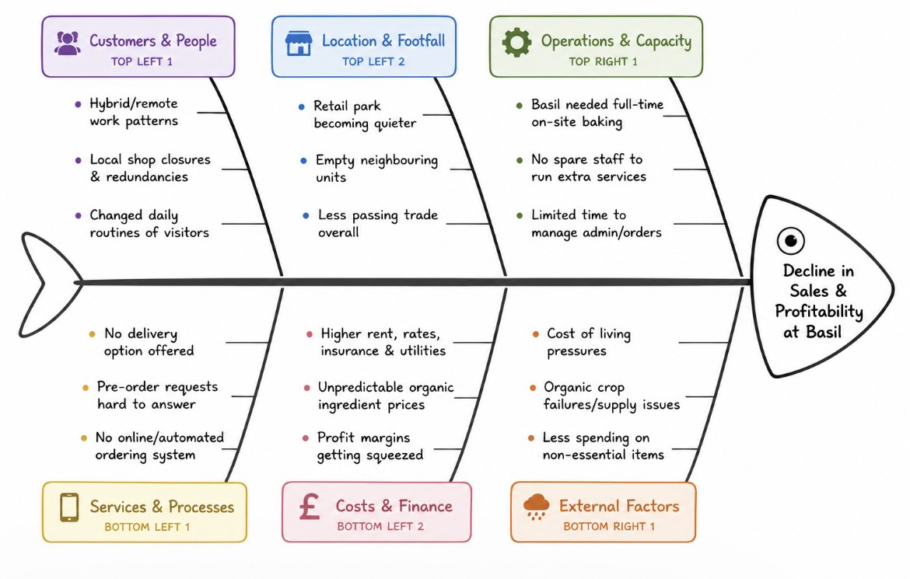
Fishbone Diagram: Root Causes of Sales Stagnation
identify ​all roots causes leading to a specific problem, grouping related factors
Helps move past symptoms to underlying issues; limitation: needs accurate data to avoid bias (Ishikawa 2022)
Central problem: sales 25% below 2019 levels

Slide 6
Key findings
-Sales stagnation comes from multiple linked factors, not just one single issue
-External shifts like hybrid working and retail park decline are combining with internal gaps
-Unmet customer demand for delivery/ pre-order means missed income opportunities
-Rising fixed costs and volatile ingredient prices are squeezing margins further
-Current operating model relies fully on Basil being on-site, limiting ability to adapt

Slide 7
REFERENCES ​
​reference's
Chaffey, D. and Ellis-Chadwick, F. (2024)
Digital Business and E-Commerce Strategy. 8th edn. Harlow: Pearson Education.
CIPD (2025) Hybrid Working Trends and Impact on Local Economies. London:
Chartered Institute of Personnel and Development. Available at:
Https:// www.cipd.org/research (Accessed: 20 July 2026).
DEFRA (2025) UK Organic Food Supply and Production Report. London:
Department for Environment, Food & Rural Affairs. Available at: https:// www.gov.uk/defr
a (Accessed: 21 July 2026).
FSA (2025) Food Business Compliance
Guidance. London: Food Standards Agency. Available at: https:// www.food.gov.uk Gov.uk (2025) Business Rates and Retail Sector Support Guidance. London: HM
Government. Available at: https:// www.gov.uk/business-rates
(Accessed:
20 July 2026).
Ishikawa, K. (2022) Guide to Quality Control. 3rd edn. London: Routledge.
Morden, T. (2023) Business Strategy and Planning. 4th edn. London: Kogan Page.
ONS (2026) UK Inflation and Cost of Living Review: January-June 2026.
London: Office for National Statistics.
Available at: https://www.ons.gov.uk
(Accessed: 22 July 2026).
Slack, N., Brandon-Jones, A. and Johnston, R. (2023) Operations
Management. 12th edn. Harlow: Pearson Education.

