Slide 1
The political environment: state and business actors
Impacts of politics in international business

Slide 2
Summary of contents
The political sphere
Authority in the nation-state
Political risk
Political systems
Authoritarianism
Democracy
Systems of government
Politics in practice
Global politics
Challenges and responsibilities
Conclusions

Slide 3
The political sphere
Politics is about the processes by which power is exercised in a social group
Public and private spheres -
Public: institutions of state, government structures and the individuals who play roles in political decision-making
Civil society – private sphere in which people can pursue their own goals, including freedom to join groups such as political parties, trade unions
Pluralism – existence in society of a multiplicity of groups and interests

Slide 4
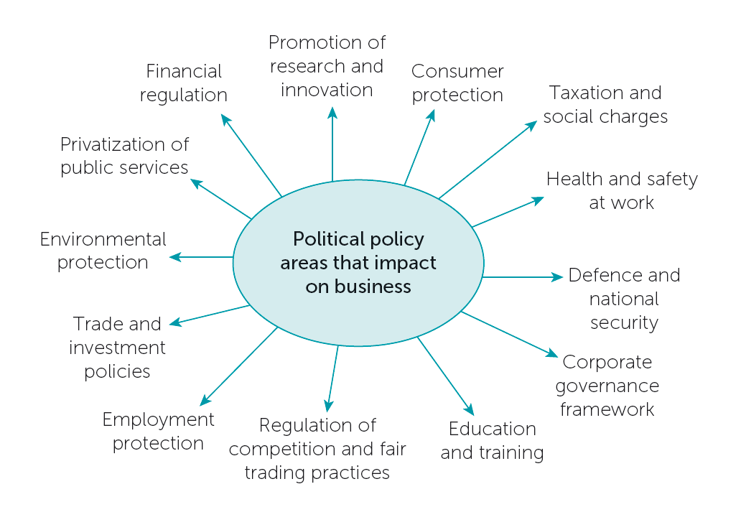
Impact of policy

Slide 5
Nation-states
The nation-state (or just state) is the basic unit into which the world’s peoples are divided; its characteristics:
Sovereignty - supreme law-making authority over inhabitants of its territory
Monopoly over legitimate use of coercive force in its territory
Government – Institutions by which laws are made and implemented in the state
Internationally, states recognize the sovereignty of each other
Sovereignty vs actual exercise of power – The military regime exercises power, but without legitimacy

Slide 6
Sources of authority in the state
In every viable state there is a legitimate source of authority, which can be:
Religion, as in a theocracy
Ideology – an all-encompassing set of beliefs, such as communism
Constitutionalism – set of rules recognized as authoritative in the society
The rule of law – principle of the supremacy of the law over both governments and individuals

Slide 7
Unitary and federal systems
In a unitary system, all authority radiates out from the centre
In a federal system, authority is shared between the centre and local or regional units
What are the advantages of federalism?
Seen as suitable for countries where regional units have strong loyalties and identities
Seen as advantageous to balance the power of central government

Slide 8
Political risk
Political risk – the uncertainties associated with the exercise of governmental power both within a country and from external forces
Internal factors:
Arbitrary government action, especially where the rule of law is weak
Social unrest
Corruption
External factors:
Wars and conflicts with other states
Terrorism

Slide 9
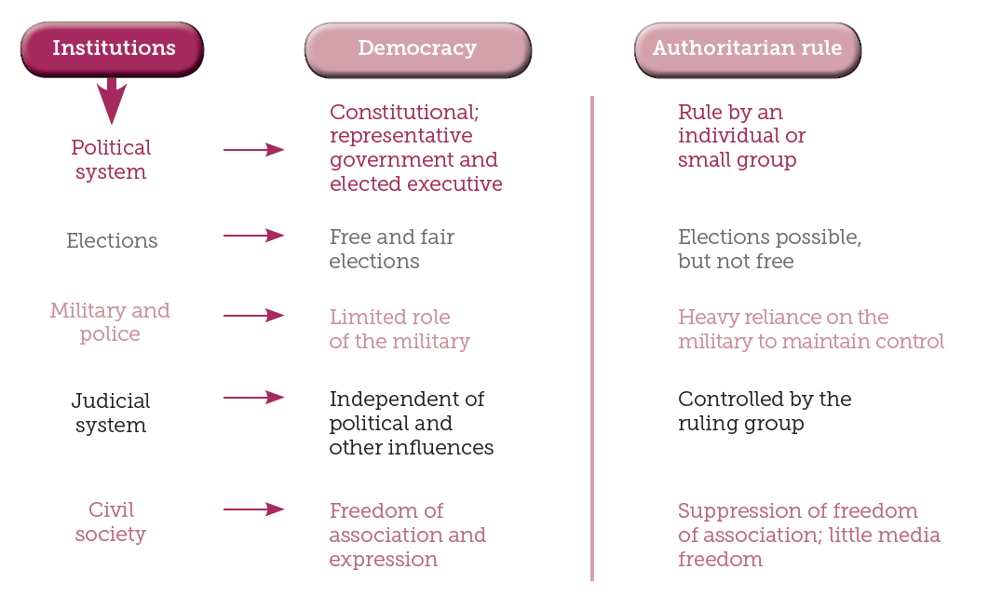
Democracy and authoritarianism

Slide 10
Democracy
Formal institutions such as elections constitute a minimal approach, but can lack the pluralism and freedoms of genuine democracy
Basic principles of democracy:
Rule of law
Free and fair elections, for representatives with law-making authority
Universal right to vote
Freedom of expression, speech and association
Majority rule and minority rights

Slide 11
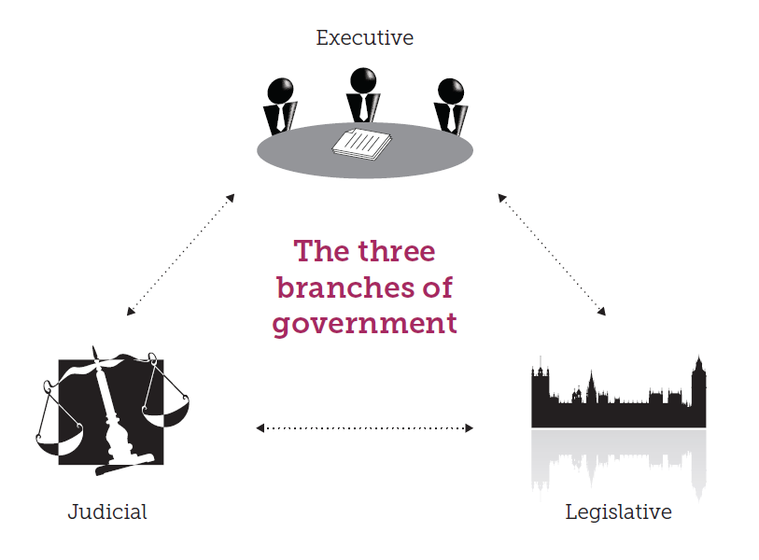
Systems of government
Separation of powers between the three branches of government
Checks and balances to ensure the accountability of each

Slide 12
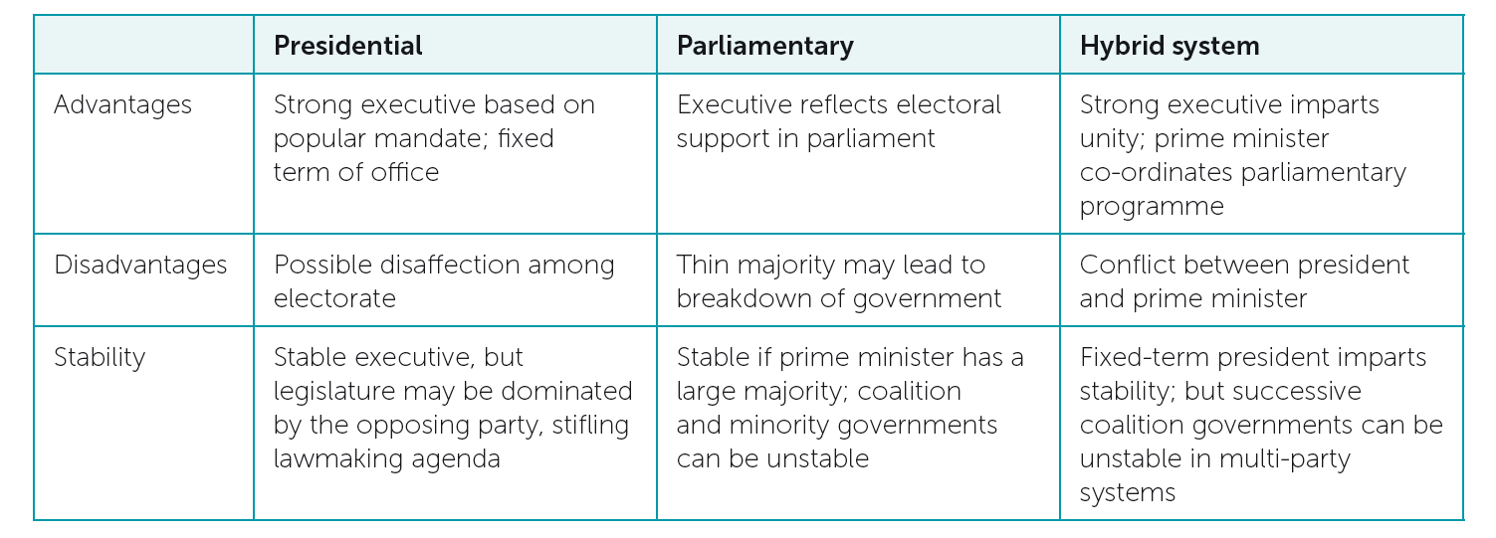
Systems of government

Slide 13
Legislative assemblies
The legislative assembly is a body of representatives which has law-making responsibilities
Elected representatives are central to constitutional law-making in a democracy, where there are free and fair elections
In authoritarian systems, the assembly can be non-elected or elected from hand-picked candidates; powers confined to rubber-stamping of the executive or advisory role only
Elections:
Traditional first-past-the-post
Proportional representation – tend to better reflect diverse groups

Slide 14
The judiciary
The judicial function focuses on the country’s system of courts
The rule of law and independent judiciary are core elements in a democracy
Judges should be seen as impartial -
Not in the pay of interest groups or powerful individuals
Not subservient to the government or to political interests
The judiciary acts as a check on the other two branches -
Can decide whether laws passed by the legislature are constitutional
Can declare executive actions unconstitutional

Slide 15
Political parties
The political party - organization of people who come together voluntarily to participate in political activities, e.g. by submitting candidates for election
Each party has its own perspective and policy agenda:
Parties to the left tend towards socialism, trade union values, government spending on social priorities
Parties to the right, generally conceived as conservative, tend towards enterprise values and minimal government intervention
Parties may also be religious in perspective, or focused on a range of issues, such as green parties
If there are numerous parties which obtain electoral support, a coalition government is a likely outcome

Slide 16
Business and politics
Lobbying – activities of organizations aiming to influence policies of legislators and government office holders
Lobbying is a huge business
Lobbyists have grown in number in Washington, DC, the UK and the EU
In theory, lobbying is regulated, but in practice, much of it is outside regulatory regimes
‘Revolving door’ between political leaders and lobby organizations – can lead to corruption

Slide 17
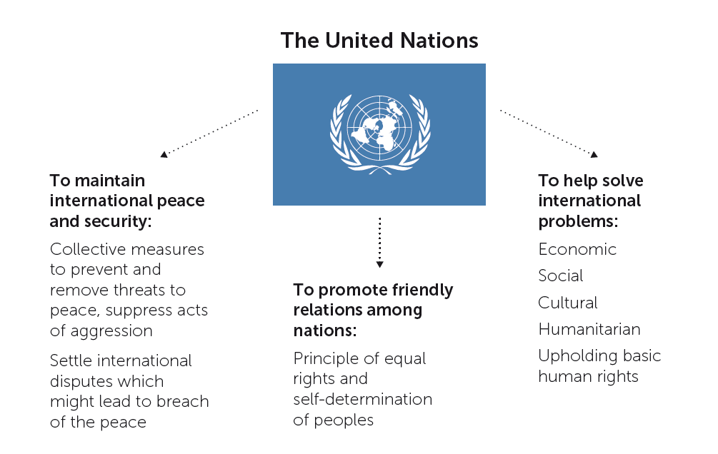
Global politics: The United Nations

Slide 18
UN institutions
The General Assembly, in which all member countries have one vote
The Security Council – made up of permanent members (with the power of veto) and rotating members
Can authorize peacekeeping operations, economic sanctions, arms embargoes against particular countries
UN agencies, such as…
The International Labour Organization (ILO) – sets standards for health & safety, workers’ rights, child labour

Slide 19
The European Union (EU)
The Council – conceived as the EU’s supreme law-making body; ministers from member states
The Commission – source of much legislation and policy
Composed of 28 commissioners, one from each member state
The Parliament – conceived as a check on the other two bodies, but now with greater law-making power, through co-decision (expanded by the Lisbon Treaty of 2009)
Membership for each state based on population
Members of the European Parliament (MEPs) have been directly elected since 1979

Slide 20
Changing balance of power in the world
The UN’s membership, originally only 45 states, is now nearly 200, most of these newer members being developing countries
The G20, in which emerging economies feature strongly, are now more representative of the changing balance of power than the UN Security Council
But the G20 has no permanent structure and no binding authority in international law. Like the UN, it is made up of sovereign states
Formal institutions are the ‘face’ of global politics, but beneath the institutions, economic and military power remain important

Slide 21
Challenges and responsibilities
Processes of governance involve governments, businesses and civil society organizations
As businesses reach more deeply into political life, potential for positive contributions – or negative, in the form of corruption
Companies involved in delivering public services: who are they serving?
Transparency and ethics are increasingly expected of companies in the public spotlight

Slide 22
Conclusions
For international business, political risk can arise from internal factors in a country or external forces.
Businesses desire a stable political environment, and they are active in interacting with governments, both authoritarian and democratic.
Democratic political systems, which are accountable to the populace, rest on free and fair elections, freedom of expression and the right to form groups in civil society.
Global political institutions, most notably the UN, provide the means for resolving global issues, but economic, political and military might of sovereign states remains important in global politics.

