Slide 1
The Body, Culture and Society
The Three Bodies:
Reading Scheper-Hughes and Lock (1987)

Slide 2
First the title……
Scheper-Hughes, N. and Lock, M. (1987) The Mindful Body: A Prolegomenon to Future Work in Medical Anthropology. Medical Anthropology Quarterly, 1, 6-41.
prolegomenon = ‘an introduction or preface to a book etc., esp. when critical or discursive’ (Oxford English Reference Dictionary)

Slide 3
The Three Bodies
The Individual Body
The Social Body
The Body Politic

Slide 4
The Three Bodies
The Individual Body – compartmentalised or holistic?
The Social Body – symbolic
The Body Politic – regulated and controlled

Slide 5
Theoretical Approaches
Behind the Three Bodies
The Individual Body - phenomenology
The Social Body – structuralism, symbolism
The Body Politic - poststructuralism

Slide 6
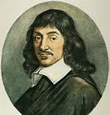

Epistemological assumptions of Western biomedicine
René Descartes (1596-1650): French Enlightenment philosopher
Discourse on the Method – principle of scientific thought based on knowledge of the truth, rejecting unprovable beliefs
Cogito ergo sum – perception is unreliable, the only truth is the existence of thought, of which we are conscious
Reason only admits of deduction based on this first principle

Slide 7
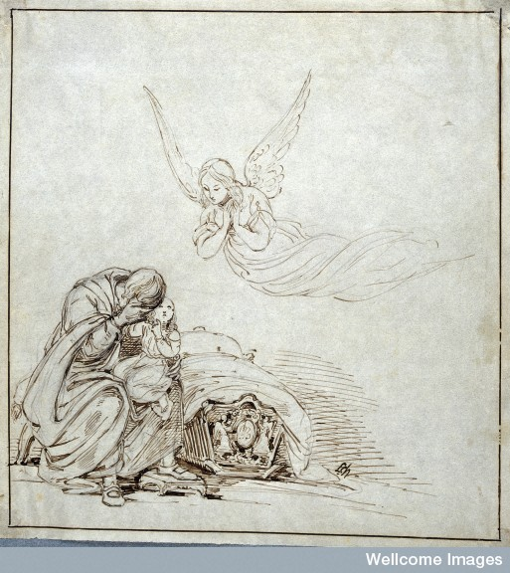
Cartesian dualism
Body/mind
Real/unreal
Physical/intangible
Natural/supernatural
Disease/illness
Biological/psycho-social

Slide 8
Other dualisms in Western philosophy
Nature/culture
Passion/reason
Individual/society
Conscious/unconscious
Labour humanises and domesticates nature (Marx)

Slide 9
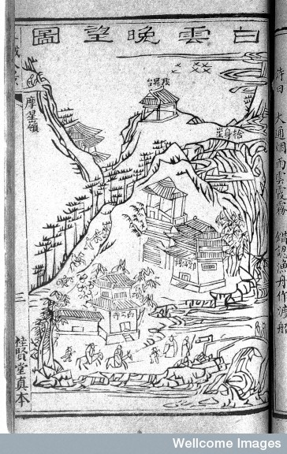
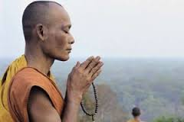
Some non-dualistic conceptions

Slide 10
The Social Body
Body as Symbol
Mary Douglas – the body is a natural symbol supplying some of the richest sources of metaphor
Pollution and danger
Images of the body reflect our idea of society

Slide 11
Body alienation
“The world in which most of us live is lacking a comfortable and familiar human shape. At least one source of body alienation in advanced industrial societies is the symbolic equation of humans and machines.’ (p. 22)

Slide 12
The Body Politic
Relationships between individual and social bodies are about power and control.
Threats to social group (real or imagined) result in heightened controls (self-control of bodies, social control)
Social reproduction of ‘the kinds of bodies they [societies] need’ (p. 25)
Body politic filters human unrest and protest into the idiom of sickness, which can be managed by doctor-agents (p. 27)

Slide 13
Final discussion
Scheper-Hughes and Lock claim that emotion is the mediator of the three bodies. How does emotion relate the individual, the social and the political bodies?

