Slide 1
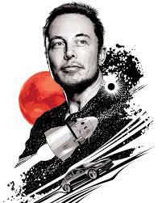
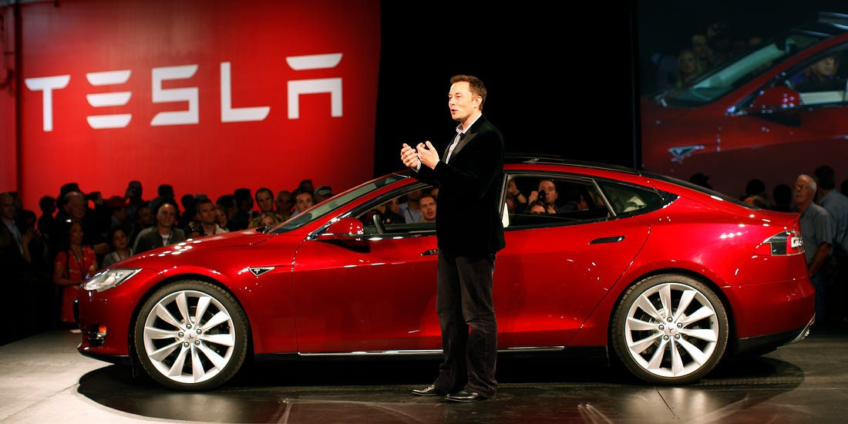
Introduction
The man who took the space industry by storm and promised to make us a multi-planetary species by establishing human civilization on mars started out as a simple programmer who made computer games. But with deliberate will, passion and hard work, Elon musk brought many innovative ideas to life through his companies such as SolarCity, TESLA and Spacex. His life adventure also includes the digitization of financial exchange and many ups and downs and sleepless nights.

Slide 2
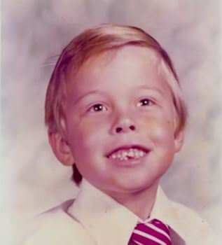
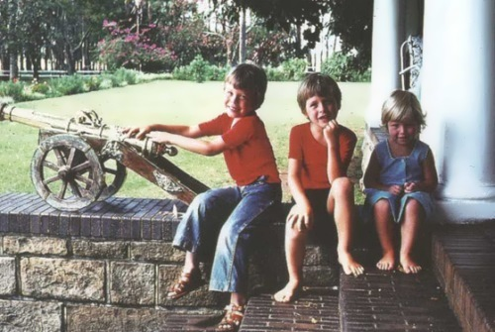
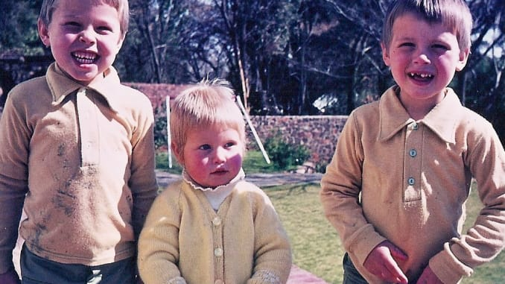
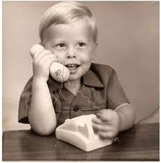
Early Life
Elon Musk was raised in Pretoria, South Africa. He was born on June 28,1971.His mother was a model and his father was an Electro-mechanical Engineer. As a child Musk had a reading habit and a keen interest in computing. He taught himself computer programming in BASIC before he turned 13. Just as a child he showed his aptitude in business by selling the code of a game he developed to ‘PC and Office Technology Magazine’. He used to read science fiction novels from writers such as Isaac Asimov which greatly influenced his mind. Musk studied at Pretoria Boys High School where he was severely bullied throughout his high school life but managed to stay strong and focused on his studies. He and his younger brother Kimbal Musk tried to open a gaming arcade but couldn’t get permission from the authorities.

Slide 3
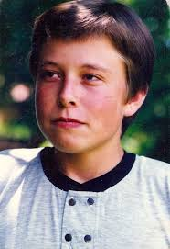
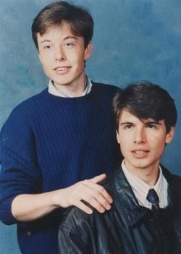
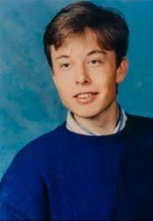
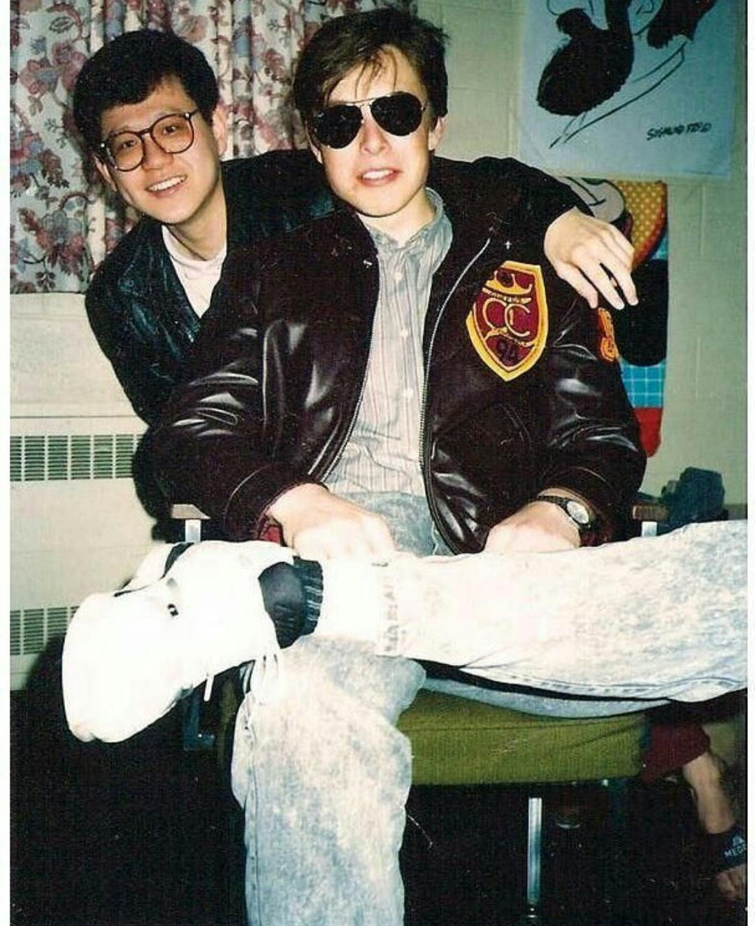
Education
After high school, Musk intelligently avoided mandatory Military service in the South African military by admitting himself to Queen’s University, Canada in 1989 by using his mother’s Canadian citizenship. In 1992, he left Queen’s University to study in America at University of Pennsylvania. He did a double major in physics and economics and graduated two Bachelor’s degree in Physics and Economics. He interned at Pinnacle Research Institute which was an energy storage startup. Then he did another internship at a Palo-Alto based startup called Rocket Science Games where he worked in assembly programming of device drivers. Musk then got into Stanford for a PhD in energy physics and material science but dropped out after just two days to pursue his first company ‘Zip2 Corporation’.

Slide 4
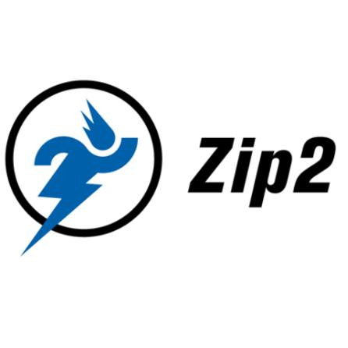
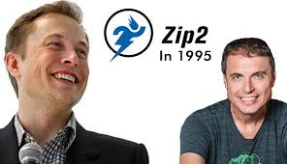
Elon’s First company
Elon Musk founded a company much like Google Maps called ‘Zip2’.It is a web based software company that provided an Intercity guide for the newspaper industry. The finance for this company was raised from a small group called angel investor. The company obtained contracts from many newspapers companies such as The New York Times and Chicago Tribune. Later a company named ‘Compaq’ acquired Zip2 for US$307 million in cash and also US$34 million in stock options.

Slide 5
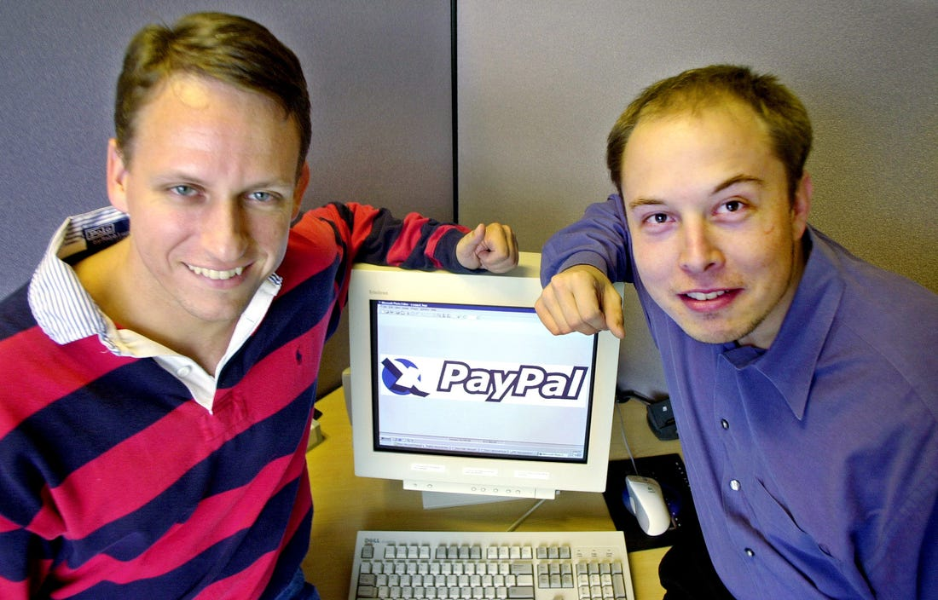
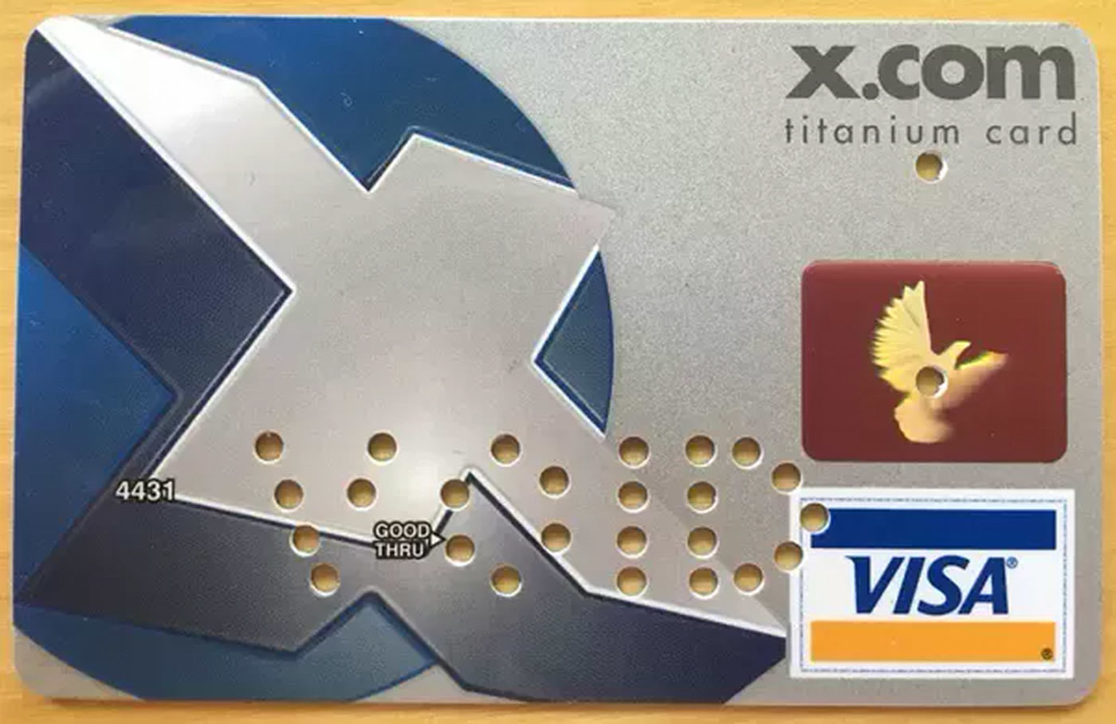
Digitising the finance industry
After becoming a millionaire,Elon Musk founded ‘X.com’, an online financial service and email payment company.He used his 10 million dollars from the sale of Zip2 to finance it. This company merged with ‘Confinity’ one year later. This had a money transfer service called ‘PayPal’. Later the company renamed itself to PayPal in 2001. This company grew by viral marketing where the customer received money for signing up which drew in a lot of new customers. This way ‘X.com’ became ‘PayPal’ which turned out to be a billion dollar company. But in October 2000, Musk lost his role as CEO due to disagreements with other leaderships of the company when he wanted to PayPal’s Unix based infrastructure to Microsoft Windows. And after a few years, in 2002, PayPal was acquired by ‘eBay’ for US $ 1.5 billion. Musk had the highest share of 11.7% of PayPal for which he received 165 million US dollar.

Slide 6
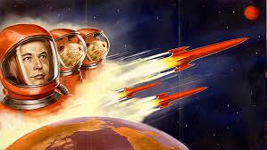
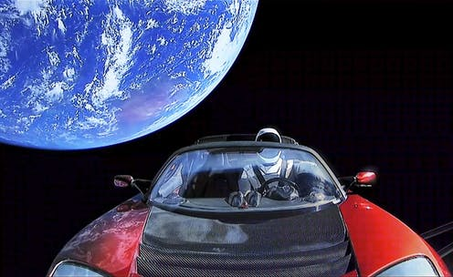
Going to space
After having millions in hand, Elon Musk wanted to do something meaningful. He noticed that there was not that much public interest in space exploration, so he tried to draw some public interest using ‘Mars Oasis’ which is a project to land a greenhouse on Mars with food crops growing in it. So in 2002, he brought along Mike Griffin, who was an ex-venture capitalist for CIA and had also worked for NASA’s Jet Propulsion Laboratory. Mike was a maker of satellite and spacecrafts. Musk envisioned that he could start a company that can build affordable rockets. He calculated that the raw materials for building a rocket was just 3% of the sale price of rockets at that time. He measured that by using vertical integration, the price of a rocket launch could be reduced by a factor of 10. Then, Elon Musk founded SpaceX.

Slide 7
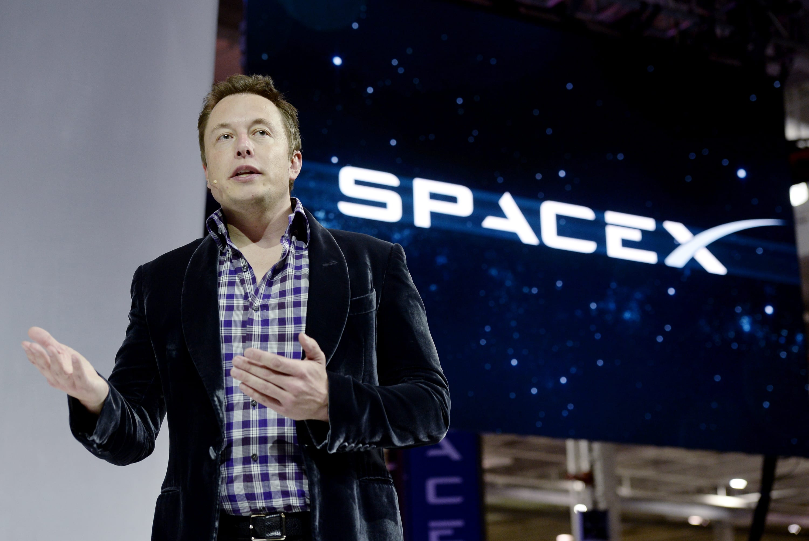
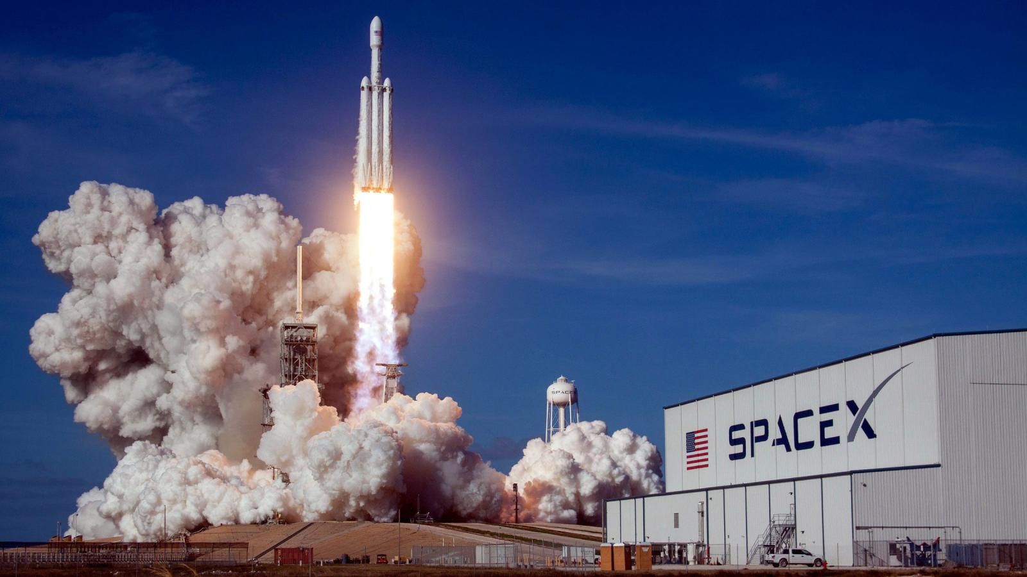
Spacex growth
Using 100 million dollars of his own money Elon Musk founded ‘Space Exploration Technologies’. Musk founded SpaceX with the long-term goal of making us a true spacefaring civilization. His first rocket Falcon 1 became the first privately funded liquid-fueled vehicle to put a satellite into Earth’s orbit in September 2008. SpaceX also built a multipurpose spacecraft called ‘Dragon’ and produced hundred operational Merlin 1D engines. SpaceX got a contract from NASA in 2006 to continue the development of Falcon 9 and Dragon spacecraft to carry cargo to The International Space Station. In February 2018, SpaceX launched ‘Falcon Heavy’- the highest capacity rocket ever built after Saturn 5,Energia and N1. SpaceX has begun the development of the ‘Starlink constellation’- a satellite system to provide global internet coverage directly from the satellites is the sky.

Slide 8
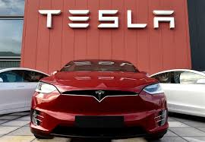
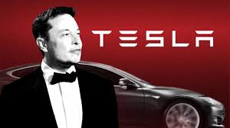
Tesla: Revolution in automobile.
One of Elon Musk’s greatest achievement came from joining Tesla Inc. but this is also the company which almost made him bankrupt. Tesla is an electric car company which now produces electric sedan and sportscars. Musk joined Tesla Inc. in 2004 as the chairman of the board of directors. He led the Series A round investment and played an active role in the company and supervised the product designed of the Roadster at a detailed level. Musk was appointed the leader of the company as the CEO and product architect in 2008. His economic strategy was to first build sportscars and use the money generated to build affordable cars for normal public. Tesla Roadster was the first car they built which was a sportscar. With sales of 2,500 roadsters to over 31 countries, the company started to build four-doors sedan car ‘Model S’ which was sold at a very affordable price and after that the ‘Model 3’ and ‘Model X’ which were all much more affordable than most other electric cars made by Ford and General Motors.

Slide 9
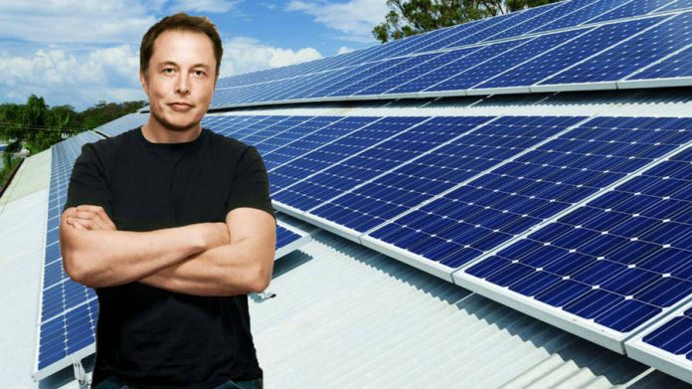
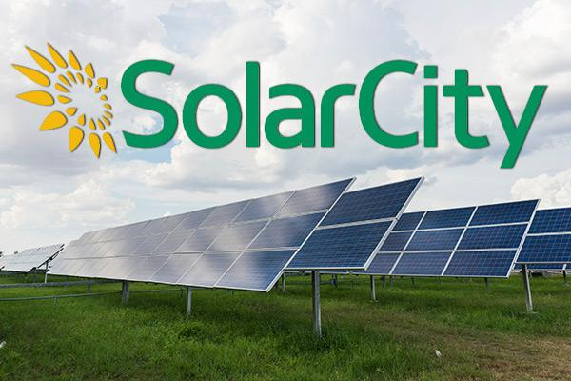
Harnessing solar energy
Musk co-founded and provided the first major finance to the company SolarCity which manufactured efficient solar panels which were so aesthetic that they could be places as roof tiles. One installation of these solar panels can provide a home with electricity directly produced from sunlight. In 2013 SolarCity was the second largest provider of solar power systems in the United States. SolarCity was later acquired by Tesla Inc. in November 2016 and has been a subsidiary of Tesla since.

Slide 10
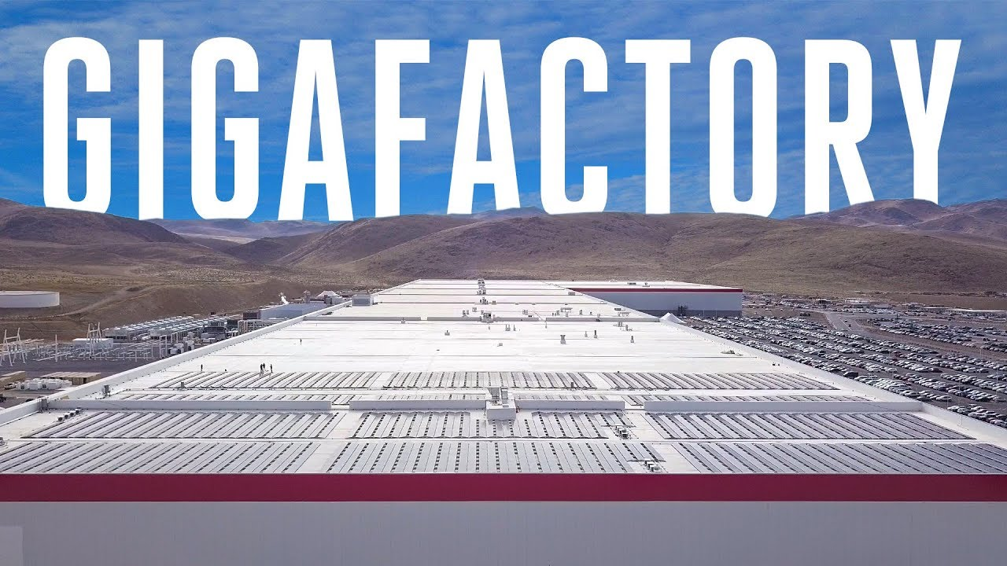
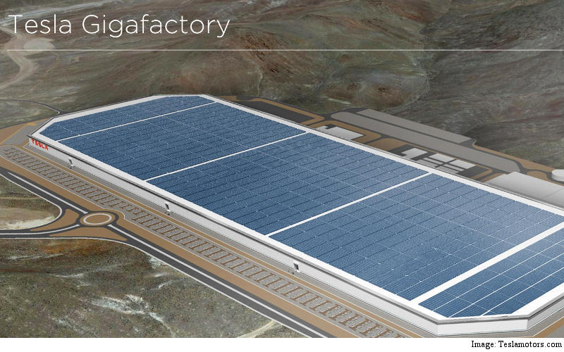
Gigafactory:storing energy
The electric cars manufactured by Tesla and the solar panels produced by SolarCity needs batteries to run. Musk built a battery manufacturing plant called ‘Gigafactory’ which can manufacture 3.5 million batteries a day. The factory is placed on Reno,Nevada.

Slide 11
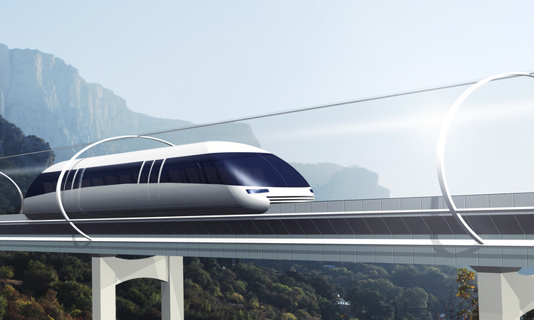
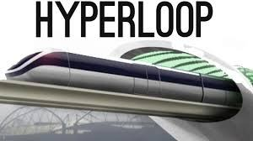
Hyperloop:Travelling underground
Musk also founded a high speed transportation system called ‘Hyperloop’. In this system pressurized capsules containing passengers travels through a vacuum tube. He founded Hyperloop in 2013 and held a competition for students to design a Hyperloop Pod in 2015. The capsules in the Hyperloop can travel at 1200 km/h speed.

Slide 12
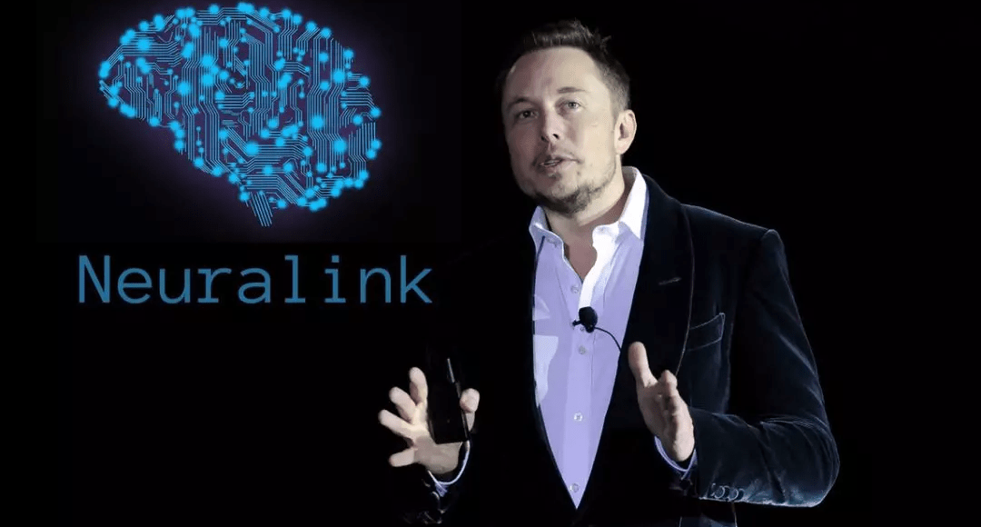

Neuralink:Combining Brain with computer
Elon Musk co-founded ‘Neuralink’ which is a company determined to integrate the human brain with artificial intelligence. The goal is to create devices that can be implanted in the human brain which will increase processing speed, cognitive abilities and memory. This company eventually wants to produce mind-computer interfaces.

Slide 13
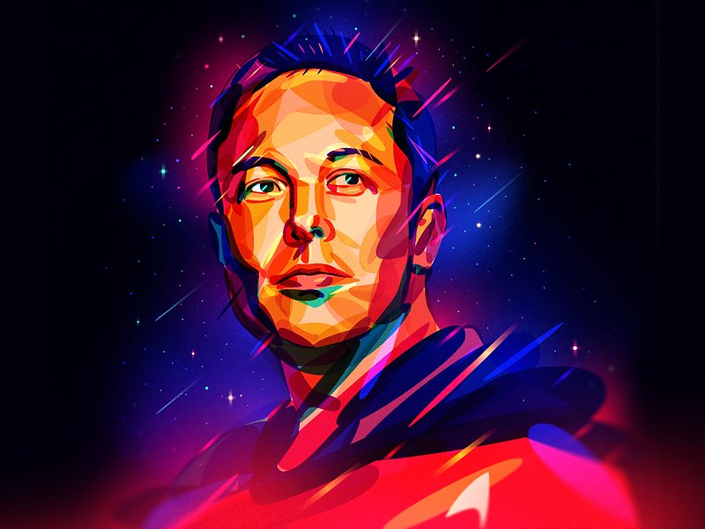
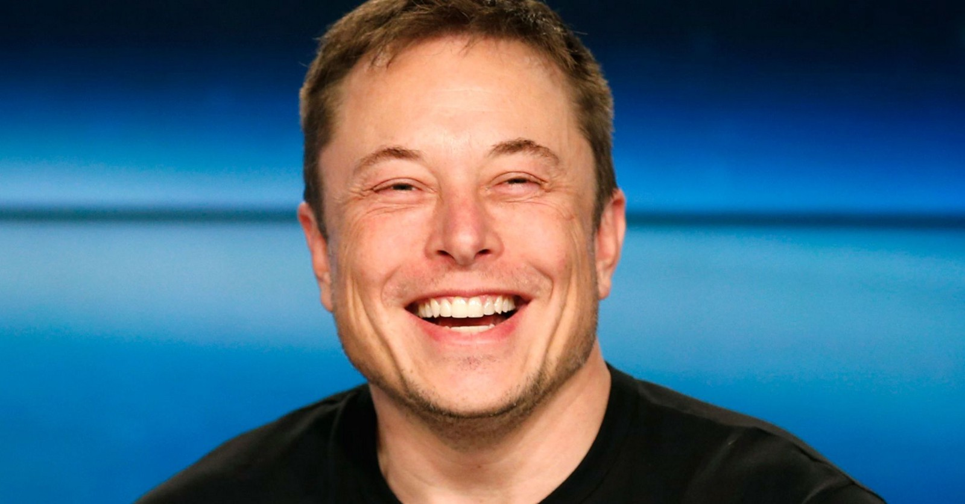
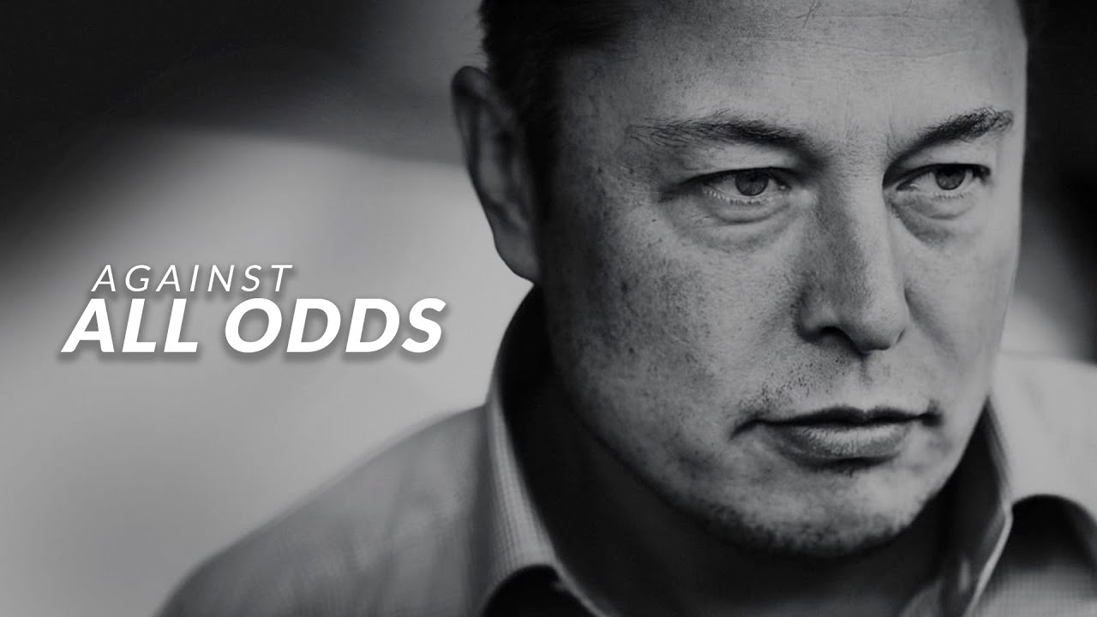
Conclusion
To conclude, it will probably not be crazy to declare that Elon Musk is the most extra-ordinary entreprenuer our planet has experienced in 21st century. Probably one day the man with a vision along with his extraordinary and all consuming passion will take us to Mars. It’s not far when we will be able to buy a duplex villa in Mars and we will book our tickets for inter-planetary journey online while streaming live video on youtube. Maybe he is a dreamer, probably a very crazy one but he is a success.

Slide 14
Thank you
Diolch Yn Fawr

