Slide 1
Sports Industry Research Project

Slide 2
Title
Volunteering for Glamorgan Cricket Club

Slide 3

Rationale
Worked for Glamorgan Cricket Club (CC) for 6 months
Responsible for managing 20 to 30 volunteers on match days
Extremely interested in why volunteers give up their time and what motivates them to do so
To help Glamorgan CC grow their volunteer programme as it is beneficial to the club and it helps improve customer experience

Slide 4
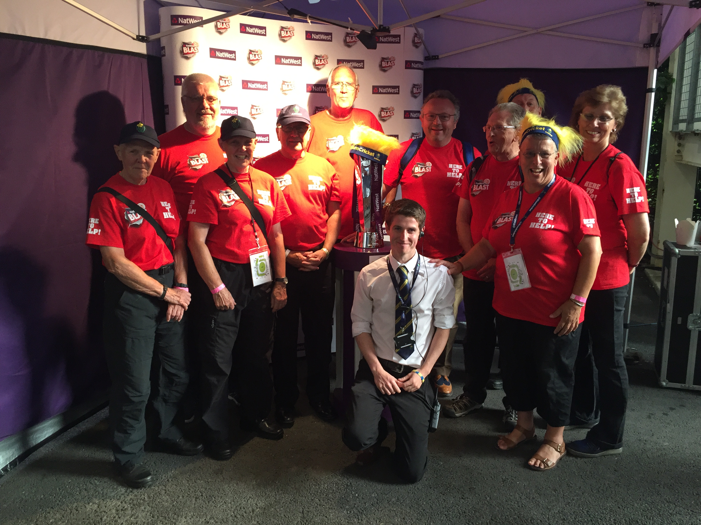

Slide 5
Aim
To identify what motivates people to volunteer for Glamorgan CC, and to improve Glamorgan CC’s volunteer programme
Notes:
*improvement due to friction between club and volunteers at times

Slide 6
Objectives
Analyse data from Glamorgan CC volunteers and staff regarding the volunteer programme
Evaluate the advantages and disadvantages of volunteering for Glamorgan from the volunteers’ perspective
Identify key recommendations to improve Glamorgan’s volunteer programme

Slide 7
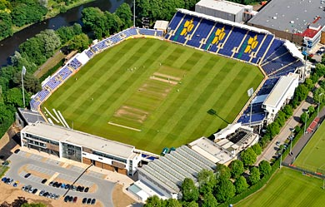
Background
Glamorgan Cricket Club
  Formed in 1888
  The only Welsh first-class cricket team
  Based at the SSE SWALEC Stadium in Cardiff
Glamorgan Cricket Club Volunteers
  Required since the development of T20 cricket in 2003
  Stadium redevelopment in 2008 led to ‘Category A’ status
  Resulted in a need for volunteers for International Matches and Concerts

Slide 8
Literature Review
Theories of Motivation in Volunteer Studies (i)
  Three Factor Model – McClellend, Atkinson and Lowell (1953)
    Achievement, power, affiliation (linked to Maslow (1943))
  Two Factor Model – Frisch and Gerrard (1981)
    Altruistic (intangible rewards) and egoistic motivation (tangible rewards)
      Cited by Esmond and Dunlop (2004)
  Motivation to Volunteer – Cnaan and Goldberg-Glen (1991)
    5 point scale through review of previous studies
    Integrated three factor and two factor models

Slide 9
LITERATURE REVIEW
Theories of Motivation in Volunteer Studies (ii)
Volunteer Functions Inventory – Clary and Snyder (1999)
  Values, Understanding, Enhancement, Career, Social, Protective
Self-Determination Theory – Ryan and Deci (2000)
  Distinction between autonomous motivation (free will) and controlled motivation (external pressure)

Slide 10
Literature Review
Studies into Motivation of Volunteers in Sport
Various studies and reports
  Typically these focus on mega-events i.e. London Olympics 2012 or community clubs
    Alexander, Kim and Kim (2015) – Segmenting Volunteers by Motivation in the 2012 London Olympic Games
    Sport Wales (2011) – The Value of Sports Volunteering in Wales
    Sport England (2016) – Motivations of Sport Volunteers in England
None specific to professional cricket clubs in the UK

Slide 11
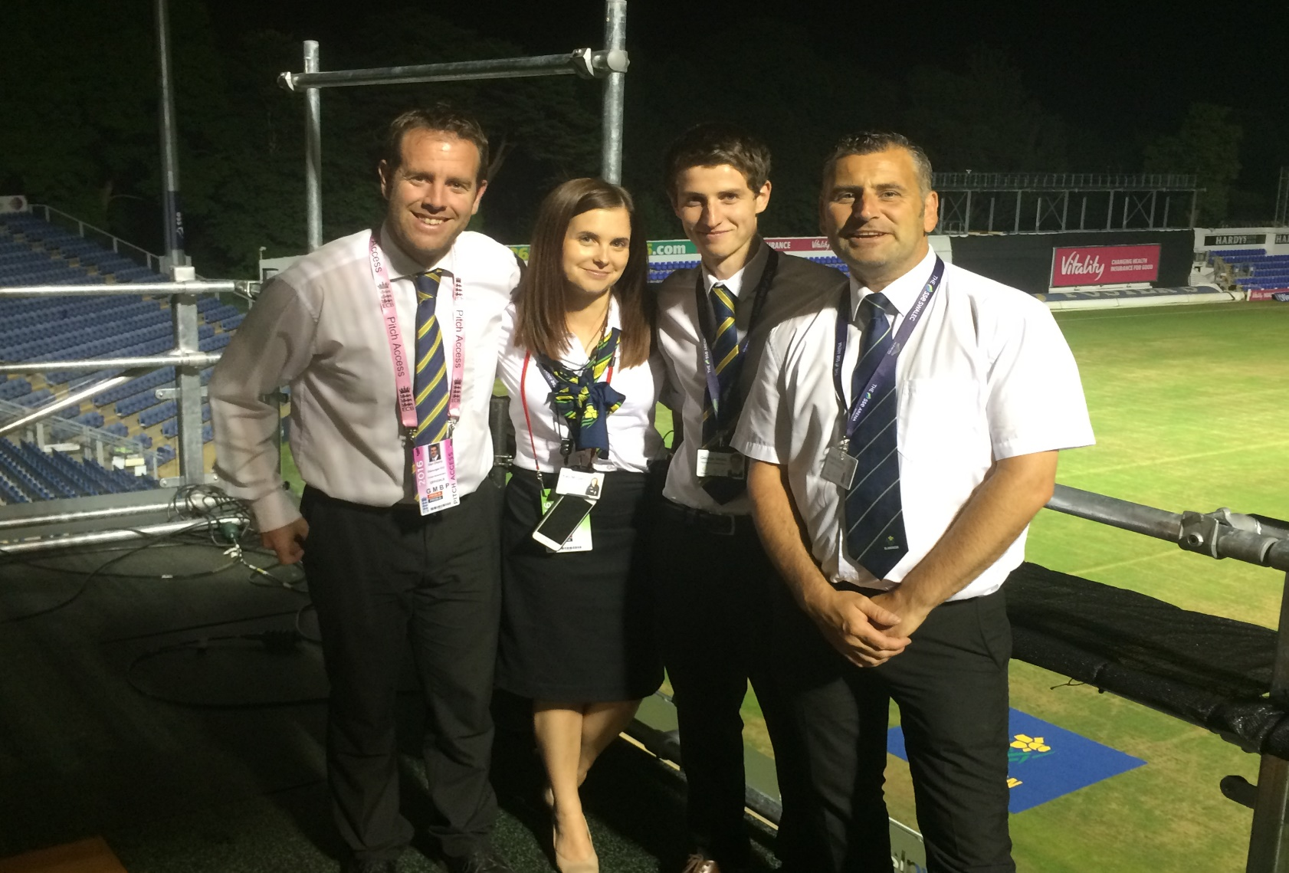
Access to Resources
Contacts in Glamorgan CC
  Dan Cherry – Head of Operations
  Katy Morgans – Operations Manager
  Wayne Sankey – Volunteer Co-ordinator
Through contact with these, communication will be established with volunteers in order to arrange interviews
Secondary Research
  Journals, books, voluntary surveys, online articles, National Governing Body (NGB) reports

Slide 12
Methodology
Questionnaires
  20 to 25 Glamorgan volunteers
  Initial questionnaire to gather the volunteer’s background information
    Age, gender, employment status – quantitative data
    Closed questions – “Easy to code, record, and analyse results” (Gorgens and Kusek, 2009, p.300)
  Interviews
  10 to 20 Glamorgan volunteers
  Opinion of volunteers
    “Interviews are better at gaining richer data from smaller sample groups” (Gratton and Jones, 2010, p.155)
  Glamorgan staff – Dan Cherry and/or Hugh Morris
Focus Groups
  With two to three x6 Glamorgan volunteers
    “Focus groups are particularly useful for exploring attitudes, perceptions and feelings about a topic” (Crowther and Lancaster, 2008, p.149)
Notes:
These are my options for methodology
Q’s – easy set-up, cheap, easy to analyse – could sent to everyone – should gather info easily + quickly
I’s – good for small sample, unlikely to get through 20/25 volunteers – probably on phone/skype
F’s – need everyone is same place – may be alternative to interviews – quicker than interviews

Slide 13
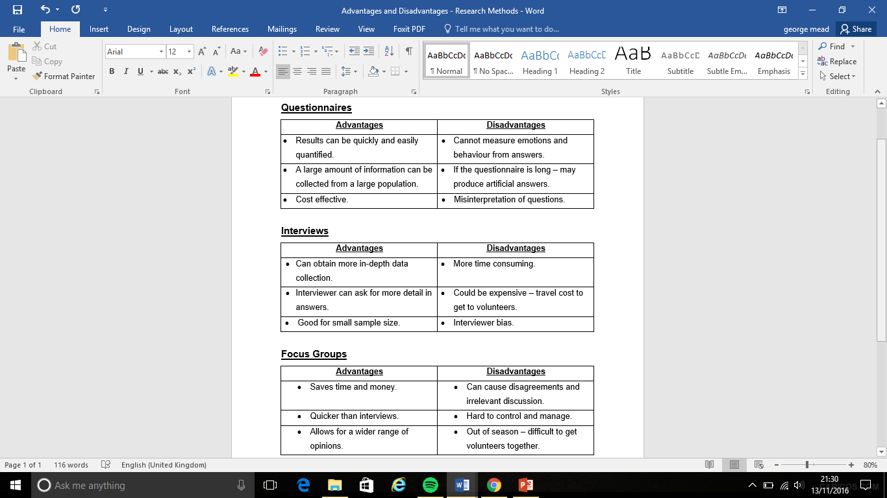
Methodology
Notes:
Q’s – easy set-up, cheap, easy to analyse
I’s – good for small sample, unlikely to get through 20/25 volunteers
F’s – need everyone is same place – out of season – travel – only willing on match day

Slide 14
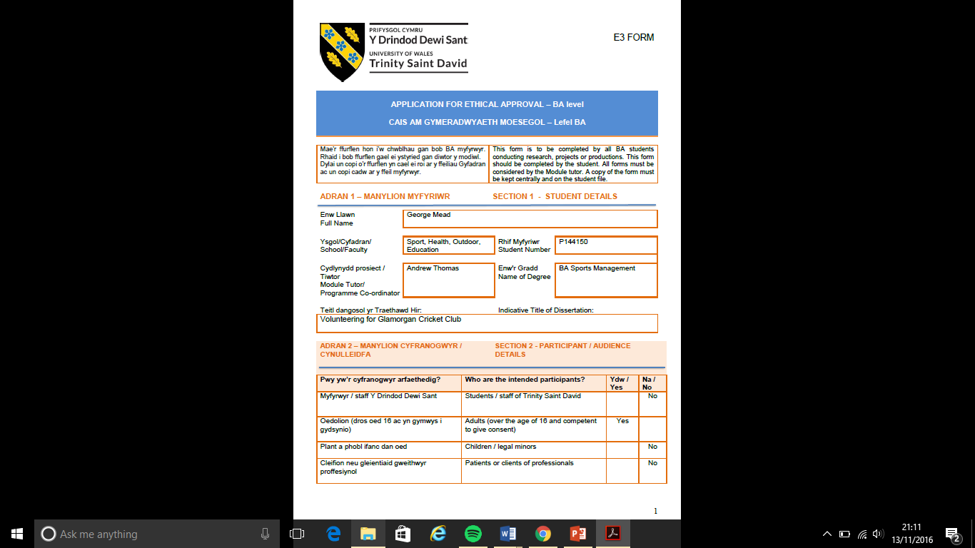
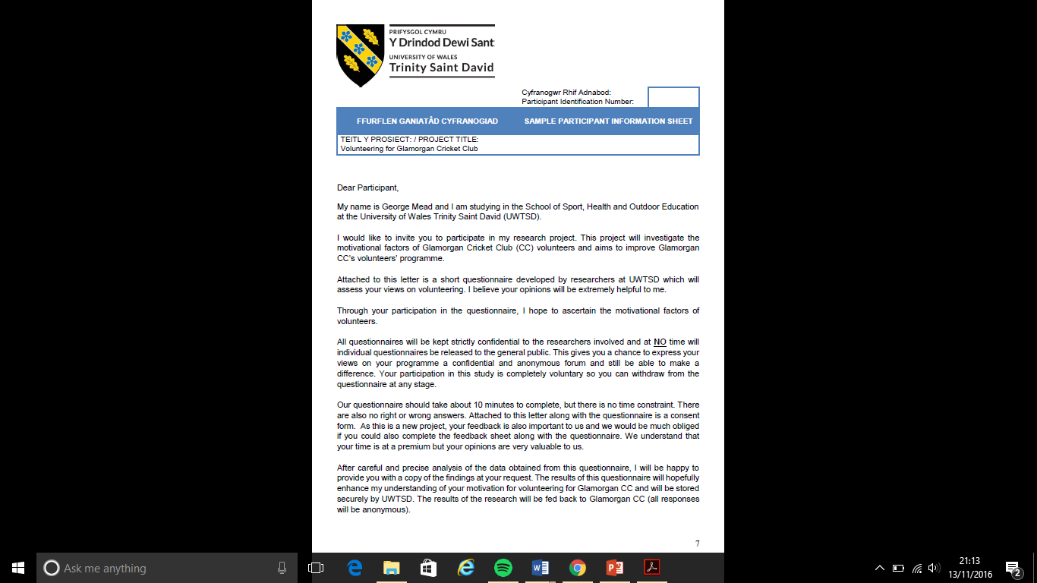
Ethical Consideration

Slide 15
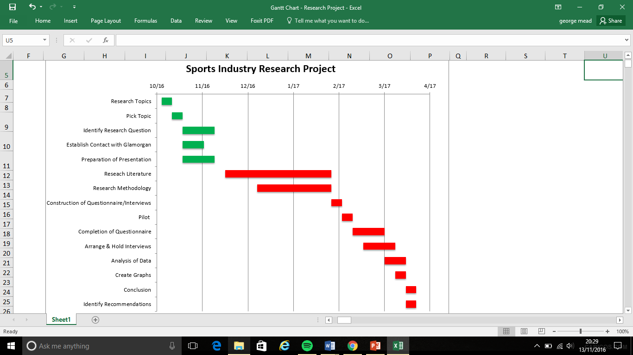
Timeline

Slide 16
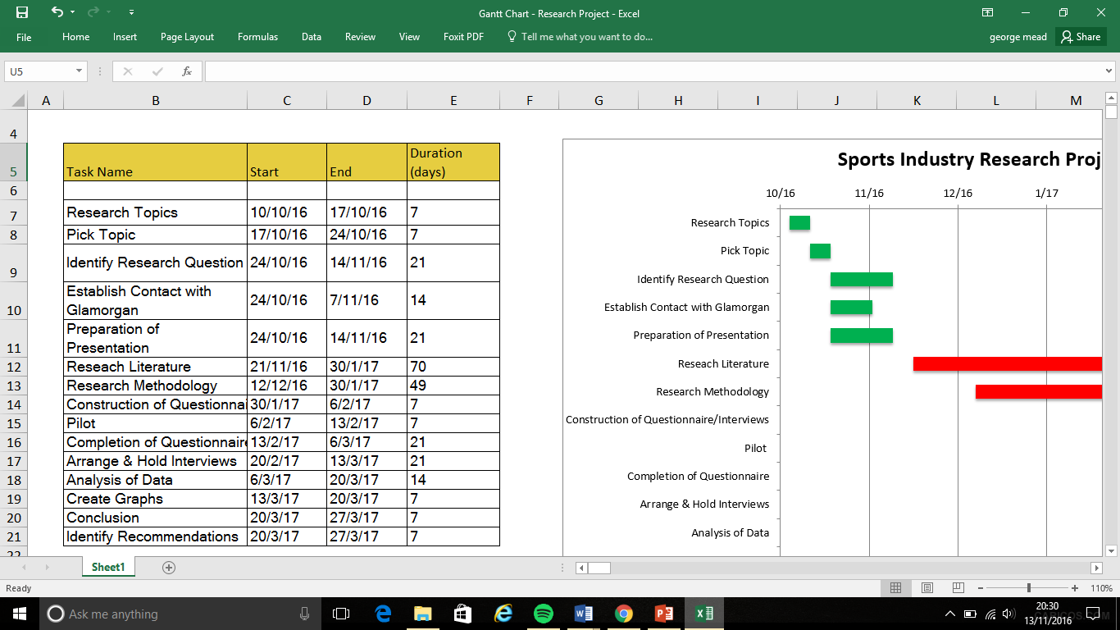
Timeline

Slide 17
references
Alexander, A., Kim, S. and Kim, D. (2015) Segmenting volunteers by motivation in the 2012 London Olympic Games. Tourism Management, [online] 47, pp.1-10. Available at: http://ac.els-cdn.com.ezproxy.uwtsd.ac.uk/S0261517714001721/1-s2.0-S0261517714001721-main.pdf?_tid=8f87ce94-a9e4-11e6-a44b-00000aab0f02&acdnat=1479071160_b525df9046f5aca9118d48daa700dcb3 (Accessed: 6 November 2016).
Clary, E. and Snyder, M. (1999) The motivations to volunteer: theoretical and practical considerations. Current Directions in Psychological Science, 8(5), pp.156 - 159.
Cnaan, R. and Goldberg-Glen, R. (1991) Measuring motivation to volunteer in human services. Journal of Applied Behavioral Science, 27(3), pp.269 - 284.
Crowther, D. and Lancaster, G. (2008) Research methods. 2nd ed. Oxford: Elsevier Butterworth-Heinemann, p.149.
Esmond, J. and Dunlop, P. (2004) Developing the volunteer motivational inventory to access the underlying motivational drives of volunteers in Western Australia. [pdf] CLAN WA, pp.11 - 16. Available at: https://volunteer.ca/content/clan-wa-inc-developing-volunteer-motivation-inventory-assess-underlying-motivational-drives (Accessed: 8 November 2016).
Görgens, M. and Kusek, J. (2009) Making monitoring and evaluation systems work. 1st ed. Washington, DC: World Bank, p.300.
Gratton, C. and Jones, I. (2010) Research methods for sports studies. 2nd ed. London: Routledge, p.155.
Ryan, R. and Deci, E. (2000) Self-determination theory and the facilitation of intrinsic motivation, social development, and well-being. American Psychologist, 55(1), pp.68 -78.
Sport England (2016) Motivations of sport volunteers in England. [pdf] Available at: https://www.sportengland.org/media/10205/motivations-of-sport-volunteers.pdf (Accessed: 8 November 2016).
Sport Wales (2011) The value of sports volunteering in Wales. [pdf] pp.1, 2. Available at: http://sport.wales/media/937041/volvalue201101.pdf (Accessed: 10 November 2016).

