Slide 1
CertHE Skills for the Workplace
Module: BMSK4002
Effective Team Working and Communication
Session 1 (Communication)

Slide 2
Overview of Workshop
Aim of module topic
Link to assignment
What is communication?
Elements of Communication
Non-verbal communication
Barriers to communication

Slide 3
Aim & objectives
Aim: To develop understanding and ability to communicate effectively, as required by a practising or potential middle manager.
Objectives:
To understand the importance of effective communication in management
To be able to develop effective communication skills as a reflective manager

Slide 4
BMSK4002 Topic Areas To Consider & Research
Develop criteria to evaluate your own communication skills
Tone, language & formality
Be able to develop effective communication skills as a reflective manager
Communication theories & models
Management Communication Skills
Understand the importance of effective communication in management
Collect, analyse & evaluate feedback on communication skills
(Completed) Prepare and deliver a short, 15 minute presentation
Verbal & written communication
Prepare a Presentation Plan
Prepare visual aids to support briefings/presentations
Notes:
Take the group through the diagram, which highlights areas they need to study, in order to improve their skills and knowledge, but also to complete the assignment.

Slide 5
What is Communication?
Notes:
Discuss what the group come up with before showing the definition. Compare and contrast – see what similarities and differences. Did the students use ‘plain English’? Too simplistic? Too complex? Highlight here that communication scholars Frank Dance and Carl Larson in 1976, identified 126 different definitions of communication….and that was 40 years ago! It’s a surprisingly complex topic, and, generally, we are not very good at it!

Slide 6
Definition
‘Communication is the exchange of thoughts, information, or ideas that results in mutual understanding between two or more people. The process requires at least one sender, one receiver, and a message that is transmitted within a communication medium’ (Griffiths and Dunham, 2015).

Slide 7
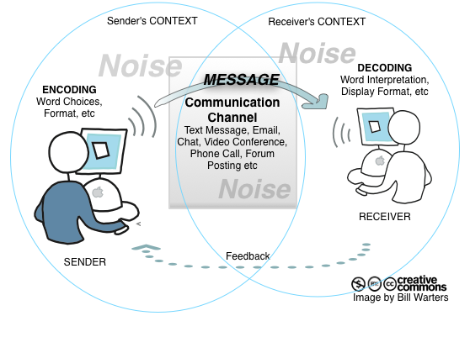
Notes:
It begins with an idea or concept in the mind of the sender. He or she encodes the idea into meaningful symbols in the form of words, pictures or gestures (ie language). The sender then selects a medium to transmit those symbols so a receiver can access them through one or more senses. The medium can be a face-to-face conversation, a piece of artwork hanging in an art gallery, a text message or any growing number of electronic transmission media. The receiver then decodes the symbols in order to interpret the message and understand the intent of the sender.
Meaningful communication takes place when the receiver accurately understand the message. But lots can go wrong – the message can become distorted.

Slide 8



The Elements of Communication
1. Vocal
2. Visual
3. Verbal
The Voice
The look
The Words
This includes the vocal variety, quality, rate and vocalised pauses
This includes eye contact, posture, gestures & facial expression
This is what the person says

Slide 9
Are We Good Communicators?
What forms of communication are there at work?
What is a good communicator?
Do you think you are a good communicator?
Do your staff/friends/colleagues/manager think that you are?
Exercise – In your groups, answer the above questions. You have 15 mins.
Notes:
Lead a discussion with the group. Draw out key points – not just about talking at people. It’s an exchange, usually involving information, and usually with a purpose. Go back to earlier definitions the group came up with. How do they rate themselves? What’s their evidence? Ask for examples. What about others they know or work with/for? Examples again. What about their fellow students? What about their tutors?! Discuss the fact that good communicators are not that commonplace. Draw out that good communication is difficult and needs good skills, knowledge and attitude/behaviours.

Slide 10
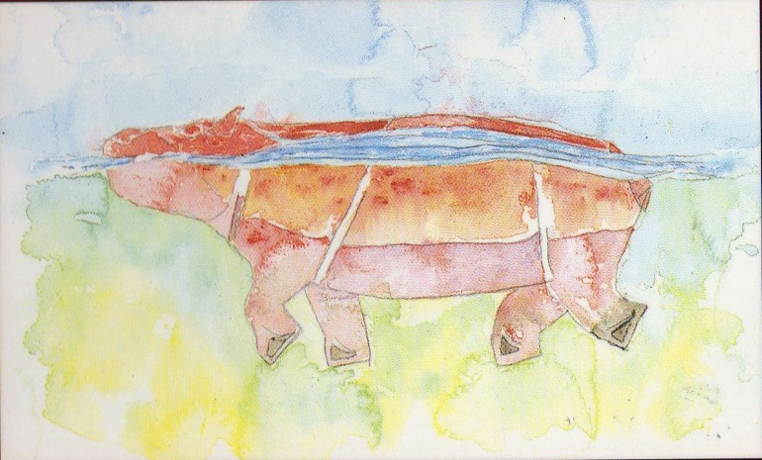
Communication Hippo!
Behaviour – What you see on the surface
Thoughts
Motives
Attitudes
Feelings
Emotions
Values
What's going on below the surface
}
Notes:
Discuss the hidden factors with the group. What are the implications? We have to be careful with our communications!

Slide 11
Non Verbal Communication
Forming impressions – perceptions
Do we take it too seriously?
What impact or difference can it really make?
Words, Tones and Gestures……what percentage of each of these makes up typical communications?
Notes:
Take the group through the slide and ask them to suggest percentages for Words, Tone and Gestures…..summarise their thoughts before showing the next slide.

Slide 12
Language %
What is said - 7%
Voice or tone - 38%
Gestures, etc. - 55%
Notes:
From research conducted by Mehrabian (1981), cited in Griffiths and Dunham (2015).

Slide 13

Barriers to Communication
Within your groups discuss and list as many barriers to communication as you can.
Within your groups devise a solution to improve or remove those barriers.
Capture your findings on a flipchart and present them to the group
Exercise - 15 mins

Slide 14
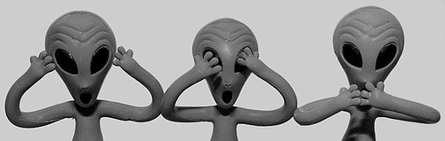
Barriers to Communication
Environmental Barrier
Linguistic Barriers
Psychological Barriers
Physiological Barriers
Perceptual Barriers
Content Barriers
Personal Barriers

Slide 15

Communication Barriers
The choice of words or language which a sender uses (called 'encoding the message’)
Misreading body language, tone, and other non-verbal forms of communication
Ignoring non-verbal language
Selective hearing
Hesitation to be candid
Distrust
Value judgment
Power struggles
Notes:
For each of the points on the following couple of slides, ask for the group’s experiences of these barriers – either when communicating to someone or receiving communications. Also, use your own examples to illustrate key points. How many of these can be overcome with the right skills, techniques, knowledge, attitudes and behaviours? If students say “Yes, but what about the other person’s skills, techniques, knowledge, etc.?”, refer to Covey’s Circle of Influence/Circle of Concern model – deal with the things within your control or influence!

Slide 16
Communication Barriers
Unreliable transmission
Defensiveness (a typical barrier in a work situation, especially when negative information or criticism is involved)
Distorted perception (How we perceive communication is affected by experiences)
Perception is also affected by the organisational relationship two people have

Slide 17
Communication Barriers
Distortions from the past
Stereotyping (assuming the other person has certain characteristics based on the group to which they belong without validating that they in fact have these characteristics)
Cultural
Guilt

Slide 18
Activity – Design and Present a Poster
Work in groups of 3 to 4 people.
Read the factsheet on Employee Communication.
Design a poster for new managers entitled ‘Effective Communication’ that highlights the important points – for example ‘Communication should be two way’.
Acknowledge the source: CIPD(2017).

