Slide 1

Sustainability in the Hotel and Hospitality Sector: A Focus on Waste Reduction
Presented by: Maria Francesca Scurtu 2117746
Lecturer: Natalie Brailsford
Date: 11 Nov 2024

Slide 2

Introduction
What is Sustainability?
Key Principles
Why Focus on Waste Reduction?

Slide 3
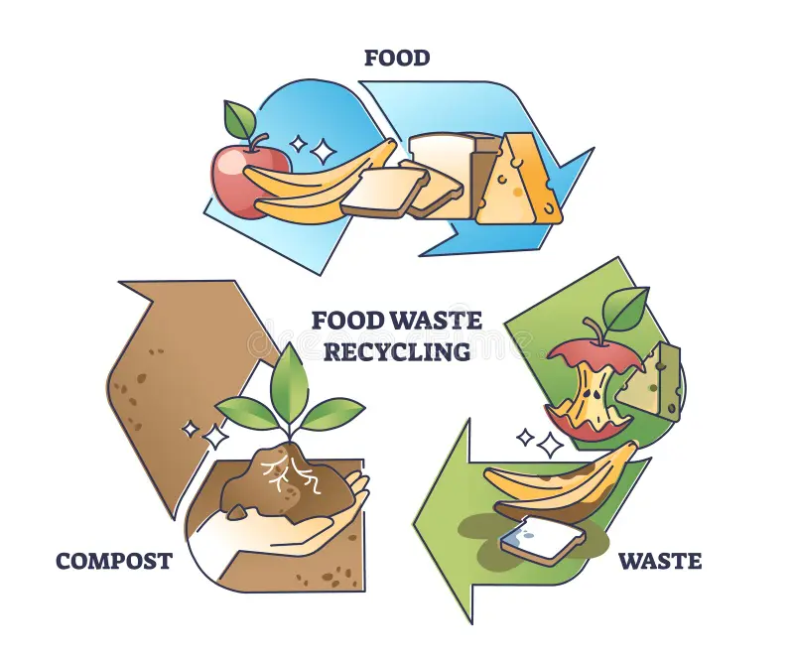
Literature Review
Food Waste Reduction Strategies
The Role of Consumer Engagement and Staff Training
Challenges and Limits

Slide 4

Application in Hospitality
Industry Feedback to Waste Management
Waste Audits and Training Strategies
Composting Strategies
Technology Integration
Consumer Engagement Programs

Slide 5

Critical Reflection on Impact Levels
Determine Strength by evaluate the benefit of waste reduction strategies
Impact on Environment and Business : Short and Long-Term Benefits

Slide 6
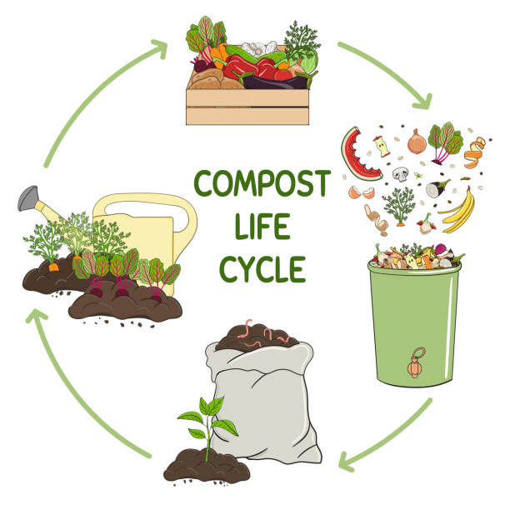
Future Policies and Management Options
Innovative Approaches
  Explore New Initiatives for Waste Management
Policy Recommendations
Recommended Guidelines for the Industry

Slide 7

Management Benefits
Operational Efficiency
Cost Savings and Resource Optimisation
Future Policy Options
Aligning with Sustainability Trends

Slide 8
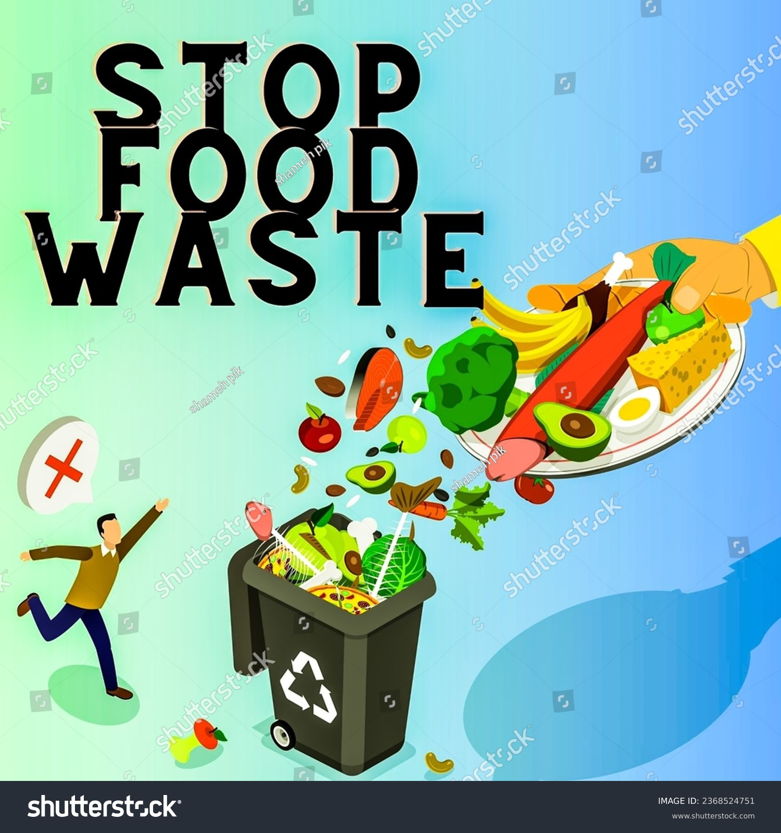
Recommendations for the Hospitality Industry
Recommended Operations for Hotels to Reduce Waste :
Adopting a Food Donation Program
Implement Digital Menus
Composting
Engaging Stakeholders
    Involve Guests
    Collaborate with Local Farmers
    (Zhao et al., 2022).

Slide 9

Conclusion
  Sustainability is indispensable for the hospitality industry, with waste reduction being a key focus (Garcia & Thompson, 2022).
  Competent initiatives include accurate menu planning, staff training, and engaging guests.
Adopting the best strategies leads to cost savings, enhanced operations, and a positive environmental impact (Kumar et al., 2023).

Slide 10
References
Garcia, R., & Thompson, L. (2022). Sustainability in Hospitality: The Role of Corporate Social Responsibility. Journal of Sustainable Tourism
Kumar, S., et al. (2023). Understanding the dynamics of food waste in hospitality: A systematic review. Journal of Cleaner Production.
Zhao, Y., et al. (2022). Composting in hotels: Impacts on waste reduction and sustainability. Journal of Sustainable Tourism,
Socaci, S. A. (Ed.). (2020). Food preservation and waste exploitation. IntechOpen.
Annemarieke de Bruin. (2022). Understanding why people waste food. Stockholm Environment Institute.

Slide 11

Any Questions ?

