Slide 1
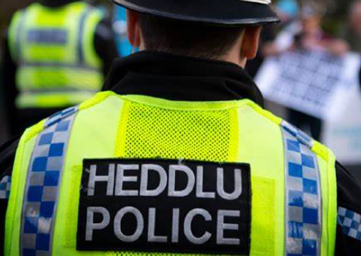
Plismona Cymru / Policing Wales
BMPL5016
Introduction to Module

Slide 2

Learning outcomes
Upon the successful completion of this module, the student should be able to:
• evaluate, in detail, the importance of the Welsh Language Standards in a policing workplace;
• demonstrate a working capability of communicating in the Welsh language.

Slide 3
Assessment 1
Portfolio
3 elements/ 2000-word equivalent
Weighing 50%

Slide 4
Assignment 1 – Portfolio 3 elements
2000 words
500 words - case study on the Miner’s strike relationship with police and Welsh communities
1000 words - Evaluation on key priorities in Welsh police forces
500 words - Is there a need for one police force in Wales - evaluate

Slide 5
Assessment 2
Individual Presentation 15 minutes 50%
This is to be discussed with the Welsh Tutor in more detail.

Slide 6

The history of policing in Wales
Notes:
Local services - NHS Wales
Fire and rescue authorities operational statistics: April 2023 to March 2024 [HTML] | GOV.WALES

Slide 7

Welsh forces
There are four police forces in Wales:
Dyfed-Powys Police
Gwent Police
North Wales Police
South Wales Police

Slide 8
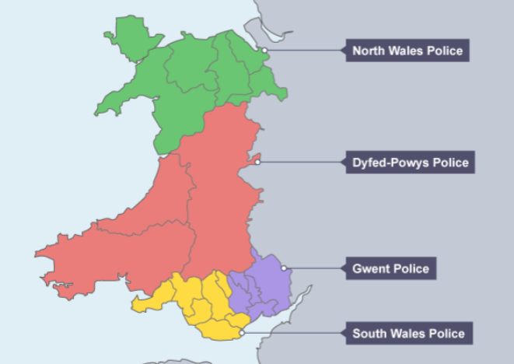
Force Areas
The largest police force in Wales is the South Wales Police, and it’s the seventh largest force in the UK. This police force was originally known as the South Wales Constabulary.
In 2006, it was suggested that the four police forces in Wales should merge into one force. However, this has yet to happen.

Slide 9
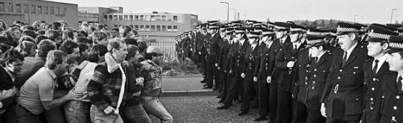
The Miners Strike of 1984
On 1 March 1984, the National Coal Board announced that it planned to close 20 coal mines with the loss of 20,000 jobs. The year-long strike that followed changed the political, economic and social history of Wales forever.
Notes:
On 1 March 1984, the National Coal Board (NCB) announced its plan to close 20 coal mines, which would result in the loss of 20,000 jobs
This announcement triggered a year-long strike by the National Union of Mineworkers (NUM), led by Arthur Scargill
The strike became one of the most significant industrial disputes in British history, deeply affecting the political, economic, and social landscape of the UK
1The strike was marked by widespread picketing, demonstrations, and significant community support, especially in mining areas like South Wales and Yorkshire.
It also led to intense confrontations between miners and the government, headed by Prime Minister Margaret Thatcher, who aimed to reduce the power of trade unions.

Slide 10
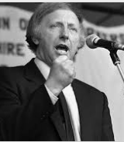
Arthur Scargill
President of the National Union of Mineworkers (NUM
He was a central figure in organising the strike against the National Coal Board's (NCB) who plan to close 20 coal mines, which would result in the loss of 20,000 jobs
Scargill believed that the government's ultimate goal was to dismantle the coal industry and weaken the power of trade unions
He argued that the NCB's plan was more extensive than publicly stated, claiming that up to 75 pits were at risk of closure
Despite the lack of a national ballot, Scargill called for a national strike on 12 March 1984
This decision was controversial and led to divisions within the NUM, particularly in regions like Nottinghamshire, where many miners continued to work

Slide 11
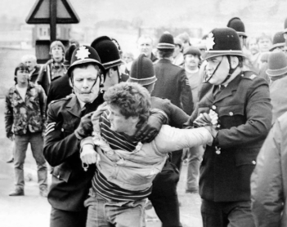
Most Welsh miners initially voted against a strike but later played a major part in picketing and demonstrations.
Margaret Thatcher, PM at the time stated,
“We had to fight the enemy without in the Falklands, but we always have to be aware of the enemy within, which is much more difficult to fight and more dangerous to liberty."

Slide 12
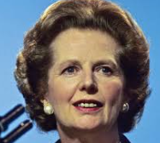
Margaret Thatcher
The speech to the Committee on 19 July 1984, referred to the challenges faced by her government
When she mentioned "the enemy without," she was referring to the external threat posed by Argentina during the Falklands War in 1982
This was a clear, identifiable enemy that the UK had to confront militarily.
In contrast, "the enemy within" referred to internal threats, particularly militant trade unions like the National Union of Mineworkers (NUM), which were leading the miners' strike at the time
Thatcher viewed these unions as a significant threat to the country's stability and economic reforms. She believed that their actions were more insidious and dangerous to the nation's liberty because they could undermine the government's authority and disrupt the economy from within
TO TAKE CONTROL NOT THE MILITARY BUT THE POLICE

Slide 13
Thatcherism
Profound and lasting impacts on the UK – economically & police community relationships
Economic Changes: introduced the privatisation of state-owned industries like British Airways and British Telecom, railways – lead to job loss and the decline of traditional industries.
Reduction in Trade Union Power: Thatcher's government introduced legislation to curb the power of trade unions – impacted on Labour’s Party relations within the UK – Weakened the influence of unions
Social Inequality: While some sectors of the economy thrived, Thatcher's policies also led to increased social inequality. Working –class communities and Industrial regions faced economic hardship / wealth disparities grew
Political Landscape: Thatcherism reshaped the Conservative Party and influenced British politics for decades. It also contributed to the rise of New Labour under Tony Blair, which adopted some of her market-oriented policies

Slide 14
Miscarriages of Justice in Wales

Slide 15
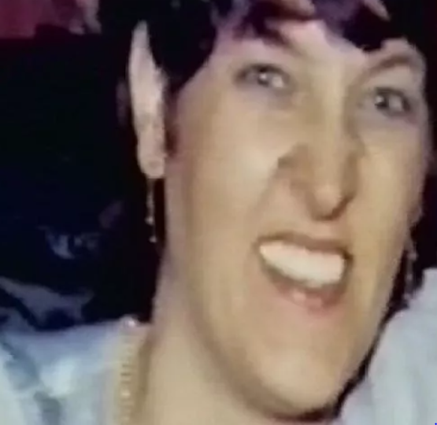
Sandra Phillips Murder 1985
June 1985 Sandra Phillips was murdered at her place of work in Dillwyn Street, Swansea.
She was sexually assaulted, hit on the head and strangled.
Petrol was poured on her and the shop she was in but not set alight.
Brothers Paul and Wayne Darvall were arrested for the murder.
There were no forensic evidence linking the brothers to the murder.
Wayne Darvall made a series of admissions leading to their convictions.

Slide 16
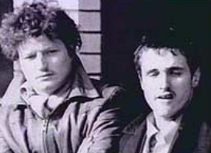
Case concerns
Wayne had a history of wrongly confessing to things. A former teacher confirmed Wayne would confess to things he had not done. The teacher described Wayne as a “fantasist”.
Example Wayne told police where to locate the murder weapon, but it was not there.
He said he had taken a St Christopher medal from the victim, but she never owned one.
He told police that he had taken a charity box from the shop, but it was found to be from another location.
Notes:
Although the brothers were seen in the area at the time of the murders. Eye witnesses reported them wearing the same clothes before and after the murder. There was blood splattered across the shop of the murder. The culprit would have been visibly blood stained.

Slide 17
Re-trial – 7 years later.
It was suggested SWP had doctored confession statement notes and suppressed scientific evidence. Scientific evidence, including an examination of a palm print in blood that excluded the two men, was kept from defence lawyers.
Devon and Cornwell Police had been asked to investigate the conviction.
After a 2-day trial the men were free.
The brothers spent seven years in jail for a crime they did not commit.
In a statement, Robert Lawrence, the Chief Constable of South Wales, said he ‘deeply regretted’ the wrongful convictions.
The true murderer was never found.
Notes:
Both brothers were awarded £80,000 for their wrongful conviction. Paul Darvell died in 2005 at the age of 42
A police official also ordered fingerprint experts to stop further work on the print, and detectives were alleged to have planted evidence. Statements by two detectives that they saw the brothers near the scene of the murder were shown to be wrong, as an examination of their diaries showed they had been elsewhere at the time..

Slide 18
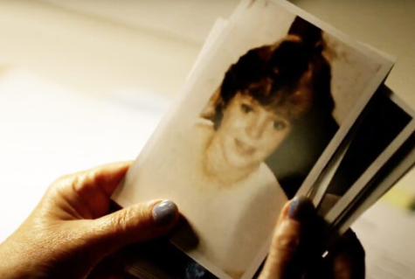
Murder of Lynette White 1998
This was after a miscarriage of justice and led to a series of investigations and reviews.
Lynette White was a 22-year-old prostitute working in Cardiff.
Her body was found in February 1988 in a flat in Janes Street Butetown.
She had been stabbed numerous times and her throat cut.

Slide 19
Conviction and Acquittal
Eleven months after the killing the police arrested and then charged 5 men including Lynette’s boyfriend, Stephen Miller.
There was no forensic evidence linking them to the murder.
Stephen confessed to the murder. He and two others Yuself Abdullahi and Tony Paris were convicted in 1990 and sentenced to life.
The two other men were acquitted.
1992 their convictions were overturned as evidence emerged to suggest that the confessions had been forced out of them by overly forceful police questioning.
Jeffery Gafoor was convicted in 2003 following being identified through familial DNA. He was sentenced to life.

Slide 20
Miscarriage of Justice
Stephen Miller underwent 13 hours of questioning taking place over five days using 19 interview tapes.
The questioning techniques used were oppressive.
During interview Miller denied involvement over 300 times before being persuaded to make four admissions.
In November 2004, the Independent Police Complaints Commission (IPCC) announced that it would carry out a reinvestigation into the original police inquiry.
South Wales Police were found to have gravely mishandled the original investigation.

Slide 21
Police trail collapses
8 former police officers failed trial for conspiracy to pervert the course of justice.
The trail judge found “irregularities in the criminal disclose process”.
The judge held that the trial could not continue as it would be unfair.
Files had been intentionally destroyed by South Wales Police’s investigating officers.
South Wales Police had also led the investigation into its own officers which raised concerns about transparency.

Slide 22
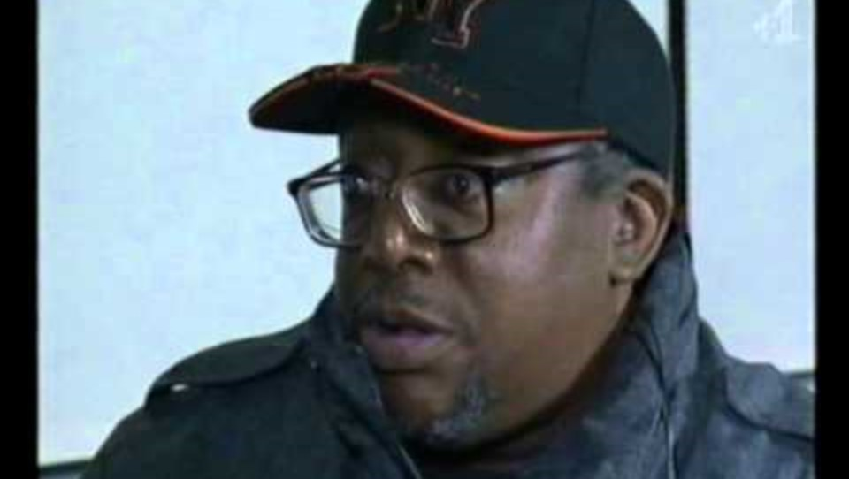
The Cardiff Three
Notes:
Min 2:00
THE CARDIFF THREE - YouTube

Slide 23


Slide 24
What is devolution?
Devolve powers to Wales, Scotland and Northern Ireland.
Devolve several powers including possibly, government, parliament and judiciary to each country.
However, parliament can take this power back, or the power can be given back to parliament.
After the referendum- devolved powers to Scotland, Wales, and reinforced in Northern Ireland.
Notes:
Parliament can still make law in those countries despite devolution.
Parliament can take back the devolved powers by passing laws that repeal the Scottish and Welsh Acts that created devolution.
Parliament are still the supreme law making body.
They can still legislation in these countries in these areas.

Slide 25
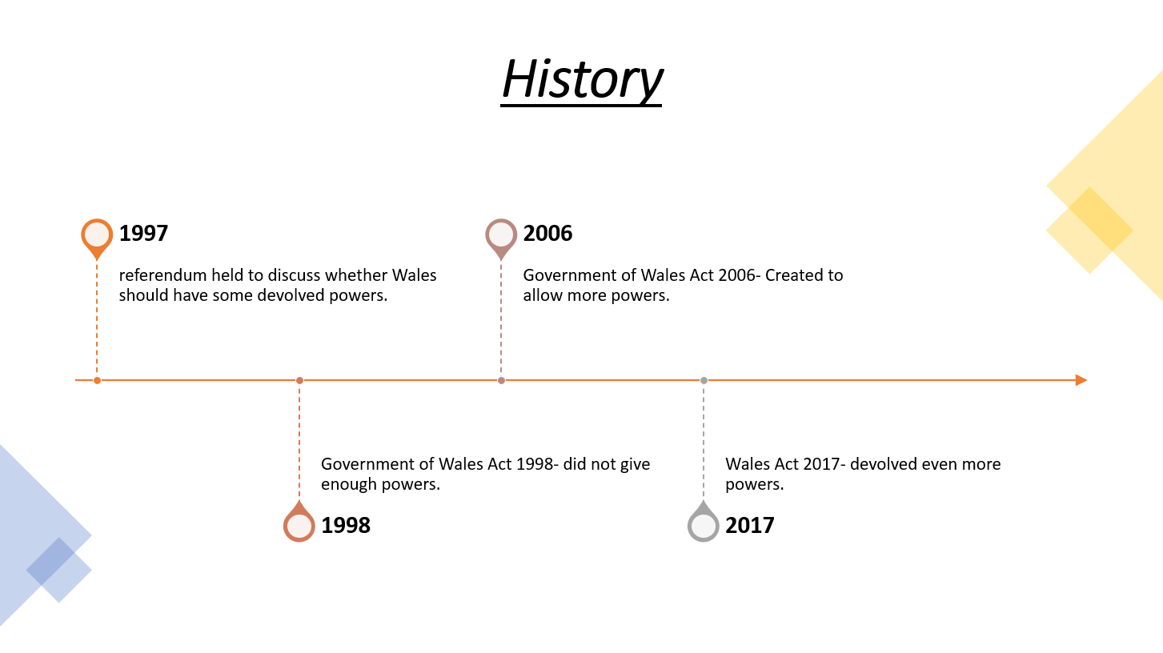

Slide 26
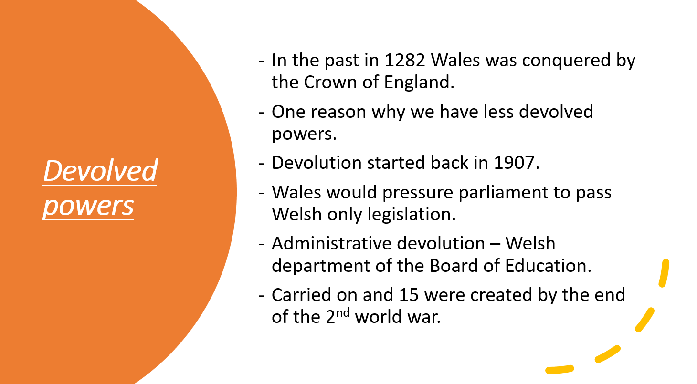

Slide 27
Continued
Minister of Welsh Affairs in 1951, approved the drowning of the Trynewyd valley.
Decided that we need a representative for Wales in the government.
So, 1964 Secretary of State for Wales.
1970, given powers in different areas.
There was an idea that Wales should have devolved powers. 50.1% of people voted for devolution in Wales.
Government of Wales Act 1998 – created the national assembly for Wales.
Notes:
Issues with the Government of Wales Act 1998 – unclear to all what the powers of Wales were.
The were some issues devolved and some not and this caused issues and problems.
Not clear the role between parliament or government.
Fixed this in 2002 with a Welsh government.

Slide 28
The Government of Wales Act 2006 created. Therefore, the Assembly became parliament.
Welsh Assembly Government was established.
In 2011 referendum to ask if we wish for Wales to be able to make laws on matters in the area’s devolved to us.
63.5% said yes and the power was devolved.
These are now known as assembly acts.
Schedule 7 of the Government of Wales Act 2006 – lays out the limits on the powers devolved to Wales.

Slide 29
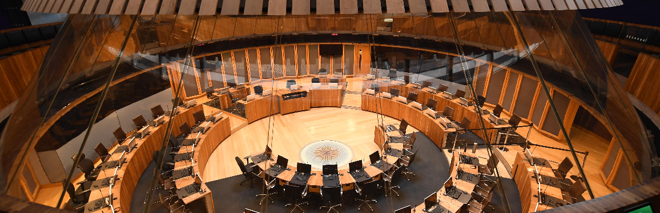
Wales Act 2017
The Wales Act 2017 (WA 2017) enshrines Senedd Cymru, the Welsh Government and the laws that they make as a permanent part of the UK’s constitutional arrangements.
Neither Senedd Cymru nor the Welsh Government can be abolished without the agreement of the people of Wales.

Slide 30

Devolution and Justice and Policing
At present Justice and Policing is not a devolved power. Wales is the only devolved nation within the United Kingdom that does not have its own justice system.
The Independent Commission on the Constitutional Future of Wales has recommended that The UK Government should agree to the legislative and executive devolution of responsibility for justice and policing to the Senedd and Welsh Government.
The two Governments should agree a timescale for this.
Starting with policing, probation and youth justice services.
Notes:
Final Report of The Independent Commission on the Constitutional Future of Wales

Slide 31

The Welsh Government manifesto for the devolution of Justice and Policing in Wales was set out in 2021 Senedd election.
A report from the independent Commission on Justice in Wales chaired by Lord Thomas of Cwmgiedd, found that for the criminal justice system to be reformed in Wales.
The policies and decisions about justice need to be determined and delivered in Wales.
This would ensure that it aligns with the distinct social, social justice and education policy and services in Wales.

Slide 32
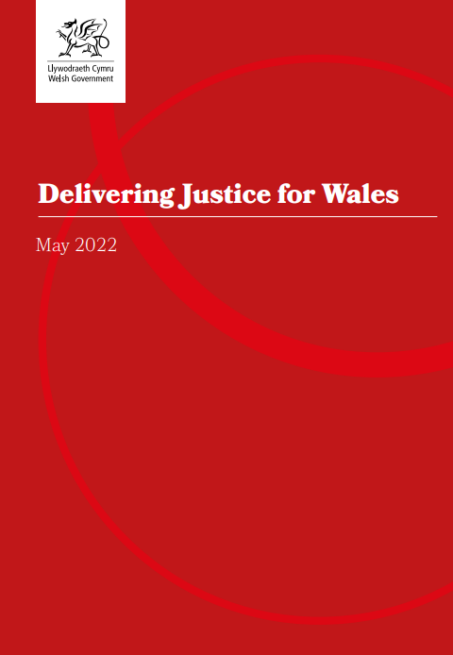
Welsh Government - 2022
Delivering Justice for Wales
Further reading
Notes:
delivering-justice-for-wales-may-2022-v2.pdf

Slide 33

Notes:
History of the Senedd

Slide 34
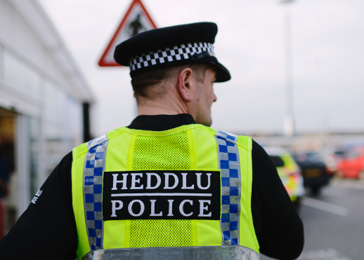
Police and Crime Commissioners

Slide 35

Police and Crime Commissioners (PCCs)
Police and Crime Commissioners (PCCs) are responsible for shaping policing priorities in Wales.
They are elected officials who hold significant influence over funding, strategy and community engagement with the police.
Policing in Wales is overseen by the UK Home Office. However, day-to-day decision making has been delegated to the PCCs.
In Wales, there are four PCCs overseeing policing in each police force area

Slide 36
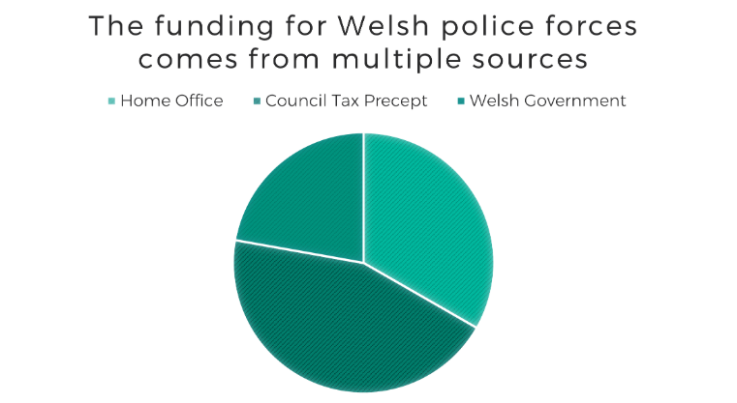
Funding
PCCs also set the budget and policing council tax precept (paid by residents) for the force area (Welsh Government, 2024)

Slide 37
Why do we have PCCs?
The role of the PCC is to replace local police authorities in England and Wales.
They represent the community and aim to enhance accountability.
Previous concerns about police transparency and the way in which they respond the concerns raised by the public led to the introduction of PCCs.
PCCs are elected by the community. The aim is to ensure that those responsible for overseeing the police are also accountable for the community that they serve.

Slide 38
Main Aims of PCCs
PCCs must not influence the operational independence of the police in their area (this is the responsibility of the Chief Constable).
Their role is to set a strategic direction for the force, to scrutinise the police and hold them to account.
Set the policing budget
(Welsh Government, 2024)

Slide 39

Notes:
Some of the policing priorities identified by the four Police and Crime Commissioners in Wales (Senedd Research)

Slide 40
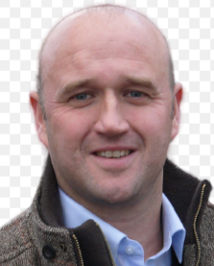
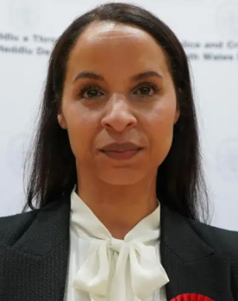
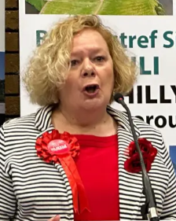
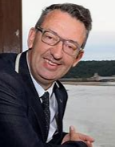
Who are the PCCs for Wales?
Emma Wools – South Wales
Dafydd Llywelyn – Dyfed-Powys
Andy Dunbobbin – North Wales
Jane Mudd - Gwent

Slide 41
Legislation

Slide 42
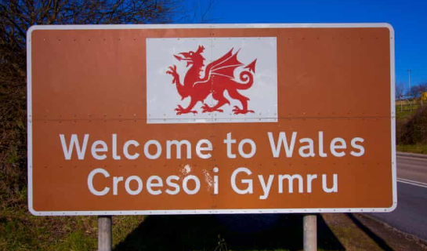
Welsh Language Act 1993
The core of the law relating to the Welsh language is to be found in primary legislation (or 'statutes') made by either the UK Parliament or Senedd Cymru.
The Act established the Welsh Language Board.
Certain public bodies should where reasonably practicable treat both Welsh and English languages the same in the conduct of public business in Wales ( Welsh Government, 2020)
The Welsh Language Commissioner now carries out the role of the abolished Welsh Language Board.
Notes:
Before April 2012, the Welsh Language Board was responsible for requiring certain public bodies who provide services to the public in Wales to have a Welsh language scheme and for monitoring their compliance with the scheme. Those bodies were required to prepare a scheme which specified how they proposed to give effect to the principle that in the conduct of public business and the administration of justice in Wales, the English and Welsh languages should be treated on a basis of equality.

Slide 43
Welsh Language (Wales) Measure 2011
The National Assembly passed the Welsh Language (Wales) Measure 2011 to reform the existing laws regarding the use of Welsh in the delivery of public services.
The Welsh Language Board has been replaced by a Welsh Language Commissioner and the existing system of Welsh language schemes is gradually being replaced with standards of conduct relating to the Welsh language.

Slide 44

Welsh Language Commissioner
Efa Gruffudd Jones is the Welsh Language Commissioner and has been in the role since 2023.
The Welsh Language Commissioner's main statutory aim is to promote and facilitate the use of the Welsh language. The Commissioner's vision is for a Wales where people can use Welsh in their everyday lives.
The Commissioner has an important role to play in increasing the provision of services in Welsh and the use of the language and upholding the rights of Welsh speakers.

Slide 45
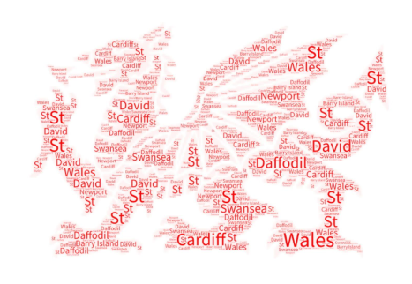
Discuss
Why do you think its important for Welsh Police Officers to be able to communicate in Welsh?

Slide 46


Further reading
See link saved within Moodle

Slide 47
Task - tomorrow
Layout 1
Read the above document and bring your opinions tomorrow on the effect of the strikes in Wales.
Miners SPEAK OUT On Police Brutality | Miners' Strike 1984: The Battle for Britain | Channel 4
What happened at the 'Battle of Orgreave'? – video explainer | Police | The Guardian
Maggie and the miners - were the army at the ready?
Miners' strike - 30 years since the pit crisis of 1984

Slide 48
Tuesday Class
Discuss
What happened at the 'Battle of Orgreave'? – video explainer | Police | The Guardian

Slide 49
Any Questions?
Unrhyw gwestiynau?

