Slide 1
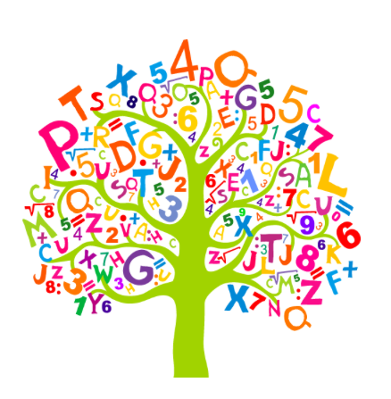
ECES5022/C
Y Tri R
The Three Rs
Sesiwn 7 / Session 7

Slide 2

Asesiad y Modiwl Module Assessment
Tasg: Cyflwynwch astudiaeth achos yn arddangos addysgu a dysgu traws-gwricwlaidd effeithiol ar gyfer datblygu sgiliau llythrennedd neu rifedd, a sgiliau cymhwysedd digidol, grŵp penodol o ddysgwyr.
Task: Present a case study highlighting effective cross-curricular teaching and learning for the development of literacy or numeracy skills, and digital competence skills, of a specific group of learners.

Slide 3

Asesiad y Modiwl Module Assessment
Fydwch chi yn ffocysu ar ddatblygiad llythrennedd neu rhifedd a sgiliau cymhwysedd digidol?
Ar draws fa faes/feysydd?
Ydych chi wedi penderfynu ar grwp oedran/lefel sgil penodol?
Will you be focussing on the development of literacy or numeracy and digital competence skills?
Across which area/s?
Have you decided on a particular age group / skill level?

Slide 4

Beth yw cymhwysedd digidol?
What is digital competence?
Fel unigolyn, sut fyddech chi'n diffinio 'cymhwysedd digidol'?
Trafodwch eich diffiniad gyda'ch grŵp.
Fel grŵp, sut fyddech chi'n diffinio 'cymhwysedd digidol' ar y cyd?
Pa sgiliau ydych chi'n meddwl sy'n cael eu cynnwys?
As an individual how would you define ‘digital competence’?
Discuss your definition with your group.
As a group how would you jointly define ‘digital competence’?
Which skills do you think are included?

Slide 5

Beth yw cymhwysedd digidol?
What is digital competence?
Cymhwysedd digidol yw'r set o sgiliau, gwybodaeth ac agweddau sy'n galluogi defnydd hyderus, creadigol a beirniadol o dechnolegau a systemau. Mae'n hanfodol i ddysgwyr os ydynt am gael gwybod, yn alluog ac yn meddu ar y potensial i fod yn llwyddiannus yn y gymdeithas sydd ohoni.
(Llywodraeth Cymru, 2018)
Digital competence is the set of skills, knowledge and attitudes that enable the confident, creative and critical use of technologies and systems. It is essential for learners if they are to be informed, capable and have the potential to be successful in today’s society.
(Welsh Government, 2018)

Slide 6
Beth yw cymhwysedd digidol?
What is digital competence?
Ni ddylid cymysgu cymhwysedd digidol â thechnoleg gwybodaeth a chyfathrebu (TGCh). Mae cymhwysedd digidol yn un o'r tri chyfrifoldeb trawsgwricwlaidd, ochr yn ochr â llythrennedd a rhifedd; mae'n canolbwyntio ar ddatblygu sgiliau digidol y gellir eu cymhwyso at ystod eang o bynciau a senarios y gellir eu trosglwyddo i fyd gwaith.
(Llywodraeth Cymru, 2018)
Digital competence should not be confused with information and communication technology (ICT). Digital competence is one of the three cross-curricular responsibilities, alongside literacy and numeracy; it focuses on developing digital skills which can be applied to a wide range of subjects and scenarios that are transferrable to the world of work.
(Welsh Government, 2018)

Slide 7

Llinynau Cymhwysedd Digidol
Dinasyddiaeth
Rhyngweithio a chydweithio
Cynhyrchu
Data a meddfwl cyfrifiadurol
Digital Competence Strands
Citizenship
Interacting and collaborating
Producing
Data and computational thinking

Slide 8
Dinasyddiaeth Citizenship
Hunaniaeth, delwedd ac enw da
Iechyd a lles
Hawliau digidol, trwyddedu a pherchenogaeth
Ymddygiad ar-lein a seiberfwlio
  Identity, image and reputation
  Health and well-being
  Digital rights, licensing and ownership
  Online behaviour and cyberbullying

Slide 9

Rhyngweithio Interacting and Collaborating
Cyfathrebu
Cydweithio
Storio a rhannu
  Communication
  Collaboration
  Storing and sharing

Slide 10
Cynhyrchu Producing
Cynllunio, cyrchu a chwilio
Creu
Gwerthuso a gwella
  Planning, sourcing and searching
  Creating
  Evaluating and improving

Slide 11
Data a meddwl cyfrifiadurol
Data and computational thinking
Datrys problemau a modelu
Llythrennedd gwybodaeth a data
  Problem solving and modelling
  Data and information literacy

Slide 12
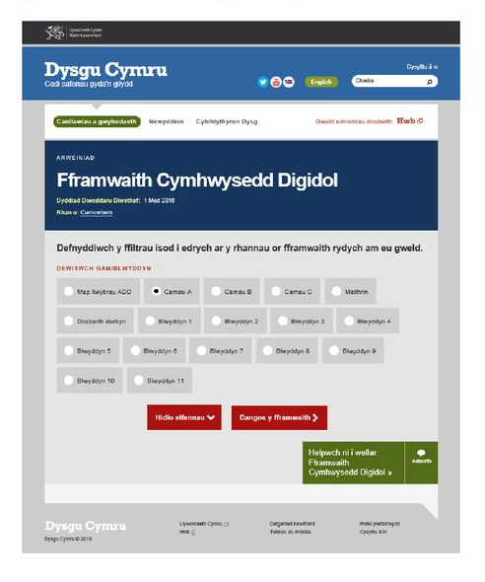
Ewch i’r FfCD ar Hwb Go to the DCF on Hwb
Pa sgil/iau sy’n apelio atoch?
Sut allwch chi ei ddatblygu?
Sut mae’n cysylltu gyda’ch sgil/iau llythrennedd neu rhifedd dewisol?
Oes gennych ffocus trawsgwricwlaidd?
Which skill/s appeal to you?
How could you develop this skill?
How does it connect with your chosen literacy or numeracy skill/s?
Do you have a cross-curricular focus?

Slide 13
Arfer effeithiol / Effective Practice
Defnyddio dysgu digidol yn arloesol | Estyn (llyw.cymru)
Darllenwch ymarfer da a nodwyd gan Estyn. Pwysleisiwch y dysgu a’r addysgu traws-fwndodol effeithiol ar gyfer datblygu sgiliau llythrennedd a chymhwysedd digidol. Edrychwch ar y ddau fframwaith. Pa edafedd sy’n cael eu datblygu?
Using Digital learning innovatively | Estyn (gov.wales)
Read the good practice identified by Estyn.
Highlight the effective cross-curricular teaching and learning for the development of literacy and digital competence skills.
Look at both frameworks. Which strands are being developed?

Slide 14
Arfer effeithiol / Effective Practice
Darparu profiadau wedi’u cyfoethogi i ddatblygu medrau | Estyn (llyw.cymru)
Darllenwch yr ymarfer da a nodwyd gan Estyn.
Nodwch yr addysgu a'r dysgu cyd-destunol effeithiol ar gyfer datblygu sgiliau rhifedd a chymhwysedd digidol.
Edrychwch ar y ddau fframwaith. Pa linynnau sy'n cael eu datblygu
Providing enriched experiences to develop skills | Estyn (gov.wales)
Read the good practice identified by Estyn.
Highlight the effective cross-curricular teaching and learning for the development of numeracy and digital competence skills.
Look at both frameworks. Which strands are being developed?

Slide 15
Llyfryddiaeth References
Llywodraeth Cymru (2015)/Welsh Government (2015) A Curriculum for Wales- A Curriculum for Life. Available at
A curriculum for Wales – a curriculum for life (gov.wales)
(Accessed 17.09.2023)
Llywodraeth Cymru (2018) /Welsh Government (2018) Digital Competence Framework Guidance. Available at digital-competence-framework-guidance-2018.pdf
(Accessed 19.09.2023)

