Slide 1
Sugar Tax
Week 4 Thursday – BMPE6003

Slide 2
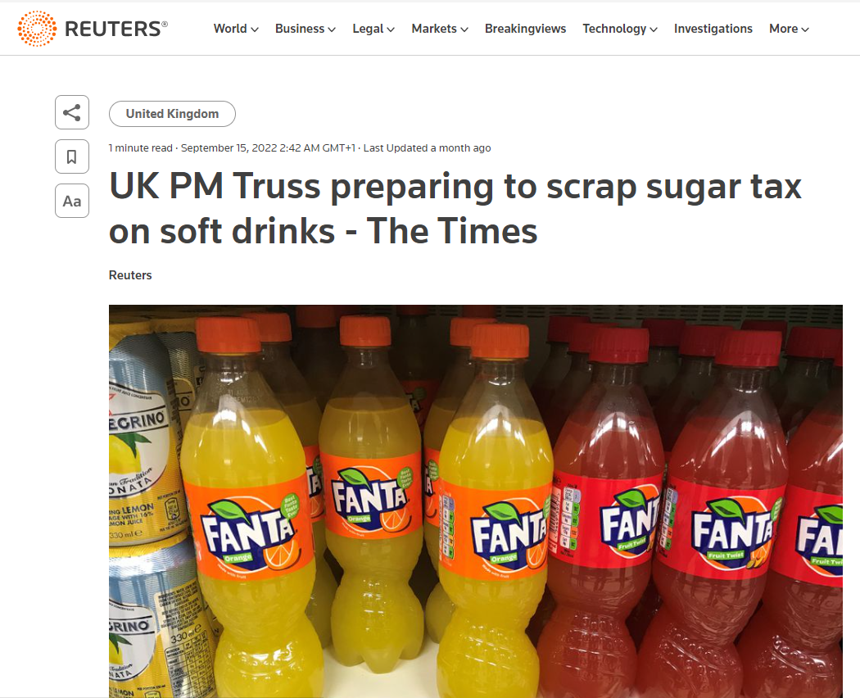

Slide 3
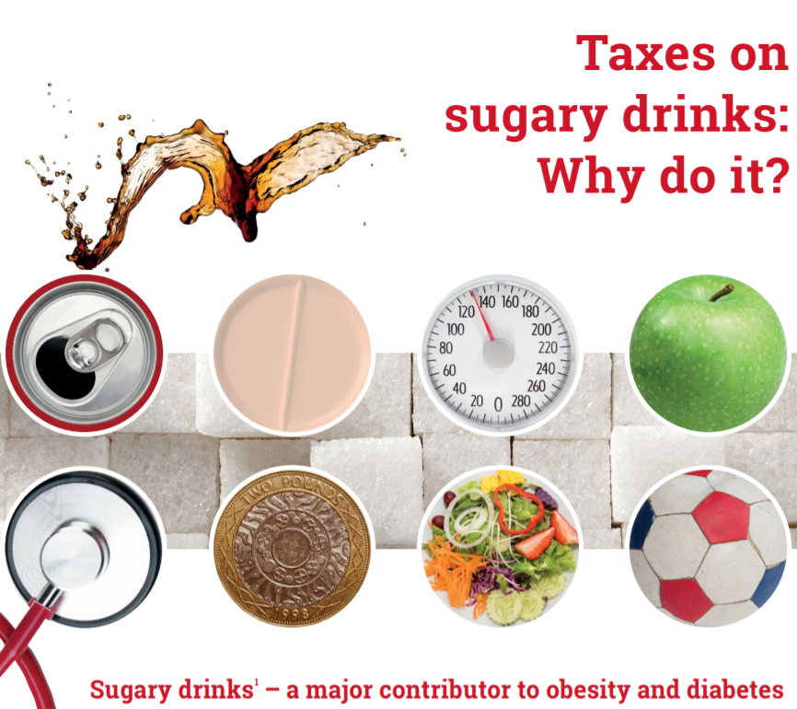
WHO - 2016

Slide 4
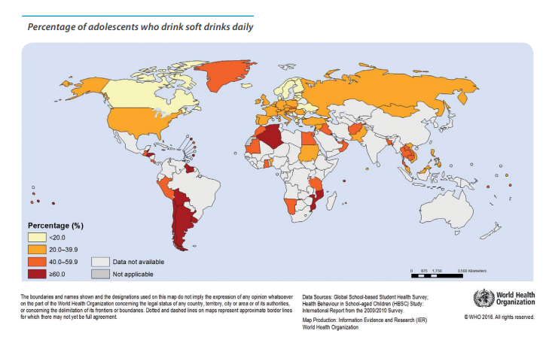

Slide 5
Problems with excess sugar
Dietary sugar, especially in liquid form, increases risk of dental issues, adiposity, and type 2 diabetes.
The United Kingdom Soft Drinks Industry Levy (SDIL) was announced in March 2016 and implemented in April 2018, Charges manufacturers and importers at:
  £0.24 per litre for drinks with over 8 g sugar per 100 mL (high levy category),
  £0.18 per litre for drinks with 5 to 8 g sugar per 100 mL (low levy category),
  and no charge for drinks with less than 5 g sugar per 100 mL (no levy category).
  Fruit juices and milk-based drinks are exempt.

Slide 6
Globally what is happening?
With the global prevalence of obesity and associated health risks continuing to increase (WHO, 2016) health-related taxes have become an established policy option intended to reduce energy intake.
Most of these have focused on sugar-sweetened beverages (SSBs) due to their consistent association with energy intake, weight gain, risk of type 2 diabetes, as well as dental caries (Scientific Advisory Committee on Nutrition, 2015).
  In the USA, six local jurisdictions have a tax on sugary beverages implemented due to health concerns
  Chile taxes drinks with high levels of sugar at a rate 8% higher in comparison to drinks containing less sugar
  More recently, Portugal and Catalonia (Spain) implemented a two-tiered tax on sugary drinks
  the United Arab Emirates and Saudi Arabia introduced a 50% tax on carbonated drinks and Brunei and Thailand introduced an excise duty on sugary drinks.
  (World Cancer Research Fund, 2017).
There are similar plans across a number of other countries such as Estonia, the Philippines, Indonesia, Israel and South Africa (Public Health England, 2015).
The UK government started an industry levy in April 2018 to incentivise producers to reformulate their products or, if not, to increase the price of SSBs (UK Department for Health, 2016).

Slide 7
Research to date suggests that increasing the price of SSBs generates a small, but significant, reduction in their purchase (broadly, a 10% price rise reduces purchases by 6%–8%)
A more pronounced effect is found in poorer households and that substitution towards other soft drink categories only minimally offsets the energy reductions achieved through decreases in SSBs (Cornelsen et al., 2015; Briggs et al., 2013;2017)
However, there has been little research on the impact such a price increase could have on other contributors to sugar and energy intake, including alcohol (Quirmbach et al., 2018) and sweet snack foods (such as confectionery, cakes and biscuits).

Slide 8
Pro’s and Con’s of a sugar tax?

Slide 9
Pro’s and Con’s of a sugar tax?
Negatives…
Which foods should be taxed? Debate
Regressive tax – higher % comes from lower income groups
Obesity is caused by many factors – is sugar the main one?
Positives…
Raises revenue for the government
Encourages firms to produce healthier snacks?!
Provides incentives to reduce the consumption of sugar / unhealthy food.

Slide 10
Arguments for a sugar tax
External costs – NHS / businesses.
Sugary drinks impose high external costs on society. The overconsumption of sugar is a major cause of health problems such as:
  Tooth decay (especially amongst children)
  T2 Diabetes
  Obesity and obesity-related illnesses, such as back pain, heart disease,
These external costs are reflected in higher costs imposed on the national health service.
  Poor health also adversely affects work and productivity.
  Therefore, the social cost of sugar consumption is greater than the private cost of sugar.

Slide 11
‘Sugary drinks impose high external costs on society. The overconsumption of sugar is a major cause of health problems’
Discuss…

Slide 12

Lack of awareness of the harm caused
People may be unaware of the personal costs involved in sugar consumption?
Addictive qualities?
Popular to ‘quit sugar’?

Slide 13
Lack of awareness of the harm caused
People may be unaware of the personal costs involved in sugar consumption. Alternatively, people may be aware sugar is bad for you, but struggle to reduce consumption because of its addictive qualities.
How much sugar does an average person consume per week?
  Within foods?
This lack of awareness about sugar is an example of information failure – consumers not having full information to make informed choices.
  The amount of sugar in certain foods/drinks
  The harmful effects of sugar

Slide 14
Generates some much needed revenue
A great way of raising some tax revenue?
Revenue generated by these taxes could be spent on efforts to improve health care systems, encourage healthier diets, increase physical activity, or build capacity for effective tax administration, further increasing the value of this measure.

Slide 15
Continued…
Fund spending on growing health problems of sugar consumption (e.g. obesity management)
Tax to fund spending in a particular area? Would this make it more acceptable to the general public?
Tax raised used to fund health care or education about healthy eating?
Norway – very high tax on alcohol – goes directly to health care and treating problems caused by this.

Slide 16
Generates changes to supply and demand
Healthier alternatives?
Water…Awareness of hydration
Schools?

Slide 17
Generates changes to supply and demand
A sugar tax creates an incentive for firms to supply alternatives which are healthier.
Coca Cola – change in recipe – gradual sugar reduction
If you go into certain fast food restaurants, sugary drinks have often been heavily promoted – e.g. free refills in 5 Guys.
  It could be argued that supply creates its own demand. But, if firms have incentives to promote healthier drinks with substantially lower sugar content, then consumers will to an extent follow the supply.
  Meal deals in supermarkets – healthy drinks alternatives.
Evidence from the UK sugar tax suggests this is true. In the two years after the UK introduced a tax on sugary drinks, manufacturers responded by reducing the sugar content in their drinks to avoid the tax (Scarborough et al., 2020).

Slide 18
Sugar tax in the UK – freedom of choice / who is paying for this?
£0.24 per litre for drinks with over 8 g sugar per 100 mL (high levy category),
£0.18 per litre for drinks with 5 to 8 g sugar per 100 mL (low levy category)
no charge for drinks with less than 5 g sugar per 100 mL (no levy category)
A study (Scarborough et al., 2020) on the effect of the UK sugar tax, found prices only rose by 31% of the tax levy, suggesting manufacturers absorbed 2/3 of the tax increase themselves, suggesting demand is price sensitive for sugary drinks – with many alternatives.

Slide 19
Scarborough et al., 2020
Impact of the announcement and implementation of the UK Soft Drinks Industry Levy on sugar content, price, product size and number of available soft drinks in the UK, 2015-19:
The stated aim of the SDIL was to encourage the soft drinks industry to improve the healthiness of the drinks they produce, by reducing sugar content or reducing portion sizes. The SDIL was implemented in April 2018.
This study measured the impact of the SDIL on the soft drinks that are available to buy in the UK to evaluate whether the SDIL achieved its aim of influencing industry practice.
What did the researchers do and find?
They used data on 209,637 observations of soft drinks available from UK supermarket websites at 85 time points between September 2015 and February 2019.
At each time point, they measured the percentage of drinks with sugar levels greater than 5 g per 100 mL, the price of drinks, the volume at which they were sold, and the number of different drinks available to purchase and compared these with estimates of what would have happened if the SDIL was not introduced.
Changes were found to sugar levels in drinks.
  The percentage of drinks with sugar over 5 g per 100 mL fell from an expected level of 49% to 15% over the time period.
  There was little change in the product size or the number of products available to consumers.
  The price of high sugar drinks increased after the implementation of the SDIL but only by one third of the amount of the tax.
  The results show that the SDIL was associated with a considerable impact on the soft drinks industry, particularly with regard to the amount of sugar in soft drinks.
  The SDIL was not associated with a reduction in the size of the soft drinks marketplace.

Slide 20
Arguments against sugar tax

Slide 21
It is unfair on low-income groups
It is argued that the sugar tax is regressive because it will take a higher percentage of income from those on low-incomes.

Slide 22
Regressive tax – disproportionate impact on low-income groups
It is argued that the sugar tax is regressive because it will take a higher percentage of income from those on low-incomes.
However:
  People can switch to non-sugary drinks and avoid tax.
  Everyone could benefit from the increased health care spending and improved quality of life.
If there were concerns about income distribution as a result of the tax, the tax revenues could be used to reduce other regressive taxes such as VAT,
Would spending on health care be a better way to improve quality of life for those on low-incomes?
Would the income raised go towards this however?
Less likely to be able to afford private health care treatment.

Slide 23
People should be allowed to do what they like – make their own lifestyle choices…
One argument about sugar tax is that it is wrong for the government to make judgements about people’s lifestyle and influence consumer patterns.
Nanny state?
If the state is paying for the NHS – should the government have a say in what we do?
Health promotion focus rather than dealing with the consequences?

Slide 24
Other methods to reduce sugar consumption may be better?
What else could be put in place to reduce sugar consumption in the British public?

Slide 25
Case Study - Mexico
Evidence shows that implementing taxes on sugary drinks leads to reduced consumption of these products.
Several countries are well on their way to implementing taxes on sugary drinks.
In January 2014, the government of Mexico added a 1 peso per litre excise tax on any non-alcoholic beverage with added sugar (powder, concentrates or ready-to drink) to the country’s Special Tax on Production and Services, which is paid by the producer and represents about a 10% increase in price for the consumer.
A study conducted by the Mexican National Institute of Public Health and the University of North Carolina evaluating the first two years of implementation showed an average reduction of 7.6% in the purchase of taxed sugary drinks during 2014 and 2015.
Households with the fewest resources had an average reduction in purchases of 11.7%.
The study showed a 2.1% increase in purchases of untaxed beverages, particularly purchased bottled water (Colchero et al., 2017).
Over US$ 2.6 billion was raised during the first two years of implementation; some of this revenue is beginning to be invested towards installing water fountains in schools across Mexico (Nutritional Health Alliance Mexico, 2016).

Slide 26
Summary
Health implications – especially children
Cost implications – business and consumers
NHS – protect and fund?
Personal responsibility
Awareness

