Slide 1
Quality Assurance Failure in Healthcare
Root Cause Analysis of the Lucy Letby Hospital Case
Name: Mst. Sima Begum
ID: 2433426
Module: Quality Assurance and Service Improvements (LCHS7006)
Programme: MSc Public Health and Social Care in Practice

Slide 2
Introduction
This presentation critically examines the systemic quality assurance failures at the Countess of Chester Hospital during the 2015–2016 neonatal crisis.
Background
  Health care quality and service delivery includes patient safety as one of its basic elements.
  It is necessary that healthcare organisations have excellent mechanisms that reduce risk and avoid harming patients.
  The concept of quality assurance will help to identify that healthcare services are delivered to meet appropriate safety and performance (Hercus et al., 2024).
International Significance of Patient Safety
  The harm of patients due to insecure care is still a significant global health issue.
  Healthcare systems should be able to continually enhance safety structures, governance systems as well as organisational learning mechanisms.
The World Health Organisation says that to improve healthcare outcomes in the world, it is crucial to enhance the system of patient safety (World Health Organisation, 2021).

Slide 3

Patient Safety in the NHS
NHS Commitment to Safety
  National Health Service (NHS) has come up with national policies that will enhance safety among patients in healthcare organisations.
  The strategies aim to enhance reporting systems of incidents and encourage organisational learning.
Safety Culture
  The formation of the safety culture will make healthcare professionals report incidents and near-misses.
  This enables organisations to detect the risks when they are early and avoid safety failures in future.
The NHS emphasizes that the concept of patient safety should be entrenched in healthcare leadership, governance and clinical practice (NHS England, 2022).

Slide 4
Patient Safety Incident Response Framework
Incident Management
  I have used the Patient Safety Incident Response Framework (PSIRF) to give direction in the investigation of healthcare safety incident.
  It helps organisations emphasise on the reasons behind occurrence of incidences as opposed to blame game.
Key Objectives
  Enhance the learning of safety incidents.
  Determine the systemic weaknesses of healthcare processes.
  Enforce the changes that would not allow any similar incidences to take place.
This framework favours a learning-based strategy of enhancing safety in healthcare organisations (NHS England, 2024).

Slide 5

Lucy Letby Hospital Case
Lucy Letby incident involved a neonatal unit of Countess of Chester Hospital in the year 2015 and 2016 (Lawrence and Conn, 2024).
A number of infant deaths were an issue of concern in terms of safety and quality in the neonatal unit.
Case Study Background
Investigative Findings
The investigation found out that there were various organisational problems such as staffing problem and infrastructure problem.
The hospital management was reported to not respond promptly to complaints made by older doctors.

Slide 6
Governance and Patient Safety
Significance of Clinical Governance
  Clinical governance is used to ensure high quality of care and safety among healthcare organisations.
  It involves observing clinical performance and risk management and accountability (Southall et al., 2024).
Governance Functions
  Tracking patient safety measurements and healthcare results.
  Staffing incident reporting.
  Assuring regulatory compliance and learning in an organisation.
Well-established governance systems enable healthcare organisations to notice risks in time and take measures to enhance them (Hibbert et al., 2023).

Slide 7
Incident Reporting and Learning
Importance of Reporting Systems
Challenges in Learning from Incidents
  The incident reporting systems enable healthcare organisations to record safety events and examine the causative factors.
  These systems contribute to recognizing the trends of damage and possible dangers in the medical services.
  In other organisations, an analysis of incident information or improvements is not successfully accomplished.
  The effectiveness of learning safety event can be constrained by bad communication and organisational culture (Louch et al., 2025).

Slide 8

Quality Improvement in Healthcare
Role of Quality Improvement
  Quality improvement strategies are meant to improve the healthcare services by systematic analysis and intervention.
  Such approaches entail monitoring, appraisal and refining of healthcare processes continuously.
Improving Incident Reporting
  Information received through the incident reporting systems can be used to reveal systemic risks and organisational vulnerabilities.
  This information can be utilized by the healthcare teams to develop specific improvement strategies.
The quality improvement processes enable enhancement of safety surveillance systems in healthcare organisations (Santos, Ajayi-Obe and Aurelio, 2025).

Slide 9
Root Cause Analysis
Role of Healthcare Regulators
  Root Cause Analysis (RCA) is a process that is structured to investigate the incident involving patient safety.
  It aims at establishing the root causes of healthcare mistakes.
Purpose of RCA
  Determine healthcare systemic weaknesses.
  Know the causes of safety accidents.
  Both come up with the right actions to avert recurrence.
In healthcare, RCA is extensively applied to enhance the learning and patient safety (Parmar et al., 2026).

Slide 10
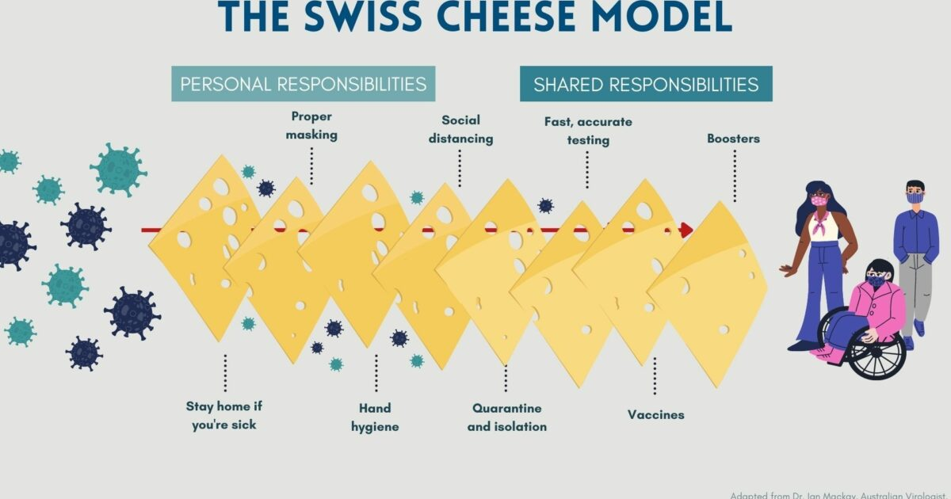
Swiss Cheese Model – Lucy Letby Case
The Swiss Cheese Model helps to understand how patient safety incidents can happen when the barriers to safety fail and their weaknesses are aligned.
In the Lucy Letby case, failures in incident reporting, leadership response and governance oversight meant that concerns about neonatal deaths were able to be ignored (Vincent et al., 2025).
.
Key system failures
    Delayed response to clinician concerns
    Weak incident reporting systems
    Poor leadership and governance oversight
    Staffing pressures in the neonatal unit

Slide 11
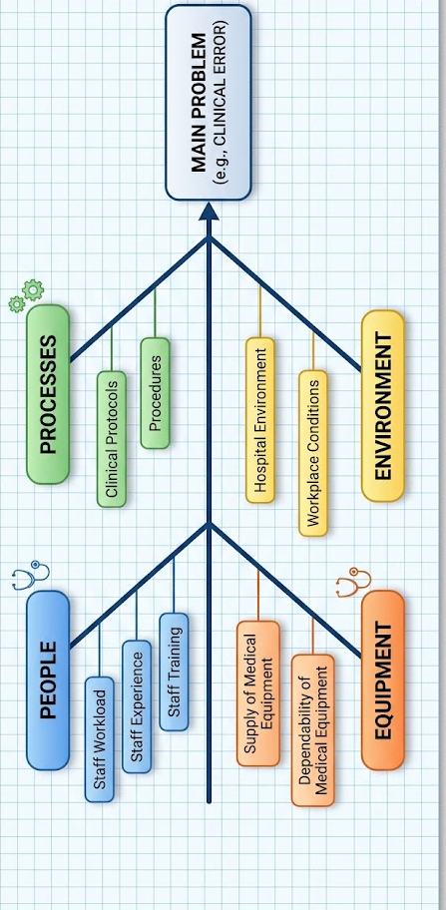
Fishbone Diagram
Analytical Tool
  The Fishbone Diagram is an illustrative tool that is employed to examine the causes of organisational issues.
  It assists teams to in orderly point out elements that cause safety incidents.
Categories of Causes
  People - staff workload, experience and training.
  Processes- clinical protocols and procedures.
  Equipment - supply and dependability of medical equipments.
  Environment - hospital environment and workplace conditions.
This is a tool that enables systematic research of healthcare quality improvement problems (Kumah et al., 2024).

Slide 12
Regulatory Oversight
The role of healthcare regulators.
Care Quality Commission (CQC)
  The healthcare organisations are regulated to ensure that they maintain the required safety standards.
  These agencies make inspections, audit and interpret performance and implement regulatory compliance.
  The CQC is a body tasked with the regulation of healthcare practitioners in England.
  It assesses the safety, effectiveness, and responsiveness of the services to the needs of the patients.
The CQC is significant in raising accountability and safety amidst healthcare organisations (CQC, 2022).

Slide 13
Transparency and Accountability
Importance of Transparency
  Transparency promotes healthcare organisations to take full responsibility on their mistakes and learn.
  Transparency contributes to the establishment of trusts between medical practitioners and their patients.
Leadership Responsibilities
  Accommodators in the safety reporting.
  Promote organisational growth and development.
  Fulfill patient safety outcomes responsibility.
The patient safety culture in healthcare organisations can be reinforced through transparency promotion (Fukami, 2024).

Slide 14
Recommendations
  Strengthen incident reporting systems using frameworks like Patient Safety Incident Response Framework to improve learning from errors (Fukami, 2024).
  Improve clinical governance and leadership accountability to ensure timely response to safety concerns.
  Enhance staff training and workforce support in patient safety and risk management.
  Promote a transparent and open safety culture to encourage reporting of incidents.

Slide 15
Training, Workforce and Conclusion
Importance of Training
  Healthcare professionals should be trained in the area of patient safety, quality improvement and risk management.
  Training enhances employee effectiveness in the ability to identify the risks and act appropriately towards safety accidents.
Benefits of Training
  Better incident reporting behaviour.
  Increased organisational safety culture.
  Improved patient care and quality of care.
The programs on education are important to equip healthcare professionals to handle safety issues (Tsimtsiou et al., 2025).

Slide 16
References
CQC (2022). Care Quality Commission. [online] https://www.cqc.org.uk/. Available at: https://www.cqc.org.uk/ [Accessed 15 Mar. 2026].
Fukami, T. (2024). Enhancing Healthcare Accountability for Administrators: Fostering Transparency for Patient Safety and Quality Enhancement. Cureus, [online] 16(8), pp.1–6. doi:https://doi.org/10.7759/cureus.66007.
Hercus, C., Baird, A., Ibrahim, S., Turnbull, P., Appleby, L., Singh, U. and Kapur, N. (2024). Suicide in individuals with eating disorders who had sought mental health treatment in England: a national retrospective cohort study. The Lancet Psychiatry, 11(8), pp.592–600. doi:https://doi.org/10.1016/s2215-0366(24)00143-3.
Hibbert, P.D., Stewart, S., Wiles, L.K., Braithwaite, J., Runciman, W.B. and Thomas, M.J.W. (2023). Improving Patient Safety Governance And systems through Learning from Successes and failures: Qualitative Surveys And interviews with International Experts. International Journal for Quality in Health Care, 35(4). doi:https://doi.org/10.1093/intqhc/mzad088.
Kumah, A., Nwogu, C.N., Issah, A.-R., Obot, E., Kanamitie, D.T., Sifa, J.S. and Aidoo, L.A. (2024). Cause-and-Effect (Fishbone) Diagram: a Tool for Generating and Organizing Quality Improvement Ideas. Innovations Journals, [online] 7(2), pp.85–87. doi:https://doi.org/10.36401/JQSH-23-42.
Lawrence, F. and Conn, D. (2024). A superbug, doctor shortages and a neonatal unit ‘out of its depth’: failures at Lucy Letby hospital revealed. [online] the Guardian. Available at: https://www.theguardian.com/uk-news/article/2024/sep/08/a-superbug-doctor-shortages-and-a-neonatal-unit-out-of-its-depth-failures-at-lucy-letby-hospital-revealed [Accessed 15 Mar. 2026].
Louch, G., Macrae, C., Talbot, R., McHugh, S. and O’Hara, J.K. (2025). How Were Patient Safety Incidents Responded to, Investigated, and Learned From Within the English National Health Service Before the Implementation of the Patient Safety Incident Response Framework? A Rapid Review. Journal of Patient Safety. doi:https://doi.org/10.1097/pts.0000000000001349.
NHS England (2022). Patient Safety. [online] England.nhs.uk. Available at: https://www.england.nhs.uk/patient-safety/.
NHS England (2024). Patient Safety Incident Response Framework. [online] www.england.nhs.uk. Available at: https://www.england.nhs.uk/long-read/patient-safety-incident-response-framework/ [Accessed 15 Mar. 2026].
Parmar, D., Patel, N., Kenneth-Ogah, C., Yazdouni, S., Desai, C., Raveshia, D. and Patel, R. (2026). Root causes of surgical never-events: a systematic review. Patient Safety in Surgery. doi:https://doi.org/10.1186/s13037-025-00474-8.
Santos, C., Ajayi-Obe, A. and Aurelio, M. (2025). Using Quality Improvement to improve serious incident reporting in the English NHS. BMJ Open Quality, [online] 14(3). doi:https://doi.org/10.1136/bmjoq-2024-003234.
Southall, S., Patrick, H., Harris, K. and Bird, C. (2024). Introducing a systematic and sustainable patient safety oversight function in a U.K. arms-length healthcare body. Journal of Patient Safety and Risk Management, 29(5), pp.257–262. doi:https://doi.org/10.1177/25160435241282044.
Tsimtsiou, Z., Pagkozidis, I., Pappa, A., Triantafyllou, C., Vasileiou, C., Stridborg, M., Fonseca, V.R. and Breda, J. (2025). What Do We Know About Contemporary Quality Improvement and Patient Safety Training Curricula in Health Workers? A Rapid Scoping Review. Healthcare, [online] 13(12), pp.1445–1445. doi:https://doi.org/10.3390/healthcare13121445.
Vincent, C., Irving, D., Bellandi, T., Higham, H., Michel, P., Staines, A., Adams, S., Brown, J., Hibbert, P.D., Hemmelgarn, C., Joseph, L., Pires, K., Sheridan, S., Sunol, R., Ushiro, S., Wu, A.W. and Zambon, L. (2025). Systems analysis of clinical incidents: development of a new edition of the London Protocol. BMJ Quality & Safety, [online] p.bmjqs-2024-017987. doi:https://doi.org/10.1136/bmjqs-2024-017987.
World Health Organisation (2021). Global Patient Safety Action Plan 2021-2030. [online] www.who.int. Available at: https://www.who.int/publications/i/item/9789240032705 [Accessed 15 Mar. 2026].

Slide 17
THANK YOU

