Slide 1
Student Name: Kinga Starczewska
Student Number: 2312239
BMHP6029_BIRM – Component 1 – Poster Presentation
Title of Poster: Social, cultural, and political forces shaping treatment for Anorexia Nervosa ICD-11

Slide 2
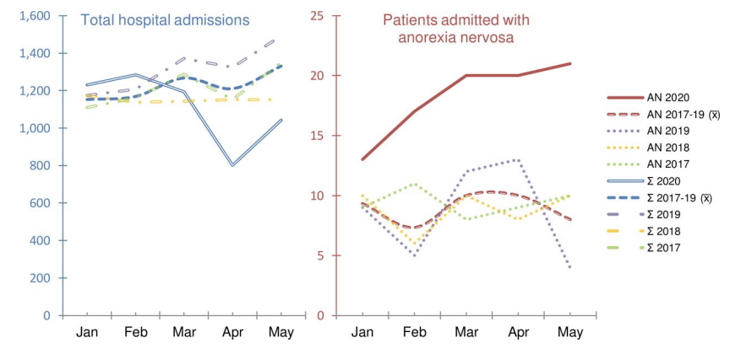

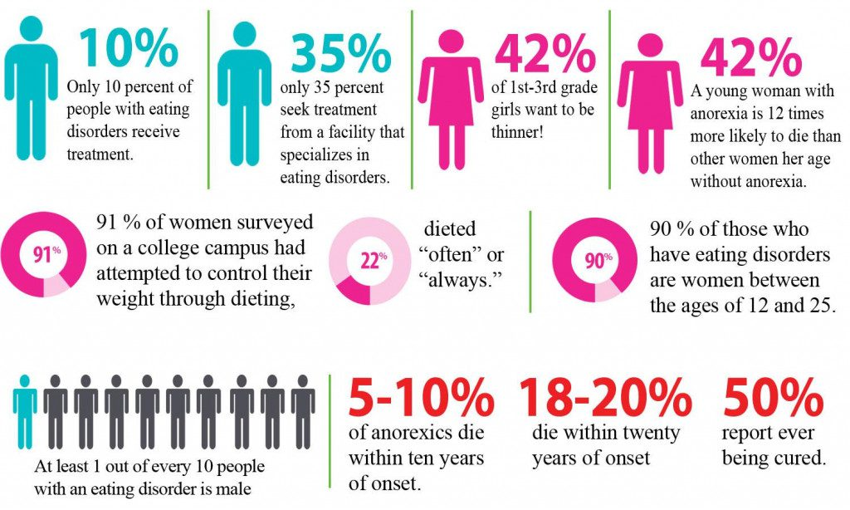
Social, cultural, and political forces shaping treatment for Anorexia Nervosa ICD-11
Anorexia nervosa ICD‑11 6B20 is an eating disorder and a serious mental health disorder. People with anorexia starve themselves to achieve a body weight as low as possible. They choose methods such as excessive physical activity, not eating enough food, inducing vomiting, or taking laxatives. This leads to serious illnesses. They believe they are obese when they are underweighted (NHS, 2024).
Anorexia Nervosa: Historical Understanding
Medieval era: Self-starvation seen as religious devotion.
9th century: Recognized as a medical disorder by Gull (1873) and Lasègue (1873) — described as “nervous loss of appetite.”
Early 20th century: Interpreted through psychoanalytic and family perspectives.
Critical social, cultural, and political contexts of anorexia nervosa
Historically seen as vanity, not a mental illness — led to stigma and delayed help-seeking (House of Commons Library, 2018).
Social stigma causes fear of judgment and treatment delays (Wall et al., 2024).
Media idealizes slimness, promoting unhealthy body standards (NEDA, 2023).
Often viewed as a “women’s issue,” overlooking male sufferers.
Modern treatments consider cultural beliefs around food, family, and health (Wall et al., 2024).
Low income linked to delayed or inadequate treatment (House of Commons Library, 2018).
Advocacy and charities helped recognize eating disorders as serious mental health issues.
NHS FREED policy introduced early intervention for ages 16–25 (NHS, nd.).
International Classification of Diseases (ICD-11): A system developed by the World Health Organization (WHO) that classifies diseases and conditions for the purposes of clinical documentation, research, mortality, morbidity, and resource allocation (WHO, 2025).
DSM-5 Diagnostic and Statistical Manual of Mental Disorders: Primarily used by mental health professionals in the United States to identify and diagnose mental disorders (American Psychiatric Association’s , 2025).
Recommendations for Future Policy & Practice (NICE 2020)
Patients should be involved in care decisions.
Ensure all individuals with anorexia receive specialized support.
Use a multidisciplinary approach with psychoeducation and health monitoring.
Offer individual CBT-ED therapy (NHS, 2024).
Provide MANTRA therapy tailored to patient needs (NHS, 2024).
SSCM therapy focuses on building a positive (NHS, 2024)
therapist–patient relationship and includes education, nutrition, and health monitoring.
Use FPT therapy if other methods are ineffective (around 40 sessions).
Inform untreated patients they can request a referral anytime.
Offer dietary advice to support recovery.
Avoid using medication as the sole treatment option.
LAW
Using the Mental Health Act for people with anorexia nervosa.
Mental Health Act 1983. Compulsory inpatient treatment is considered when the life of the person with an eating disorder is at risk, and they do not consent to treatment.
Mental Health Act 1983/2007 or the Children Act 1989. If the physical health of a child or young person who does not consent to treatment is at risk, their parents or guardians should be asked to give consent and, if necessary, use the appropriate legal framework for compulsory treatment.
- Feeding people without their consent should only be done by multidisciplinary teams who are competent to do so (NICE 2025)
Treatment & Care Delivery
Treatment for AN in the UK is provided by the NHS, private clinics, and voluntary organisations. Multidisciplinary teams are involved to support physical and mental recovery (NICE, 2020).
Outpatient care: Therapy, nutritional advice, and GP monitoring.
Inpatient or residential care: For individuals at serious medical or psychological risk.
Community services: Support from psychiatrists, psychologists, dietitians, and social workers (NICE, 2020).
Therapies: Cognitive Behavioural Therapy (CBT-ED) and Family-Based Therapy (FBT) (NICE, 2020).
Charitable support: Organisations such as Beat and Mind provide helplines and recovery groups (Beat, 2023).
Care focuses on restoring health, rebuilding a positive relationship with food, and addressing emotional wellbeing.

Slide 3
Reference List
Beat (UK eating disorder charity). (2025.). The UK’s Eating Disorder Charity. Available at: https://www.beateatingdisorders.org.uk/ (Accessed 7 October 2025).
FREED. (2025). What is FREED? (for Professionals). Available at: https://freedfromed.co.uk/what-is-freed-for-professionals (Accessed 8 October 2025).
Innovative Trials. (2025). Eating Disorders Awareness Week. Available at: https://innovativetrials.com/eating-disorders-awareness-week/ (Accessed 13 October 2025).
Kessler, C. (2020). What’s Anorexia Nervosa? Causes, Symptoms & Treatments. Lighthouse Recovery Institute. Available at: https://lighthouserecoveryinstitute.com/what-is-anorexia-nervosa/ (Accessed 13 October 2025).
Naylor, H., 2022. Understanding the Rise of Eating Disorders in the UK – 2022. The London Centre for Eating Disorders. Available at: https://www.thelondoncentre.co.uk/the-blog/understanding-the-rise-of-eating-disorders-in-the-uk-2022 (Accessed 12 October 2025).
National Eating Disorders Association (2025). Media and Eating Disorders. Available at: https://www.nationaleatingdisorders.org/media-and-eating-disorders/ (Accessed 7 October 2025).
NHS (2024). Treatment – Anorexia nervosa. Available at: https://www.nhs.uk/mental-health/conditions/anorexia/treatment/ (Accessed 8 October 2025).
NHS (2024). Overview – Anorexia nervosa. NHS. Available at: https://www.nhs.uk/mental-health/conditions/anorexia/overview/ (Accessed: 6 October 2025).

Slide 4
Reference List
NHS England. (n.d.). First Episode Rapid Early Intervention for Eating Disorders (FREED). Available at: https://www.england.nhs.uk/mental-health/case-studies/other-mental-health-case-studies/first-episode-rapid-early-intervention-for-eating-disorders-freed/ (Accessed 9 October 2025).
NICE (2020) Eating disorders: recognition and treatment. NICE Guideline NG69: Recommendations. London: National Institute for Health and Care Excellence. Available at: https://www.nice.org.uk/guidance/ng69/chapter/Recommendations (Accessed: 6 October 2025).
Powell, T., Harker, R. & Bellis, A. (2018) Reducing stigma around eating disorders. Debate Pack CDP-0220, House of Commons Library, 15 October. Available at: https://reserchbriefings.files.parliament.uk/documents/cdp-2018-0220/cdp-2018-0220.pdf (Accessed: 7 October 2025).
Wall, P.L., Fassnacht, D.B., Fabry, E., O’Shea, A.E., Houlihan, C. & Mulgrew, K., et al., 2024. Understanding stigma in the context of help-seeking for eating disorders. Journal of Eating Disorders, 12, 126. Available at: https://jeatdisord.biomedcentral.com/articles/10.1186/s40337-024-01086-w (Accessed 10 October 2025).
World Health Organization (2025). Classification of Diseases. Available at: https://www.who.int/standards/classifications/classification-of-diseases (Accessed 11 October 2025).

