Slide 1

Why the Production Concept is the Most Effective Marketing Model for Business in 2025
Presenter: Cristina tecu

Slide 2

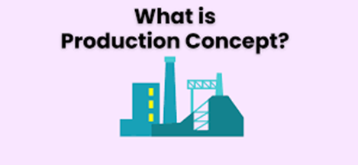
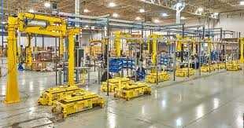
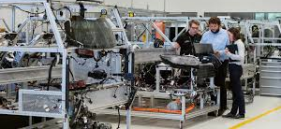

Overview of the Production Concept
Definition:
The Production Concept centers on effective production, low cost, and broad product distribution and availability.
It assumes consumers care more about low cost and product accessibility than customisation or brand loyalty.
Key Elements:
Very efficient production
Economies of scale lead to lower prices
Standards, or "cookie-cutter" production
Mass distribution
Very standardised and little to no customisation.
This strategy was and is primarily associated with manufacturing (e.g. Ford, etc.)
Most modern examples (e.g. Shein and Tesla) are not purely production focused but they are still leveraging data plus automation.

Slide 3
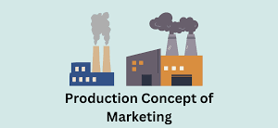
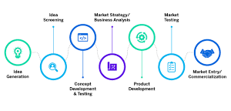

Why It Works in 2025?
Modern Relevance:
Globalised Supply Chains → Support large-scale production
AI & Automation → Boost operational efficiency
Economic Pressure on Consumers → Demand for affordability
E-commerce Growth → Rewards fast, scalable fulfilment
Sustainability Trends → Efficient production → reduced waste
Bottom line
A production-led strategies enable companies to achieve value at scale - all fundamentally important in the price sensitive, rapidly evolving markets of 2025.

Slide 4
Comparing Marketing Concepts
Marketing Concept | Focus | Fit for 2025 Business
Production | Efficiency & Low Cost | Excellent – scalable, affordable
Product | Quality & Innovation | Costly, may limit reach
Selling | Sales Tactics | Outdated, low customer loyalty
Marketing | Customer Satisfaction | Effective but resource-heavy
Societal Marketing | Ethics & Social Impact | Important, but harder to scale

Slide 5

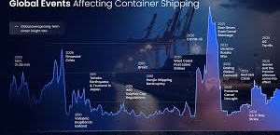
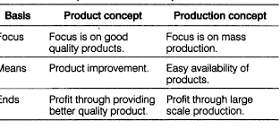
Conclusion
Why Production Concept Wins?
Addresses the modern consumer's expectations of affordability, speed, and access
Aligns with digitally enabled business models, using the global model
Provides an easy to scale business without large marketing or R&D expenses
Applies to direct-to-consumer models, especially digital first
Best model for 2025 when matched with real-time data and sustainability elements.

Slide 6

References
Darmawan, D., & Grenier, E. (2021). Competitive advantage and service marketing mix. Journal of Social Science Studies (JOS3), 1(2), 75–80.
Grewal, D., & Levy, M. (2021). M: Marketing (p. 480). McGraw-Hill Education.
Kpalou, J. Y. G. (2012). Difficulties experienced by small business managers in marketing their businesses (Doctoral dissertation, Nelson Mandela Metropolitan University).
Kumar, P. (2023). Principles of marketing. Sultan Chand & Sons.
Maganga, D. P., & Taifa, I. W. (2023). Quality 4.0 conceptualisation: An emerging quality management concept for manufacturing industries. The TQM Journal, 35(2), 389–413.
Muluk, S., & Pahurkar, R. (2022). The implementation of marketing practices based on marketing philosophies in small and medium-sized enterprises. Journal of Positive School Psychology, 6(8).
Nigussie, Y. (2014). Empirical investigation on the application of marketing practices in micro and small enterprises (MSEs). International Journal of Advancements in Research & Technology, 3(5), 110.
Sahoo, S. (2022). Big data analytics in manufacturing: A bibliometric analysis of research in the field of business management. International Journal of Production Research, 60(22), 6793–6821.

