Slide 1
Organize the Warehouse project Vintner
By Light Solutions Ltd.
Notes:
We are Light Solutions Ltd
Hello and welcome to our presentation ,over the next few minutes we will be taking you through step by step on how we will help and organize your project move from Shirley to Sparkhill.
This will help you to understand how it will be done and how we will deliver to you your completed project with maximum results.
Light solutions ltd offers planning and management services to clients looking for new office spaces or location to shift their business.

Slide 2
Light Solutions Ltd
Team Members :
Shameem Akhtar
Nazia Bi
Asma Akhtar
Salma Bibi
BMSK5004- group 3
Notes:
The team is run by dedicated and committed members who I would like to introduce you to:
Asma Akhtar, Shameem Akhtar, Nazia Bi, and Salma Bibi.
The company has an excellent track record in the industry and has built a strong rapport among its customer as a reliable and efficient service provider.
On top of its primary business services, Light Solution ltd also offers consultation services to its customer as an offshoot offering.
Light Solution ltd welcomes enquiries and suggestion from its customers as it seeks to continuously improve the quality of services it provides.

Slide 3
Overview
Aims and Objectives
To carry out a smooth shift from the shop in Shirley to the warehouse in Sparkhill
Re construct the warehouse in Sparkhill
To set up a new business process
Notes:
Our team provides all their customers with the PRINCE2 methodology.
PRINCE2 structures each stage of the process from start to finish focusing on the organisation as well as taking control over the entire project.
PRINCE2 has become one of the most popular and widely used project management methodologies available today. Following the success across the UK , interest has spread across the globe; it is a best practice framework that helps managers deliver projects on time and within budget

Slide 4
Project Life Cycle
Includes 5 phases
Discovery (1st phase)
Initiation (2nd phase)
Delivery (3rd phase)
Closure (4th phase)
Realization (5th phase)
Notes:
Project life cycle includes five phases which starts from discovery and ends with realization of the end goal with each step taken in between to fulfill that very goal.
For this particular project, we primarily relied on the user stories from Vintners Antiques for the discovery of business opportunity.
Following collection of information regarding business opportunity through user stories in the discovery phase, we moved on to second phase of the project; initiation which was conducted for which brainstorming among the team members. It helped us to be prepared and take on the next step of delivery where customers were delivered the product or service. Even though the product is delivered to the client, the project is still not completed, as project resources are to be released and the success of the project is to be determined. In the final phase the delivered project is checked whether it matches with the project goal or not. In this project it is checked with the user stories provided by the Vintners Antiques stakeholders regarding the requirement of a warehouse.

Slide 5
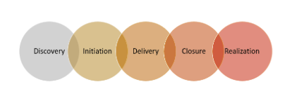
Project Life Cycle Concluded
Notes:
We used smart art for the diagram above
(Roberts, 2012)

Slide 6
Project Steering Group
Sponsor
Denis Vintner: Specialist
Omar King: Specialist
Suha Madani : User
Work Steams
Install electric
Build internal rooms
Repair roof
Steering Group
Doreen Vintner
Project manager
Light Solutions Ltd
Interior design
Notes:
Through acquiring a new warehouse, Vintners Antiques can expand its business operation. Major decision for the project will be taken by the sponsor, Doreen Vintner which is then assessed by the steering group which includes professional such as financial experts, user and specialist. Specialist for the steering group are Denis Vintner, Omar king and Suha Madani, among them the first two are the specialist while the latter one is the user of the warehouse. After it has been approved by the steering group, the project will be handed to the project manager who will then allocate the task. The project manager to lead the actual work is Light Solutions ltd. The Project manger will divide the whole project into smaller measurable task and allocate them as per the skill of workers. Firstly the electric equipments will be installed in the warehouse, followed by repair of the roof to make it waterproof. Internal rooms will be built, and interior part will be designed to accommodate more goods in the warehouse. Finally when the project is completed as per the requirement it will be handed over to the client.

Slide 7
User Stories
Doreen Vintner and Denis Vintner, ”As owner of the business, we want to expand its operation”.
Omar King, “As an employee, I want an additional warehouse as the one currently in use is getting overcrowded”.
Suha Madani,”As an employee, I want an additional warehouse as it helps the business to grow”.
Notes:
User stories shows the expectation of all stakeholders regarding the project, which in this case is the completion of the warehouse as it helps them from different sides. Through the user stories collected from stakeholders of the Vintners Antiques, it is clear that the clients are looking for a new warehouse to increase their business. For this purpose, Light Solutions Ltd will conduct a brain storming session among its team members and come up with a plan to move forward with the project.

Slide 8
User Stories Concluded
Notes:
Here we spent some time brainstorming in using the brown paper method, writing down simple descriptions of what you will need for the construction collecting stakeholder ideas
User Stories have been designed to build shared understanding between the Customer Team and the Developer Team.

Slide 9
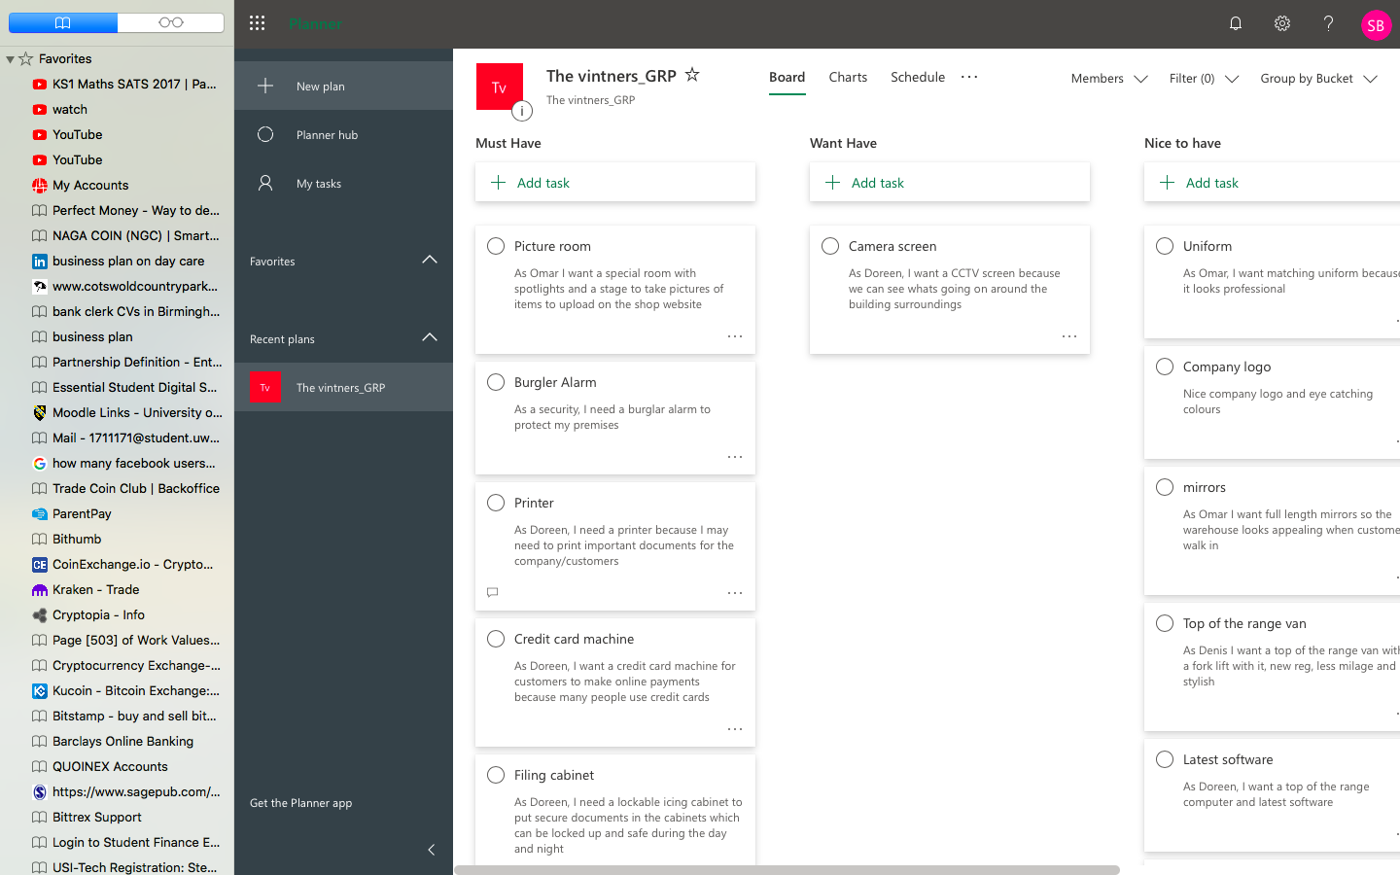
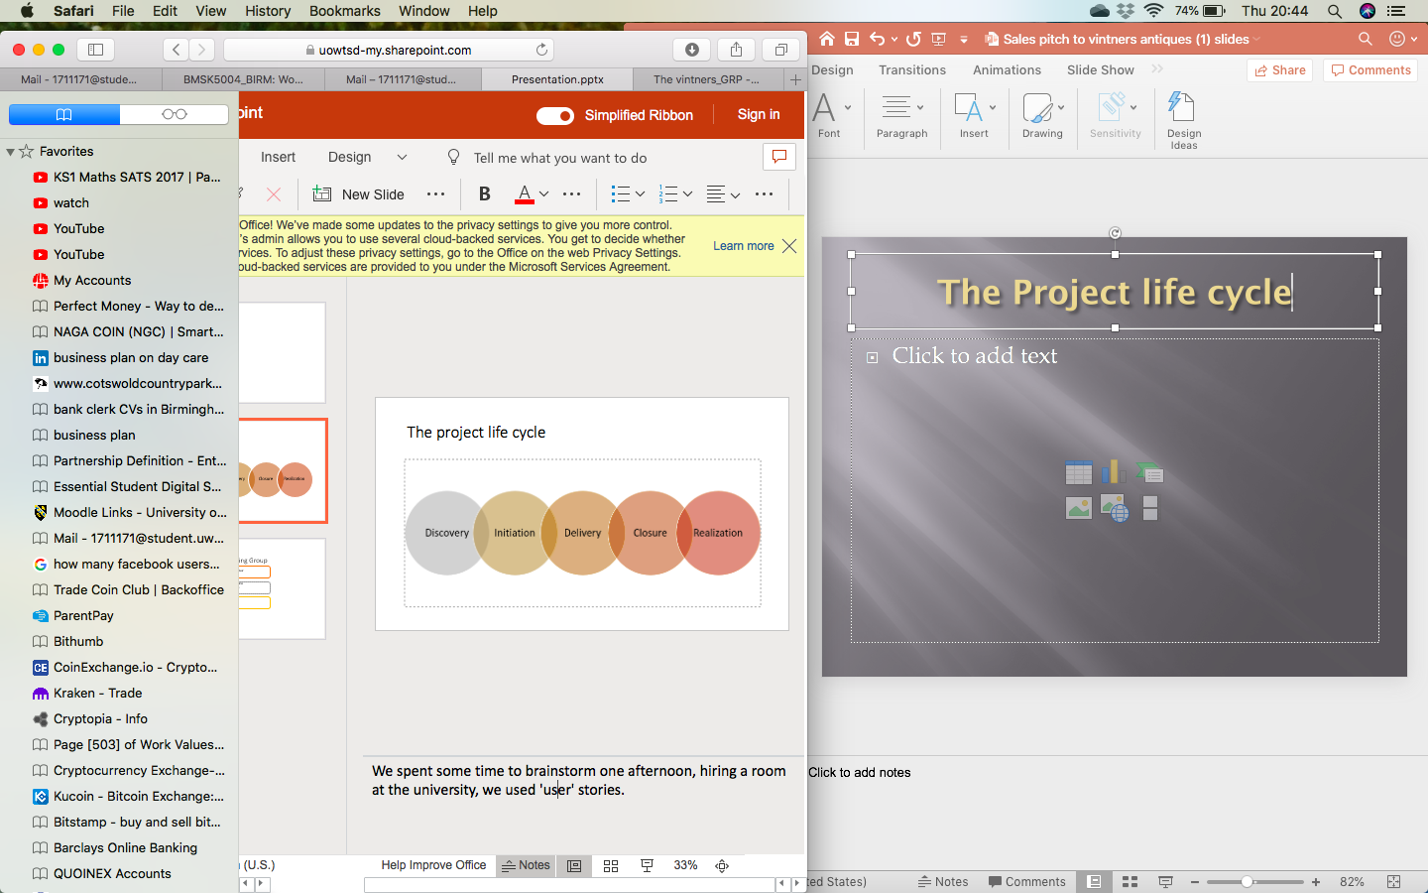

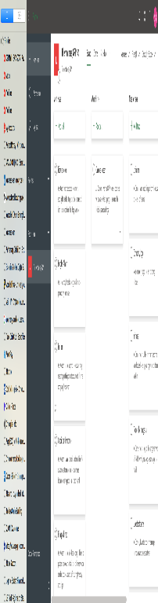
Chevron
Notes:
We then transferred all the information on the ‘brown paper’ on to a digital version (Microsoft Planner).
This helped us put it in to groups and prioritize the must haves from want to have and nice to have.
This is a more detailed format of user stories on Microsoft planner and helps us be more professional and organized as well as not losing the sticky notes.

Slide 10
Project Chevron Concluded
Problem: Current warehouse is full
Must
Wants
Nice
Warehouse of 2000 sq ft.
Air, water and fireproof building
Alarm system
Work space and DIY equipment
Storage
Removal van
Gas and electric
Office space with equipment
Display room for merchandise
Kitchen area
Modern lighting for display products
Small kitchen appliances
Area for tea breaks
Mission: To find a warehouse that meets all the must and as many of the others possible.
Notes:
The project chevron shows the what is important to the sponsor and steering group. In the case of Vintners Antiques, the must is a warehouse with at least a size of 2000 sq ft with water, air and fire proofing within. It is essential to safeguard the items within the room incase of any leakage or accidental fire breakouts. The wants for the project includes gas and electric, office space and equipment, display area and kitchen space .For the nice, an area for relaxation or tea break incase people need to be in the warehouse for long period of time and that customers could use if they wanted to.

Slide 11
Product Project Technique
Notes:
This technique allows us to allocate a time frame of the work which needs to be carried out (Roberts, 2012)
This table allowed us to determine the complexity and size of the job, and will enable us to figure out how many man days it will take for the job to be completed.

Slide 12
The Iron Triangle
Scope
Warehouse construction
Cost
Time
Notes:
While the number and importance of stories can differ as per the stakeholders, a project manager needs to prioritize the one that holds the most significance for the completion of the project. For this particular project, it is to construct a new warehouse to expand the Vintners Antiques business. As the stories of the clients does not vastly differ from the main goal of constructing a warehouse, the project manager will find it easy to keep the balance between scope, cost and time allocated for the project.

Slide 13
Gantt Chart
Date | 1^{st/2nd week} | 3rd/4th week | 5th/6th week | ^{7th/8th week}
Activities
Install electric
Repair roof
Build internal rooms
Interior design and furnishing
Notes:
Gantt chart shows the time frame and activities undertaken to complete the project (Sharp et al, 2009). For the charts we used the SmartArt option to save time and get the project going. The project is to be completed in a 2 month time period with each activities requiring two weeks of time. Installing electrical parts is carried out in the first two weeks, then roof of the warehouse is repaired, then the internal rooms are built, and finally interior part of the warehouse is managed to accommodate goods in efficient way. As the activities are independent, competition of each task is essential to move forward in the project.

Slide 14
Cost
Total budget = £50,000.
Install electric = £8000
Repair roof = £10,000
Build internal rooms = £16,000
Interior design and furnishing= £11,000
Removal Van=£5,000
Notes:
The total budget for the project is £50,000 which will be divided under four headings namely, £8,000 is allocated for installing electric would, £10,000 is allocated for repairing roof, £16,000 is allocated for building internal rooms, £11,000 is allocated for interior designing and furnishing and £5,000 for the removal van. If the budget allocated for the project overruns or undercuts, then the sponsor will be notified as per the situation.

Slide 15
Thank you for your time

Slide 16
References
Sharp, N.A., Enzi, J., Fountoulakis, E., Lam, B. and Rabbior, M.C., International Business Machines Corp, 2009. Gantt chart map display and method. U.S. Patent Application 12/018,964.
Roberts. P (2012). Effective project management. London, U.K.: Kogan Page 119
Roberts. P (2012). Effective project management. London, U.K.: Kogan Page 8

