Slide 1


Marketing environment
TITLE : “KNOCKOUT”
BY:
Vasilica Georgiana Andrei (1815340)
Marius Stefan Andrei (1815330)
Sorin Tudor (1815536)
Petru Ion (1816311)
LECTURER NAME: JAHANZEEB QURASHI

Slide 2
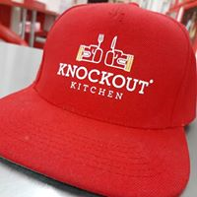
EXECUTIVE SUMMARY
Marketing is refer as creating awareness about product and services offered by company to enhance it sales by building positive relationship with employees (Pike, 2015).
Marketing include conducting market research to identify needs of customer, promoting and selling products by providing value to consumers.
This is based on ”Knockout’’ restaurant which is new restaurant located in UK. This is a family restaurant which serves authentic food with some traditional touch to attract all age group people.

Slide 3
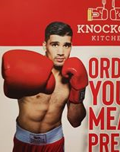
COMPANY OVERVIEW
Marketing is a study which help and manage marketing activities of business. Main motive of marketing is to attract more customer to business product and services. Identifying needs of customers and fulling it is ultimate objective of company.
‘’knockout’’ restaurant is also based on this objective. This restaurant offers high quality and fresh food to customer which is able to serve value to consumer. Atmosphere and ambience of restaurant is very attractive and it is special for sports lover and kids as it also has gaming section within restaurant. This restaurant food prices are not too high. Price of services justify with its quality and speciality to customers.

Slide 4
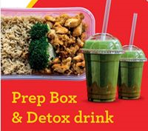
PRODUCT AND SERVICES
PIZZA MEALS
BURGERS FAMILY MEALS
PASTA BUY 3 AND GET 1 FREE
OMELETTE DELIVERY
CHICKEN
VEGETABLES
DETOX JUICES

Slide 5
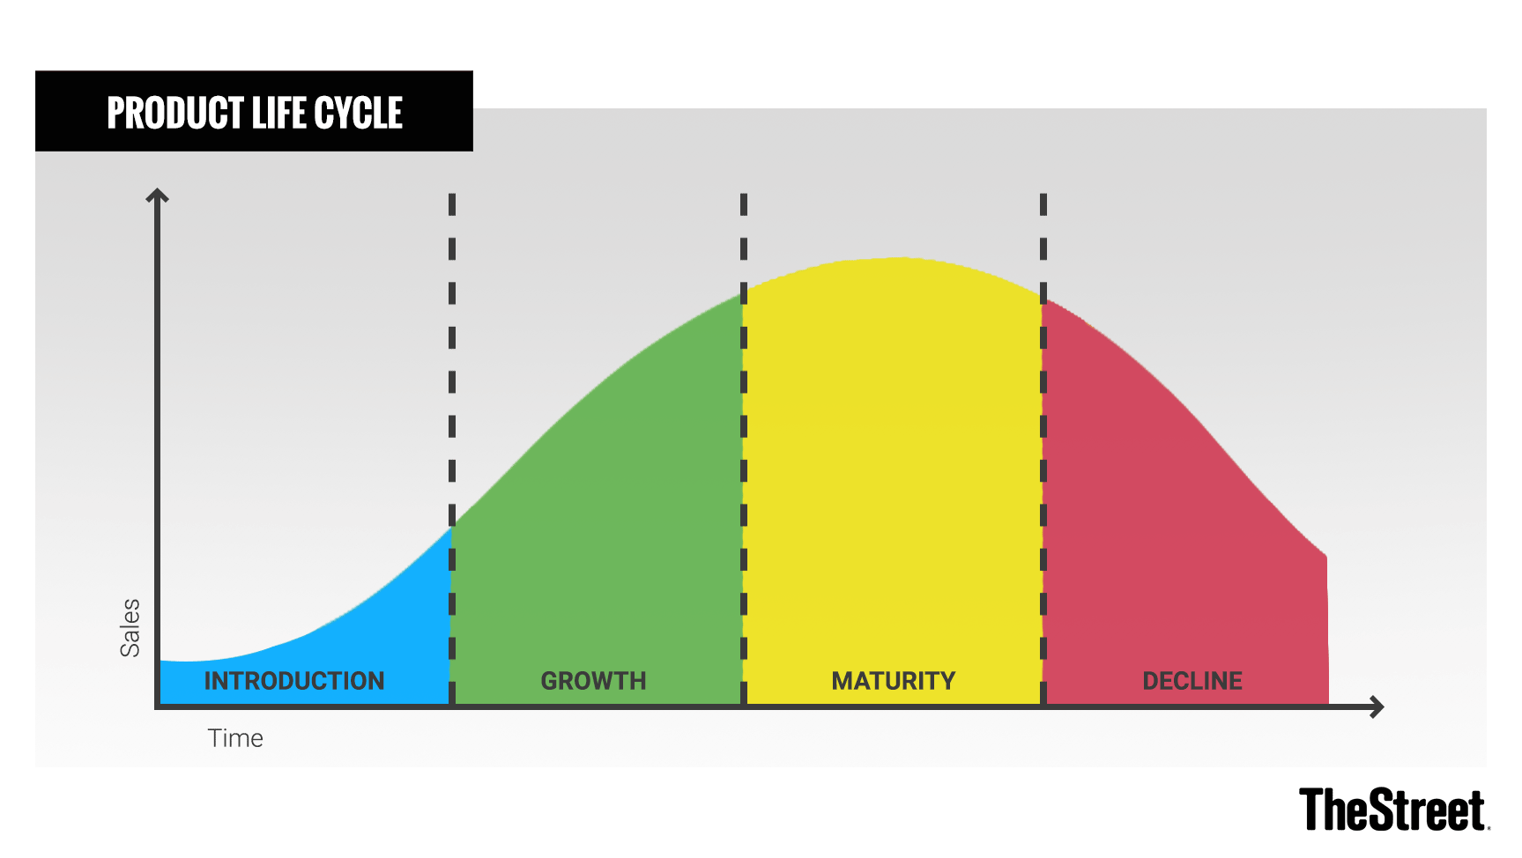
”Knockout”
https://www.google.co.uk/url?sa=i&source=images&cd=&ved=2ahUKEwjAvcb6lvDiAhVC8OAKHaCOD0gQjRx6BAgBEAU&url=https%3A%2F%2Fwww.thestreet.com%2Fmarkets%2Fcommodities%2Fproduct-life-cycle-14882534&psig=AOvVaw2mPLgDWNi0ujDSgem0-sXl&ust=1560849195845165

Slide 6
Environmental audit
To understand market environment in which “Knockout” restaurant is dealing, it is very important to evaluate and analyses internal as well as external environment.
For conducting environmental audit, SWOT can be used for analysing internal environment of “Knockout” and PESTLE for external environment of business.

Slide 7
SWOT
“KNOCKOUT”
STRENGTHS
Fresh and good quality food
Team of restaurant is well qualified, experienced and highly enthusiastic about their work
WEAKNESSES
New restaurant open in market
There is not enough space for large gathering
Marketing team needs to work effectively to overcome this weakness
OPPORTUNITIES
Can add healthier food in menu
Is located in centre place
THREATS
Some rival businesses are offering home delivery and takeaway facilitates to customers
Change in taste of customer is also threat to customer

Slide 8

PESTLE ANALYSES
Political
Political factors will influence Knockout business decisions by various time to time changes in health regulation and tax reforms and BREXIT
Economic
Income, tax rates, interest rate
People will cut out eating outside foods and in restaurants as their first priorities will be to save money
Social
Making decisions according to new trends in society
Knock-out restaurant team needs to identify needs and wants of customers
Technological
Updated technology will help in becoming more productive
Technology factor will help Knockout restaurant to other offer facilities to their customers
Legal
Restaurant have to maintain quality in food products
These rules and regulation are implemented to control provision of food products in market
Environmental
Should use environment friendly way to manage waste
Are more concern with ecology and atmosphere

Slide 9
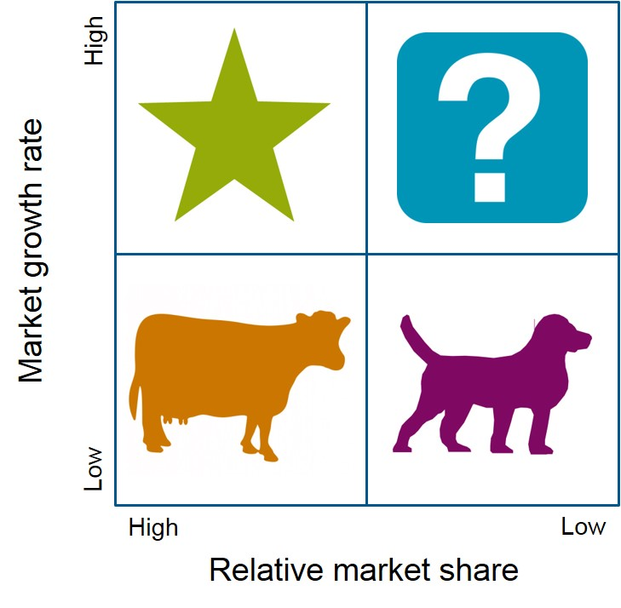
BOSTON CONSULTING GROUP (BCG)
STARS - traditional food are specialities of restaurant and customers purchase this most frequently
Question mark - products or service in this part have high growth prospect
Dogs – these are those items which are neither popular or profitable in comparison to other products for business
Cows – this is those which have high market popularity but does not contribute much in profitability of business

Slide 10

Segmentation and communication mix
Segmentation is a process of dividing market into small parts (Clow and James, 2014). Knockout restaurant have to understand and identify customers needs and divide potential customers of market into sub group according to some set basis.
By dividing market in various segments, it will help deciding most suitable segments and it will also lead to develop profiles of key segments which will be most profitable segment for Knockout.

Slide 11
Segmentation and communication mix
Geographic
These segmentation is bases on geographic boundaries to target customers (Baker and Magnini, 2016)
Demographic
age, gender, family size, income, occupation, religion, race and nationality
Psycho-graphic
Is used to divide market of prospective customers by their personality traits, beliefs, attitudes, interest and other factors (Mueller and et.al, 2015).
Behavioural
This restaurant offers party services to customers which attract customers on their special occasions such as birthday, anniversary etc.

Slide 12
Communication mix
Communication mix can be refer as methods which is used to promote business products to target customers.
“Knockout” have to use various techniques to attract target customers by informing them about restaurant products and serves.

Slide 13

Communication mix
Advertising
Personal selling
Digital marketing
Staff member communication with customer will help in building strong relationship with them and improve convening power.
Print media, radio, paper ads, billboards
Advertisement should include proper details about restaurant.
Internet or online marketing will help in targeting large audience at same time (Carr, 2014)
Email, mobile messages etc.

Slide 14
CONCLUSION
In order to start business in hospitality industry it is very essential to identify marketing environment audit. This will help in understand various internal and external factors which affect marketing and business decisions.
Before targeting any market for new business, it is required to divide market in various segment . Segmentation will help in targeting right audience with right communication mix tool.
Different communication mix strategy has been evaluated for market offering of business. Also BCG matrix help in identifying products and services which are more popular and profitable for business.

Slide 15

REFERENCES
Books and journals
Pike, S., 2015, Destination marketing: essentials, Routledge.
Simkin, L. and Dibb, S., 2013, Marketing essentials, Cengage Learning, EMEA.
Baines, P., Fill, C. and Page, K., 2013, Essentials of marketing, Oxford University Press.
Malhotra, N. K., 2015, Essentials of marketing research: A hands-on orientation. Essex: Pearson.
Campbell, R., Martin, C. and Fabos, B., 2018. Media essentials: A brief introduction. Bedford/ St. Martin’s.
Lane, P., 2016. Human resources marketing and recruiting: essentials of employer branding. Handbook of Human Resources Management, pp. 23-52.
Clow, K. E. and James, K. E., 2014. The marketing research process. Essentials of marketing research: Putting research into practice, pp. 25-61
Baker, M. A. and Magnini, V. P. 2016. The evolution of services marketing, hospitality marketing and building the constituency model for hospitality marketing. International Journal of Contemporary Hospitality Management. 28(8). pp. 1510-1534.
Mueller, J. P., and et. Al., 2015. Community-based livestock breeding programmes: essentials and examples. Journal of Animal Breeding and Genetics. 132(2). pp. 155-168.

Slide 16
De Jong, M., Marston, N. and Roth, E., 2015. The eight essentials of innovation. McKinsey Quarterly. 2. pp. 1-12.
Pike, S. D., 2016. Destination marketing organizations-research opportunities in an era of uncertainty. In Book of Abstracts-6th International Conference on Tourism. International Association for Tourism Policy (IATOUR).
Carr, E. R., 2014. E-cigarettes: facts, perceptions and marketing messages. Clinical journal of oncology nursing. 18(1).
Desai, S. S., 2913. An Analyses of the Competitive Marketing Strategies of the Hospitality Industry in UAE. IUP Journal of Management Research. 12(1).
https://www.facebook.com/knockoutkitchenrochdale/photos/a.161972594145979/812988619044370/?type=3
https://www.facebook.com/knockoutkitchenrochdale/photos/a.161972594145979/903686699974561/?type=3
https://www.google.co.uk/url?sa=i&source=images&cd=&ved=2ahUKEwjAvcb6lvDiAhVC8OAKHaCOD0gQjRx6BAgBEAU&url=https%3A%2F%2Fwww.thestreet.com%2Fmarkets%2Fcommodities%2Fproduct-life-cycle-14882534&psig=AOvVaw2mPLgDWNi0ujDSgem0-sXl&ust=1560849195845165
https://www.google.co.uk/url?sa=i&source=images&cd=&ved=2ahUKEwjFkYiqn_DiAhWF2eAKHcxyAQYQjRx6BAgBEAU&url=https%3A%2F%2Fwww.howandwhat.net%2Fbcg-matrix-how-to-use-bcg-matrix%2F&psig=AOvVaw1cBOuZ4eUsFjXf3Y9fxFEX&ust=1560849998782041
https://www.facebook.com/knockoutkitchenrochdale/photos/a.161972594145979/900290640314167/?type=3

Slide 17

THANK YOU!

