Slide 1
- MODULE NAME: Problem solving and decision making
- MODULE CODE : LCLM4004
- STUDENT NAME : Tedros Alem
- STUDENT ID: 2531435
- LECTURER: Charles Obinwa
- Assignment 1: Presentation

Slide 2
OVERVIEW
Introduction
Company background
Problem nature and scope
PESTLE ANALYSIS: Basil’s Bakery
Cause and effect analysis
Fishbone diagram
Conclusion
References

Slide 3
Introduction
What the presentation is about?
This presentation is identifying and analysing the current problems for Basil’s Bakery.
Definitions of the concepts
Pestle
PESTLE is a strategic business framework used to analyze and monitor the external macro-environmental factors that impact an organization. CIPD (2025)
Fishbone diagram
A fishbone diagram is a visual business tool used to find the root causes of a specific problem. It organizes different causes into clear categories like people, methods, and environment that look like the bones of a fish.it called created by Dr. Kaoru Ishikawa, a famous Japanese professor. BGMC(2024)
W52H
The 5W1H is a questioning approach and a problem-solving method that answers all the basic elements within a problem which are what, who, when, where, why, and how. It aims to view ideas from various perspectives and gain an in-depth understanding of a specific situation. This method is commonly utilized as a continuous process-improvement technique in an organization. Reyes(April 2026)

Slide 4
Company background
Basil’s Bakery
Founded in
Basil’s Bakery was founded in 2015.
Owners
The sole owner of the bakery is Basil.
He is an independent, artisan baker who started the business himself.
Sells
Basil’s Bakery sells cakes, pastries and breads.
Location: A shopping retail park in Coventry, UK.
Unique Selling Point: High-quality, organically grown ingredients

Slide 5
Problem: nature and scope
What (What is the problem?)
Sales dropped: Total sales are 25% lower than they were in 2019.
Higher costs: Bills, rent, and organic ingredient prices are rising quickly.
Why (Why is it happening?)
Fewer visitors: Shops are closing down and fewer people visit the retail park.
Working from home: Office staff only come to the area a few days a week.
Who (Who is affected?)
Basil: He is working too hard, losing money, and stressed about the future.
Loyal customers: People who want to buy bread cannot get delivery or pre-order easily.

Slide 6
Problem: nature and scope
Where (Where is it occurring?)
Inside the shop: Long queues and unanswered phones happen at the bakery counter.
The retail park: The shopping area in Coventry is becoming quiet and empty.
When (When does it happen?)
Since 2020: The problem started in lockdown and sales never recovered.
During lunch hours: Peak busy times cause long waiting times for customers.
How (How does it manifest?)
Missed phone calls: Basil is too busy baking to answer pre-order calls.
Unpredictable budgets: Bad weather causes organic crop failures, making ingredient prices double suddenly.
How Much (How much does it cost?)
25% lost revenue: A quarter of the bakery's historical income is completely gone.
Expensive waste: Basil pays full price for rent and high utilities despite having fewer shoppers.

Slide 7
PESTLE ANALYSIS: Basil’s Bakery
P – Political: Government policies, tax laws, business rates, trading regulations, and political stability.
E – Economic: Inflation, interest rates, economic growth, utility costs, and changes in consumer disposable income.
S – Sociocultural: Shift in consumer lifestyle trends, shopping habits, demographics, and cultural workplace changes (like working from home).
T – Technological: Digital automation, the rise of e-commerce, mobile applications, and on-demand delivery platforms.
L – Legal: Employment laws, health and safety regulations, food safety standards, and consumer protection acts.
E – Environmental: Sustainability, climate change impacts on crop yields, organic sourcing ethics, and carbon footprint regulations.

Slide 8
Cause and effect analysis (Fishbone diagram)
Fishbone Summary: Why Sales Have Decreased
People: Office staff work from home; retail neighbours lost their jobs.
Methods: No delivery service; Basil is too busy baking to answer phones.
Machinery: No online ordering website; long waiting lines drive customers away.
Materials: Organic ingredient prices are unpredictable and rising fast.
Environment( Location): Retail park is quieter as nearby shops close down.
Measurement: Higher bills for energy, rent, and business rates.
BGMC(2024)

Slide 9
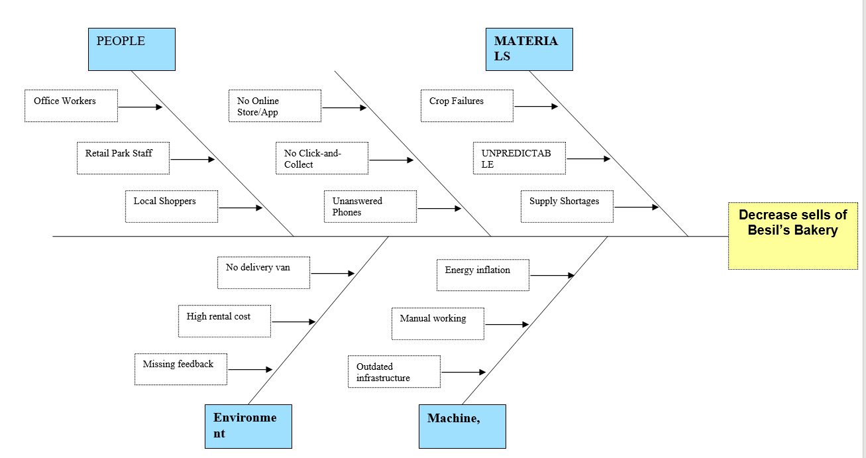
Fishbone diagram Decrease sells of Basil’s Bakery

Slide 10
Conclusion
Lower Sales: Sales are stuck at 25% lower than before 2020 because customer habits changed permanently.
Fewer Shoppers: Local shops are closing down, which means fewer people visit the retail park.
Working from Home: Nearby office workers commute less often, so they buy fewer daily lunches.
Higher Expenses: Rent, energy bills, business rates, and insurance costs have all gone up.
Pricey Ingredients: Sourcing only organic ingredients makes budgeting hard because prices change quickly.
Lost Business: Basil misses out on sales because he cannot offer delivery or handle phone pre-orders.
Outdated Model: The bakery cannot survive long-term if it only relies on walk-in customers at this location.

Slide 11
References
CIPD (2025) PESTLE ANALYSIS Available at: https://www.cipd.org/en/knowledge/factsheets/pestle-analysis-factsheet/ (Accessed: 10 July 2026)
BGMC(2024) Exploring the Fishbone Diagram: Types, Advantages, Drawbacks, and Revealing the Six M ’s of Change Available at: https://bgmcgroup.com/exploring-the-fishbone-diagram-types-advantages-drawbacks-and-revealing-the-six-ms-of-change/ (Accessed: 10 July 2026)
Understanding the Ishikawa Diagram: A Key Tool for Root Cause Analysis https://kaizen.com/insights/ishikawa-diagram-root-cause-analysis/(Accessed: 10 July 2026)
Reyes(April 2026) A Comprehensive Guide to the 5W1H Method :Available at: https://safetyculture.com/topics/5w1h(accessed :12/07/2026)
LCLM4004_PRS_JUNE 2026_A1 PDF /TASK DESCRIPTION/
https://moodle.uwtsd.ac.uk/course/section.php?id=208160 (Accessed: 6 July 2026)

Slide 12

Questions

