Slide 1
Module Name: Electronics I
Module Code: ACDB5002
Lecture – 1
Lecture By,
Mrs. Jenifer Prince Devaraj,
Lecturer - Embedded Electronics,
Faculty of Applied Computing,
UWTSD
Email:j.prince-devaraj@uwtsd.ac.uk

Slide 2
Programme : HN/BEng Embedded Electronic Systems
Module Name : Electronic I
Module Code : ACDB5002
Credits : 20
Level : 5

Slide 3
Electronics I
Assessment Component 1
☐ | Written exam | ☒ | Coursework | ☐ | Practical
Assessment Summary
Mode of assessment | Volume | Weighting
Assignment | 2500 Words | 60%
Activity type | Percentage
Written exam | 0%
Coursework | 60%
Practical | 40%
TOTAL | 100%
Assessment Component 2
☐ | Written exam | ☐ | Coursework | ☒ | Practical
Mode of assessment | Volume | Weighting
Timed Lab exercise | 2 hr timed session | 40%

Slide 4
Essential Books
Horowitz, P. and Hill, W. (2015) The Art of Electronics, 3rd ed Cambridge: Cambridge University Press | ☒
Scherz, P. and, Monk, S. (2016) Practical Electronics for Inventors, New York: McGraw Hill | ☒
Further Books
Embedded Control Handbook – Microchip Technologies http://ww1.microchip.com/downloads/cn/devicedoc/cn_00711a.pdf | ☐
Elektor – Electronics Design Magazine. UWTSD Owen Library. | ☐

Slide 5
LEARNING OUTCOMES
Upon the successful completion of this module, the student should be able to:
- Demonstrate and critically analyze the deployment of discrete components and microcontrollers in the design of functional building blocks and complete circuits.
- Critically analyze and demonstrate an understanding of existing hardware designs and software-based design tools.

Slide 6
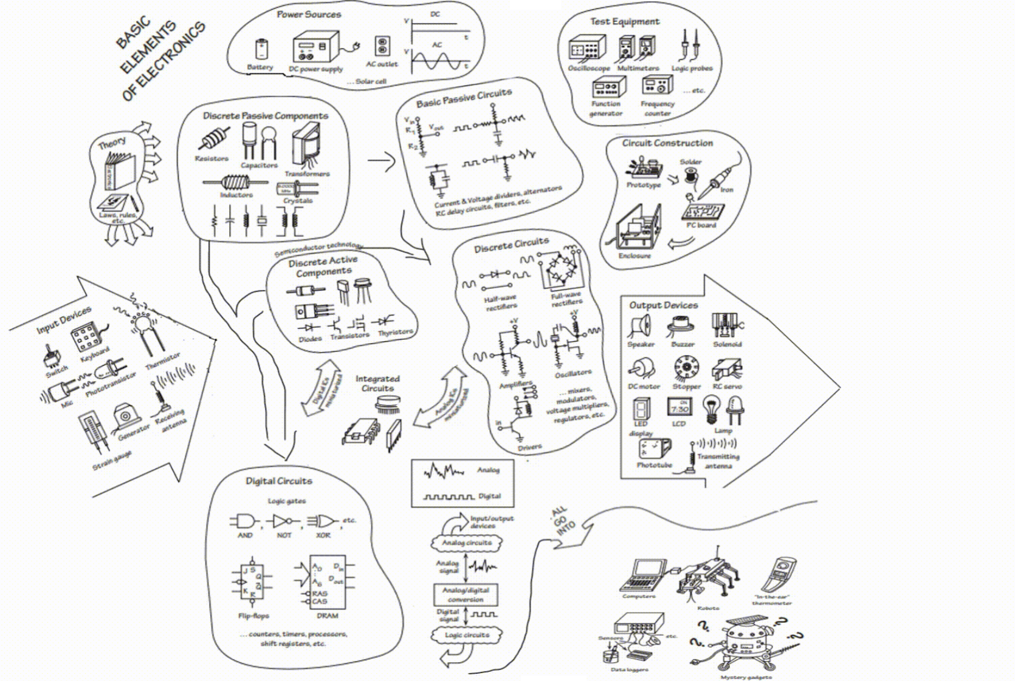
Basic Elements of Electronics

Slide 7
Focused Areas
Power Supplies
Single, Split and multi rail Power Supplies.
SMPS Principles, Buck, Boost Configurations.
Data acquisitions
Interfacing Components – Serial, Parallel , Bus, Cables
Input and Output Devices – Sensors, Switches, LED, Buzzer, etc..
Microcontroller Based Experiments – PIC 16/18f for Practice.

Slide 8
Thank You

