Slide 1

Student Name: Ria Jones
Student ID: 2527082
Lecturer’s Name: Dr Fa Wang
Module Code: LCLM 4004
Module Name: Problem Solving and Decision-Making
Component 1: Basil’s Bakery

Slide 2
Basil’s Bakery Analysis
Good afternoon my name is Ria
In my presentation I will Provide an overview of Basil’s Bakery, the nature and scope of the problems they are encountering
Provide a critique and application of the PESTEL framework.
Provide a critique and application of the Cause-and-Effect model.
And, finally, provide a summary of the key findings.

Slide 3
Overview of Basil’s Bakery
• Independent bakery located on a retail park
• Sells freshly baked organic products
• Previously attracted a loyal customer base
• Recently experiencing declining sales and rising costs
• Customers are requesting delivery and pre-order services
• Basil is concerned about the future viability of the business

Slide 4

Problems Basil’s Bakery Are Facing
Problems Causing Sales Stagnation
Internal Problems (within Basil’s control) | External Problems (outside Basil’s control)
No delivery service available Inefficient pre-order system Unable to answer customer calls consistently Reliance on in-store sales only | More customers working from home Reduced footfall at the retail park Rising utility, rent and insurance costs Increasing cost of organic ingredients Unpredictable supply due to crop failures
Impact on the business:
- Falling customer numbers
- Reduced revenue and profit margin

Slide 5
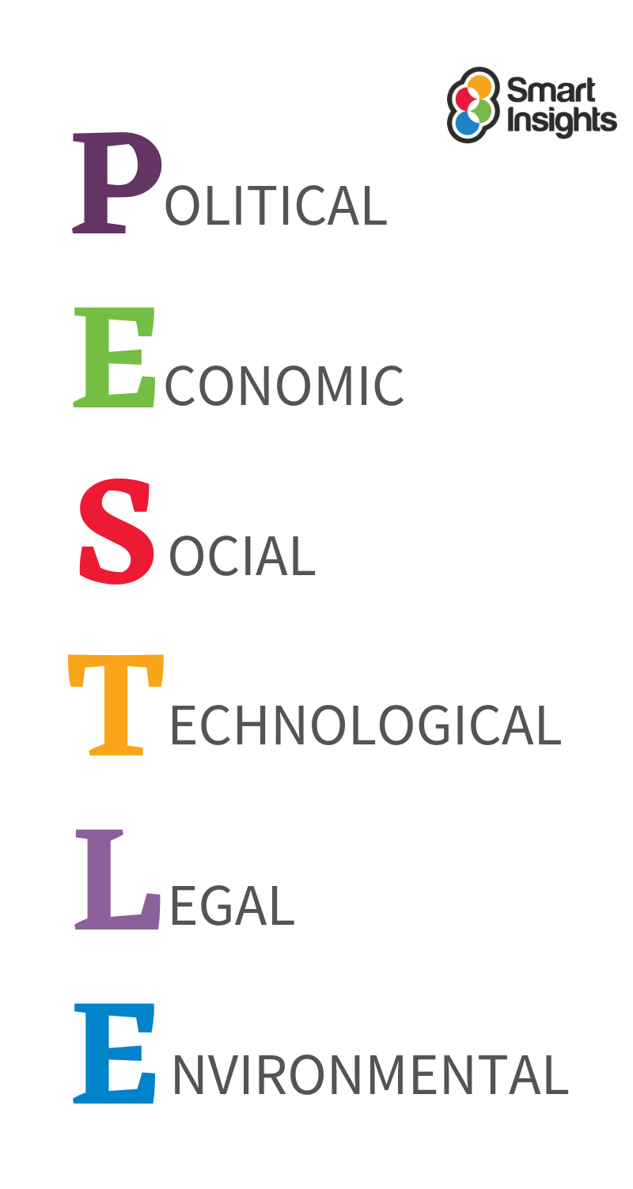
P E S T L E
A pestle framework is a framework of external macro-environmental factors used in strategic management and market research
It is used for business analysis, strategic business planning, workforce planning, marketing planning, product or service development, organisational change and people strategies, reports and projects.
Source: Smart Insights (n.d.)
P- Political
E – Economic
S – Sociological
T – Technological
L – Legal
E – Environment
Benefits: cost-effective, provides an understanding of business, alertness to threats and methods to exploit opportunities. (Makos, n.d)
Criticism of Pestle:
It can’t offer the full picture
Factors change quickly
Simple isn’t always better
Most data isn’t easily found
It eats up all of your time
The risk of mishandling information.

Slide 6
PESTLE Framework
Here is the tabular PESTLE analysis of Olive Tree Bistro.
Political Factors | Economic Factors | Social Factors | Technological Factors | Legal Factors | Environmental Factors
National Living wage increases Government employment policies | Inflation Cost of living crisis | Health conscious consumers Changing dietary requirements | Modern baking equipment Online ordering system. | Food safety regulations Health & Safety Law | Sustainable packaging Reducing food waste
Sources: GOV.UK (2025); ONS (2025; Food Standards Agency (2025)

Slide 7
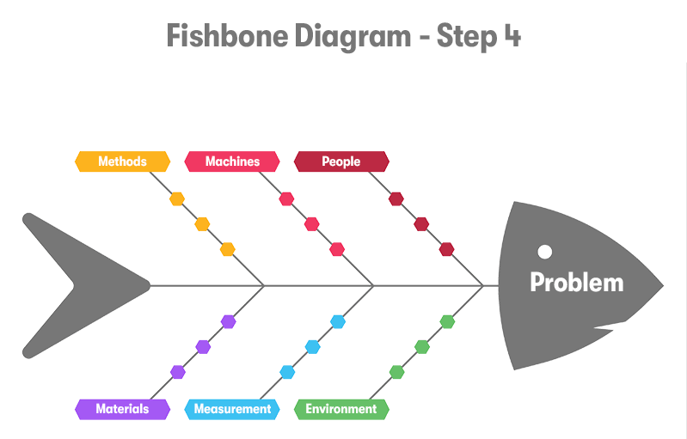
The Cause & Effect Model
The cause-and-effect model also known as the fishbone diagram, is used to identity the root causes of a problem (Ishikawa, 1986)
Why is it used?
It helps businesses identify the factors contributing to a problem
It encourages structured problem- solving
Benefits:
Easy to understand and use
Helps identify root causes rather than symptoms
Encourages teamwork and discussion
Criticisms:
Can oversimplify complex problems
Depends on accurate information being available
Does not provide solutions, only identifies possible causes (BGMC Group,2025)
Application to Basil’s Bakery: The model helped identify key causes of declining sales, including poor marketing, lack of delivery services, rising ingredients costs and increased competition.

Slide 8
Basil’s Bakery Cause & Effect Diagram (Fishbone)
Methods
Machines
People
Poor marketing strategy
Outdated baking machine
Inconsistent service quality
Slow customer service
Equipment breakdowns
Lack of staff training
Root Problem: Declining Sales & Profit’s at Basil’s Bakery
Rising ingredient costs
Poor sales tracking
Increased competition from chains
Supplier issues
Lack of customer feedback analysis
Cost of living crisis
Materials
Measurement
Environment
Sources: Office for National Statistics (2025); Federation of Bakers

Slide 9
Key Findings Within Basils Bakery
    Key Finding 1: Basil’s Bakery is experiencing declining sales due to a combination of internal and external factors affecting business performance.
    Key Finding 2: The PESTLE analysis identified inflation, rising costs, changing consumer preferences and legal requirements as major influences on the bakery.
    Key Finding 3: The cause-and-effect (Fishbone) diagram highlighted root causes including poor marketing, lack of delivery services, staff training issues and rising ingredient costs.
    Key Finding 4: The Bakery could implement online ordering, delivery services and improving operational efficiency could increase sales, customer satisfaction and long-term sustainability.

Slide 10
Reference List:
BGMC Group (2025) Introduction to the Fishbone Diagram. Available at: Exploring the Fishbone Diagram: Types, Advantages, Drawbacks, and Revealing the Six M’s of Change - BGMC GROUP (Accessed: 15th June 2026)
Food Standards Agency (2025) Food safety regulations. Available at: https://www.food.gov.uk (Accessed 14th June 2026).
Federation of Bakers (2025) Representing the UK bread industry. Available at: https://www.fob.uk.com (Accessed Friday 12th June 2026)
Ishikawa, K (1986) Guide to Quality Control 2nd rev.edn. Tokyo: Asian Productivity Organisation
Makos, J (n.d.) Advantages of PESTLE in Analysis in Business Strategic Planning. PESTLE analysis. Available at What is PESTLE Analysis? (Free Template)/ (Accessed Friday 12th June 2026).
Office for National Statistics (2025) Inflation and cost of living. Available at: https://www.ons.gov.uk (Accessed on Friday 12th June 2026)
Smart Insights (n.d.) How to create a PESTLE analysis for marketing planning. Available at: PESTLE Analysis - Smart Insights (Accessed Friday 12th June 2026)

Slide 11


Slide 12


