Slide 1
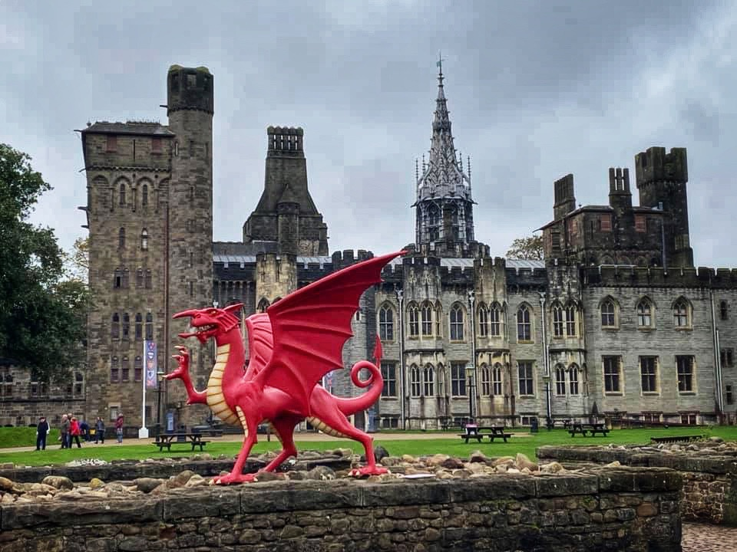

Critically explore an historical event that has significantly had an impact on the education of language in Wales
Kirsty Roberts - 1806117
(www.tripadvisor.com, n.d.)

Slide 2
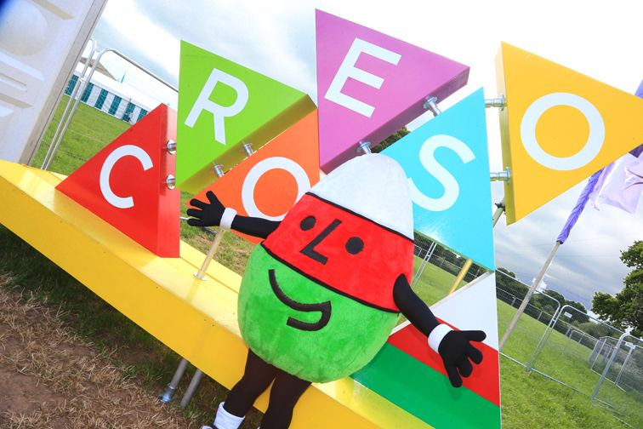
Key Aims
Importance of the Welsh Language
Critically exploring the Welsh Governments policies and procedures within Welsh Education
Identifying the concept of Population and the belonging within the Nation of Wales
Discussing the Urdd Gobaith Cymru
Exploring the historic key events on a timeline for Urdd
Looking at what the Urdd has done throughout of Pembrokeshire on reflection on a working practice
(Gov.Wales,2019)

Slide 3
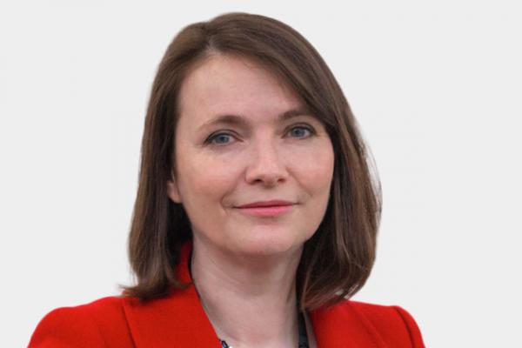
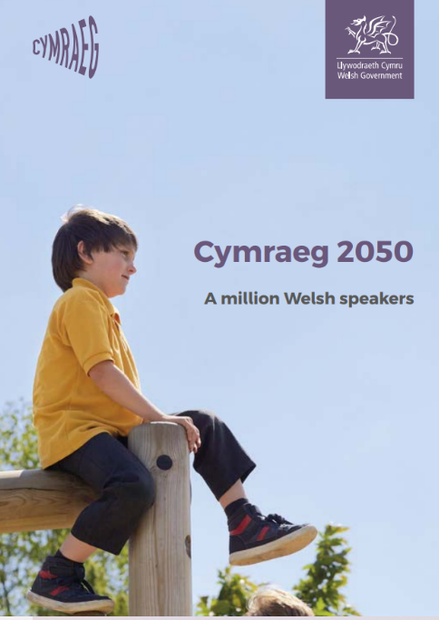
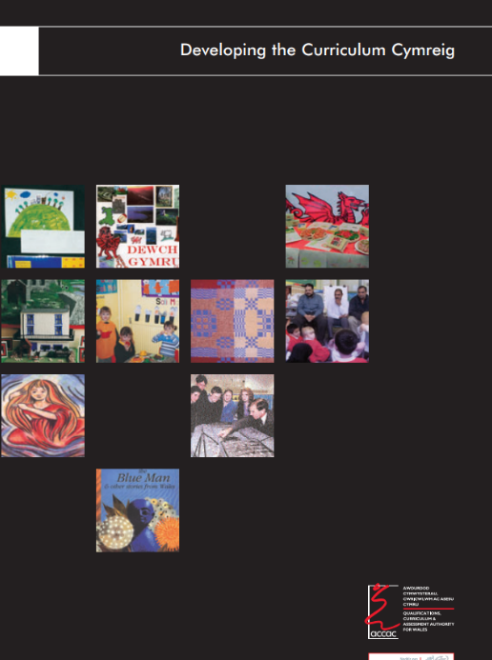
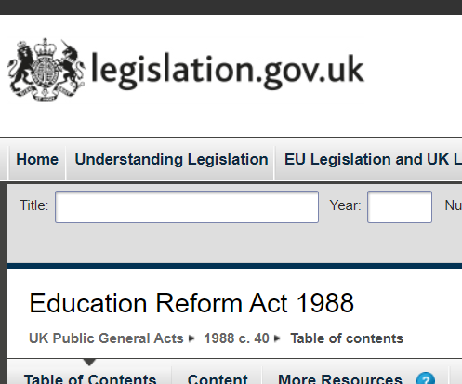
The Welsh Government
“All our young people, from all backgrounds, should come out of the education system ready and proud to use the language in all contexts. It is a matter of equity, and we as ministers and as welsh government must set the direction and provide leadership” -(Welsh Government, 2017-2021)
(Welsh Assembly Government,2003), (Welsh Government,2017a), (Welsh Government,2017b), (The National Archives,2020)

Slide 4
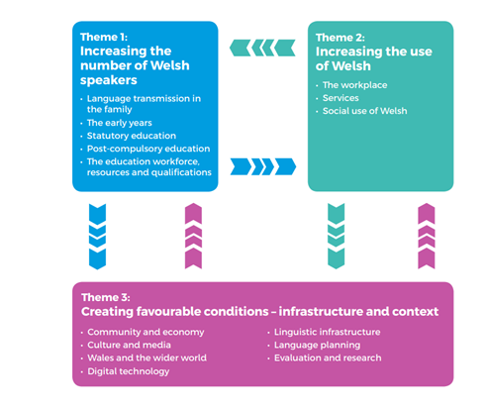
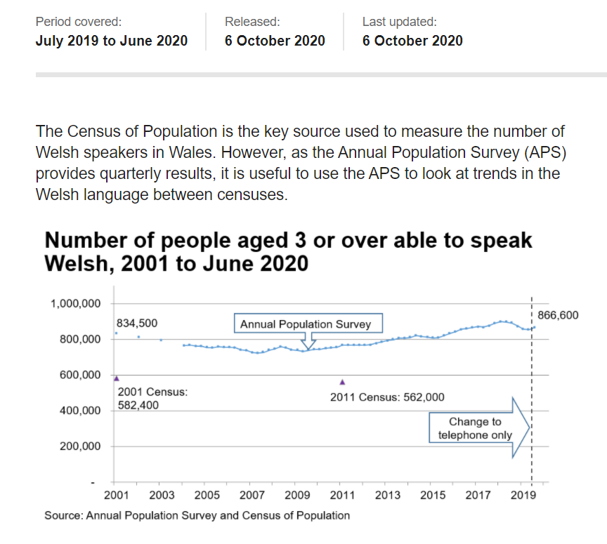
The Three Strategy Plan
The Population of Welsh Speakers
(Walters,2020),(Welsh Government,2017b)

Slide 5
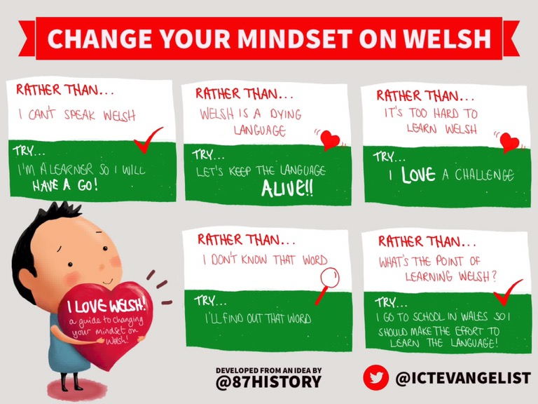
“The ability to speak, read and write in two languages. In Wales, bilingualism relates to Welsh and English, as the official languages of Wales. When we inspect bilingualism, we look at learners’ achievement in Welsh and English and the extent to which providers promote and develop learners’ bilingual skills” - (Estyn,2017)
(Estyn,2017), (Jones,2016)

Slide 6
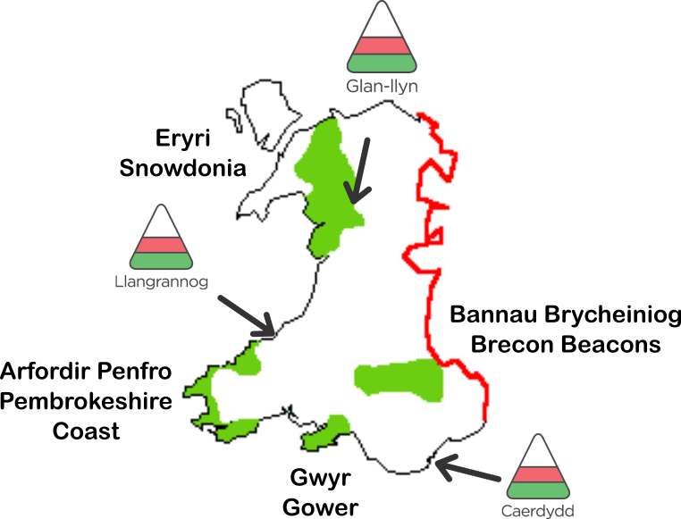
Urdd Gobaith Cymraeg
The Urdd is a National Voluntary Youth Organisation across Wales for children and young people between the age of 8-25 years old.
It enhances children to develop personal and social skills which enable them to make a positive approach within their community. It provides a positive approach to the Welsh Language within their culture.
Urdd states that it has had an impact on children’s mental health over the years and that it helps with their confidence.
They do lots of activities and competitions across Wales. They also offer weekday breaks to invite children in Schools to be a member of the Urdd.
(Urdd Gobaith Cymru,2020), (Urdd Gobaith Cymru,1992b)

Slide 7

The History of Urdd
1922- The Urdd was established.
1928 – Corwen attended a meeting for the Eisteddfod to be funded by the Urdd.
1935 – The most memorable Eisteddfod was held in Carmarthen.
1932- Sir Ifan made a permanent camp called Llangrannog.
1950-There was a new camp established in Snowdonia called Glan-llyn.
1927- Sir Ifan’s idea was to bring children from Wales together in a residential centre.
(Urdd Gobaith Cymru,1992b)

Slide 8
The History of Urdd
1980’s- The Eisteddfod became popular and it turned into a musical and theoretical festival for six days.
1957- There was a magazine called ‘Cymraeg’ established for Welsh Learners.
1970’s – The Urdd held the eisteddfod for four days instead of three days.
1976- Mistar Urdd was born in September and It was a popular attraction.
1983 – A funfair was added to the Eisteddfod for all the children.
1962- The Urdd started supporting modern Welsh literature by selling Welsh books to the public.
(Urdd Gobaith Cymru,1992b)

Slide 9
The History of Urdd
1990’s – The Urdd had three popular children’s magazines with clips, news, posters, puzzles and competitions.
2005 – In Cardiff Millennium Centre The Urdd Youth Theatre company performed Les Misérables on stage.
1997- To celebrate their 75th anniversary they held a big jamboree in Cardiff.
1995- The Urdd worked closely with UNICEF to celebrate the fiftieth anniversary of The League of Nations.
2000’s- They made new facilities for Llangrannog to become bigger and to accommodate more children.
2007 –A partnership was formed between the Urdd and S4C to promote poetry to young people.
(Urdd Gobaith Cymru,1992b)

Slide 10
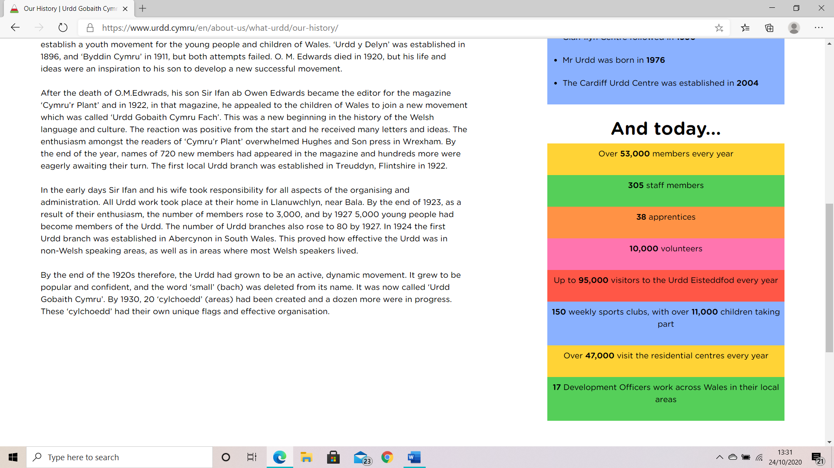

The Future of Urdd
In 2022 they celebrate their 100th Birthday
(Urdd Gobaith Cymru,1992a)

Slide 11
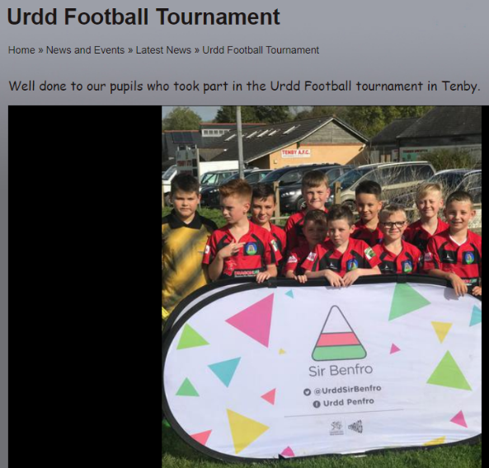
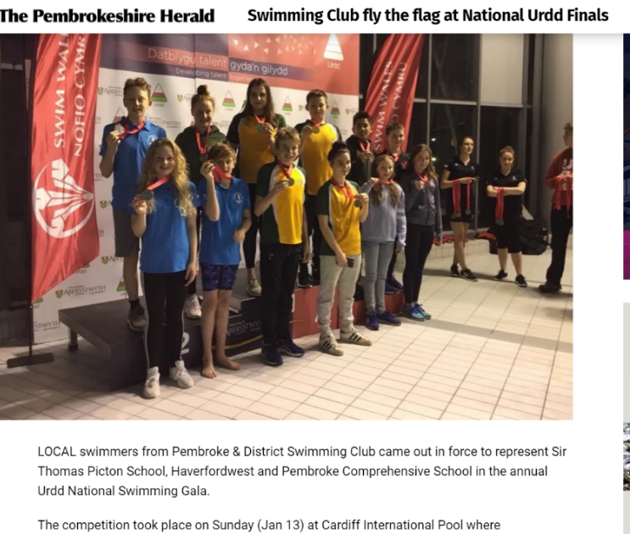
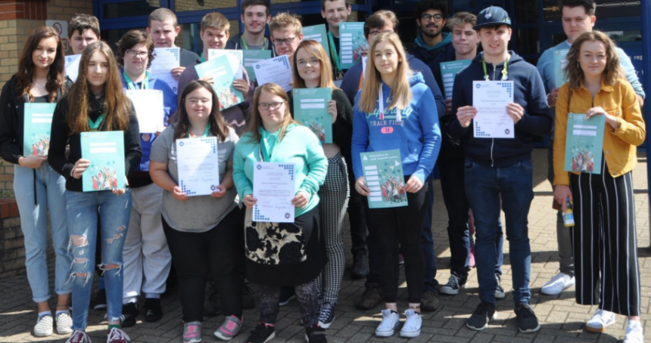
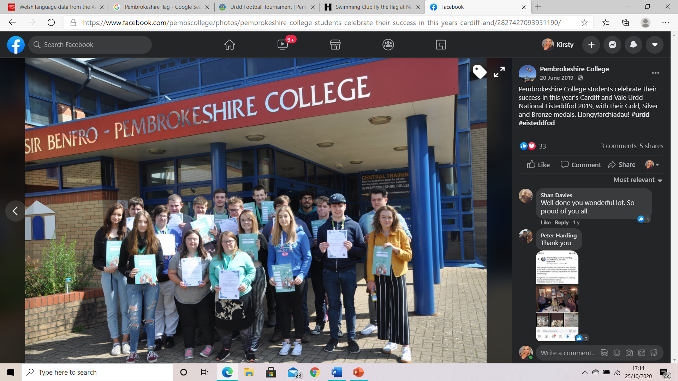
Llangrannog and The Urdd Community in Pembrokeshire
Throughout of Pembrokeshire there have been many rewards with Urdd.
Pembroke swimming club flew the flag for the Urdd national finals.
Many local schools have been involved in football tournaments .
Pembrokeshire College have been in many competitions from the Urdd which was for Art and Design, Textiles and Dancing.
(The Pembrokeshire Herald,2018), (Pembroke Dock Community School,2019), (Facebook-Pembrokeshire College,2019)

Slide 12
Reference list
Estyn (2017). Welsh-medium and bilingual teaching and learning in further education. [online] Estyn.gov.wales, Cardiff: Estyn, pp.1–23. Available at: https://www.estyn.gov.wales/system/files/2020-07/Bilingual%2520Teaching%2520in%2520FE.pdf [Accessed 30 Oct. 2020].
Facebook - Pembrokeshire College (2019). Pembrokeshire College. [online] www.facebook.com. Available at: https://www.facebook.com/pembscollege/posts/great-urdd-newscongratulations-to-our-students-who-competed-and-won-in-the-creat/2783912078302692/ [Accessed 30 Oct. 2020].
Jones, K. (2016). Developing and promoting bilingualism in Wales. Teaching. Available at: https://lovetoteach87.com/2016/07/24/developing-and-promoting-bilingualism-in-wales/ [Accessed 2020 Oct. 2020].
Office for National Statistics (2011). 2011 Census analysis - Office for National Statistics. [online] www.ons.gov.uk. Available at: https://www.ons.gov.uk/peoplepopulationandcommunity/culturalidentity/ethnicity/articles/whatdoesthe2011censustellusaboutthecharacteristicsofgypsyoririshtravellersinenglandandwales/2014-01-21#:~:text=In%20the%202011%20Census%2C%20respondents [Accessed 30 Oct. 2020].
Pembroke Dock Community School (2019). Urdd Football Tournament | Pembroke Dock Community School. [online] www.pembrokedockcommunityschool.co.uk. Available at: https://www.pembrokedockcommunityschool.co.uk/news/detail/urdd-football-tournament/ [Accessed 30 Oct. 2020].
The National Archives (2020). Education Reform Act 1988. [online] Legislation.gov.uk. Available at: https://www.legislation.gov.uk/ukpga/1988/40/contents [Accessed 25 Oct. 2020].
The Pembrokeshire Herald (2018). Swimming Club fly the flag at National Urdd Finals. [online] The Pembrokeshire Herald. Available at: http://pembrokeshire-herald.com/41967/swimming-club-fly-flag-national-urdd-finals/ [Accessed 30 Oct. 2020].

Slide 13
Tripadvisor (2019). Welsh dragon in Cardiff Castle - Picture of Cardiff Castle Connoisseur Tour - Tripadvisor. [online] www.tripadvisor.com. Available at: https://www.tripadvisor.com/LocationPhotoDirectLink-g186460-d12561855-i430052147-Cardiff_Castle_Connoisseur_Tour-Cardiff_South_Wales_Wales.html [Accessed 30 Oct. 2020].
Urdd Gobaith Cymru (1992a). Urdd Gobaith Cymru / Hafan. [online] www.urdd.cymru. Available at: https://www.urdd.cymru/cy/ [Accessed 25 Oct. 2020].
Urdd Gobaith Cymru (1992b). Urdd Gobaith Cymru / Our History. [online] www.urdd.cymru. Available at: https://www.urdd.cymru/en/about-us/what-urdd/our-history/ [Accessed 30 Oct. 2020].
Urdd Gobaith Cymru (2020). Urdd Gobaith Cymru / Cardiff. [online] www.urdd.cymru. Available at: https://www.urdd.cymru/en/residential-centres/cardiff/ [Accessed 30 Oct. 2020].
Walters, L. (2020). Welsh language data from the Annual Population Survey: July 2019 to June 2020. [online] Gov.Wales. Available at: https://gov.wales/welsh-language-data-annual-population-survey-july-2019-june-2020#:~:text=For%20the%20year%20ending%2030 [Accessed 30 Oct. 2020].
Welsh Assembly Government (2003). Developing the Curriculum Cymreig. [online] Hwb.gov.wales, Cardiff: ACCAC Publications, pp.2–14. Available at: https://hwb.gov.wales/api/storage/8e68e2f5-851f-43b8-af24-9eb38cf62482/developing-the-curriculum-cymreig.pdf [Accessed 30 Oct. 2020].
Welsh Government (2017a). Cymraeg 2050 A million Welsh speakers. [online] Cymraeg 2050 : A million Welsh speakers, Cathays Park, Cardiff: Welsh Language Division, pp.4–13. Available at: https://gov.wales/sites/default/files/publications/2018-12/cymraeg-2050-welsh-language-strategy.pdf [Accessed 25 Oct. 2020].
Welsh Government (2017b). Welsh in Education : Action Plan 2017-2021. [online] Gov.wales. Available at: https://gov.wales/sites/default/files/publications/2018-02/welsh-in-education-action-plan-2017-21.pdf [Accessed 25 Oct. 2020].

