Slide 1
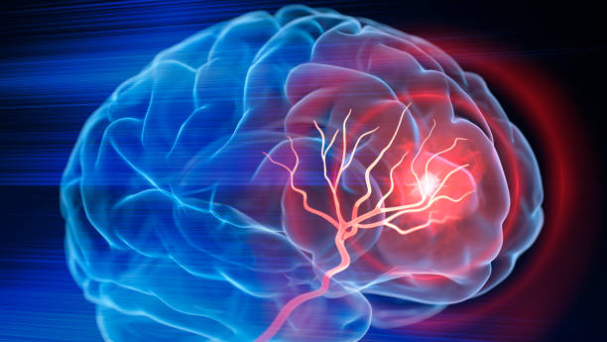
Neurology in relation to Posttraumatic stress disorder (PTSD)
Harry Foster

Slide 2
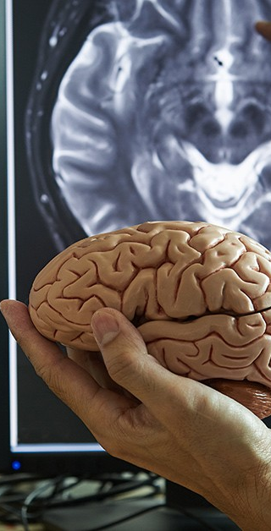
Modern History of neurology in ptsd
Introduction of DSM III (1980) – controversial acknowledgement of criteria A being any stressor evoking symptoms of PTSD.
Blanchard (1982)- Comparison of Vietnam Veterans with PTSD to gender/ sex matched individuals to SR reactions. Physiological measures include (Increased HR, SBP, DBP) – resulting in link to NORADRENERGIC (NA) SYSTEM (Blanchard., et al. 1998)
DSM V (2013) – Criteria A categorised by a feeling of immanent death, terror, pain, helplessness from a specific event. Removing any debate of victims suffering from vicarious experiences (Marx, B P., et al. 2023)
Use of MRI to treat PTSD – MRI scans are now heavily used to understand the alterations and volumes of affected brain areas (hippocampus, amygdala, frontal cortex) Assessing volumes gives us a deeper understanding of brain activity associated to PTSD symptoms (Bremner. 2007)

Slide 3

HPA = Hypothalamic Pituitary Adrenal
LC = Locus Coeruleus(NE)
NA = Noradrenergic System
NE = Norepinephrine
dl PFC = Dorsal Lateral Prefrontal Cortex
vm PFC = Ventromedial Preffrontal Cortex

Slide 4
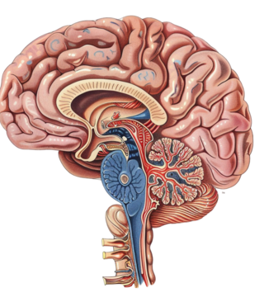
Impacted areas of the brain
(Shin, L M. 2006)
HIPPOCAMPUS
ROLE: Memory processing & encoding
IMPACT: Stress hormone release & hippocampal decrease
AMYGDALA
ROLE: Reaction to threat related stimuli
IMPACT: Reinforcement of cues can lead to hyperactivity
FRONTAL CORTEX
ROLE: Fear conditioning & extinction learning
IMPACT: Damage can lead to inability to extinct learning
INSULA
ROLE: Emotional control centre when reacting to a stimulus
IMPACT: Decreased activity can result in dysregulated endocrine system. Resulting in physiological reactions (heart rate creating anxiety)

Slide 5
Impacted areas of the brain
NORADRENERGIC (NA) SYSTEM
ROLE: Neurotransmitter signals to muscles as “fight or flight” reaction
IMPACT: Physiological reactions to combat stressors.
LOCUS COERULEUS (LC)
ROLE: Sends response to NE to enhance sensories, alertness, and motor response.
IMPACT: Physical reaction to combat stressors
HYPOTHALAMUS PITUITARY ADRENAL AXIS (HPA)
ROLE: Release of hormones to regulate physiological stressors. Including GR, CRH.
IMPACT: Irregular release of hormones can lead to a number of physio and genentic issues and provide negative feedback to the axis.

Slide 6
HOW DO THEY ALL LINK?
Cue can be verbal or visual to prompt reaction
Cue will promote encoded memories that may have similar properties
Fight or Flight mechanism triggered.
Send response to physiological areas.
Stimulus Cue
Hippocampus/ amygdala activity
NA System
HPA Axis
Send this response to related physical areas
Activity is heightened/ lessoned in combat stressors
Stressors can negatively affect the body causing sickness
PFC will encode this reaction to heighten future response.
LC Reaction
Insula Activity
Endocrine system
(vm)PFC

Slide 7

PTSD Testing methods
DSM IV/V: Set criteria on different types of PTSD dependent on situation. Categorised the individual experience of what ‘trauma is’
MET: Treatment designed to enhance the engagement of those not actively seeking treatment but acknowledge they may need it.
MRI/fMRI: Brain scanning of affected areas understanding volume and reaction.
Combat Exposure Scale: Series of scenarios in combat environment to understand reation to combat affected soldiers.
Empathy Quotient: Measurement of empathy shown by those affected by PTSD
CES: (Keane, T M., Et al. 1989)
MET: (Kaysen, D., Et al. 2022)

Slide 8
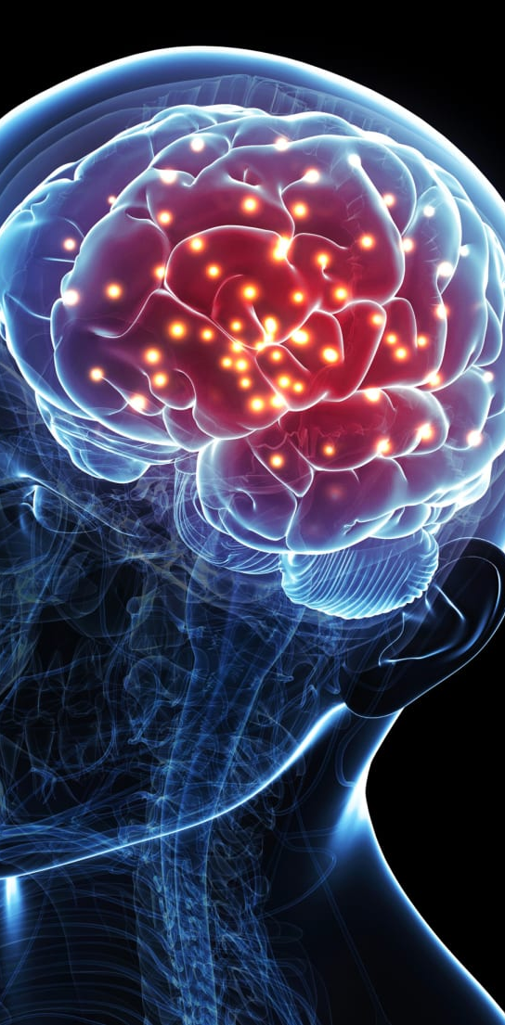
A breakdown of memory in relation to ptsd
NE activation leads to emotional arousal impacting memory and suggesting forms of memory impairment through the amygdala (Xiang – Hui, L., et al. 2019)
Closely linked to flashbacks as episodic memory can link to vivid emotions, time, and place of an event. Stimulus can prompt retrieval of episodic memory. (Zlomuzica, A., et al. 2017)
NE Influence
Episodic Memory
Those who may be suffering from PTSD would avoid re-experiencing events which may lead to the failure to encode new information. Failure to encode information can cause defects to hippocampal functions. (Choudhar, T., et al. 2023)
Inhibited attention and emotional responses due to distracting triggers. Reduced attention can result in the inability to retain information and processes. (Schweizer, S., & Dalgleish, T. 2016)
Declarative Memory
Working Memory

Slide 9

Vietnam twin study
(Bremer, j, Et al,. 2020)
STUDY: looking at a pair of twins where one was sent to Vietnam and the other did not.
Want to understand Hippocampal volume to associate social and environmental factors
METHOD: ‘Combat Exposure Scale’ & MRI. – Understand activity in stimulus reaction.
RESULT: 11% less in right hippocampal volume & 3% less in left.
Testing on monozygotic (Identical) twins highlights shows accuracy of environmental factors influencing brain activity
THEORY: Results not significant enough to prove empirical relation of environmental factors attributing to hippocampal volume

Slide 10

Italy earthquake
(Mazza M, Et al,. 2014)
STUDY: looking at levels of cognitive & emotional empathy in PTSD victims in comparison to those with no PTSD
METHOD: Empathy Quotent, MET, fMRI – Understand competence by looking measuring arousal and brain activity in reaction to picture presentation.
RESULT: Cognitive = No Difference
    Emotional = Impairment
Increased activity in MFG, Left IFG, Left Palliclum, Right Interior Insula.
THEORY: Reduced frontal lobe and increased limbic area is in correlation as a coping strategy to protect oneself from traumatic re-experience
Low arousal is in place to prevent overwhelming sensations.
PTSD experienced individuals are mainly impacted by emotional empathy.

Slide 11
ATTITUDE CHANGES TO PTSD AFTER INTRODUCTION TO NEUROSCIENCE
Clinical evidence of brain activity in association to PTSD
Measurable on improvement/ regression for treatment of PTSD
Understanding on brain function to PTSD is still limited. Interconnections and modifications to brain activity is difficult to study
Individual differences, environmental/ social factors, pre-existing conditions may hinder studies
Change to DSM criteria became an issue as everybody perceives trauma differently and considered immeasurable as a scale.

Slide 12
Neurology in relation to Posttraumatic stress disorder (PTSD)
Harry Foster

Slide 13
Picture References
BIS Research. 2022. 5 Brain Imaging Technologies That Neurologists are Excited About. https://www.linkedin.com/pulse/5-brain-imaging-technologies-neurologists-excited-bis-research/
Houser, K. 2017. Brain implant boosts memory for first time ever. https://www.nbcnews.com/mach/science/brain-implant-boosts-memory-first-time-ever-ncna821016
Mercyhealth. 2018. At What Level of Stress Do I Need to See a Doctor? https://blog.mercy.com/when-to-see-a-doctor-for-stress-anxiety/
PNGTree. Cross Section Human Brain Detail Flowers Free PNG and Clipart.

Slide 14
References
Blades, R. 2020. The Role of the Insula in Classical and Dissociative PTSD: A Double Case Study. https://doi.org/10.1080/13554794.2021.1978502
Blanchard., et al. 1998. Utility of Psychophysiological Measurement in the Diagnosis of Posttraumatic Stress Disorder: Results From a Department of Veterans Affairs Cooperative Study. DOI: 10.1037/0022-006X.66.6.914
Bremner, J. 2007. Neuroimaging in Posttraumatic Stress Disorder and Other Stress-related Disorders. doi: 10.1016/j.nic.2007.07.003
Bremner, J., et al. 2020. The environment contributes more than genetics to smaller hippocampal volume in Posttraumatic Stress Disorder (PTSD). https://doi.org/10.1016/j.jpsychires.2020.10.042
Choudhary, T., et al. 2023. Effect of transcutaneous cervical vagus nerve stimulation on declarative and working memory in patients with Posttraumatic Stress Disorder (PTSD): A pilot study. https://doi.org/10.1016/j.jad.2023.07.025
Kayson, D., et al. 2022. Development of Stress Check: A telehealth motivational enhancement therapy to improve voluntary engagement for PTSD treatment among active-duty service members. https://doi.org/10.1016/j.cct.2022.106841
Keane, T M., et al. 1989. Combat Exposure Scale. https://doi.org/10.1037/t03749-000
Marx, B p., et al. 2023. The PTSD Criterion A debate: A brief history, current status, and recommendations for moving forward. https://doi.org/10.1002/jts.23007
Mazza, M., Et al. 2014 Neural activity related to cognitive and emotional empathy in post-traumatic stress disorder DOI: 10.1016/j.bbr.2014.12.049
McNally, R J. 2009. Can we fix PTSD in DSM-V? DOI: 10.1002/da.20586
Mehta, D and Binder, E B. 2011. Gene × environment vulnerability factors for PTSD: The HPA-axis. https://doi.org/10.1016/j.neuropharm.2011.03.009
Naegeli, C., et al. 2017. Locus Coeruleus Activity Mediates Hyperresponsiveness in Posttraumatic Stress Disorder. https://doi.org/10.1016/j.biopsych.2017.08.021
Schweizer, S., and Dalgleish, T. 2016. The Impact of Affective Contexts on Working Memory Capacity in Healthy Populations and in Individuals With PTSD. DOI: 10.1037/emo0000072
Shin, L M. 2006. Amygdala, Medial Prefrontal Cortex, and Hippocampal Function in PTSD. https://doi.org/10.1196/annals.1364.007
Xiang-Hui, L., et al. 2019. Norepinephrine Induces PTSD-Like Memory Impairments via Regulation of the β-Adrenoceptor-cAMP/PKA and CaMK II/PKC Systems in the Basolateral Amygdala. DOI:10.3389/fnbeh.2019.00043
Zlomuzica, A., et al. 2017. Deficits in episodic memory and mental time travel in patients with post-traumatic stress disorder. https://doi.org/10.1016/j.pnpbp.2017.12.014

Slide 15
AI Acknowledgements
I can confirm that AI of any kind has not been used within this presentation.

