Slide 1
TECHNOLOGY ‘B’
Constructional Designs and Techniques Applicable to medium to high-rise buildings:-
Structural Frames
Building Envelopes
Structural Floors
Material Selection
The drive towards the production of intelligent buildings:-
Flexibility of Design
Suspended ceiling systems, raised floors & demountable partitioning
Services Provision
Sustainability & building ecology
The concept of buildability
Building Refurbishment
Safe methods of working

Slide 2
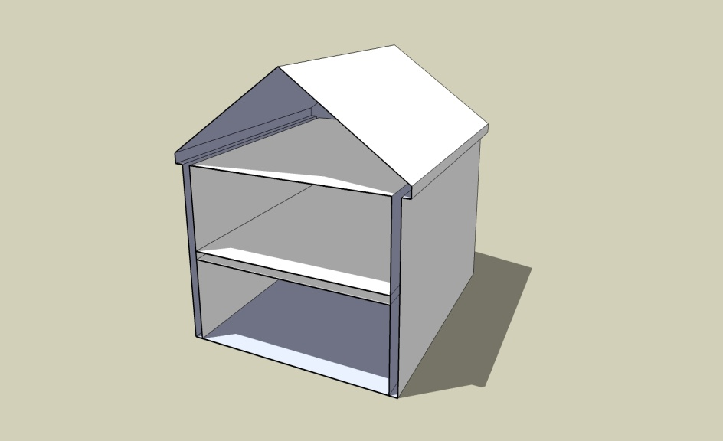
Functional Requirements of the Building Fabric

Slide 3
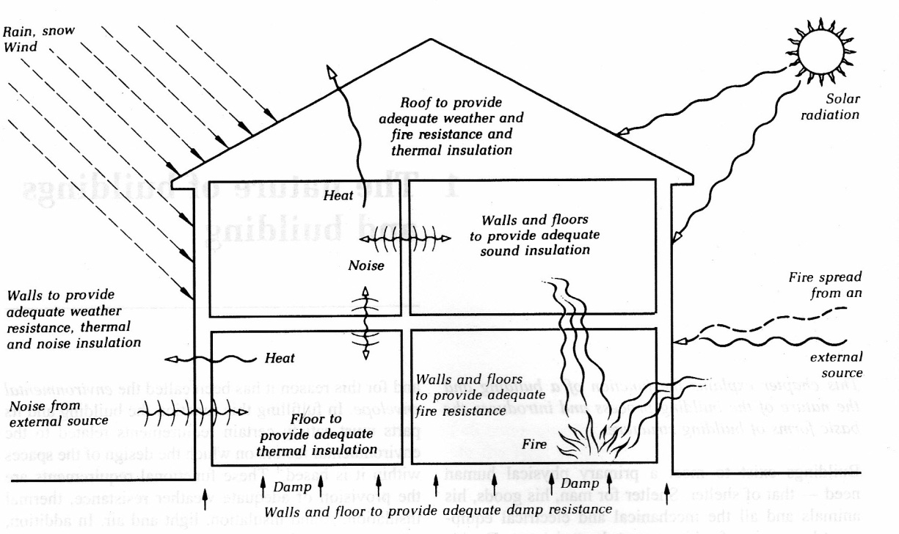
Functional Requirements of the Building Fabric

Slide 4
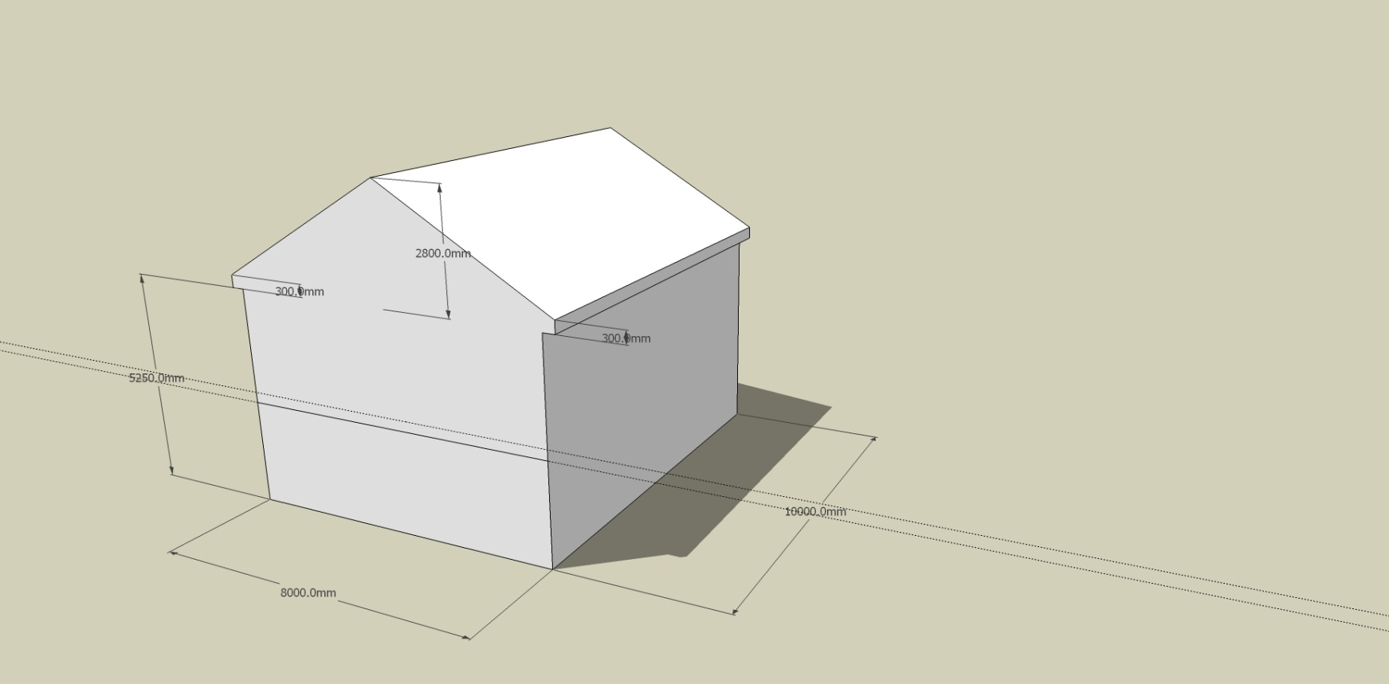
Functional Requirements of the Building Fabric

Slide 5
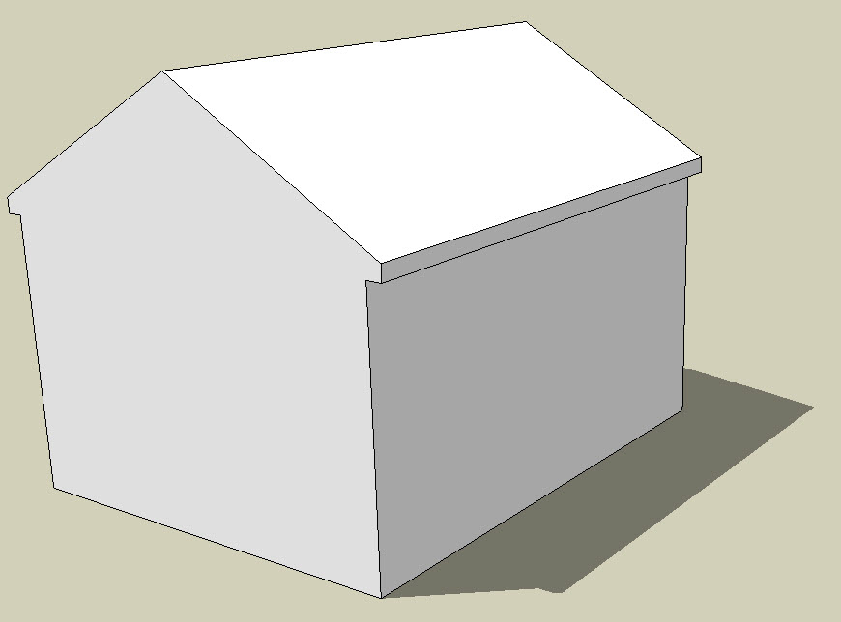
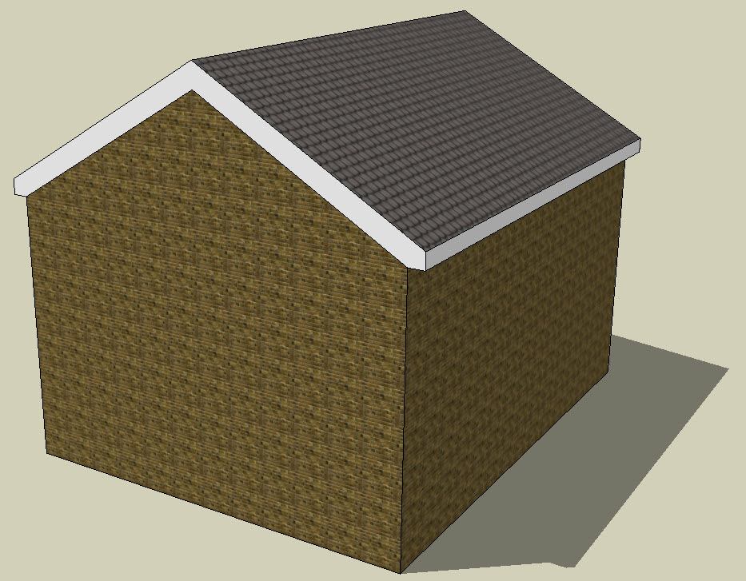
Functional Requirements of the Building Fabric

Slide 6
Structural Concepts
The building fabric must be of such nature that it can withstand, safely, all the forces to which the building is subjected.
Therefore it must be developed as a structure.
Throughout history, buildings vary widely in form and appearance but all have developed from 3 basic types of structures:-
Skeletal
Space Enclosure
Solid Structure

Slide 7
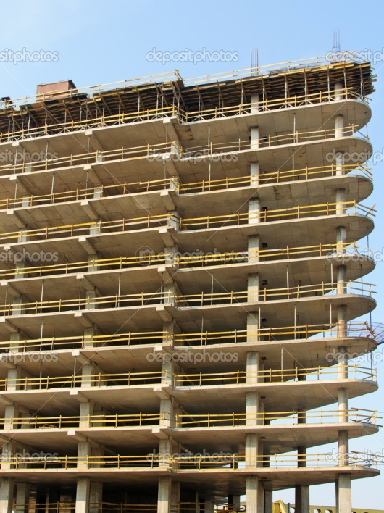
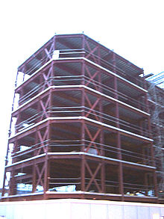
Structural Concepts
Skeletal Structure
  As the name suggests, this consists essentially of a skeleton or framework which supports all of the loads and resists all the forces acting upon it, and through which all loads are transferred to the ground on which the building rests.
  This type of structure has a framework which consists of, essentially, pairs of uprights supporting some form of spanning member. These are spaced apart and tied together by longitudinal members to form the volume of the building.
  Other forms of skeletal structure are the frameworks or lattices of interconnected members known as grid structures.

Slide 8
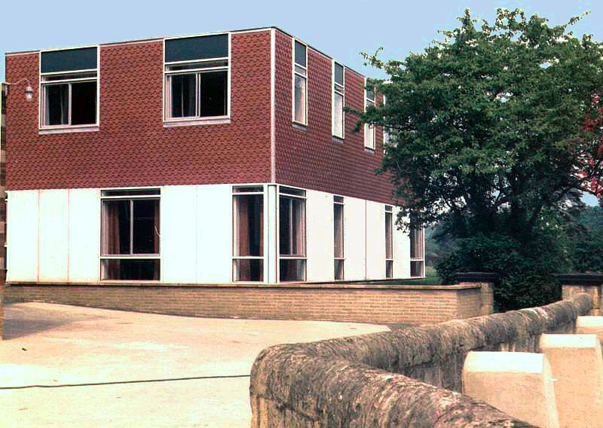
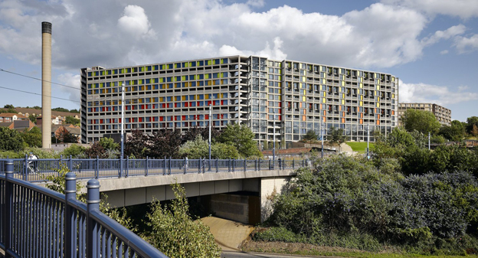
Structural Concepts
Space Enclosure
  By its very nature the skeletal structure cannot enclose the space within its envelope.
  The space enclosure element can be made very light and thin and is not fixed in its position relative to the skeletal frame – it may be placed outside or inside the frame or may fit into the panels of the frame as often seen in contemporary steel or concrete structures.

Slide 9

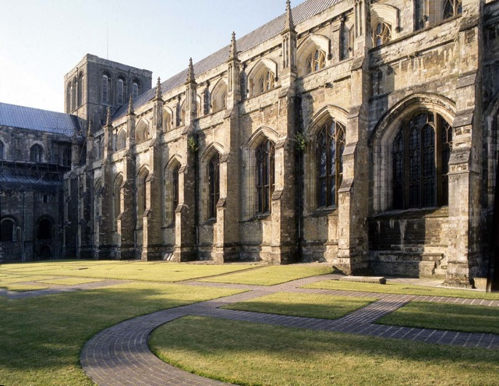
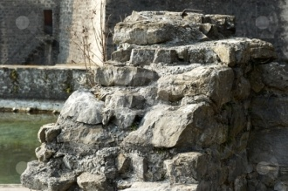
Structural Concepts
Solid Structure
  In this form of structure the wall acts as both the enclosure and supporting element.
  It falls, therefore, within the category of loadbearing wall structures.
  This is an inclusive term implying a structure in which all loads are transmitted to the ground through the walls.
  The characteristic of this type is a wall of substantial thickness and the manner in which they are used, such as in masonry and mass concrete work.
  Solid construction in the form of brick and stone wall buildings has been used over the centuries and is still a valid and economic type of construction.

Slide 10
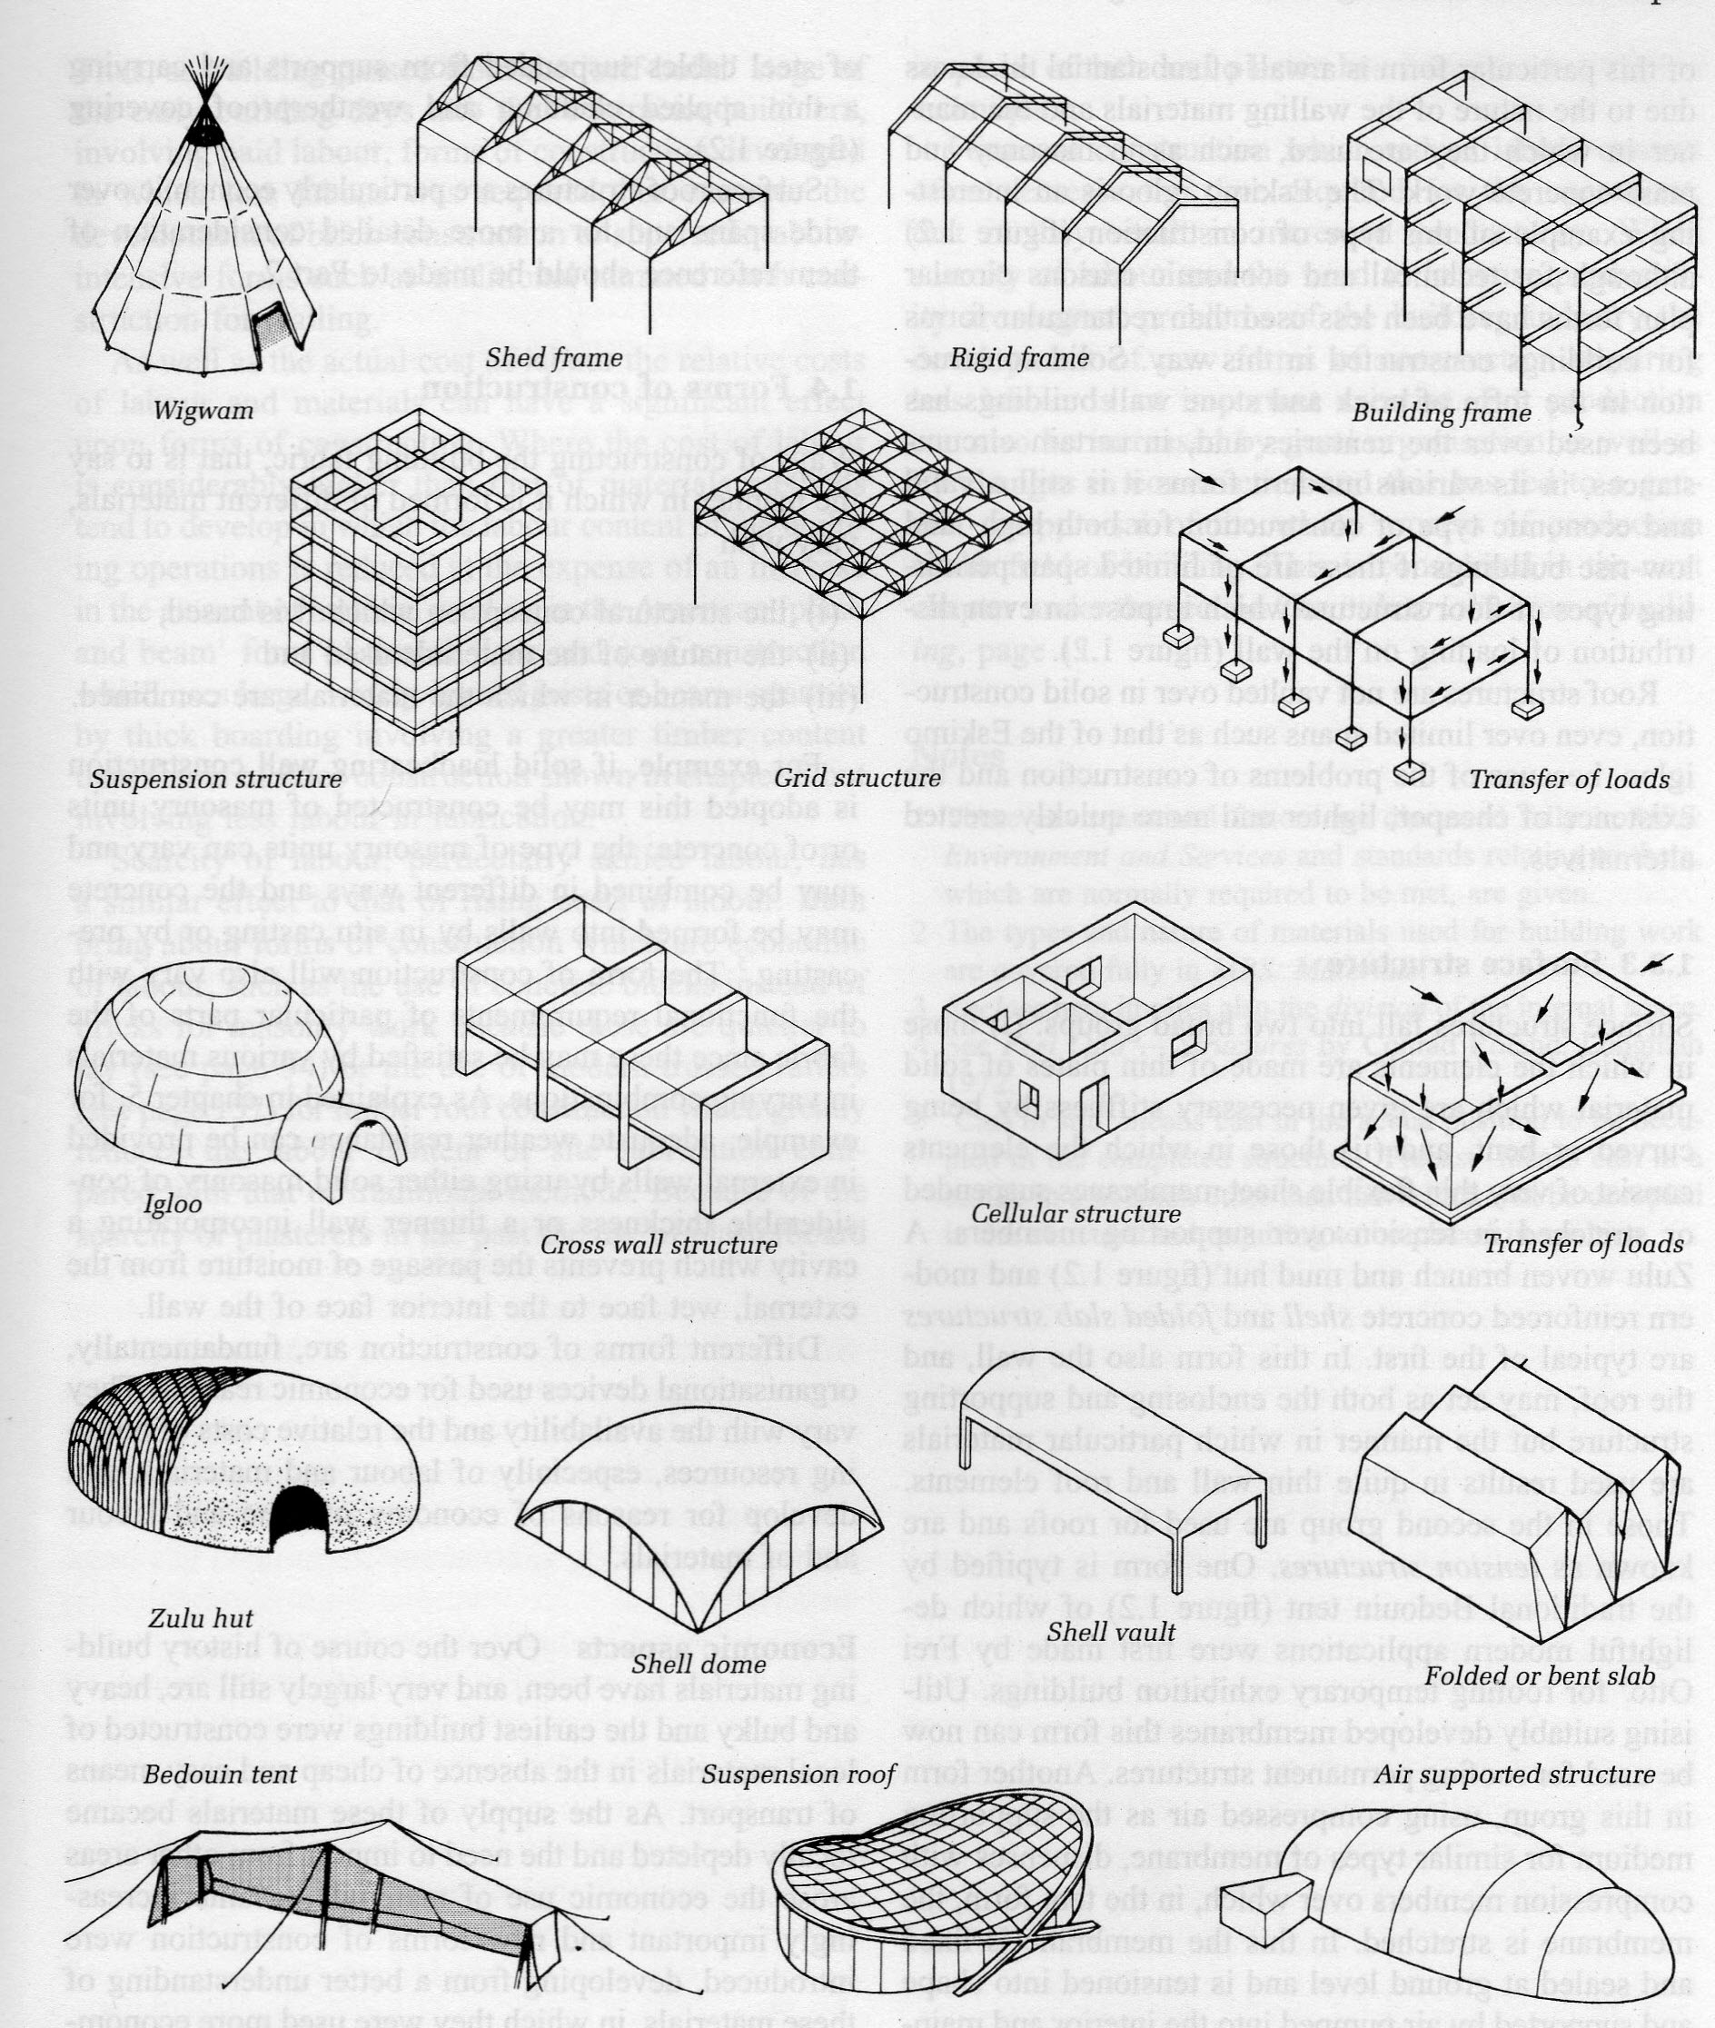
  Identify the various types
  of structure

