Slide 1
BMSW4009 - Effective Teamworking and Communication

Slide 2
Today we will…
Recap everything covered so far
Confirm your presentation groups
Explore Communication Models through theory, practice and a case study
Debate preparation

Slide 3
Week 1
Understanding people and teamwork foundations: Individuals are all different, shaped by experiences, and both collaboration and conflict are natural, effective teamwork starts with self-awareness and recognising these differences.
Importance of relationships and trust: Strong relationships (built on trust, knowledge, and mutual respect) are essential for achieving effective outcomes; prioritising bonds over just tasks improves teamwork success.
Valuing and balancing differences: High-performing teams actively seek diverse perspectives, but must balance individuality with collective goals, too much of either can hinder effectiveness.
Self-awareness and behavioural impact (Betari’s Box): Attitudes and behaviours influence others in feedback loops; reflecting and adjusting one’s response can transform negative team dynamics into positive, collaborative outcomes.

Slide 4
Week 2
OK Corral framework for relationships: Effective teamwork is built on the “I’m OK, you’re OK” mindset, avoiding blame and recognising how attitudes toward self and others shape interactions.
Barriers to building relationships: Factors like poor communication, lack of trust, differing values, personality clashes, and cultural differences can hinder strong working relationships.
Transactional Analysis (PAC model): Behaviour operates through Parent, Adult, and Child states; recognising and choosing appropriate states (especially Adult–Adult) improves communication and reduces conflict.
Groups vs teams distinction: Teams differ from groups through shared goals, interdependence, mutual accountability, and strong cohesion, whereas groups tend to focus on individual contributions and looser structure.

Slide 5
Week 3
Tuckman’s stages of team development: Teams progress through Forming, Storming, Norming, Performing, and Adjourning, each with distinct behaviours; understanding these stages helps manage conflict, roles, and performance effectively.
Team development in practice: Conflict (storming) is normal and necessary, leading to clearer roles and cooperation (norming) before high performance; leaders must adapt their approach at each stage.
Applying Tuckman’s model: The framework helps anticipate challenges, reflect on team progress, and improve performance, though it can oversimplify real, dynamic team situations.
Belbin’s team roles: Effective teams balance nine complementary roles (action-, people-, and thinking-oriented), each with strengths and weaknesses, highlighting the importance of diverse contributions for team success.

Slide 6

Presentation Groups

Slide 7
What do we know about communication:
It is shaped by the environment
People see things differently
People are weird!
Conflict is inevitable
Continually changing/adapting
We often do it poorly!
Notes:
This is a chance to both disrupt and reinforce students understanding of people.
We are deliberately starting with understanding individuals and how each person’s awareness of themselves, their relationships and the world around them determines how well they can interact and do things together at a deep and effective level.

Slide 8
Effective Communication
What does it involve?
  Clarity and conciseness
  Active listening
  Choosing the appropriate medium
  Emotional intelligence
  Feedback and engagement
  Nonverbal communication

Slide 9
Effective Communication and Contributing to Discussions
In any communication, the listener’s impression is based on…
Body language (gestures and movements) (55%)
Tone (38%)
Words (7%)
Notes:
This demonstrates the importance of outside factors rather than what we say. Our tone of voice, energy, attitude, emotions, dress, body language, eye contact, facial expressions, movements and gestures have a stronger impact than words alone. By taking these into consideration in our communication style we can build rapport and relationships more effectively.

Slide 10
The Shannon-Weaver Mathematical Model (1949)
Information Source/ Sender
Transmitter (Encoder)
Channel
Receiver (Decoder)
Destination
Signal
Received
Signal
Message
Message
Noise Source
Notes:
Video link to explore the theory further.
What is this model telling us? This time there is noise……but is this ‘atmospheric interference’….it is 1949, or is it more than this? Students can look this up in their own time and answer these questions! This also seems ‘one-directional’…..is it?

Slide 11
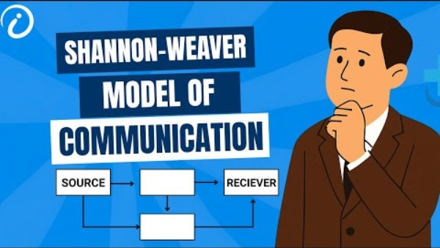
Shannon-Weaver Model of Communication explained - YouTube

Slide 12
Activity
Consider the communication breakdown scenarios on the handout and identify the following:
  Source
  Encoder (how the message was packaged)
  Channel
  Types of noise (physical, technical, semantic, psychological)
  Decoder
  Receiver
  Evidence (or absence) of feedback
Once you have done this, redesign the scenario to make communication more effective.

Slide 13
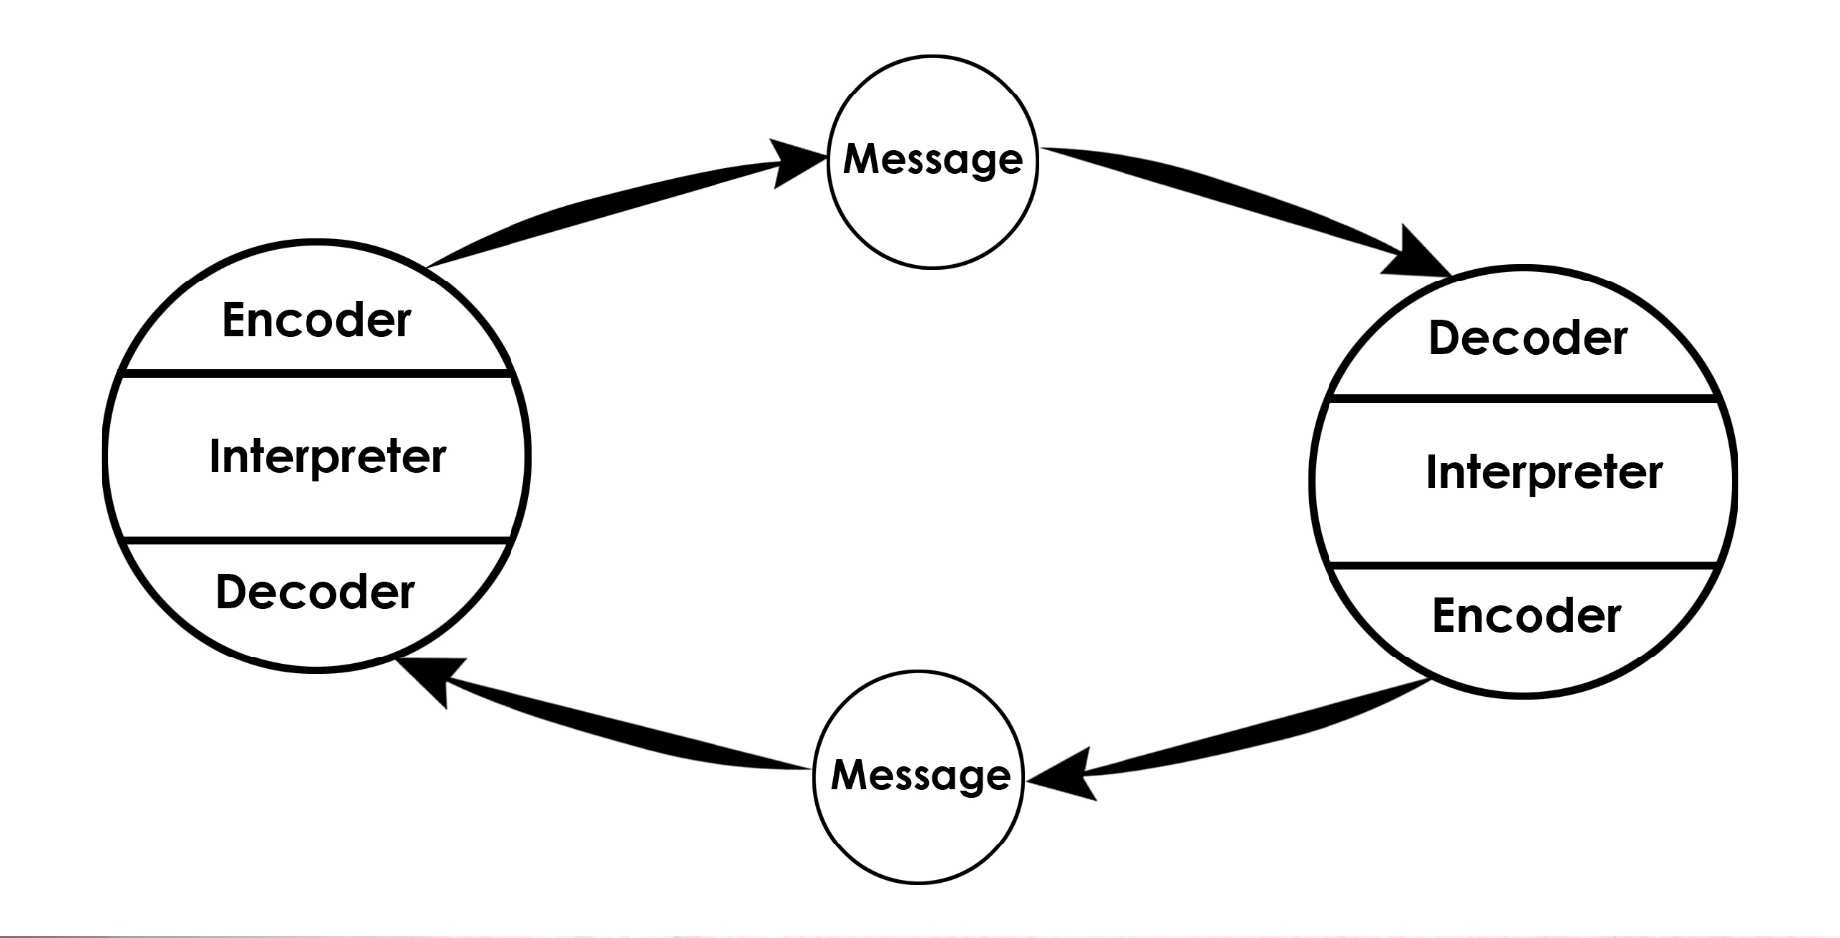
Schramm’s Model of Communication (1954)
Notes:
Schramm's communication model is an easy-to-understand framework that explains how communication works as a two-way, circular process between people. Instead of seeing communication as a simple one-way transmission, Schramm argued that both the sender and receiver continuously exchange roles, with each person encoding (creating), sending, decoding (interpreting), and providing feedback about messages.​
Key Elements
Sender/Source: The person who starts the communication by encoding a message (turning thoughts into words, symbols, or signals).​
Message: The idea or information sent from the sender to the receiver, which can be verbal, written, or non-verbal.​
Channel: The method or medium used to send the message (speech, writing, visual cues, etc.).​
Receiver/Destination: The person who gets the message and decodes it (interprets its meaning).​
Feedback: The receiver’s response to the message, which is sent back to the original sender, turning them into the new receiver.​
Circular Process
Schramm’s model is cyclical, meaning communication doesn’t stop after a message is sent; instead, both parties keep sending messages and feedback in a continuing loop. This ongoing exchange helps both people clarify and better understand each other.​
Importance of Common Experience
For successful communication, Schramm emphasized that sender and receiver should share some common experience or background. Misunderstandings happen when people don’t have similar knowledge or context—for instance, a technical expert talking to someone without the same expertise may be misunderstood.​
Example
If one person says something in a conversation, the other listens, interprets the meaning, and then replies. This reply acts as feedback, creating a roundtrip of messages that helps both sides refine understanding.

Slide 14
Berlo’s Model of Communication – SMCR (1960)
Video of Berlo’s Model of Communication
Source
Communication Skills
Attitudes
Knowledge
Social System
Culture
Message
Content
Elements
Treatment
Structure
Code
Channel
Hearing
Seeing
Touching
Smelling
Tasting
Receiver
Communication Skills
Attitudes
Knowledge
Social System
Culture
Encodes
Decodes
A Source encodes a Message for a Channel, then to a Receiver, who decodes it: S-M-C-R Model
Notes:
Video link for further exploration.
Discuss this with the students – another approach to the tricky subject of communications.

Slide 15
Communication timeline
1950s: One-way, technical communication
1960s–70s: Telephones, limited back-and-forth
1980s: PCs, faxes, early digital messages
1990s: Email dominance, two-way chains
2000s: Instant messaging, real-time chat
2010s: Teams/Zoom, mobile communication
2020s: AI, hybrid communication models
Notes:
Key modern models
Helical Model (Frank Dance, 1967; still relevant): Communication spirals upward, growing more complex with each interaction as shared history accumulates—ideal for teams where past exchanges shape future ones.[ from prior]
Transactional Model (Barnlund, 1970; dominant in workplaces): All parties co-create meaning simultaneously through verbal/non-verbal cues, influenced by culture and environment; feedback is instant and mutual, fitting Slack/Teams chats.
Convergence Model (Rogers & Kincaid, 1981; networked era): People exchange info via channels until they "converge" on shared understanding, perfect for collaborative platforms like intranets where async updates align teams.​
Digital Workplace Model (2020s trends): Hyper-personalised, async/hybrid flows via AI tools (e.g. Jint, Teams Copilot) that segment audiences, reduce noise, and enable bottom-up feedback—reaching deskless/frontline workers mobile-first.

Slide 16

Group discussion
What barriers to communication have you experienced?
How have you/could you overcome these?

Slide 17
Verbal and Non-verbal Communication
Verbal communication is the things we say
Non-verbal communication is the things we don’t say
Both are important and can say different things.
It is important we are aware of our own and others verbal and non-verbal communication.

Slide 18
The Elements of Communication
1. Vocal
2. Visual
3. Verbal
The Voice
The look
The Words
This includes the vocal variety, quality, rate and vocalised pauses
This includes eye contact, posture, gestures & facial expression
This is what the person says

Slide 19
Communication Exercise
Split into pairs and await instructions
Start by facing away from each other
One member of the pair to give instructions, the other has to draw a specific route on the map following these instructions
Reflect on how you found the exercise, what were the challenges?
Notes:
Map exercise
Start by facing away from each other
One member of the pair to give instructions, the other has to draw a specific route on the map following these instructions

Slide 20
Components of Communication
Paralinguistic cues
Non-verbal behaviour
Our words and language:
  language function: instructions, suggestions, directions, statements, questions
  confidence, communication and power-behaviour
  using language and communicating tactfully in difficult conversations
Notes:
A paralinguistic cue is a feature of the voice or non-verbal behaviour that accompanies speech and helps convey meaning, emotion, or attitude beyond the actual words.
In practice, this includes things like tone of voice, pitch, volume, pace, rhythm, and pauses, as well as non‑lexical sounds such as sighing or laughing.
A flat, quiet “I’m fine,” for example, may signal distress because of its paralinguistic cues, even though the words alone sound positive.

Slide 21
Applying Communication Skills
Active listening:
‘Active listening is the active search for an accurate understanding of another’s message, through the interpretation of verbal and non-verbal messages’.

Slide 22


Listening...
Listen with Fascination
The single most dignifying thing you can do is just listen to someone
Seek first to understand before being understood

Slide 23
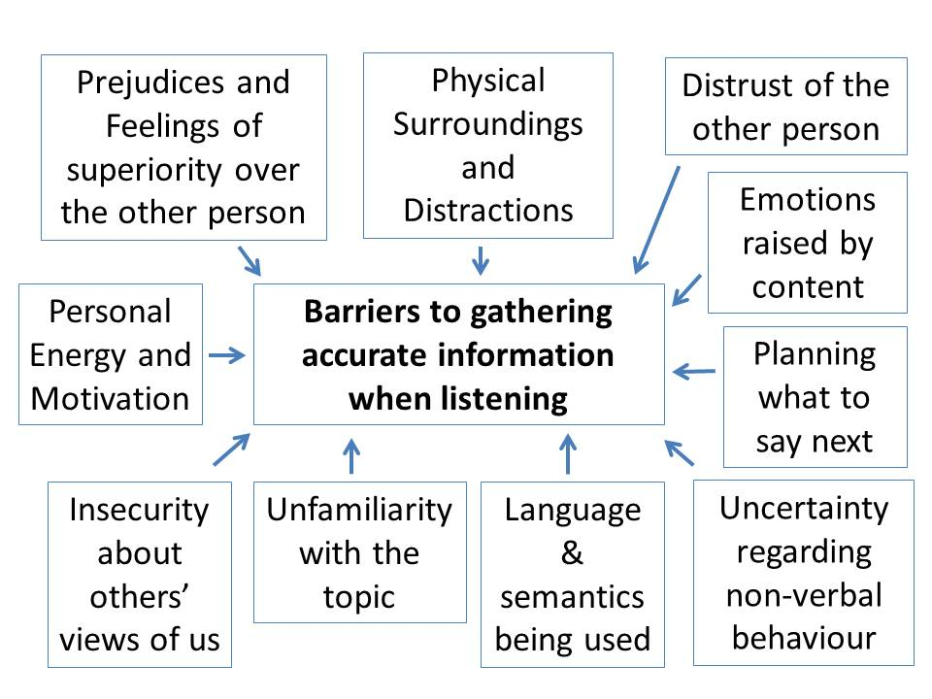
Active Listening: being aware of barriers

Slide 24
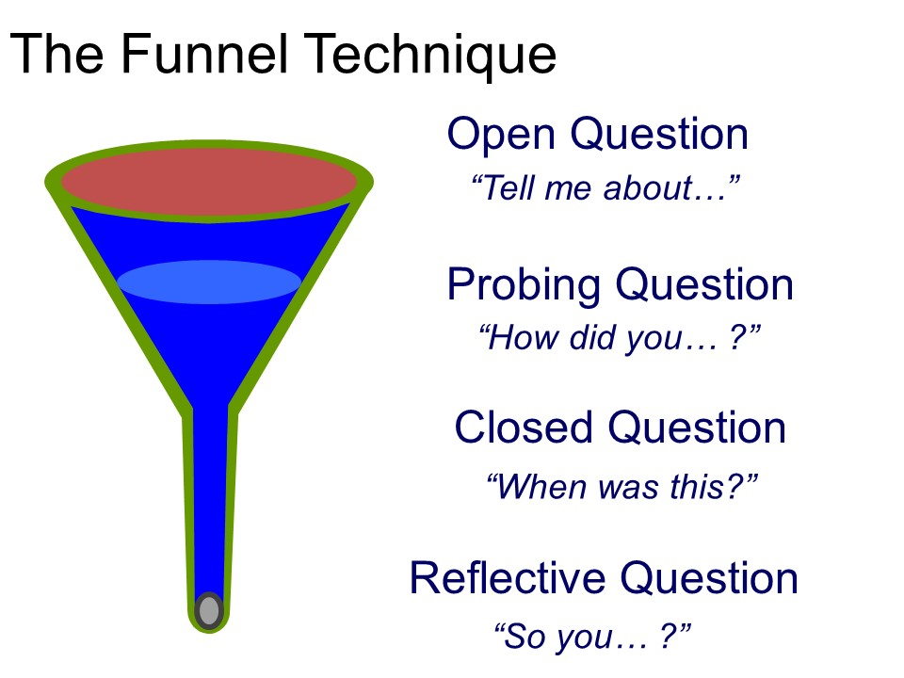
Using questions to build relationships
Questions in conversation…
Notes:
Keeping asking questions to funnel down to get to the answer – Talk through the guidance below and ask the group to test it with each other by asking about their weekends.
Open Questions:
Start with broad, open-ended questions to encourage detailed responses and set a comfortable tone. Use words like who, what, when, where, why, tell, explain, describe to begin these questions
Probing Questions:
Listen carefully to the initial answer and ask follow-up questions that dig deeper into specific points mentioned. These questions should be based on the interviewee’s previous answer and help you gather more detail or clarify understanding
Closed Questions:
End with a closed question to confirm your understanding or clarify a specific detail. These questions typically lead to a “yes” or “no” answer and help wrap up the conversation or topic

Slide 25
Examples in practice (1)
Open questions (top of funnel – build rapport)
“What brought you to this role and our organisation?”
“How have your first few days been so far?”
Probing questions (narrowing – show empathy and curiosity)
“What’s gone well in meeting the team?”
“What parts of the work or culture have surprised you so far?”
“How does this role compare to your previous experience?”

Slide 26
Examples in practice (2)
Clarifying questions (deeper connection – personalise support)
“Which team members have you connected with most?”
“What one thing would make your start here even smoother?”
“Are there any skills or knowledge areas where you’d like early support?”
Closed/confirming questions (bottom – affirm and commit)
“So, connecting with Sarah on project processes would help most?”
“Shall we schedule a quick intro meeting with her this week?”
“Does Friday morning work for our first one-to-one check-in?”

Slide 27
Communicating Tactfully (1)
Check any assumptions.
1
Reframe and purpose of the conversation.
2
Use the ‘passive voice’ and ‘active voice’ appropriately.
3
Use a ‘praise sandwich’.
4
Watch your language.
5
Be clear about consequences.
6
Notes:
Link this to the session on Conflict on Week 3.

Slide 28
Communicating Tactfully (2)
Assume good intentions.
Avoid emotion during a conversation.
Ensure there are no surprises.
Leave the conversation on a positive note.
Listen well – avoid interrupting.
Notes:
Link this to the session on Conflict on Week 3.

Slide 29

Case study
Read the case study on Moodle and answer the following questions in groups or pairs:
What were the main communication barriers faced by the TechNova project team at the beginning of the project?
List three strategies the project manager implemented to improve team communication.
How did clarifying roles and responsibilities help the team and why is it important?
What lessons can be applied to your own academic teams?

Slide 30
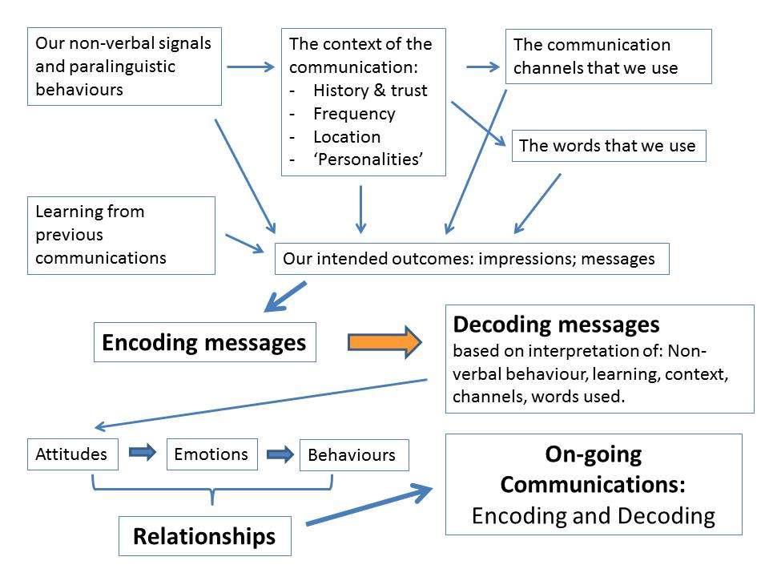
In Conclusion – Communication is Complicated!

Slide 31
Group debate
Choose a topic from the list provided
Split your group into two (pros and cons)
Spend some time preparing your arguments with evidence to support your points
At the start of the next lecture, you will debate your topic for 10 minutes
Reflect on how it went and feedback to the class
It is not about who wins the debate, it’s all about communicating effectively

Slide 32

Any questions?

