Slide 1
Learning Styles
Myth Busters
&
“Theory into Practice”
Jon Haylock 2019

Slide 2

What are learning styles all about?

Slide 3
Learning Styles
“Learning: the acquisition of knowledge or skills, through study, experience or being taught”(Oxford Dictionary)
Academics for years have been attempting to formulate ideas, concepts and models about how we learn which have influenced how we teach.

Slide 4
What is your learning style?
There are many different learning style theories in existence, with an abundance of literature surrounding them.
One of the most popular is V-A-K or its variant V-A-R-K…….

Slide 5



V - A - K
Visual
Audial
Kinaesthetic

Slide 6
V - A - K
MYTH
Visual
Audial
Kinaesthetic

Slide 7


V - A - K - O ?
Olfactory

Slide 8
You are not alone!!!
A survey by Dekker et al. (2012) showed that 93% of UK schoolteachers believed the (unsupported) statement that “individuals learn better when they receive information in their preferred Learning Style”.

Slide 9
A survey of 39 Higher Education institutions in the US found that 29 of them (72%) taught ‘learning style theory’ as part of faculty development for online teachers (Meyer and Murrell, 2014).

Slide 10

2016 Level 2 Coaching Qualification Handbooks still refer to focusing in on individuals V-A-K learning styles

Slide 11
But Why Not?
A comprehensive review by Pashler et al. (2008) determined that there was no evidence to support the use of Learning Styles in education, based upon a lack of evidence to support ‘matching’.
Coffield et al. (2004) reviewed the literature pertaining to 71 different Learning Styles classifications, with the aim of answering the question “should we be using them in post-16 education.” The answer was a resounding ‘no’.

Slide 12




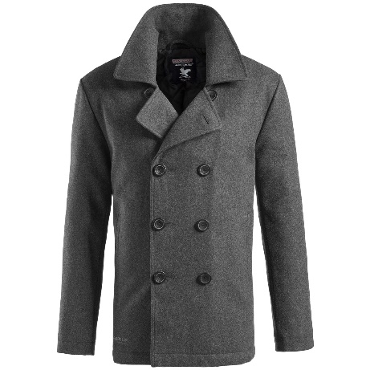
How has this been tested?
Cat
Coat
House
Bag

Slide 13
The learning is the same regardless of how the content is presented.

Slide 14
But why!! Its sounds so good!!
Learning is stored in terms of meaning.
Learning is not related to a singular style of learning or method of delivery.

Slide 15
Style is different to preference

Slide 17


Slide 18
Having a good visual memory, ability or preference might help in certain tasks.
What was the colour of the coat in the earlier slide?
But that’s not typically what we are asking, we are looking for true understanding and the meaning of what is being learnt.

Slide 19
But why!! Its sounds so good!!
Learning is stored in terms of meaning.
Learning is not related to a singular style of learning or method of delivery.
The best way to learn something (teach) depends upon the content itself.
Many things are best learnt through multiple senses.

Slide 20

Multi sensory learning

Slide 21
Where’s the risk? ……
Why not believe?
1. Waste of time and resources
2. Labels can be misleading and dangerous
3. We could be limiting the learning potential of our students

Slide 22
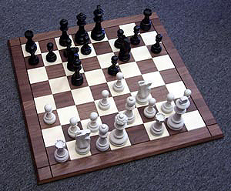
Experience Matters
Chase and Simon 1973:
Found a relationship in chess players
Experienced Vs In-experienced players were able to remember the placement of chess pieces once removed.
However when the board was set with random pieces not related to game play they could not remember the removed pieces because there was no context.

Slide 23

TAKE A BREAK

Slide 24

So….
Have we been hung out to dry?

Slide 25
Learning theories have given us a set of tools, to help us facilitate a learning process.
Predominantly that the content of what is being learn is what typically should drive what learning preference should be used.
We now know that people do have preferences in their learning style. Along side this we are now aware that we can limit the learning process by only focusing on one style of learning.
Diversifying and utilising certain preferences at the appropriate time is what will enhance the learning process and reach a point of true meaning.

Slide 26

What learning processes do
we already know about?

Slide 27
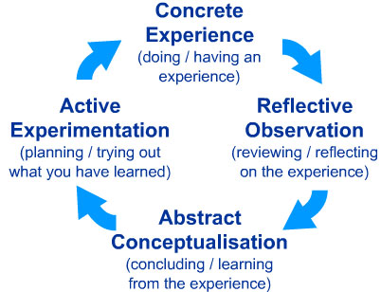

Slide 28
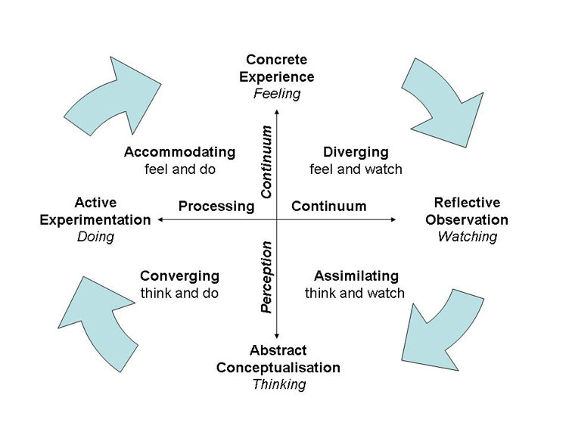
Experiential Learning Theory
Kolb 1984

Slide 29
Experiential Learning Theory
DIVERGING STYLE
These people are able to look at things from different perspectives.
They are sensitive.
They prefer to watch rather than do, tending to gather information and use imagination to solve problems.
They are best at viewing concrete situations from several different viewpoints.
Kolb called this style 'diverging' because these people perform better in situations that require ideas-generation, for example, brainstorming.
People with a diverging learning style have broad cultural interests and like to gather information.
They are interested in people, tend to be imaginative and emotional, and tend to be strong in the arts.
People with the diverging style prefer to work in groups, to listen with an open mind and to receive personal feedback.

Slide 30
Experiential Learning Theory
ASSIMILATING STYLE
The Assimilating learning preference involves a concise, logical approach.
Ideas and concepts are more important than people.
These people require good clear explanation rather than a practical opportunity. They excel at understanding wide-ranging information and organizing it in a clear, logical format.
People with an assimilating learning style are less focused on people and more interested in ideas and abstract concepts.
People with this style are more attracted to logically sound theories than approaches based on practical value.
This learning style is important for effectiveness in information and science careers. In formal learning situations, people with this style prefer readings, lectures, exploring analytical models, and having time to think things through.

Slide 31
Experiential Learning Theory
CONVERGING STYLE
People with a converging learning style can solve problems and will use their learning to find solutions to practical issues.
They prefer technical tasks, and are less concerned with people and interpersonal aspects.
People with a converging learning style are best at finding practical uses for ideas and theories.
They can solve problems and make decisions by finding solutions to questions and problems.
People with a converging learning style are more attracted to technical tasks and problems than social or interpersonal issues.
A converging learning style enables specialist and technology abilities.
People with a converging style like to experiment with new ideas, to simulate, and to work with practical applications.

Slide 32
Experiential Learning Theory
ACCOMODATING STYLE
The Accommodating learning style is 'hands-on,' and relies on intuition rather than logic.
These people use other people's analysis, and prefer to take a practical, experiential approach.
They are attracted to new challenges and experiences, and to carrying out plans.
They commonly act on 'gut' instinct rather than logical analysis.
People with an accommodating learning style will tend to rely on others for information than carry out their own analysis.
This learning style is prevalent within the general population.

Slide 33
Unfortunately….
Kolb’s theory of pigeon holing people into learning styles has come under scrutiny and been found to not hold up that well….
However….

Slide 34
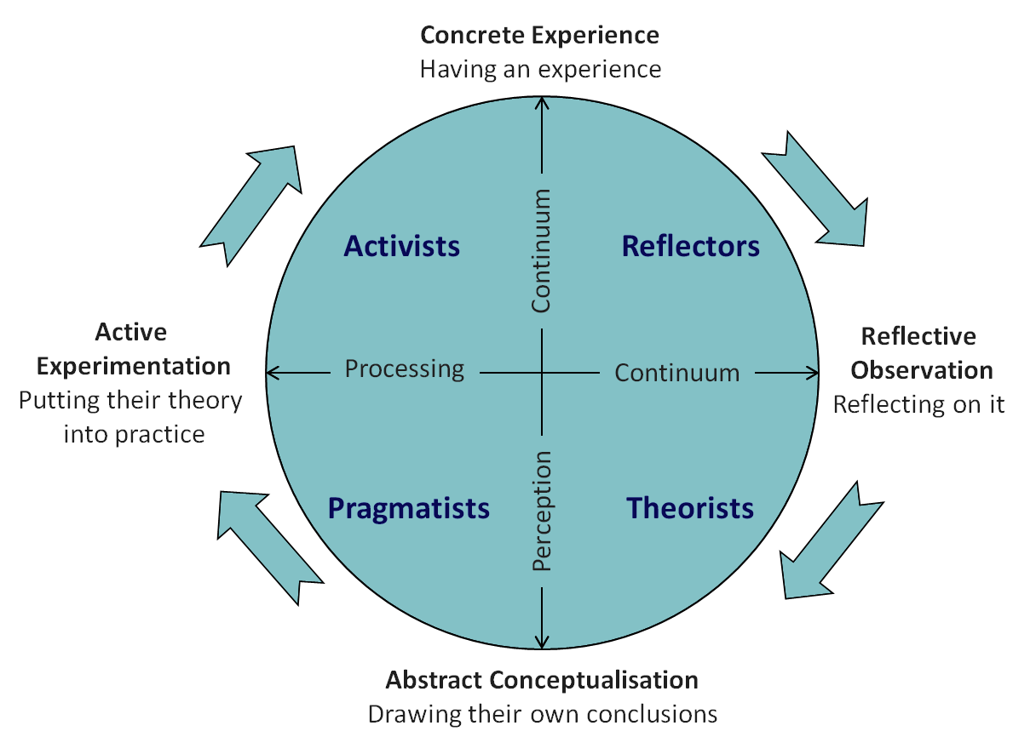
Honey & Mumford (1986)

Slide 35
In this model Mumford and Honey describe the learning styles as a continuum that learners move through over time.
However, over time, people usually come to prefer and rely on one, or more, style(s) above the others. As both teachers and Learners.
Research has shown that there is no evidence that one preference is better than another – indeed the diversity of our learning styles adds value to team work and organisational functioning.

Slide 36
Honey & Mumford (1986)

Slide 37
Reflectors
These people learn by observing and thinking about what happened. They may avoid leaping in and prefer to watch from the side-lines.
Prefer to stand back and view experiences from a number of different perspectives, collecting data and taking the time to work towards an appropriate conclusion.
Paired discussions
Self analysis questionnaires
Personality questionnaires
Time alone to think
Observing activities
Feedback from others
Coaching
Interviews

Slide 38
Honey & Mumford (1986)

Slide 39
Theorists
These learners like to understand the theory behind the actions.
They need models, concepts and facts in order to engage in the learning process.
Prefer to analyse and synthesise, drawing new information into a systematic and logical 'theory'.
Models
Statistics
Stories
Quotes
Background information
Applying theories

Slide 40
Honey & Mumford (1986)

Slide 41
Pragmatists
These people need to be able to see how to put the learning into practice in the real world.
Abstract concepts and games are of limited use unless they can see a way to put the ideas into action in their lives.
Experimenters, trying out new ideas, theories and techniques to see if they work.
Time to think about how to apply learning in reality
Real life case studies
Problem solving
Discussion

Slide 42
Honey & Mumford (1986)

Slide 43
Activist
Activists are those people who learn by doing.
Activists need to get their hands dirty, to dive in with both feet first.
Have an open-minded approach to learning, involving themselves fully and without bias in new experiences.
Brainstorming
Problem solving
Group discussion
Puzzles
Competitions
Role-play

Slide 44

Lets try to build our own
experiential learning cycle

Slide 45
References
Chase, W. G., & Simon, H. A. (1973). Perception in chess. Cognitive Psychology, 4, 55–81.
Coffield F, Moseley D, Hall E, Ecclestone K Learning Styles and Pedagogy in Post-16 Learning: A Systematic and Critical Review. London: Learning and Skills Research Centre 2004;84.
Curry L. One critique of the research on learning styles. Educ Leadership 1990;48 (2):50–6.
Dekker, S., Lee, N. C., Howard-Jones, P., and Jolles, J. (2012). Neuromyths in education: prevalence and predictors of misconceptions among teachers. Front. Psychol.
Dunn, R., Dunn, K., & Price, G. E. (1987). Manual/or the learning styles inventory (LSI). Laurence, KS: Price Systems
Honey, P. and Mumford, A. (1986a) The Manual of Learning Styles, Peter Honey Associates.
Honey, P. and Mumford, A. (1986b) Learning Styles Questionnaire, Peter Honey Publications Ltd.
Kolb, D. (1984) Experiential Learning: Experience as the source of learning and development, London: Prentice-Hall.
Kolb, D. (1985). ​ Learning style inventory. Boston: McBer.
Meyer, K. A., and Murrell, V. S. (2014). A National Study of Theories and Their Importance for Faculty Development for Online Teaching. Online J.
Pashler H, McDaniel M, Rohrer D, Bjork R. Learning styles: concepts and evidence. Psychol Sci Public Interest 2009;9 (3):105–19.
Willingham DT. Visual, auditory, and kinaesthetic learners need visual, auditory, and kinaesthetic instruction? American Educator; Spring 2005;31–5.

