Slide 1
AN
ASSIGNMENT
ON
“MARKETING MANAGEMENT:
COCA COLA
Presented by
Davinder Singh

Slide 2
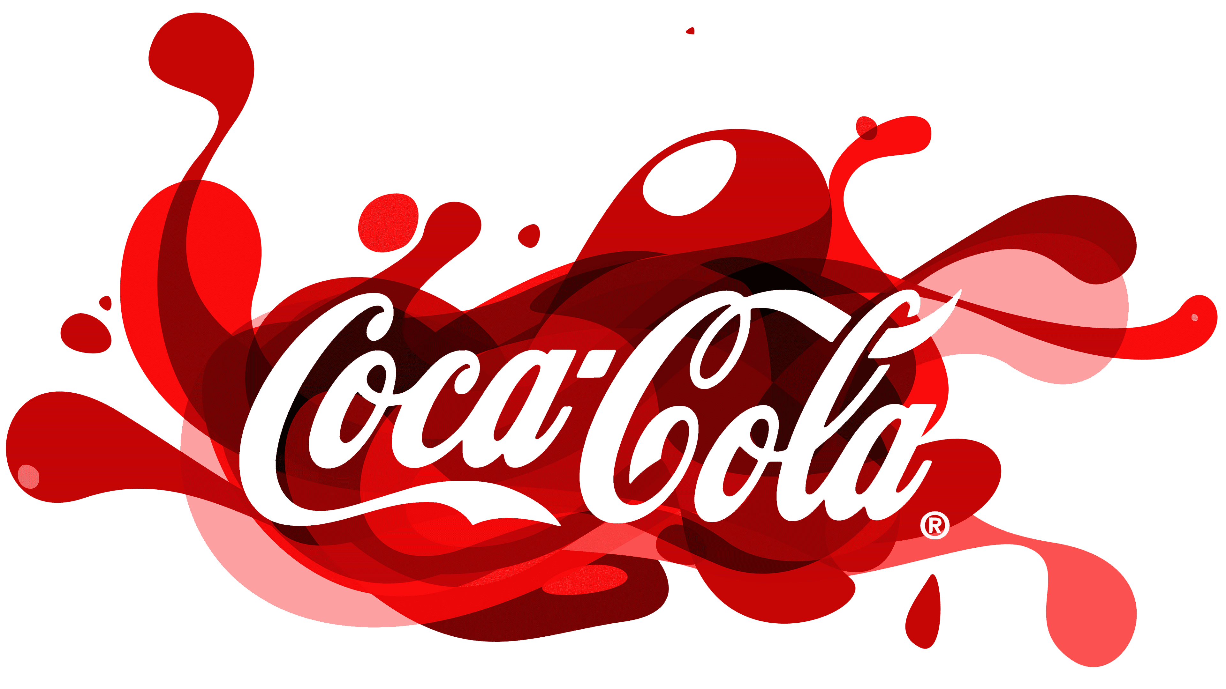

Slide 3
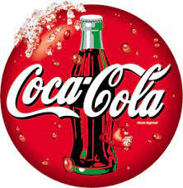
Introducation
The Coca-Cola Company (NYSE: KO) is a total beverage company with products sold in more than 200 countries and territories. Our company's purpose is to refresh the world and make a difference. Our portfolio of brands includes Coca-Cola, Sprite, Fanta and other sparkling soft drinks.

Slide 4
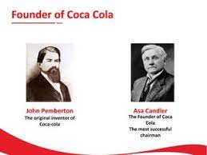
Founder Of Coca-Cola
John S. Pemberton, a pharmacist in Atlanta, Georgia, created the syrup for Coca-Cola. He carried a jug of the new product down the street to Jacobs' Pharmacy in Atlanta. There, it was sampled, pronounced "excellent" and placed on sale as a soda fountain drink for five cents a glass

Slide 5
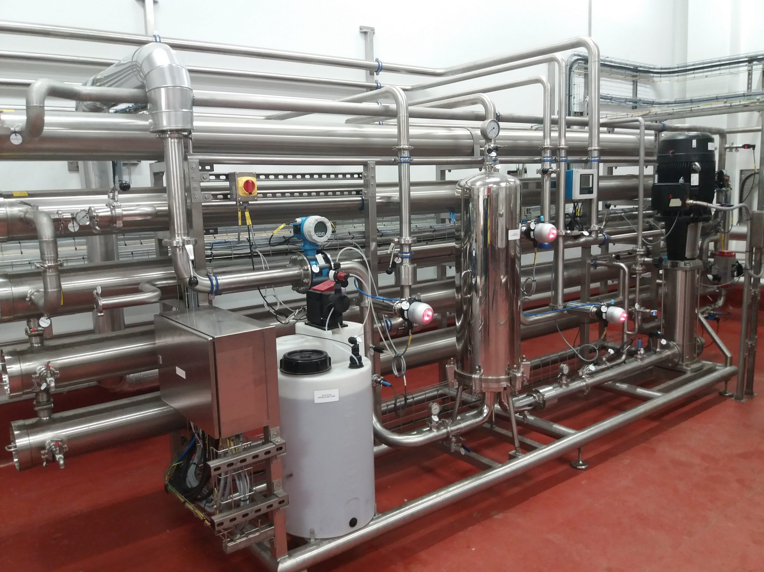
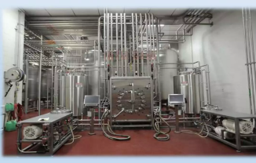
Equipment Use In Coca-Cola
Step 1
Pure water is subjected to sophisticated
filtering,softening and disinfecting to
remove all purities.
Step 2
Sugar is added , along with apporiprate
bevarge concentrate to produce “syrup”.

Slide 6
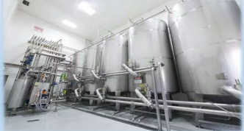
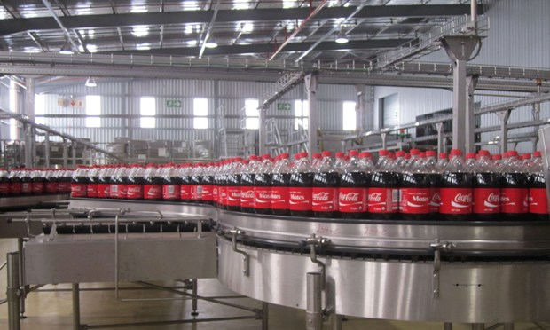
Step 3
Fizziness
Under high pressure the drinks their
renowned :fizziness: .
Step 4
Automated machinery dispenses the
mixture ,in precisely calculated quantities
into sterilized bottle, cans .

Slide 7
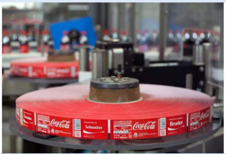
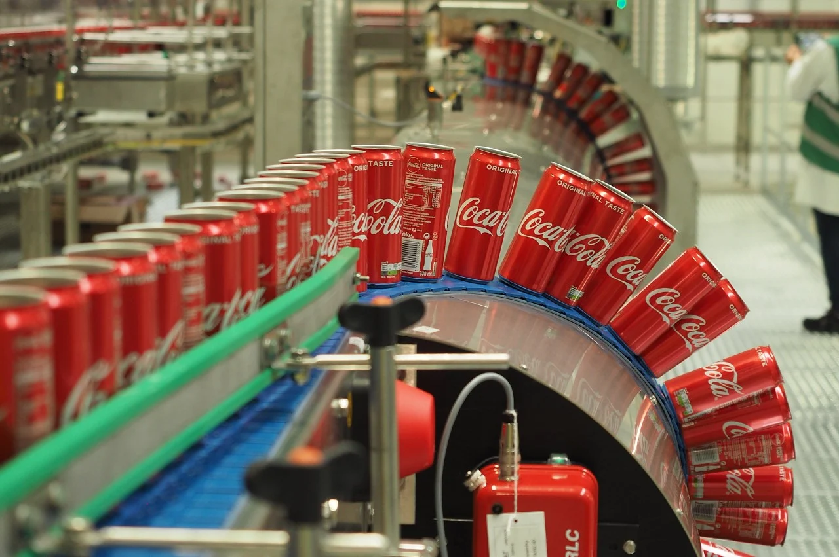
Step 5.
The containers move to another machine which apply labels and bar code.
Step 6
After final checking ,bottle and cans are transport to manchine.

Slide 8
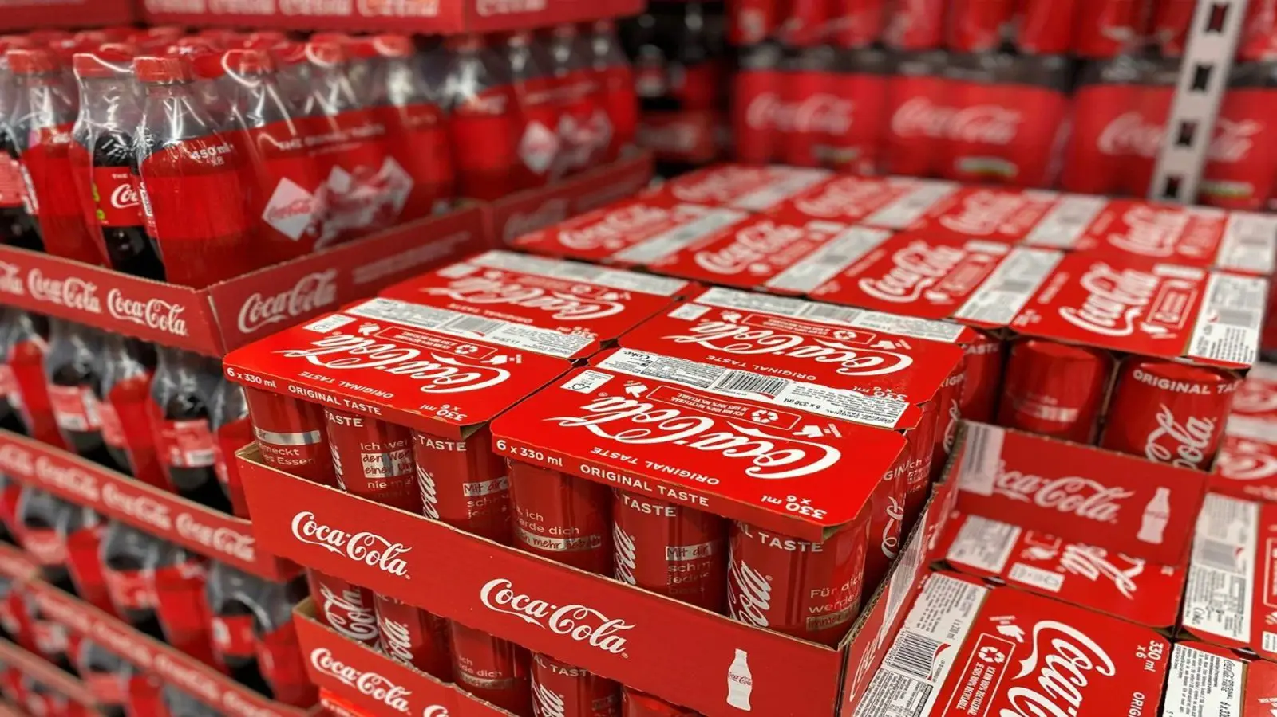
STEP 7
Packing Beverage

Slide 9
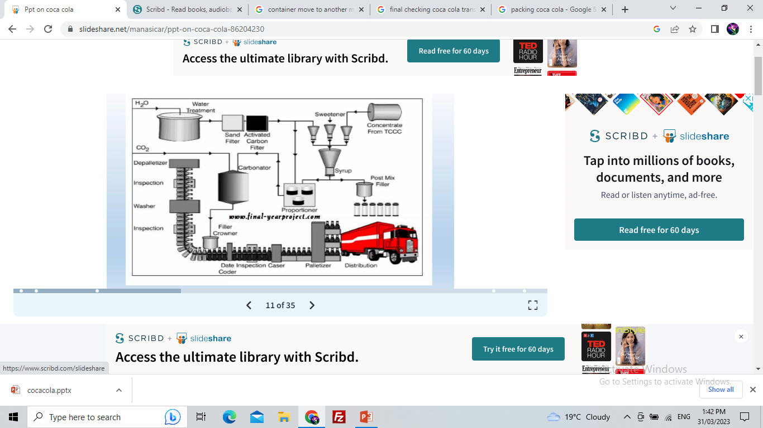

Slide 10
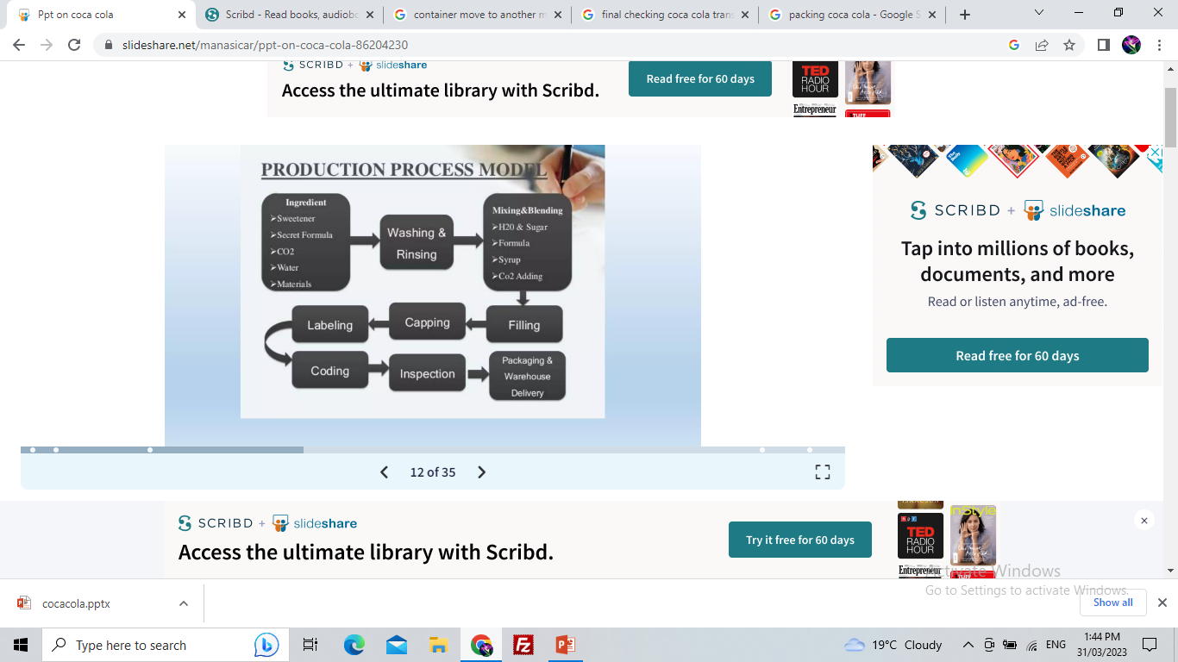

Slide 11
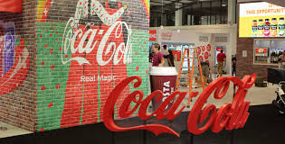
Major Product Of Coca-Cola,Produced In Khordha Plant
Coca-Cola, or Coke, is a carbonated soft drink manufactured by the Coca-Cola Company. In 2013, Coke products were sold in over 200 countries worldwide.
The Coca-Cola Company started operating in India in 1956. Coca-Cola is India's largest beverage maker and is estimated to have around 40% share of the country's branded beverages market.14-Apr-2021

Slide 12
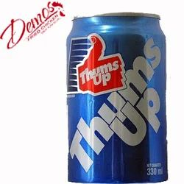
Thums up
Thums Up [sic] is an Indian multinational brand of cola in India. It was introduced in 1977 to offset the withdrawal of The Coca-Cola Company from India.
The original way to Taste The Thunder. Made of Strong. Not for the weak.¹. It comes in following sizes : CAN: 300 ml. RGB: 200ml, 300ml

Slide 13
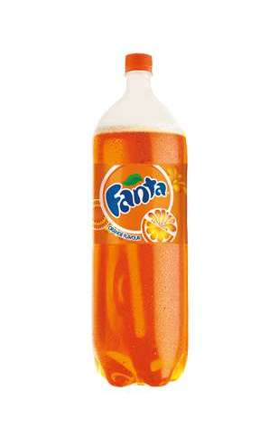
Fanta
Fanta drinks are not good for your body at all because they contain very high levels of sugar, excess citric acid, aspartame, phenylalanine, as well as a host of artificial preservatives.

Slide 14
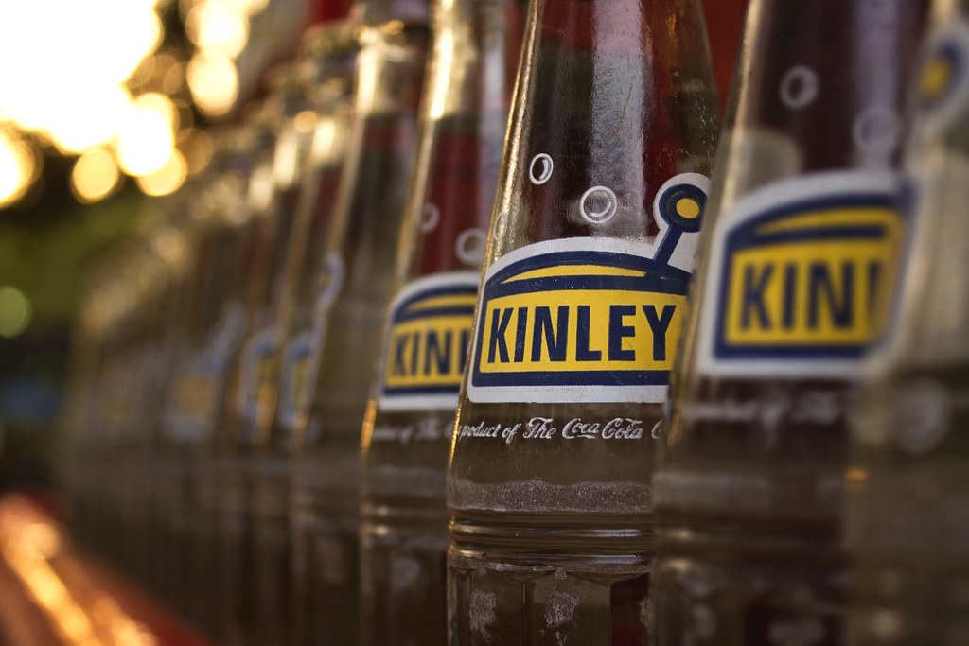
Kinley Soda
Kinley is a brand of still or carbonated water owned by The Coca-Cola Company and sold in many large European and Asian countries. Its carbonated forms are used for mixers, and also available in a variety of fruit flavors. The Kinley brand is used by Coca-Cola for two types of drinks: Packaged water.

Slide 15
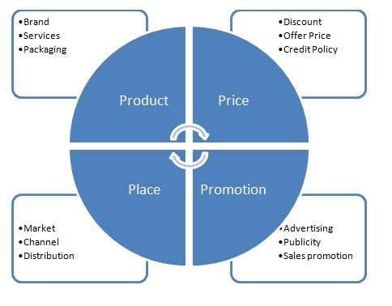
Marketing strategies
Product
Place
Price
promotion

Slide 16
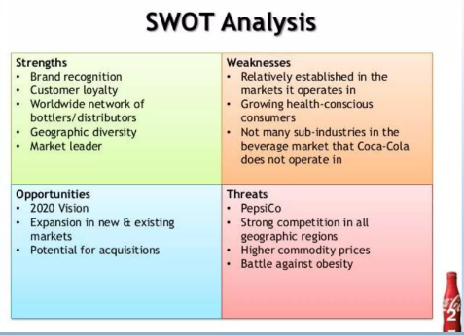

Slide 17
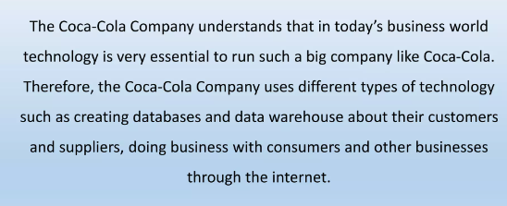
Conclusion

Slide 18
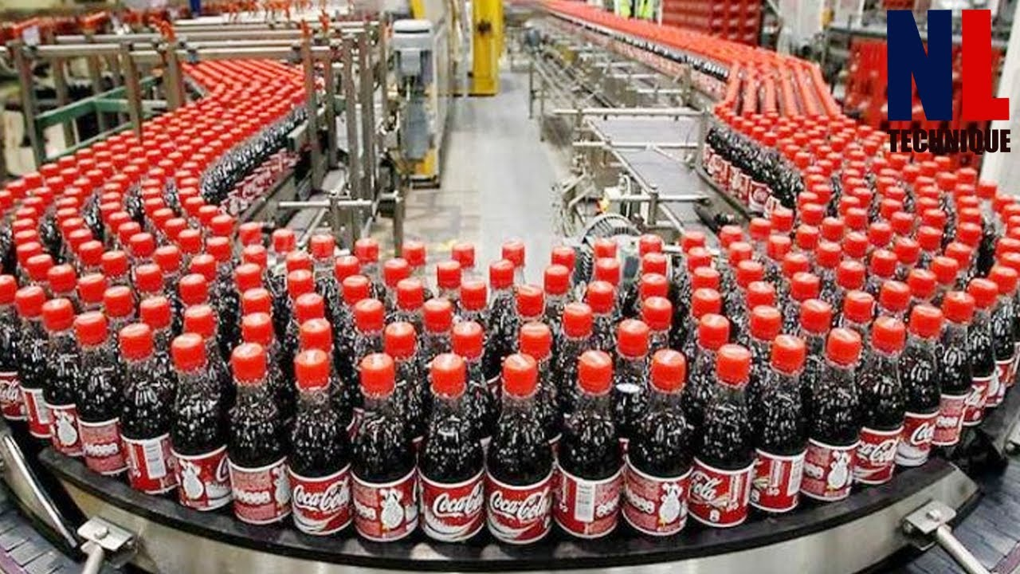
Thank you

