Slide 1
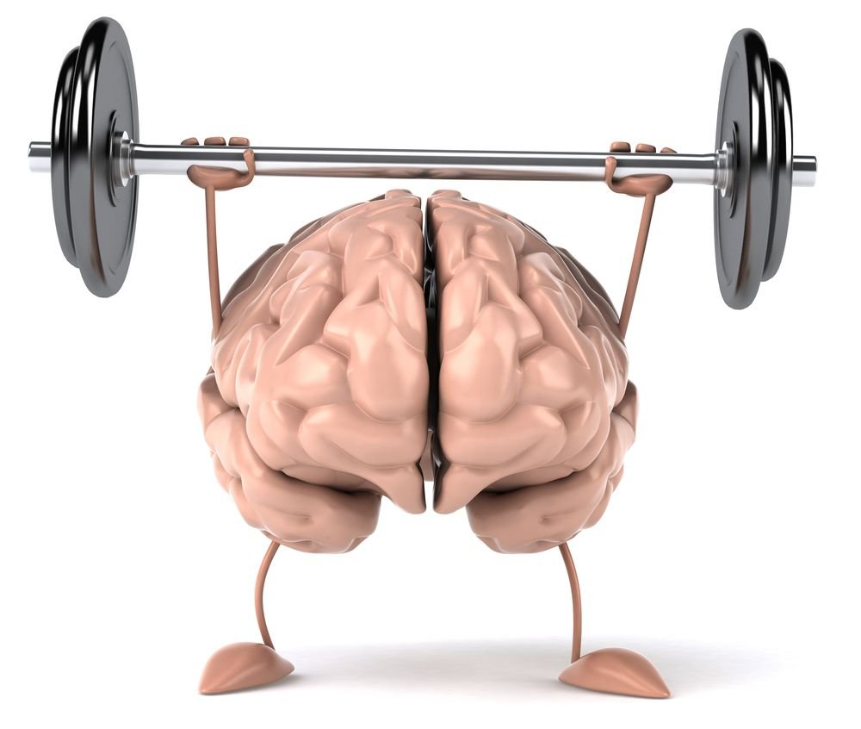
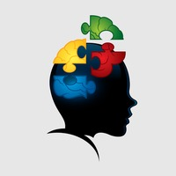
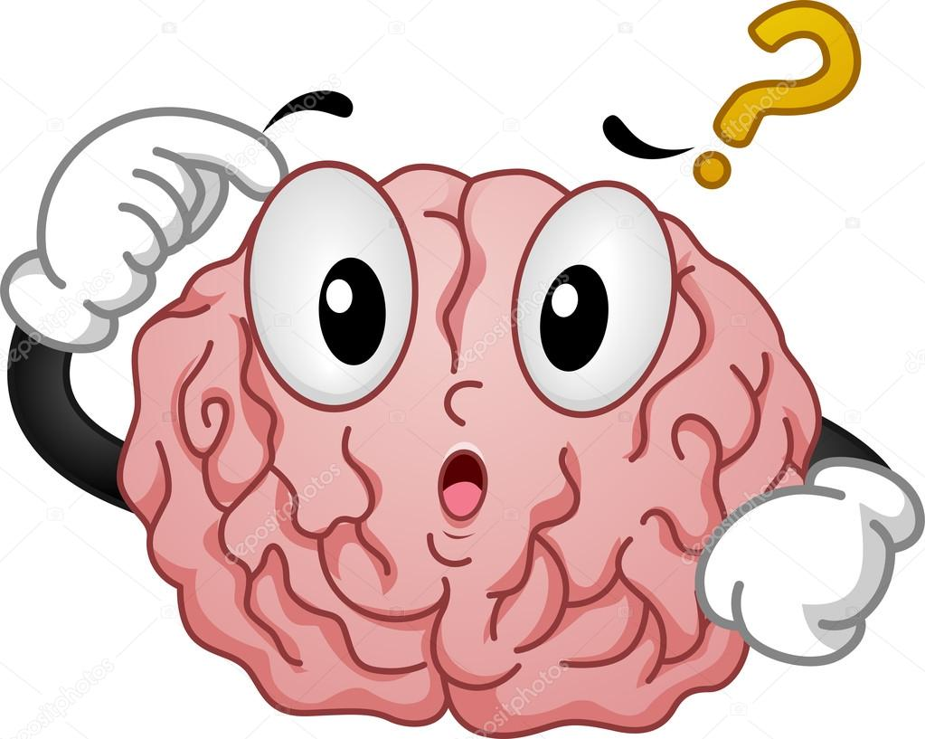
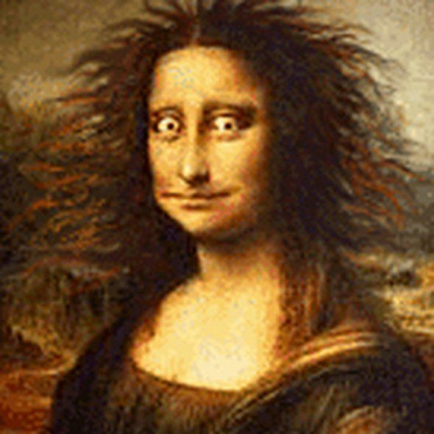

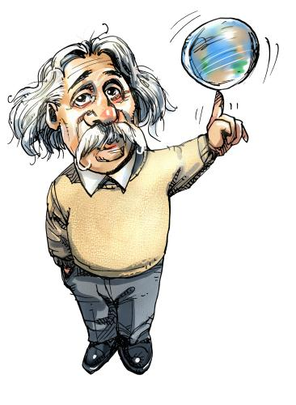
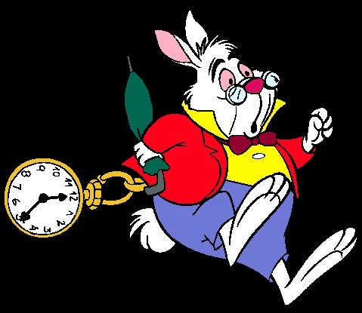
Cognitive skills
Controls our thinking
Emotional responses
Behaviour
Memory
Language
Judgement
Sexual behaviour
Ability to communicate
Fuster, J. M. (1988)
Analyse
Evaluate
Form your OWN ideas (Self regulation)
Problem solving
Debate
Learn
Develop
Progress
Freely, A., Steinberg,D.(2005/2009)
Thinking critically develops knowledge and understanding, that form piece by piece connecting together like a jigsaw puzzle.
Chilver’s, D. (2013)
Executive function
Figure 2. StockUnlimited. (n.d)
Born Realist. (2018)
Creativity
CRITICAL THINKING
Brain anatomy
Creativity is rather like play. It anchors us and makes us integrated, whole people. Creativity helps us get or life’s ‘together.’
Bruce, (2004, quoted in Chilver’s, D. 2013, p.6)
“Education is not the learning of facts, but the training of the mind to think.”
- Albert Einstein. (n.d)
Figure 1. Medina. L, (n.d)
Figure 4. [Funny Mona Lisa]. (n.d)
Time
management
Figure 6. ClipArtGuy. (n.d)
Deepen understanding and knowledge
Learn new ideas
Construct accurate meaning of text
Intuition
Identify relevant information
Precise clear formation
Understanding the theory
Practice makes perfect
Paul, R., & Elder, L. (2006)
Organising & planning
Performance
To do list
Prioritise
Focus
Delegate
Meet Deadlines
Konig, C. J., & Kleinmann, M. (2005)
Academic reading & writing
Figure 3. Atzenhofer. (2009)
Figure 5. Pooh’s Adventure Wiki. (n.d)

Slide 2

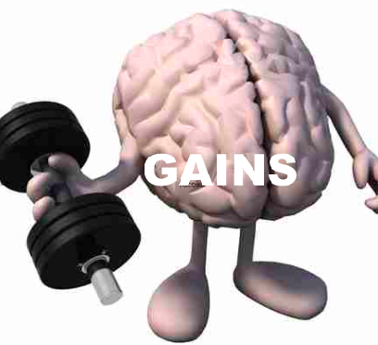
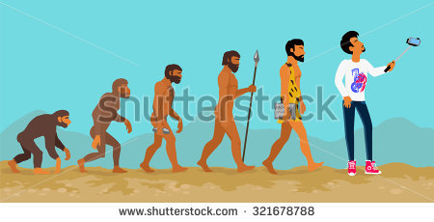
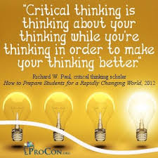
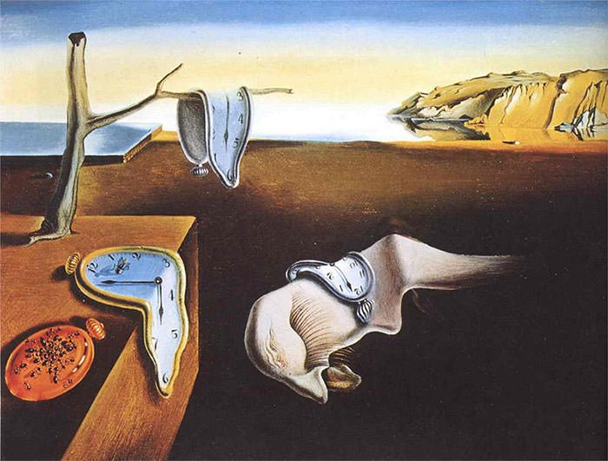
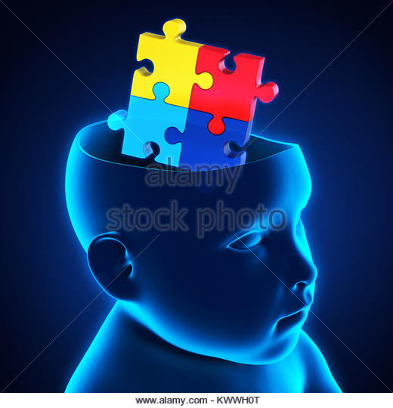
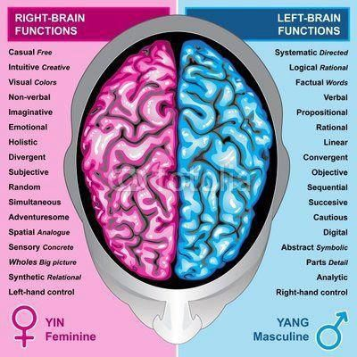
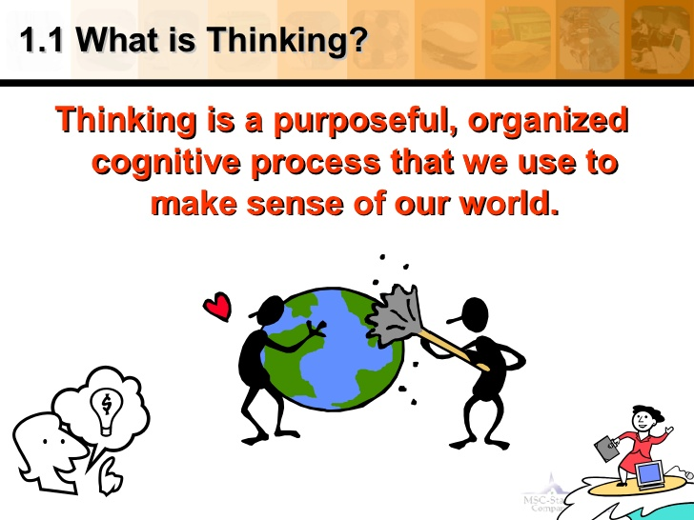
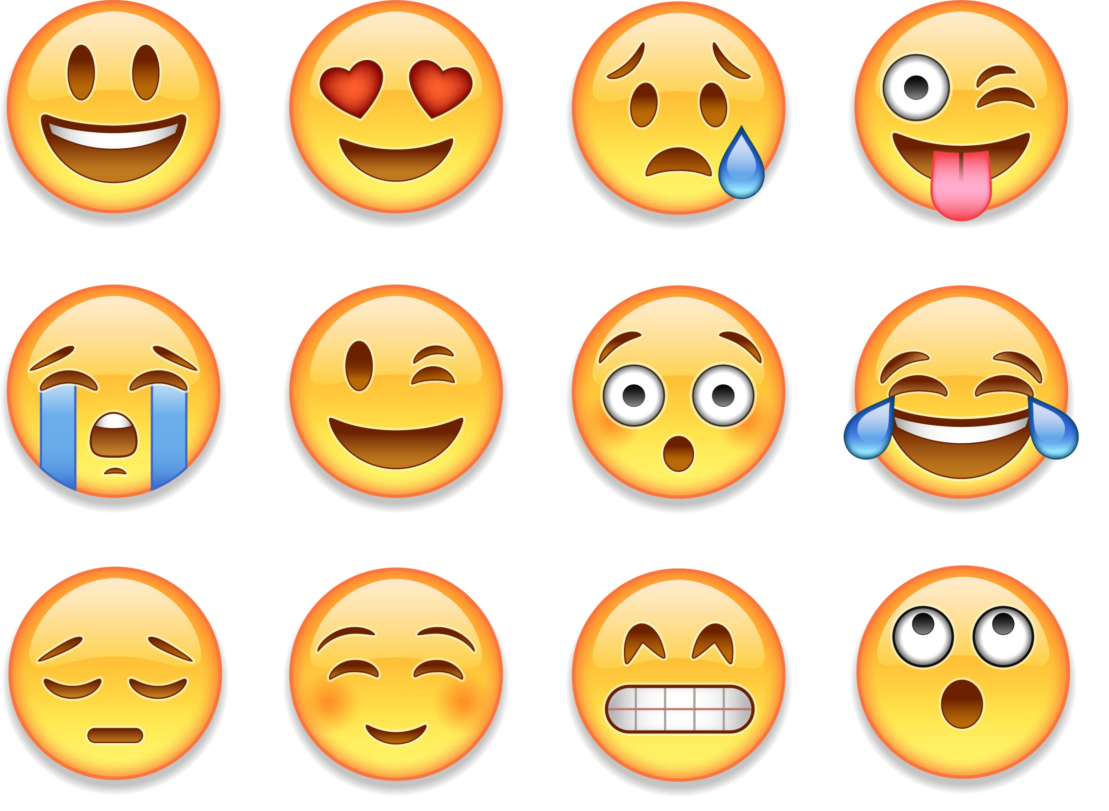
  To evaluate and create ideas
To reason effectively
Develop skills
Create solutions to problems
Decision making
Process important information. Freely, J, A:Steinberg, L, D. (2005)
Imagine, all your creativity and its elements in a pot, adding thinking critically gives it a good stir that enables human beings to transform Their knowledge.
This knowledge, would require a deeper understanding of Problem solving , forming new idea's, expressing your OWN thoughts and opinions.
Thinking + critically thinking = Progression and development.
We create a deeper thinking that helps us LEARN and develop are skills further. Through this ‘stirring’ we are creating, understanding and in-depth way of thinking, we are undertaking a ‘cognitive act’ or a ‘meta-cognitive process, this means we are actually ‘thinking about thinking’.
As stated by Robson, (2006)
Since the day we are born, we are creative thinkers and learners. Take a look around you….
If we didn’t have critical thinking we wouldn't have advanced into modern day society.
No technology
No mobile phones
No developments
No progression
Critical thinking has increased human development to were it is now and we will keep on developing are knowledge further to enhance our capabilities and skills.(Bronson, 2000)
CRITICAL THINKING?
EGOTRISM &
SOCIOTRISM

Slide 3
Reference list
[Albert Einstein quote]. (n.d). Retrieved from https://alwaysquestionauthority.files.wordpress.com/2013/03/531639_10151489118945155_660277782_n-1.jpg
Chivers, D. (2013). Creating and thinking critically: A practical guide to how babies and young children learn. London: Practical Pre-School Books.
Freely, A., Steinberg, D. (2014). Argumentation and Debate: Critical Thinking for Reasoned Decision Making. 13th edn. Wadsworth: Cengage learning. (Original work published in 2005).
Fuster, J. M. (1988). Prefrontal cortex. In Comparative neuroscience and neurobiology (pp. 107-109). Birkhäuser Boston.
Konig, C. J., & Kleinmann, M. (2005). Deadline Rush: A Time Management Phenomenon and Its Mathematical Description Relationships Between Critical Thinking and Attitudes Toward Women's Roles in Society. The Journal of psychology, 139(1), 33-45.
Paul, R., & Elder, L. (2006). Critical Thinking Reading & Writing Test. Tomales, CA: Foundation for Critical Thinking.

Slide 4
Images
Figure 1. Medina, L. (n.d). Illustration of Thinking Brain Mascot with Question Mark. 123RF. Retrieved from https://www.123rf.com/photo_22244822_illustration-of-thinking-brain-mascot-with-question-mark.html
Figure 2. Stock Unlimited. (n.d). Brain as a jigsaw puzzle in a head. Retrieved from https://www.stockunlimited.com/vector-illustration/brain-as-a-jigsaw-puzzle-in-a-head_1281261.html
Figure 3. Atzenhofer. (2009, August 06). Albert Einstein. toonpool. Retrieved from https://www.toonpool.com/cartoons/Albert%20Einstein_53189
Figure 4. [Funny Mona Lisa]. (n.d). Retrieved from https://www.pinterest.co.uk/pin/575546027351808299/
Figure 5. Pooh’s Adventure Wiki. (n.d). The White Rabbit. Retrieved from http://poohadventures.wikia.com/wiki/The_White_Rabbit
Figure 6. ClipArtGuy. (n.d). Books of reading, spelling, writing- Stock illustration. deposit photos. Retrieved from https://depositphotos.com/17240655/stock-illustration-books-of-reading-spelling-writing.html
Figure 7. Born Realist. (2018). brain-lifting-weight. Retrieved from
https://bornrealist.com/improve-focus/brain-lifting-weight/

