Slide 1
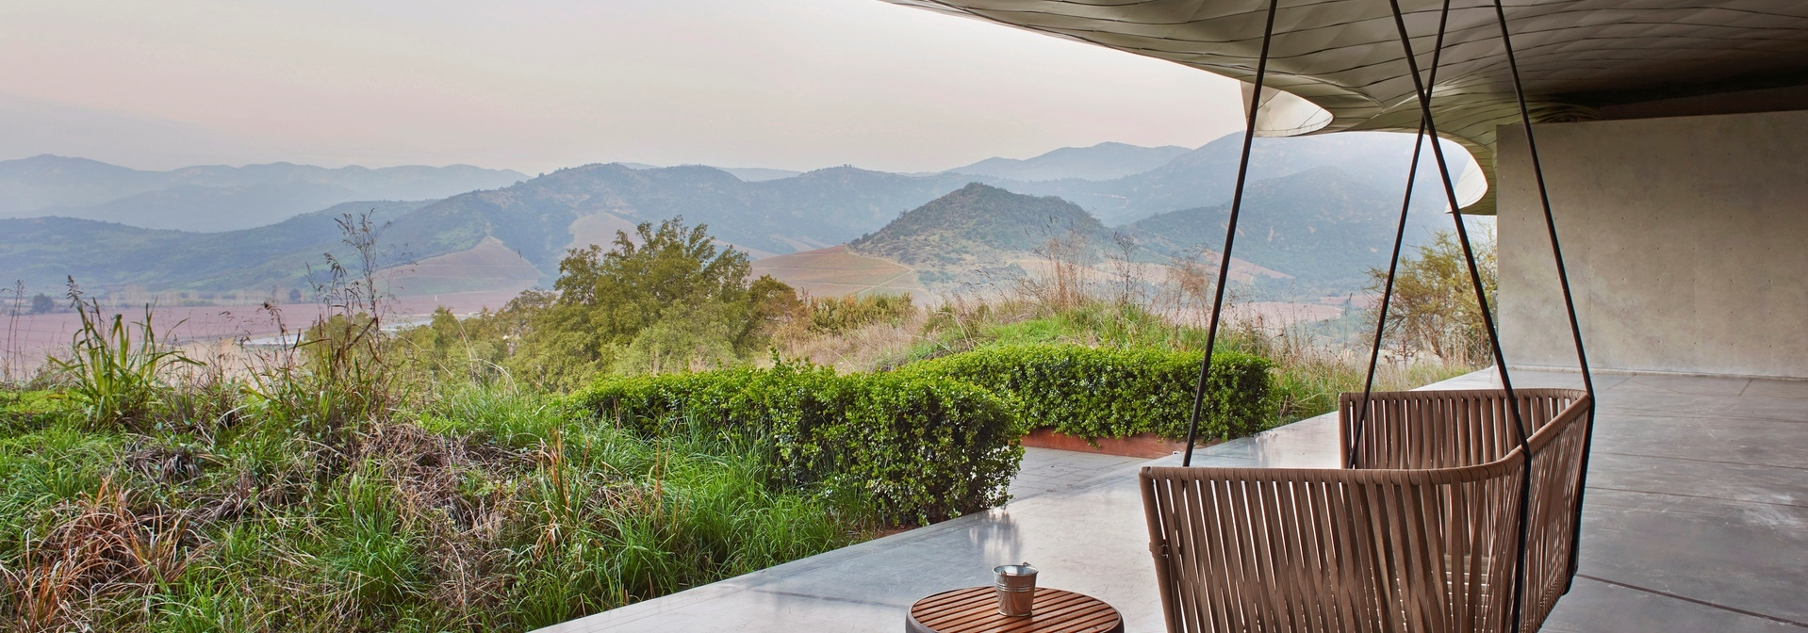
Holistic Luxury experiences
Anisa Yusuf 2425574
Module: Managing enterprise
BMSW4011
Lecturer: Melanie squire

Slide 2


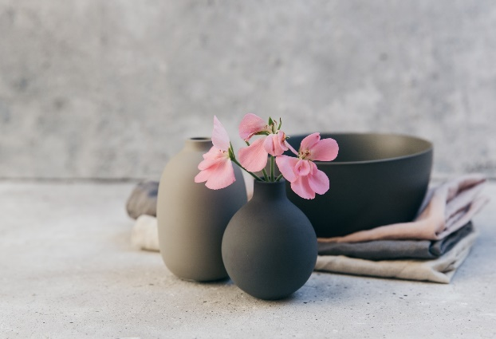
1.Business proposition
Holistic Luxury Travel Experience is a travel agency focused on providing safe, comfortable, and enriching solo travel opportunities for women, travel experiences that include:
• Luxurious accommodations (wellness retreats, five-star hotels, eco-luxury resorts)
• Holistic wellness activities (yoga, meditation, life coaching, sound healing, spa treatments)
• Personal development and empowerment workshops (group coaching, journaling, resilience training, self-discovery)
• Adventure and cultural experiences (guided treks, cultural tours, volunteering, mindful excursions)
• Safe, women-focused arrangements (women-only group options, experienced female guides, secure transportation)

Slide 3
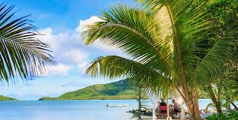
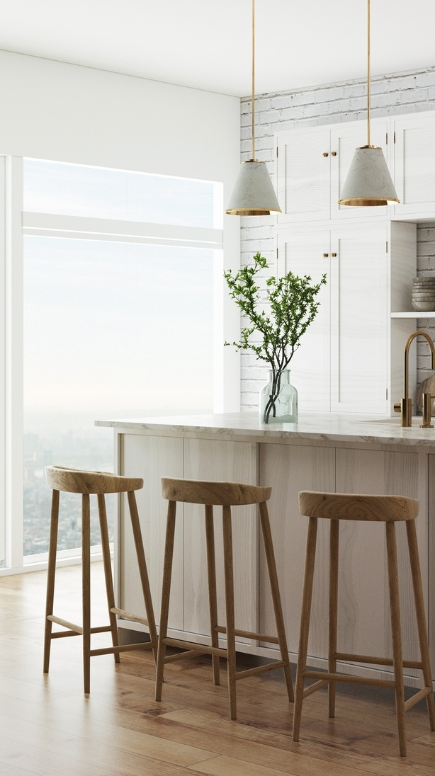


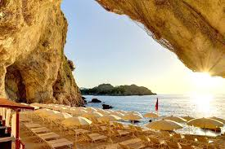
2. Story
As a holistic facing challenges of single motherhood, it has truly been a journey of connection with myself, finding peace within nature, experiences, and deep connections through relatable women whilst growing into a strong minded individual into the best version of myself.
I have found peace in traveling, immersing myself in nature, engaging in healing practices
I’ve noticed the lack of support for women to grow holistically within travel and tourism, female solo-travelers safety and empowerment, and most importantly holistic well-being. My vision is to create a business that empowers women through travel, personal growth, healing through holistic wellness.

Slide 4
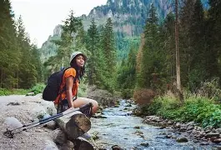
3.Market research
• The solo travel market is expanding rapidly. According to Grand View Research, female solo travellers accounted for 54.4% of the solo travel industry in 2024
• Europe is a particularly attractive market: growth in solo tourism, and especially among women for safety.
• According to a We Travel survey, 90% of wellness travel experiences are now customised, reflecting high demand for personalised retreats.
• Safety is a key concern for female travellers: 75% prefer “safe, secure destinations” according to a recent travel statistics report.
• Women-only travel is also growing particularly among those over 45, who are increasingly taking solo trips.

Slide 5
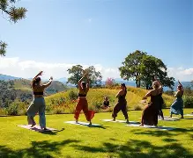
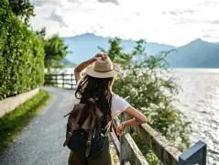
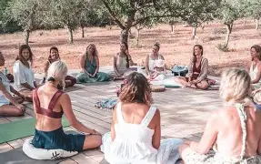
4.Mission Statement, Aim
Mission Statement:
“To empower women through luxurious, holistic travel experiences that nurture mental, physical and emotional well-being in a safe and soulful way.”
Aim:
To become the UK’s leading luxury holistic travel agency for women travellers seeking transformation, connection, and peace.

Slide 6
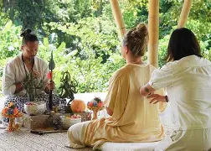
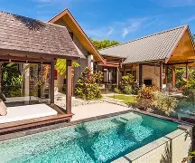
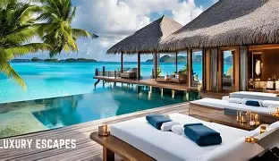
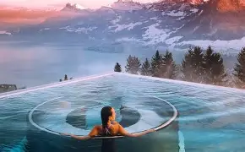
5.USP – unique selling proposition &
SMART Objectives
5A - USP
5B - SMART Objectives
Women-centred and safe: exclusive focus on women, exclusive female-led experiences, and journeys.
Holistic transformation: combines luxury travel with coaching, wellness, and empowerment.
Luxury and sustainability: eco-conscious luxury stays, curated for both comfort and gentle impact.
Secure 50 paying clients for personalised journeys.
Keep an average trip booking value of £4,000.
Reach a target of 20% repeat bookings or referrals by year's end.
Recruit female wellness & coaching partners.

Slide 7
6.Marketing & Promotional Activities
Marketing
Promotions
Website & blog: Build a premium website displaying journeys, client stories, wellness insights.
Social media: Instagram, Pinterest, and LinkedIn – share inspiring images, testimonials, wellness tips, solo travel guides.
Content marketing: Blog posts, newsletters, downloadable guides (“Safety tips for solo women travellers,” “Mindful journaling prompts on retreat”)
Offline materials: Business cards, elegant brochures/flyers to leave at yoga studios, wellness centres, women’s spaces.
This 5. PR & partnerships: Reach out to wellness magazines, women’s lifestyle blogs, travel influencers; host a launch event
Community events: Host free monthly “Solo Travel & Self-Growth” workshops locally (Reading / London) to build a community and generate leads.
Referral programme: Offer existing clients discounts or free coaching sessions for referring friends.

Slide 8
7. SWOT
Strengths:
o Niche-Clear USP: luxury + holistic + women-focused empowering
o Safety oriented
o Tailored experiences
o Passionate, mission-driven founding team
• Weaknesses:
o High upfront costs
o Limited market size Alienates- families and other service users
o Cash flow risk early on
• Opportunities:
o Partnerships with wellness retreats, yoga studios
o Expansion into digital offerings (virtual retreats)
o Targeting niche segments (women over 45, high-earning professionals)
o Eco / sustainable travel demand increasing
• Threats:
o Economic downturns affecting luxury travel budgets
o Competition from established travel agencies and OTAs
o Destination safety
o Regulatory risks in different destination countries
o Travel disruption (pandemics, political instability)

Slide 9
8. PESTLE
Political:
o Visa regulations, travel restrictions may affect trip planning
o Travel safety / geopolitical risk in destinations
• Economic:
o Luxury travel sensitive to economic downturns
o Currency fluctuations impact cost of overseas trips
• Social:
o Increasing social acceptance and demand for solo female travel
o Rising wellness consciousness among travellers
o Cultural trends of self-care, mental health
• Technological:
o Use of digital platforms for booking, virtual coaching
o Social media to build community / brand
Legal:
o Insurance and liability for travellers
o Contracts with retreat partners, guides
• Environmental:
o Demand for sustainable travel is rising
o Need to manage carbon footprint, eco-friendly options

Slide 10
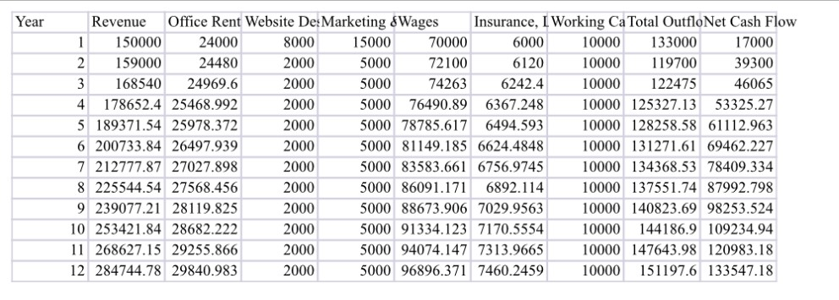
Cash flow

Slide 11
pitch
Holistic luxury travel experiences offer unique, high-value experiences at the level of luxury travel, holistic wellness, and solo-female empowerment. Backed by strong market trends in both solo travel and wellness tourism, whilst carefully confirming customer research, the business is well-positioned to serve a growing group of women looking for meaningful, safe, and transformative journeys. With high client lifetime value, low fixed staffing overheads, and a scalable model (expandable into digital retreats or group experiences), Holistic luxury experience is financially and operationally possible. Over its first year, the company aims not only to build a client base but to take on a community of empowered women travellers, laying the foundation for sustainable growth.

