Slide 1

Student Name: Melody Maseko
Student Number: 2244812
Module Code: BMHP6020
Module: Independent Project
Lecturer: Chloe Harris

Slide 2

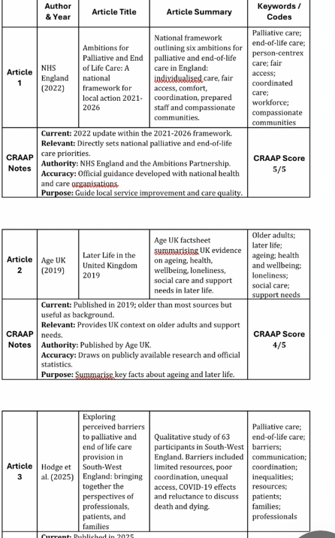
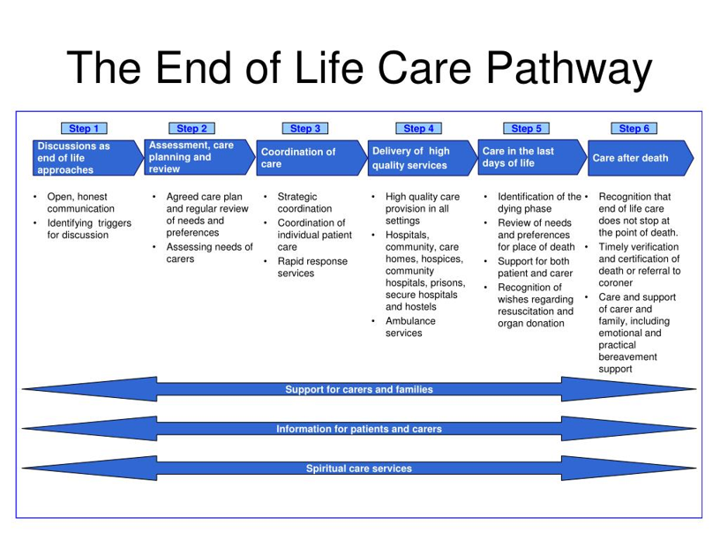
Barriers to Accessing Community-Based End-of-Life Care for the Elderly in the UK
1. Introduction
This chapter explains the method used to examine barriers to accessing community-based end-of-life care for elderly people in the UK. The dissertation used a secondary research design because the study is based on existing academic literature, policy discussion and published evidence rather than primary data collection. This approach was appropriate because end-of-life care is a sensitive field involving vulnerable older adults, family carers and bereaved people. Secondary research allowed the topic to be investigated ethically without recruiting participants or handling personal data. The method also matched the approved project proposal, which identified literature review and thematic analysis as the main approach.
2. Search Strategy
The search strategy was developed from the dissertation title, aim and objectives. The main search terms were end-of-life care, palliative care, community-based care, older adults, elderly, barriers, access, UK, care homes, home care, hospice care, primary care, integrated care and health inequalities. Synonyms included terminal care, supportive care, service access, advance care planning, multimorbidity and community nursing. Boolean operators were used to combine or narrow terms. Examples included end-of-life care AND elderly AND UK, community palliative care AND barriers, and care homes AND end-of-life care AND UK. PRISMA-S guidance highlights the importance of reporting search terms, information sources and search processes clearly so that literature searches are transparent and reproducible (Rethlefsen et al., 2021).
3. Searching for Information
Searches were carried out using databases and platforms relevant to health and social care, including PubMed, CINAHL, Scopus, Google Scholar and the university library. These platforms were selected because they provide access to peer-reviewed health, nursing, social care and palliative care literature. The search also included credible UK policy and professional sources where they supported understanding of service organisation, although peer-reviewed literature remained the main evidence base. Filters were applied to improve relevance. These included English language, full-text availability where possible, publication years from 2021 to 2026, UK focus, older adult population and relevance to community or home-based end-of-life care. International literature was used only where it supported wider background understanding.
Figure 1: End of life care pathway

Slide 3
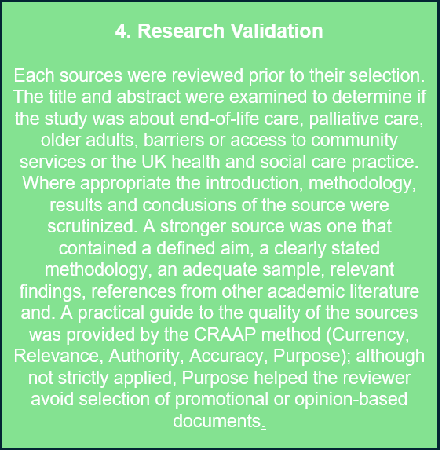
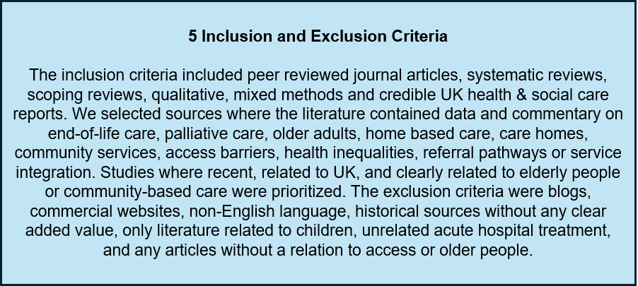
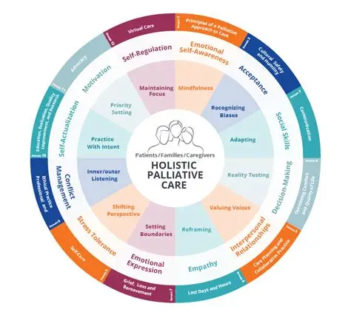
7 Ethical Considerations
No primary data was collected, and no participants were contacted. Therefore, the dissertation did not require consent forms, interviews or management of confidential participant information. Ethical responsibility was still important because the topic involves death, dying, inequality and vulnerable older adults. Sources were reported accurately, cited using Harvard referencing and interpreted fairly. The study avoided presenting elderly people as one uniform group because access can be shaped by diagnosis, ethnicity, income, geography, family support, disability and service availability. The analysis also aimed to avoid bias by including evidence showing different types of barriers.
6 Analysing Research
Analysis of the chosen sources was carried out using thematic analysis. This was deemed appropriate as the aim of this dissertation was to see where themes occurred repeatedly in published evidence, rather than measure a single statistical factor. Thematic analysis helps to systematically describe, identify and interpret meaning and patterns in qualitative material (Braun and Clarke, 2021) and so involved thoroughly reading the text of each selected source. Notes were taken on common problems encountered such as 'delayed referral,' 'fragmented service,' 'limited capacity of the workforce,' 'poor information provision,' 'cultural barrier,' 'lack of out-of-hours support' and 'unequal access based on geography.' These concepts were transformed into codes that, in turn, formed thematic headings for the analysis of the sources that formed chapter 4. Good practice rules were maintained by not coding what is stated but linking it to the aims of the dissertation and ensuring nothing is assumed or unsupported (Braun and Clarke, 2022). The table below documents author, year, type of study, key focus and emerging codes.
8 Chapter Conclusion
This chapter has explained the secondary research method used in the dissertation. It has outlined the search strategy, databases, keywords, Boolean operators, validation process, inclusion and exclusion criteria, thematic coding and ethical considerations. This method is suitable because it allows the study to review existing evidence on barriers to community-based end-of-life care for elderly people in the UK. The next chapter will present the findings through the key themes identified during the review.

