Slide 1
Computer Architecture
M4COMP
Term 2

Slide 2
Virtual Memory
Physical memory is not as large as the address space spanned by an address issued by the processor
Not all part of a program to be executed can be accommodated into the main memory.
Technique that automatically move program between data blocks(in hard disk) and main memory is called virtual memory technique.

Slide 3
Virtual Memory
Address issued by processor: virtual or logical address(location in hard disk where the requested data or instruction is available)
If the requested data is in main memory(hit) it will be accessed from it or else(miss) the data need to be moved from hard disk to main memory first.

Slide 4
Virtual Memory
Virtual address need to be translated to the physical address(the address location where the data should be placed in main memory)
Memory Management Unit(MMU) takes care address translation.
During a miss, MMU causes Operating System to load the data into main memory from hard disk.

Slide 5
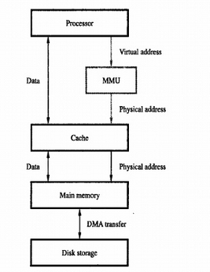
Responsible for address translation and moving data into RAM during a MISS

Slide 6
Virtual Memory – Address Translation
All programs are transferred in fixed-length units called pages(block of words).
A page table is maintained
  when each page is loaded from disk to main memory, an entry is placed in the page table.
  Page table entry : specifies the frame no.(the location in memory where the page is loaded in memory)
Virtual Address
  virtual page number
  offset(specifies the location of particular byte within a page)

Slide 7
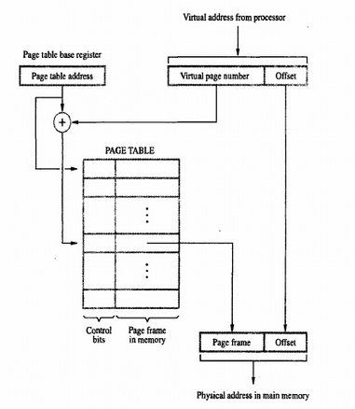
Address Translation
Page number

