Slide 1
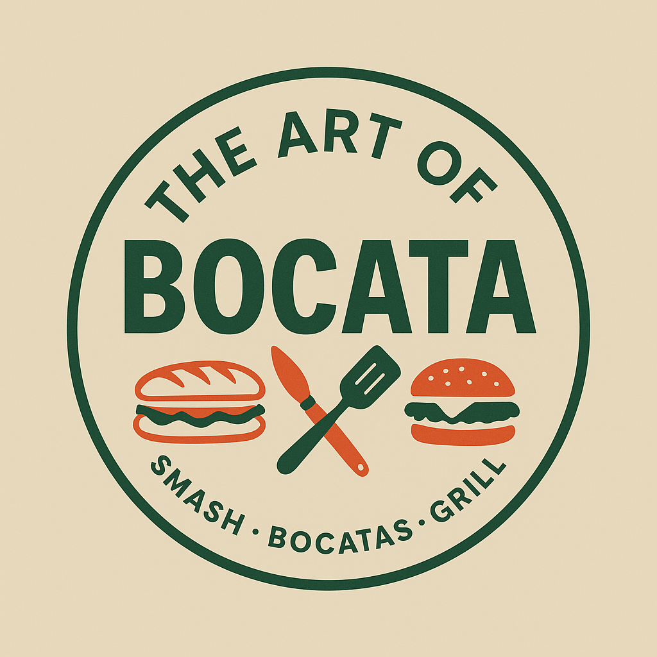
The Art of Bocata
Certificate in Higher Education Business Skills for the workplace.
Module: Enterprise and Entrepreneurship – LCLM4006.
Part 2: Individual Presentation Pitch.
Lecturer: Dr Charles Oham.
Student name: Genesis Daniela Llaguno Arteaga.
Student ID: 2435955

Slide 2
Overview of the Business Idea
What the business offers
Business set-up
Fresh bocatas made to order
Spanish style with Latin flavours
Colombian coffee
Breakfast items and pastries
Based in Streatham, South London
Family–run business
Small and easy to manage menu
Legal form: Sole trader

Slide 3
Three Important External Factors from the PESTEL Analysis
Economic:
Cost of living affects customer spending.
Rising costs can reduce profit.
Affordable pricing is important.
Social:
Customers want quick and fresh food.
People enjoy new flavours.
Diverse local community in South London
Legal:
Food safety and hygiene rules.
Allergen information must be clear
Business registration is required.

Slide 4

Marketing Strategy 1: TikTok and Instagram
Show bocatas, coffe and brand style
Attract local customers in Streatham
Build interest before and after opening
Share offers, deals and new products

Slide 5
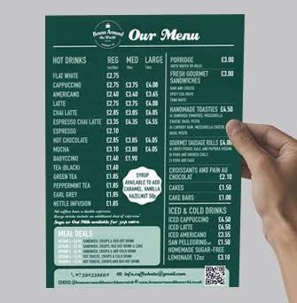
Marketing Strategy 2: Flyers and Local Promotion
Promote the business in Streatham
Reach local workers, students and residents
Use opening offers and meal deals
Encourage repeat customers and word of mouth

Slide 6
Funding Requirements and Allocation
Total funding needed: £42,000
Sources: personal savings and Start Up Loan
Deposit and advance rent: £6,500
Refurbishment and decoration: £8,000
Equipment and coffee machine: £9,000
First stock, licences, branding, and working capital
Main uses of funding
Shop set-up before opening
Support early business costs
Help the business start trading

Slide 7
Conclusion
Clear and different food concept in Streatham
Spanish style bocatas with Latin flavours and Colombian Coffee
Strong local demand from workers, students and residents
Good potential for growth through delivery and a stronger local brand

Slide 8
References
Food Standards Agency – Getting ready to start your food business https://www.food.gov.uk/business-guidance/getting-ready-to-start-your-food-business?
Food Standards Agency – Setting up your food business premises https://www.food.gov.uk/business-guidance/setting-up-your-food-business-premises?
GOV.UK – Business rates: Overview https://www.gov.uk/introduction-to-business-rates?
GOV.UK – Food business registration https://www.gov.uk/guidance/food-business-registration?
UWTSD class materials
My business plan

