Slide 1
Evidence based approaches to community policing
By Dylan Boettjer
2404410
BMPL4016

Slide 2
What is evidence-based policing?
Evidence based policing (EBP) is when the most effective and available evidence is used to train and challenge policing policies, practices and decisions, College of Policing, (2025)
From college of policing (2025),"An EBP approach can be used by everyone in policing. It can be supported by collaboration with academics and other partners."

Slide 3

What is community policing?
Examples of what community policing involves;
You’ll spend time getting to know local people, organisations and issues, then use that understanding to better protect the community.
You’ll adopt recognised problem-solving techniques to reduce the impact of crime and disorder on the community.
You’ll work with individuals and partner organisations to support those who are most at risk of reoffending – to reduce their impact on the community.
Joining the police,(2025)

Slide 4

The different types of EBP approaches to community policing
Hot spot policing, Youth Endowment Fund (2025)
Problem oriented policing(POP), London Assembly (2022)
Neighbourhood Policing, South Wales Police (2025)
Youth Endowment Fund (2025)

Slide 5
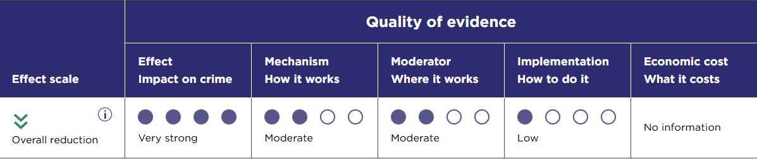
Hot Spot Policing (HSP)
Hot spot policing has proved to be effective in 2022 by reducing violence and robbery offences in the selected hot spots, Home Office (2025)
Picture showing evidence from this method, College of policing (2021)

Slide 6
Problem oriented policing(POP)
From London Assembly (2022), "The College of Policing have found that problem-oriented policing has contributed to a general reduction in offending, with one analysis finding a 33.8% reduction in crime and disorder."
Problem oriented policing has caused a massive reduction in crime and disorder by an astounding 34%. Campbell Collaboration, (2020)

Slide 7
Neighbourhood Policing
There is clear evidence to show that neighbourhood policing is most likely to be effective when its core features – targeted visible presence, community engagement, problem-solving, and procedural justice are delivered in combination, to a high standard, and at a local level. Home office, (2025)
From the HMICFRS, (2024) "The evidence is clear that neighbourhood policing is the most effective way to build community confidence." "So far, preventing and deterring crime has been the best performing area."

Slide 8
Reference list
Campbell Collaboration, (2020) Available at: https://www.campbellcollaboration.org/review/effects-of-problem-oriented-policing-on-crime-and-disorder/
College of Policing, (2025) Available at: https://www.college.police.uk/research/evidence-based-policing-EBP
College of Policing, (2025) Available at: https://www.college.police.uk/research/evidence-based-policing-EBP
College of Policing, (2021) Available at: https://www.college.police.uk/research/crime-reduction-toolkit/hot-spots-policing#:~:text=calls%2C%20and%20arrests.-,Effect%20%E2%80%93%20how%20effective%20is%20it?,conclusions%20can%20be%20ruled%20out.
Home office, (2025) Available at: https://www.gov.uk/government/publications/hot-spot-policing-in-england-and-wales-year-ending-march-2023#:~:text=Details,possible%20reasons%20for%20these%20effects.
HMICFRS, (2024) Available at: https://hmicfrs.justiceinspectorates.gov.uk/publication-html/state-of-policing-the-annual-assessment-of-policing-in-england-and-wales-2023/
Home office, (2025) Available at: https://www.gov.uk/government/publications/neighbourhood-policing-guarantee-performance-framework/neighbourhood-policing-guarantee-performance-framework-accessible#:~:text=There%20is%20clear%20evidence%20to,and%20at%20a%20local%20level.
Joining the police, (2025) Available at: https://www.joiningthepolice.co.uk/training-progression/career-progression/role-spotlights/neighbourhood-policing
London Assembly, (2022) Available at: https://www.london.gov.uk/who-we-are/what-london-assembly-does/questions-mayor/find-an-answer/problem-oriented-policing#:~:text=The%20College%20of%20Policing%20have,reduction%20in%20crime%20and%20disorder.
London Assembly, (2022) Available at https://www.london.gov.uk/who-we-are/what-london-assembly-does/questions-mayor/find-an-answer/problem-oriented-policing
South Wales Police, (2025) Available at: https://www.south-wales.police.uk/police-forces/south-wales-police/areas/about-us/about-us/neighbourhood-policing/
Youth Endowment Fund, (2025) Available at: https://youthendowmentfund.org.uk/toolkit/hot-spots-policing/

