Slide 1
Week 4
Project Scope Management
Managing Projects in the Organisation BMSW 5104

Slide 2
Learning Objectives:
After completion of this session you should be able to:
Understand the concept of project management scope
Understand how to develop work breakdown structure (WBS)

Slide 3
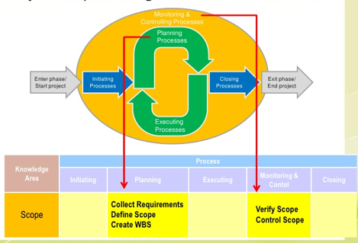
What is Project Scope Management
Scope refers to all the work involved in creating the products of the project and the processes used to create them

Slide 4
Project Scope Management Process
Process Group | Integration Management Process | Major Output
Planning | P1: Plan Scope Management | Scope Management Plan Requirement Mgt. Plan
 | P2: Collect Requirements | Req. Documentation Req. Traceability Matrix
 | P3: Define Scope | Project Scope Statement Project Docs Update
 | P4: Create WBS | Scope Baseline Project Docs Update
Monitoring and Controlling | MC1: Validate Scope | Accept Deliverables Change Requests Work Performance Info
 | MC2: Control Scope | Change Requests Project Mgt. Plan Updates Org, Process Asset Updates

Slide 5
Project Life Cycle
Authorisation
to implement
Initiation
Hand-Over
Picture of project life cycle
Feasibility
Realisation
Operation
Initial review
Appraisal
Preparation
Execution
Run-Up
Full
Operation
We Are Here!
Authorisation to appraise
Start of Full Operation
Authorisation to proceed

Slide 6
Project Planning
Tools
Work Breakdown Structures
Responsibility Matrixes
Cost Accounts
Dependency Charts

Slide 7
Project Planning
The purpose of planning
  To find out what needs to be done
  To establish who is going to do it
  To determine how much work is involved
  To find out how much it will cost
  To sort out the sequence of activities

Slide 8
Project Planning
Why Plan?
  To understand what needs to be done, and when, and by whom, and for how much
  To understand the requirement of resources needed to deliver the project
  To monitor progress as the project happens
  To compare actual progress with planned progress
  To take corrective action to get back on plan
Notes:
The strategic plan is about setting a direction for the organisation, devising goals and objectives and identifying a range of strategies to pursue so that the organisation might achieve its goals.

Slide 9
Project Planning
Why Plan as a team?
  To aid communication
  To get commitment

Slide 10
Project Planning
Levels
Strategic
  For senior managers, champions, steering groups
  At high level
Operational
  For middle managers
  Intermediate level of detail
Detailed
  For day to day control
  May be more than 1 plan
  In most detail
Notes:
The strategic plan is about setting a direction for the organisation, devising goals and objectives and identifying a range of strategies to pursue so that the organisation might achieve its goals.

Slide 11
Breakdown
Structures
PBS: Product Breakdown Structure
  A hierarchy of products
WBS: Work Breakdown Structure
  A hierarchy of work
CBS: Cost Breakdown Structure
  Budgets – allocating expenditure
OBS: Organisation Breakdown Structure
  More than an organisation chart (Lecture 12)

Slide 12
Work Breakdown
Structures
A project can be broken into work packages
This is not to confused with the phases of a project – although they may be the same!
Before we start – are the objectives clear?

Slide 13
Work Breakdown
Structures
Second level of WBS based on phases
This may be enough detail for the strategic plan
Second level of WBS based on phases
This may be enough detail for the strategic plan

Slide 14
Work Breakdown
Structures
Another way of breaking down the project, is by organisational department
This is particularly useful for functionally based organisations
The same project could be broken down as:

Slide 15
Work Breakdown
Structures
Second level of WBS based on departments

Slide 16
Work Breakdown
Structures
A third way of representing the same project, would be to break it into its constituent products
This is particularly useful for complex or modular projects
The same project could be broken down as:

Slide 17
Work Breakdown
Structures
Second level of WBS based on products
Notes:
breakdown of a product into its required components. The purpose of this breakdown is to provide a visual representation of a products components and the relationship between those components.

Slide 18
Work Breakdown
Structures
Any combination of these three methods can be used
  Phase
  Organisation
  Product
  Any combination of the above 3

Slide 19
Work Breakdown
Structures
Whichever method is used, the work packages can then be broken into activities.

Slide 20
Work Breakdown
Structures
This may be enough detail for the operational plan

Slide 21
Work Breakdown
Structures
Activities can then be broken into tasks.
If possible make these a ‘verb-noun’ composition
  Create Detailed Chassis Drawing
  Establish Component Costs
  Test Suspension Components

Slide 22
Work Breakdown
Structures
This needs to detailed enough for the day-to-day plan

Slide 23
Work Breakdown
Structures
This would make for 4 levels in the WBS
The WBS needs to as detailed as the project requires
Big projects – more detail

Slide 24
Work Breakdown
Structures
Level 1
the project title
Level 2
the work packages
Level 3
the activities
Level 4
the tasks

Slide 25
Work Breakdown
Structures

Slide 26
Milestones
Milestones are activities with Zero (or very short) duration.
  They are important events in the project.
    Completion of Deliverables
      One way of creating them is to use the end of the WBS work packages
    Key Decision Points
  Can be used as communication tools

Slide 27
New Product Project
Market Research
- Prepare Questionnaire
- Establish Market Size
- Prepare PEST Analysis
- Perform SWOT Analysis
- Perform Competitor Analysis
- Consider Social Trends
Market Research Completed

Slide 28
Work Breakdown Structures
Benefits of using a WBS:
    Focus on Planning in the early phases
    Focus on evaluation and review in the later phases
Project X
Preparation
Execution
Evaluation

Slide 29
Work Breakdown Structures
Project X
Preparation
Execution
Evaluation
Identify Team
Write Project Charter
Identify Stakeholders
Reviews
Meetings
Communication
Tests
Audits
Inspections
Review Project
Clean-Up
Get Paid
Hold Party
Don’t forget:
    Communication & Reporting Tasks
    Project Management Tasks
    Quality Management - Reviews, Checks, Tests

Slide 30
Work Breakdown
Structures
Benefits of using a WBS:
  Tasks are:
    Definable – easily understood
    Independent – minimum interfaces
    Estimate able – time and cost
    Measurable – progress easily captured
    Adaptable – can be eliminated or added

Slide 31
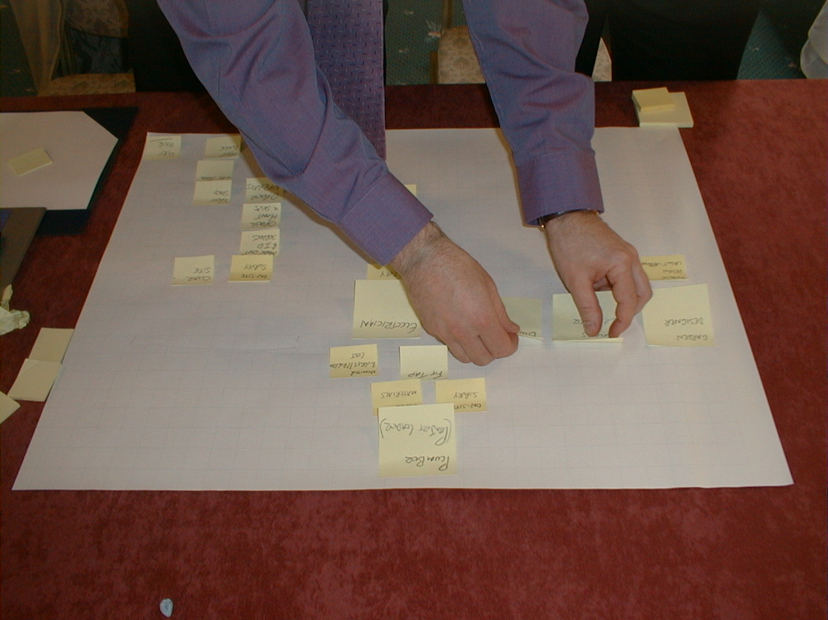
Picture of team exercise

Slide 32
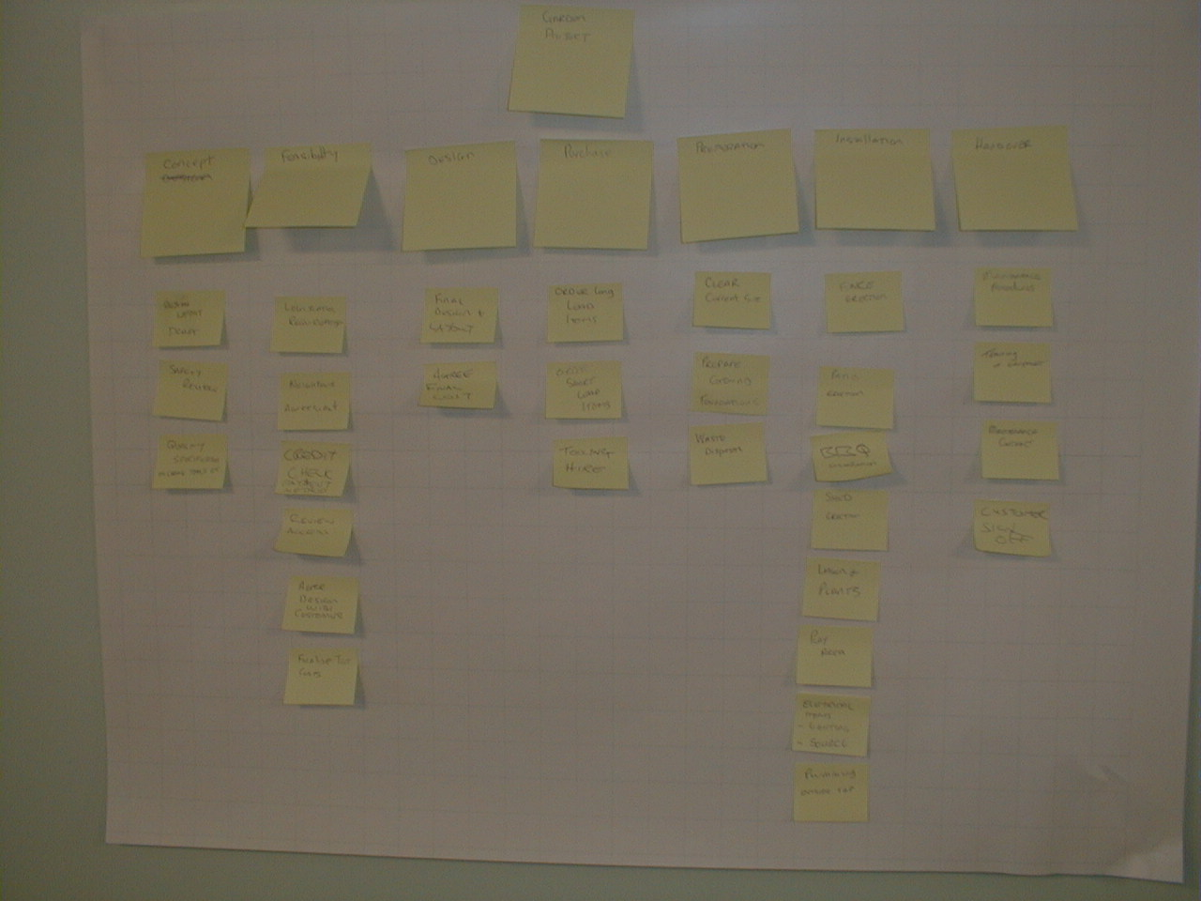
Picture of team exercise

Slide 33
318 Group Project
Market Research
Product Idea
Design
Manufacturing
Advertising
Marketing
Prepare Questionnaire
Establish Market Size
Prepare PEST Analysis
Perform SWOT Analysis
Perform Competitor Analysis
Consider Social Trends
Hold a Brainstorm
Discuss Ideas
Make Final Product Decision
Invent Product Name & Logo
Perform Product Value Analysis
Create Design Specification
Establish Basic Features
Create Bill of Material
Create Drawings
- Whole product
- Component parts
- Mechanisms
Establish Component Costs
Design Packaging & Instruction Manuals
Choose Suppliers
Set Factory Location
Establish Factory Layout
Estimate Number of Employees
Decide on Manufacturing & Packaging Processes
Make or Buy decision
Establish Logistics & Distribution Methods
Promotion Campaigns
Estimate Costs of Advertising
Choose Advertising Channels
Find Target Customer
Establish Sales Price
Determine Promotion Methods
Investigate Product
Establish Sales Routes
Establish Distribution Methods
Provide Sales Forecasts
Company Structure
HRM
Finances
Choose the Company Name
Define Company Strategy
Define the Company Structure
Prepare Mission Statement
Choose Company Location
Consider Economic Conditions
Choose Source Of Finance
Estimate:
- Cost Of Expenditure
- Machinery Costs
- Material Costs
- Cost Of Advertising
- Salary Costs
- Packaging Costs
Calculate Profit and Loss For 3 Years
Establish 3 Year Turnover Figures
Consider Company Taxation Law
Determine Personnel Requirements
Provide Operator Training
Establish Salaries
Write Job Descriptions
Establish Internal Communication Channels
Consider:
- Employment law
- Health and Safety &
- Quality Control Issues

Slide 34
Responsibility
Assignment Matrixes
Once we understand the list of tasks, we can assign them to the project team.
RAM – Responsibility Assignment Matrix
RM – Responsibility matrix for short

Slide 35
Responsibility
Matrixes
The list of tasks
Define ‘A’ Surface
Design Rear Moulding
Design Internal Fixtures

Slide 36
Responsibility
Matrixes
 | JEREMIE | MATHIAS | VINCENT
Define ‘A’ Surface
Design Rear Moulding
Design Internal Fixtures
The list of people

Slide 37
Responsibility
Matrixes
 | JEREMIE | MATHIAS | VINCENT
Define ‘A’ Surface
Design Rear Moulding
Design Internal Fixtures
√
√
√

Slide 38
Responsibility
Matrixes
A simple technique to prevent those immortal phrases
  “I didn’t think I was supposed to do that!”
  or
  “ I though Maxine was doing that!”

Slide 39
Responsibility
Matrixes
 | JEREMIE | MATHIAS | VINCENT
Define ‘A’ Surface
Design Rear Moulding
Design Internal Fixtures
√
√
√
√

Slide 40
Responsibility
Matrixes
Now Jeremie and Vincent have an excuse not to do the task –
  They can blame each other!
We must make 1 person the accountable task owner
 | JEREMIE | MATHIAS | VINCENT
Define ‘A’ Surface | √ |  | √
Design Rear Moulding |  |  | √
Design Internal Fixtures |  | √

Slide 41
Responsibility
Matrixes
 | JEREMIE | MATHIAS | VINCENT
Define ‘A’ Surface | R |  | A
Design Rear Moulding |  |  | A
Design Internal Fixtures |  | A
Each task has 1 accountable task owner

Slide 42
Responsibility
Matrixes
A = Accountable
R = Responsible
O = Owner
S = Support
P = Primary
S = Secondary

Slide 43
Responsibility
Matrixes
 | JEREMIE | MATHIAS | VINCENT
Define ‘A’ Surface | S |  | O
Design Rear Moulding |  |  | O
Design Internal Fixtures |  | O

Slide 44
Responsibility
Matrixes
 | JEREMIE | MATHIAS | VINCENT
Define ‘A’ Surface | S |  | P
Design Rear Moulding |  |  | P
Design Internal Fixtures |  | P

Slide 45
Responsibility Matrix Terms
“The Doer”
R
Who is responsible?
The person who is assigned to do the work
“The Buck Stops Here”
The person who makes the final decision & has the ultimate ownership
A
Who is accountable?
“In the Loop”
The person who must be consulted before a decision is taken
C
Who is consulted?
“Keep in the Picture”
The person who must be informed that a decision/ action has been taken
I
Who is informed?

Slide 46
Cost Breakdown
Structure
Adding labour rates, work, and cost estimates to the responsibility matrix creates a Cost Breakdown
Structure (CBS)
Often called a Budget or a “cost Account”

Slide 47
Cost Accounts
 | JEREMIE £10/h | MATHIAS £15/h | VINCENT £20/h
Define ‘A’ Surface
Design Rear Moulding
Design Internal Fixtures
√
√
√
√

Slide 48
Cost Accounts
 | JEREMIE £10/h | MATHIAS £15/h | VINCENT £20/h
Define ‘A’ Surface
Design Rear Moulding
Design Internal Fixtures
20 hours
5 hours
30 hours
12 hours
How much work in the task, & how do you know?

Slide 49
Estimating
Bottom Up Estimating
  Based on estimates for every task on the WBS
Comparative Estimating
  Based on similar past projects
Parametric Estimating
  Based on numbers
    Of IT Terminals
    Of Users to be trained
    Requires plenty of previous data
Work, Costs, and Durations

Slide 50
Cost Accounts
£ | JEREMIE £10/h | MATHIAS £15/h | VINCENT £20/h | Total
Define ‘A’ Surface | 200 |  | 100 | 300
Design Rear Moulding |  |  | 600 | 600
Design Internal Fixtures |  | 180 |  | 180
Total | 200 | 180 | 700 | 1080
20
5
30
12

Slide 51
Cost Accounts
We can now add estimates for materials, expenses, consumables and all other costs to complete the tasks

Slide 52
Cost Accounts
£ | JEREMIE £10/h | MATHIAS £15/h | VINCENT £20/h | Total
Define ‘A’ Surface | 200 |  | 100 | 300
Design Rear Moulding |  |  | 600 | 600
Design Internal Fixtures |  | 180 |  | 180
Total | 200 | 180 | 700 | 1080 1100
20
5
100
100
30
400
400
12
600
600
600
500

Slide 53
Cost Accounts
£ | JEREMIE £10/h | MATHIAS £15/h | VINCENT £20/h | Total
Define ‘A’ Surface | 200 |  | 100 | 300
Design Rear Moulding |  |  | 600 | 600
Design Internal Fixtures |  | 180 |  | 180
Total | 200 | 180 | 700 | 1080 1100 2180
20
5
100
100
30
400
400
12
600
600
600
500

Slide 54
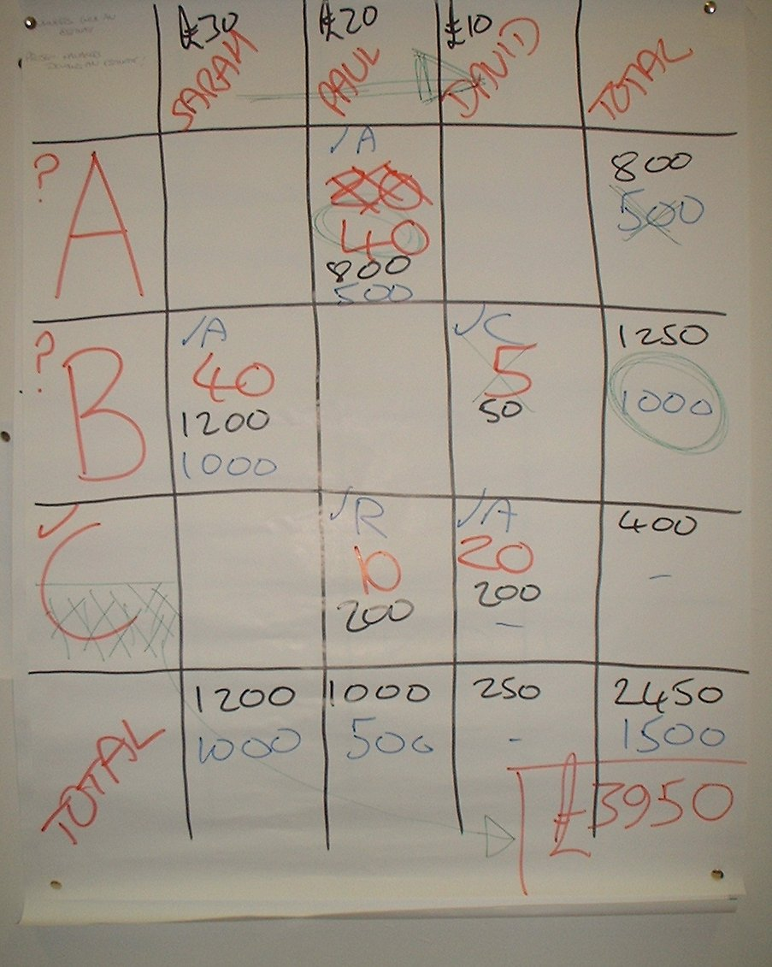
Cost Accounts
Cost Account
Team Effort

Slide 55
Cost Accounts
Functional Responsibilities
  Who does what
Work Planning and Budget Assignment
  Where the work and money are being spent
Cost Collection
  Estimates & Actuals

Slide 56
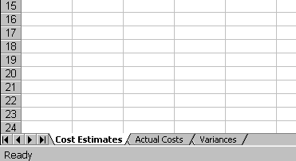
Cost Accounts

Slide 57
Cost Accounts
We can save money on the project in the following ways:
  Find cheaper labour sources internally or externally
  Find more competitive material quotes
  Do the work quicker i.e. work smarter
  Delete project tasks to save money

Slide 58
Cost Accounts
£ | JEREMIE £10/h | MATHIAS £15/h | VINCENT £20/h | Total
Define ‘A’ Surface | 200 |  | 100 | 300
Design Rear Moulding |  |  | 600 | 600
Design Internal Fixtures |  | 180 |  | 180
Total | 200 | 180 | 700 | 1080 1100 2180
20
5
100
100
30
400
400
Move work from higher paid staff to
Cheaper resources – this may include
out-sourcing to a specialist company
12
600
600
600
500

Slide 59
Cost Accounts
£ | JEREMIE £10/h | MATHIAS £15/h | VINCENT £20/h | Total
Define ‘A’ Surface | 200 |  | 100 | 300
Design Rear Moulding |  |  | 600 | 600
Design Internal Fixtures |  | 180 |  | 180
Total | 200 | 180 | 700 | 1080 1100 2180
20
5
Look at getting cheaper quotes
For materials and expenses
100
100
30
400
400
12
600
600
600
500

Slide 60
Cost Accounts
£ | JEREMIE £10/h | MATHIAS £15/h | VINCENT £20/h | Total
Define ‘A’ Surface | 200 |  | 100 | 300
Design Rear Moulding |  |  | 600 | 600
Design Internal Fixtures |  | 180 |  | 180
Total | 200 | 180 | 700 | 1080 1100 2180
20
5
100
100
30
400
400
12
600
600
Look for ways of reducing the hours
of work. Is there a better (quicker)
way of achieving the task
600
500

Slide 61
Cost Accounts
£ | JEREMIE £10/h | MATHIAS £15/h | VINCENT £20/h | Total
Define ‘A’ Surface | 200 |  | 100 | 300
Design Rear Moulding |  |  | 600 | 600
Design Internal Fixtures |  | 180 |  | 180
Total | 200 | 180 | 700 | 1080 1100 2180
20
5
100
100
30
400
400
12
600
600
Look for ways of eliminating tasks
whilst maintaining full functionality
600
500

Slide 62
Cost Accounts
To delete functionality that is written into the project aims is not allowed!
If you can’t afford to do all of the project:
  either we need to ask for more money,
  or we need to re-write the project aims.
  In both cases Senior Mangers are involved!

Slide 63
Cost Accounts
In real life a cost account is a spreadsheet.
It may be maintained by a finance department for the project manager

Slide 64
Cost Accounts

Slide 65
Activity Dependency
What task do you want to do now ?
What task do you want to do before that ?
What task do you want to do next ?
What task can be done at the same time ?

Slide 66
Dependency Chart
NOW
BEFORE
NEXT
SAME TIME

Slide 67
Dependency Chart
Activity on Node
Activity on Arrow
NOW
BEFORE
NEXT
SAME TIME
NOW
BEFORE
NEXT
SAME TIME

Slide 68
Activity Diagramming Methods
Precedence Diagramming Method (PDM)
  Activity On Node (AON)
    uses rectangular nodes to represent Activities
    connects them with arrows to show dependencies
Arrow Diagramming Method (ADM)
  Activity On Arrow (AOA)
    uses arrows to represent Activities
    uses circles to represent Events

Slide 69
Logic
Finish to Start
A
B
B depends on A
A
X
X depends on A only
Y
Y depends on A and B
B
Z
Z depends on B only

Slide 70
Merge And Burst
Nodes
Merge Node
Burst Node
Merge nodes:
  Events into which a number of activities enter and one (or several) leave.
Burst nodes:
  Events that have one (or more) entering activities generating a number of emerging activities.

Slide 71
Collector Node / Milestones
A
A
X
X
B
Y
B
Y
C
Z
C
Z

Slide 72
No Looping
J
K
L

Slide 73
No Dangling
J
K
L

Slide 74
No Dangling
J
K
L

Slide 75
Conventions
Start Task is always needed
Finish Task is always needed
Tasks have names
Task numbers follow the WBS codes

Slide 76
Dependency Chart
B
E
F
start
A
C
H
J
L
Finish
D
G
K

