Slide 1
User Experience Design
ACCA7020
Lecture 1 - Introduction

Slide 2
Aim
To support students in the development of pervasive and engaging user experiences, in particular those focussed on media-rich multi-modal interaction with ubiquitous and personal computing devices. Students will gain experience of prototyping and testing of single-user and multi-user interactions within a web environment.

Slide 3
Learning Outcomes
Upon the successful completion of this module, the student should be able to demonstrate the ability to:
  Critically reflect upon current design practice, selecting appropriate techniques and technologies for a wide range of interactions.
  Research user needs within both personal and social interactivity spheres for unconstrained problems.
  Select and apply appropriate UX methodologies and good practices to prototype innovative interaction within a social context.
  Critically analyse and reflect upon the results of UX testing.

Slide 4
Timetable
Teaching sessions
Thursday 11-1 (IQ004)
Thursday 3-5 (IQ109)
These will occur every week until Easter. Remember to bring paper, pens, coloured pens/pencils etc. as this is a very practical module
Attendance
  Attendance is highly recommended as we will be working through assignment 2 during the teaching sessions

Slide 5
Indicative Content
Stuff such as (but not limited to)
  Principles and techniques of UX/user-centred design; best practices; criticisms
  Human beings; ergonomics, psychophysics, psychology, perception and cognition
  UX Elements; visual design, information architecture, interaction design, usability, multimodality
  Interaction requirements; social and emotional requirements; single-user and multi-user interactions
  Prototyping, modelling, patterns, personae; scenarios; gamification
  UX testing; designing and running testing workshops

Slide 6
Assessment
Thwo assignments
Assignment 1 – 50% of the overall grade
  Development and evaluation of a wireframe model of an app
  Deadline: 27th March 2020
Assignment 1 – 50% of the overall grade
  Development and evaluation of a full model of an app
  Deadline: 11th May 2020

Slide 7
Textbooks
The main textbooks for the course are
  Krug, S. (2013), Don’t Make me Think Revisited. Voices That Matter.
  Beynon, D. (2013), Designing Interactive Systems (3rd Ed.). Pearson.
  Norman, D. (2013), The Design of Everyday Things (revised and expanded edition). MIT Press.
Links to these at Amazon are available on Moodle
Reading and viewing material from other sources will be made available via Moodle

Slide 8
User Experience Design vs.
Usability vs.
Interaction Design

Slide 9
Definitions
Interaction Design (IxD)
  “…[T]he practice of designing interactive digital products, environments, systems, and services.”[1]
User Experience Design (UX/UXD)
  “The goal of user experience design in industry is to improve customer satisfaction and loyalty through the utility, ease of use, and pleasure provided in the interaction with a product.” [2]
Usability
  “…[T]he degree to which a software can be used by specified consumers to achieve quantified objectives with effectiveness, efficiency, and satisfaction in a quantified context of use.” [3]
[1] Cooper, Alan; Reimann, Robert; Cronin, Dave (2007). About Face 3: The Essentials of Interaction Design. Indianapolis, Indiana: Wiley. p. 610.ISBN 978-0-470-08411-3.
[2] Kujala, Sari; Roto, Virpi; Väänänen-Vainio-Mattila, Kaisa; Karapanos, Evangelos; Sinneläa, Arto (2011). "UX Curve: A method for evaluating long-term user experience". Interacting With Computers. 23 (5): 473–483.
[3] Ergonomic Requirements for Office Work with Visual Display Terminals, ISO 9241-11, ISO, Geneva, 1998.

Slide 10
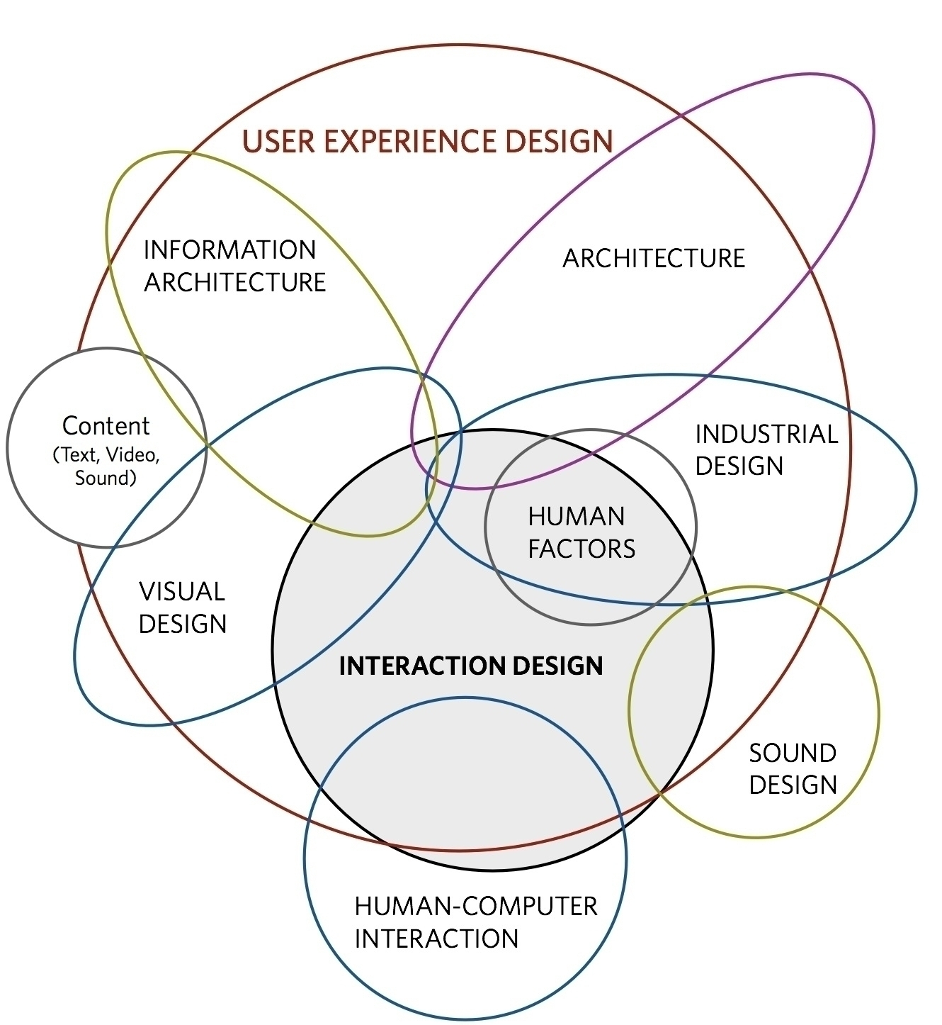

Slide 11
Development of UXD
Human Factors / Ergonomics
Human-Computer Interaction
Usability Engineering
Interaction Design
User Experience Design
HF considers how people interact with physical objects (e.g. aircraft, chairs, guns…)
HCI focuses on interactions with computers
UE applies a systematic approach to ensuring that software is effective, efficient and easy to use
IxD focuses on interactive digital systems
UX considers emotional responses to systems

Slide 12
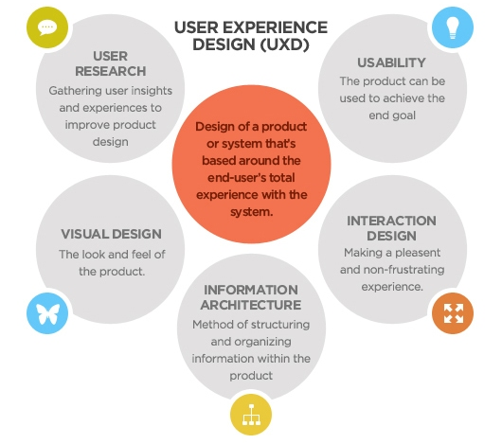
Elements of UXD

Slide 13
Coming Soon…
Next lecture: User Research
Homework: Read the Wikipedia articles on the following
  User Experience Design
  Usability
  Usability Engineering
  Interaction Design
  Human Factors and Ergonomics
  Human-Computer Interaction

Slide 14
Assignment 1
Facebook v. Google+

Slide 15
Background
Facebook and Google+ are two social networks, developed by Facebook and Google
  Both systems allow users to post text, images and photos and to comment on other people’s posts
  Internet-connected mobile devices.
  Facebook was originally released in 2004 for Harvard students and opened to the rest of the world in 2006
  Google+ launched in 2011
  Both have web-based and mobile access available

Slide 16
Research Questions
Both games use similar technology applied in different ways
  How do both sites use psychology, usability, design, and copywriting to engage and maintain user interest in the sites?
  What has Google+ learned from Facebook? How has it consciously decided to differ from Facebook?
  How do the differences between the two sites provide different social experiences for their users?

