Slide 1




Name Nasreen Akhtar
Student ID 2132945
Module Professional Development within Health and Social Care
Module Code LCHS4005_ BIRM
Key Skills Presentation-Working in teams
Lecturer Emanuel Asante
This Photo by Unknown author is licensed under CC BY-SA.

Slide 2

Introduction
In this presentation I want to emphasize on the importance of working in teams in the Health and Social Care sector. All organizations are built up by teamwork, not by one individual member, but by several individuals working together. Booker, T(1997). I will be explaining what can be accomplished by working in teams.
This Photo by Unknown author is licensed under CC BY.

Slide 3

Key Skill-Working in teams
Working in teams is an essential skill for most jobs and research careers, and it is increasingly becoming a component of student assignments. Good teamwork is greatly aided by good emotional self-management and interpersonal skills.
Cottrell, S (2019).
This Photo by Unknown author is licensed under CC BY-NC.

Slide 4

Working in teams
Working in teams encourages collaboration and improves communication skills. Working in teams is the efforts within a team to produce the highest quality and most efficient results.
This Photo by Unknown author is licensed under CC BY-NC.

Slide 5
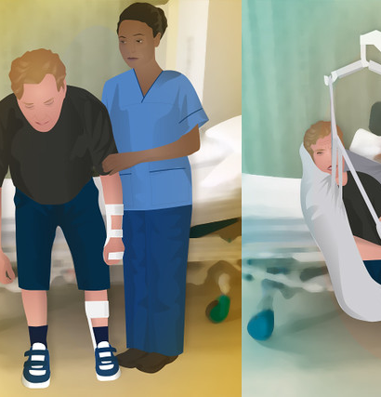
Practical example of teamwork
If a patient is admitted in the hospital with a stroke the hospitals must organize a team of medical professionals such as:
Rehabilitation specialists
Rehabilitation nurses
Physio therapists
Occupational therapists
Speech and language therapists and
Mental health professionals
To help with their treatment, and recovery.
This Photo by Unknown author is licensed under CC BY-SA-NC.

Slide 6
Conclusion
For my presentation, I chose teamwork as a key skill. I looked for real-world examples of teamwork in the Health and Social Care Practice. I discovered that working in teams is critical for the best interests of patients. I used a practical example of teamwork to demonstrate the importance of teamwork and how it can effectively and efficiently help patients' well-being.

Slide 7
References
Cottrell, S.(2019) The Study Skills Handbook.5th edn London: Red Globe Press.
Booker, T.(1997) Charlottesville, VA: Generic NL.

