Slide 1
Ancient Stories Reimagined: Is Reception of the Classical World a Help or Hindrance to the Classics Discipline?
Sophie Taylor

Slide 2
Narrowing the Focus…
Criteria for research and evidence –
  Feminist reception
  Literary format
  Produced from 2 – present
  Homeric poems, plots, characters or themes
Aims -
  A careful analysis of both ancient sources and modern literature
  Similarities and Differences
  Relationship between “tradition” and “reception”

Slide 3
Outline and Summary
Introduction
  Set out the overall Dissertation, methodology and sources
  Situate the work in context
  Offer an Outline
Chapter 1: Dealing with Debates
Chapter 2: Example Analysis – Circe
  Main ancient text [The Odyssey]
  Reception [Circe, M. Miller; Circe, Carol Ann Duffy]
Chapter 3: Example Analysis – Briseis
  Main ancient text [The Iliad]
  Reception [The Silence of the Girls, P.Barker; For the Most Beautiful, Emily Hauser]
Chapter 4: Consideration of Impact
Conclusion

Slide 4


Chapter 1: Dealing with Debates

Slide 5
Key Issues and Debates
“The way in which Greek and Roman material has been transmitted, translated, excerpted, interpreted, rewritten, re-imagines and represented”
(Hardwick; Stray. 2008. 1)
“Concerned with the artistic or intellectual process involved in selecting, imitating or adapting ancient works”
(Hardwick; Stray. 2011.)
“Reception within classics encompasses all work concerned with postclassical material”
(Martindale. 2006. 5.)
“Studies of the reading, interpretation, (re)fashioning, appropriation, use, and abuse of past texts over the centuries”
(Martindale. 2015.)
“Reception”
  What is it? How can we define it?
  Origins and development
  Approaches
  Responses
“Classical Tradition”?
  What is the “Classical Tradition”?
  How might it have led to / evolved into reception?
  Do the two relate, utilise and/or rely upon one another?

Slide 6
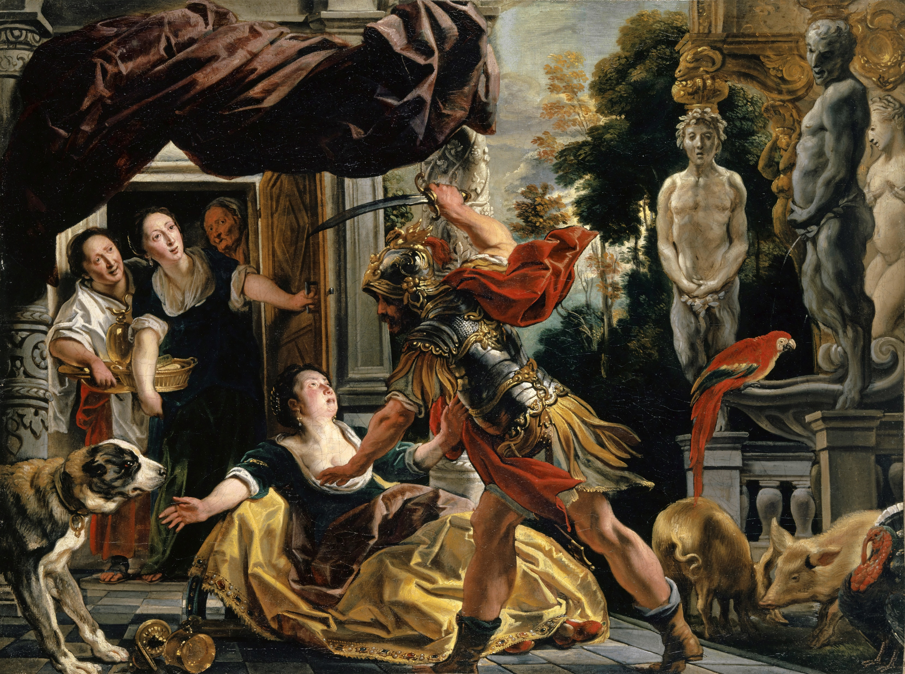
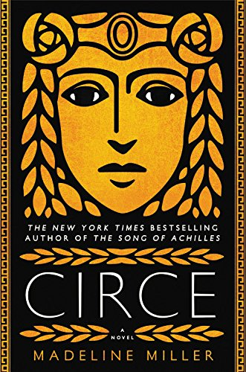
Chapter 2: Example Analysis – Circe
Jacob Jordaens I, (1630-35). ‘Ulysses threatening Circe’. Available at: Wikimedia Commons
Madeline Miller, (2018). Front Cover. Available at: Circe.

Slide 7
Main Source (Ancient)
The Odyssey (books 10 and 12)
Points:
  Participates in reception
  Circe - introduction, characterisation, use within poem, impact, what she might be used to represent etc.
Other source:
  Ovid, Metamorphoses (book 14)
  Apollonius, Argonautica (book 4)
  Plutarch, Morelia: Beasts and Rational.
Relation to overall argument?
  How has this version of Circe been received?
  Why might it have prompted feminist reception in particular?
Scholarship to use:
  McClymont, J.D. (2008). “The Character of Circe in the Odyssey”, Akroterion. 53. 21-29.
  Nadel, I. B. (1990). “Circe: textual method and textual meaning”. Studies in the Novel. 90. 22. 163-178.
  Pantelia, M. (1993). “Spinning and Weaving: Ideas of Domestic Order in Homer”, The American Journal of Philology. 114. 4. 493-501.
  Scott, J. (1916). “The Sources of the Odyssey”, The Classical Journal. 12. 2. 119-130.
  Segal, C. (1968). “Circean Temptations: Homer, Vergil, Ovid”, Transactions and Proceedings of the American Philological Association. 99. 419-442.

Slide 8
Main Source (Modern)
Circe by M. Miller
Points:
  Use of ancient sources, influence, similarities, differences etc.
  Function and purpose of the work
  Impact on ancient sources
Other sources:
  “Circe” by Carol Ann Duffy
Relation to overall argument?
  What does this work add to the ancient?
  How might it impact newcomers to the ancient world?

Slide 9
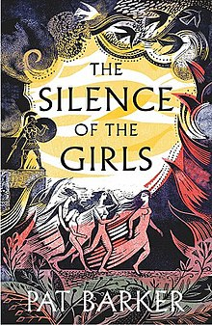
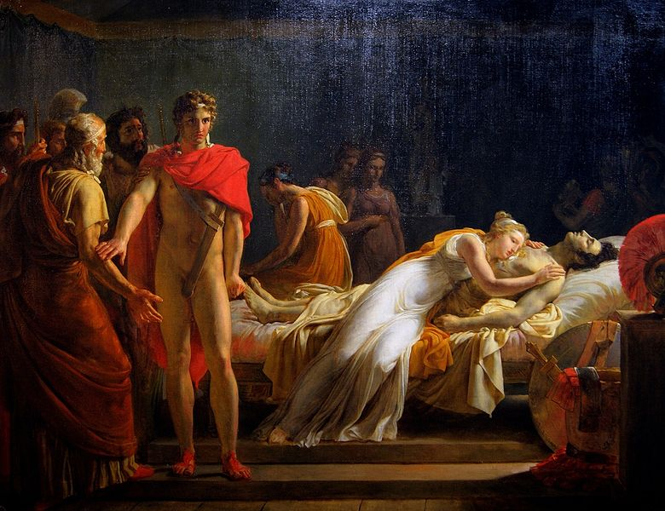
Pat Barker, (2018). Front Cover. Available at: The Silence of the Girls.
Chapter 3: Example Analysis – Briseis
Léon Cogniet (1815). ‘Briséis rendue à Achille découvre dans sa tente le corps de Patrocle’, Avalable at: Wikimedia Commons

Slide 10
Main Source (Ancient)
The Iliad
Points:
  How is she introduced and developed?
  What purpose does she serve?
  Importance of her character?
Other sources:
  Ovid, Heroides 3.
Relation to overall argument?
  Major character with very little actual mention
Scholarship to use:
  Due, C. (2007). “Learning Lessons from the Trojan War: Briseis and the Theme of Force”, College Literature, 34. 2. 229-262.
  Jacobson, H. (1971). “Ovid’s Briseis: A Study of Heroides 3”, Phoenix. 25. 4. 331-356.
  Skinner, M.B. (1982). “Briseis, the Trojan Women, and Erinna”, The Classical World. 75. 5. 265-269.
  Verducci, F. (2014). Ovid’s Toyshop of the Heart: Epistulae Heroidum. Princeton University Press.
  Wilkinson, L.P. (2015). Ovid Recalled. Cambrige University Press.
  Wright, I. (2016). “The Wife of Achilles”, Mnemosyne. 69. 1. 113-118.

Slide 11
Main Source (Modern)
The Silence of the Girls, by Pat Barker
Points:
  Use of sources, function and impact
  Changing of narrative
  Importance emphasised
Other sources:
  “For the Most Beautiful” by Emily Hauser
Relation to overall argument?
  Reception as a positive thing

Slide 12


Chapter 4: Impact on the Discipline

Slide 13
To consider:
Is there a place for Reception in the classical discipline?
What impact has/can it have?
Has it always been an essential aspect of Classics?
  Shakespeare, Renaissance art, European architecture, political usage, modern media in other forms
Scholarship:
  Beard, M. (2014). Confronting the Classics. Profile Books.
  Cox, F.; Theodorakopoulos, E. (2019). Homer’s Daughters: Women’s Responses to Homer in the Twentieth Century and Beyond. Oxford University Press.
  Hardwick, L; Harrison, S. (2013). Classics in the Modern World: A Democratic Turn?. Oxford University Press.
  Hardwick, L; Stray, C. (2011). A Companion to Classical Receptions. John Wiley & Sons.
  Martindale, C.; Thomas, R.F. (2006). Classics and the Uses of Reception. Wiley.
  Tatum, J. (2014). ‘A Real Short Introduction to Classical Reception Theory’, Arion: A Journal of Humanities and the Classics. 22. 2. 75-96.

Slide 14
Conclusion -
“Classics is not only the dialogue that we have with the culture of the classical world; it is also the dialogue that we have with those who have gone before us who were themselves in dialogue with the classical world. Classics are a series of ‘Dialogues with the Dead’.”
(Mary Beard, (2014). Confronting the Classics. 11).

Slide 15
Bibliography:
Beard, M. (2014). Confronting the Classics. Profile Books.
Cox, F.; Theodorakopoulos, E. (2019). Homer’s Daughters: Women’s Responses to Homer in the Twentieth Century and Beyond. Oxford University Press.
Due, C. (2007). “Learning Lessons from the Trojan War: Briseis and the Theme of Force”, College Literature, 34. 2. 229-262.
Hardwick, L; Harrison, S. (2013). Classics in the Modern World: A Democratic Turn?. Oxford University Press.
Hardwick, L; Stray, C. (2011). A Companion to Classical Receptions. John Wiley & Sons.
Jacobson, H. (1971). “Ovid’s Briseis: A Study of Heroides 3”, Phoenix. 25. 4. 331-356.
Martindale, C.; Thomas, R.F. (2006). Classics and the Uses of Reception. Wiley.
McClymont, J.D. (2008). “The Character of Circe in the Odyssey”, Akroterion. 53. 21-29.
Nadel, I. B. (1990). “Circe: textual method and textual meaning”. Studies in the Novel. 90. 22. 163-178.
Pantelia, M. (1993). “Spinning and Weaving: Ideas of Domestic Order in Homer”, The American Journal of Philology. 114. 4. 493-501.
Scott, J. (1916). “The Sources of the Odyssey”, The Classical Journal. 12. 2. 119-130.
Segal, C. (1968). “Circean Temptations: Homer, Vergil, Ovid”, Transactions and Proceedings of the American Philological Association. 99. 419-442.
Skinner, M.B. (1982). “Briseis, the Trojan Women, and Erinna”, The Classical World. 75. 5. 265-269.
Tatum, J. (2014). ‘A Real Short Introduction to Classical Reception Theory’, Arion: A Journal of Humanities and the Classics. 22. 2. 75-96.
Verducci, F. (2014). Ovid’s Toyshop of the Heart: Epistulae Heroidum. Princeton University Press.
Wilkinson, L.P. (2015). Ovid Recalled. Cambrige University Press.
Wright, I. (2016). “The Wife of Achilles”, Mnemosyne. 69. 1. 113-118.

