Slide 1
Master of Business Administration
Strategic Management
Introduction and Overview

Slide 2
Introduction to the Module
Key Topics covered per week
Materials
Assignment Brief
Virtual Code of Conduct

Slide 3

Introduction to the Module
Key Topics covered per week
Materials
Assignment Brief
Virtual Code of Conduct

Slide 4
Learning Outcomes
Upon the successful completion of this module, the student should be able to demonstrate the ability to:
Synthesise the relationship between the external context of an organisation and its internal context and their impact on its strategies;
Critically evaluate competitive and development strategies, in the context of contemporary strategic management issues;
Assess the factors that must be considered in strategy implementation.

Slide 5
Key Topics per Week
WEEK | TOPICS
WEEK 1 | Introduction and Overview of Strategic Management
WEEK 2 | Scanning External Environment & Industry Analysis
WEEK 3 | Evaluating a Company’s Resources , Capabilities & Competitiveness
WEEK 4 | Crafting a Business Strategy: 5 Generic Competitive Strategies
WEEK 5 | Crafting a Business Strategy: Diversification & Multibusiness
WEEK 6 | Strategy Formulation
WEEK 7 | Strategy Implementation / Execution
WEEK 8 | Ethics, Corporate Social Responsibility, Sustainability & Strategy
WEEK 9 | Evaluation and Control
WEEK 10 | Workshop
WEEK 11 | Assignment Submission

Slide 6
Key Topics per Week
WEEK | TOPICS
WEEK 1 | Introduction and Overview of Strategic Management
WEEK 2 | Scanning External Environment & Industry Analysis
WEEK 3 | Evaluating a Company’s Resources , Capabilities & Competitiveness
WEEK 4 | Crafting a Business Strategy: 5 Generic Competitive Strategies
WEEK 5 | Crafting a Business Strategy: Diversification & Multibusiness
WEEK 6 | Strategy Formulation
WEEK 7 | Strategy Implementation / Execution
WEEK 8 | Ethics, Corporate Social Responsibility, Sustainability & Strategy
WEEK 9 | Evaluation and Control
WEEK 10 | Workshop
WEEK 11 | Assignment Submission

Slide 7

Attendance
Students are required to attend all term classes.
Students will be marked LATE if arriving between 10 to 40 minutes after the beginning of their class. OR if leaving a class between 10 to 40 minutes before the end.
Two late marks will be treated as an ABSENT mark.
If your attendance mark is incorrect, only the lecturer can ask Student Services to change the mark.

Slide 8
Example: Class starts at 9.00am
Student arrives at 9.05 - full attendance
Student arrives at 9.20 – marked as late
Student arrives at 9.45 – marked as absent
NOTE:
Same rules if you leave early

Slide 9
Important
You MUST stay connected for the entire session
Prepare in advance – look at Moodle before the class starts
Make notes during the session
Correspondence – name, student number, module – make sure you check your TSD email frequently

Slide 10
Teaching and Learning
Mixture of:
  Lectures
  Seminars
  Discussions
  Group work
  Pair work
  Case studies

Slide 11
Resources
All resources and teaching materials available to you on Moodle
Important – Prepare - Check the Lesson schedule before coming to class

Slide 12
Books and Materials
Johnson, G. and Scholes, K., Exploring Strategy, Harlow: FT Prentice Hall, 2010
Lynch, R., Corporate Strategy, Harlow: FT Prentice Hall, 2010.
Mintzberg, H., Ahlstrand, B., and Lampel, J. Strategy Safari: The Complete Guide Through the Wilds of Strategic Management, Harlow: FT Prentice Hall, 2008.
Hayes, J., The Theory and Practice of Change Management, Palgrave, 2010
Ridderstral, J. and Nordstrum, K., Funky Business, Harlow: FT Prentice Hall, 2007
Senge, P. M., The Fifth Discipline, London: Random House Business Books, 2006

Slide 13
Assignment Brief
To be discussed next week

Slide 14
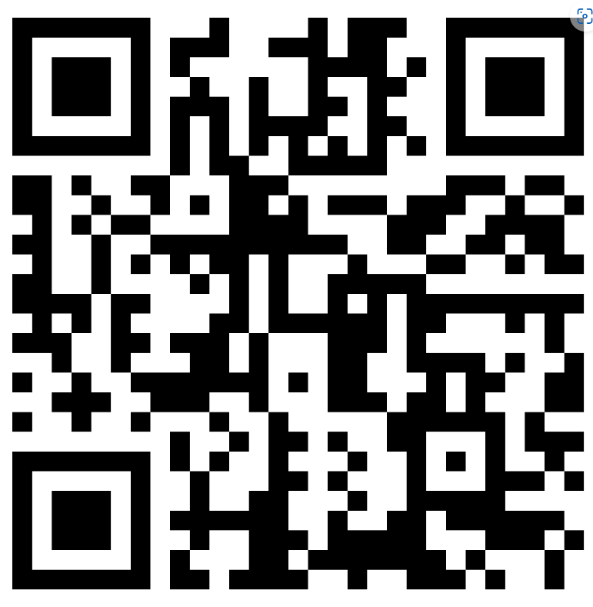
Defining Strategy
Activity 1.1
Go to the Internet and search for the definition of Strategy. Highlight the key words / phrases in the strategy definition and let’s discuss.
Send your comments to the padlet below:
https://padlet.com/sampath4/what-is-a-strategy-in-business-or-company-nid6rt4pcv98kx4n or use the QR Code here.

Slide 15
Characteristics of Strategic Decisions
Long Term Plans
Strategic fit with the business environment
Scope of Firm’s Activities
The firm’s resources and competences.
The values and expectations
Advantage over competition
Source: David, Ali, and Al-Aali (2009 )

Slide 16
Strategies
What is Strategy --- (1)
The creation of a unique and valuable position, involving a different set of activities (Porter, 1998).
Serve few needs of many customers
Serve broad needs of few customers
Serve broad needs of many customers in a narrow segment.
Notes:
Trait: Bringing influencing qualities: Trait is a distinguishing quality of an individual and defining leadership as a trait means that each individual brings to the table certain qualities that influence the way he or she leads.
Belief that traits are innate: Saying that leadership is a trait places a great deal of emphasis on the leader and on the leader’s special gifts. It follows the often-expressed belief “leaders are born, not made,” that leadership traits are innate rather than learned.
All have unique traits: All of us are born with a wide array of unique traits and that many of these traits can have a positive impact on our leadership. It is possible to modify or change these traits to become an effective leader.
Right trait in right situation: Although there are many important leadership traits, what is most important for leaders is having the required traits that a particular situation demands. Effective leadership results when the leader engages the right traits in the right place at the right time.

Slide 17
Strategies
What is Strategy --- (2)
When a Business chooses to make trade-offs in competing (Porter, 1998).
Ryanair chooses to focus on only customers with low budget
Notes:
Trait: Bringing influencing qualities: Trait is a distinguishing quality of an individual and defining leadership as a trait means that each individual brings to the table certain qualities that influence the way he or she leads.
Belief that traits are innate: Saying that leadership is a trait places a great deal of emphasis on the leader and on the leader’s special gifts. It follows the often-expressed belief “leaders are born, not made,” that leadership traits are innate rather than learned.
All have unique traits: All of us are born with a wide array of unique traits and that many of these traits can have a positive impact on our leadership. It is possible to modify or change these traits to become an effective leader.
Right trait in right situation: Although there are many important leadership traits, what is most important for leaders is having the required traits that a particular situation demands. Effective leadership results when the leader engages the right traits in the right place at the right time.

Slide 18
Strategies
What is Strategy --- (3)
It is about creating a fit amongst the company’s activities (Porter, 1998).
Notes:
Trait: Bringing influencing qualities: Trait is a distinguishing quality of an individual and defining leadership as a trait means that each individual brings to the table certain qualities that influence the way he or she leads.
Belief that traits are innate: Saying that leadership is a trait places a great deal of emphasis on the leader and on the leader’s special gifts. It follows the often-expressed belief “leaders are born, not made,” that leadership traits are innate rather than learned.
All have unique traits: All of us are born with a wide array of unique traits and that many of these traits can have a positive impact on our leadership. It is possible to modify or change these traits to become an effective leader.
Right trait in right situation: Although there are many important leadership traits, what is most important for leaders is having the required traits that a particular situation demands. Effective leadership results when the leader engages the right traits in the right place at the right time.

Slide 19

STRATEGY DEFINED
Strategy “is the direction and scope of an organisation over the long term, which achieves advantage in a changing environment through its configuration of resources and competences with the aim of fulfilling stakeholder expectations” (Johnson, Scholes and Whittington,2007).

Slide 20
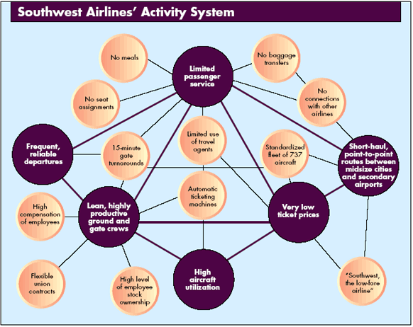

Slide 21
What is Strategy
“The means by which the long-term objectives will be achieved” (David, Ali, and Al-Aali, 2009).
Strategies are undertaken by top management team.
Require significant amount of firm’s resources.
Notes:
Trait: Bringing influencing qualities: Trait is a distinguishing quality of an individual and defining leadership as a trait means that each individual brings to the table certain qualities that influence the way he or she leads.
Belief that traits are innate: Saying that leadership is a trait places a great deal of emphasis on the leader and on the leader’s special gifts. It follows the often-expressed belief “leaders are born, not made,” that leadership traits are innate rather than learned.
All have unique traits: All of us are born with a wide array of unique traits and that many of these traits can have a positive impact on our leadership. It is possible to modify or change these traits to become an effective leader.
Right trait in right situation: Although there are many important leadership traits, what is most important for leaders is having the required traits that a particular situation demands. Effective leadership results when the leader engages the right traits in the right place at the right time.

Slide 22
Implications of Strategic Decisions
They can be complex.
Usually done in time of uncertainty.
Impact on operational decisions.
Requires integrated approach (internal and external)
Requires constant review.
Notes:
Ability: Capacity to lead: A person who has leadership ability is able to be a leader; that is, has the capacity to lead.
Ability is both natural and acquired: While the term ability frequently refers to a natural capacity, ability can be acquired. For example, some people are naturally good at public speaking, while others rehearse to become comfortable speaking in public.
Leadership as ability: John Wooden: An example of leadership as ability is the legendary University of California at Los Angeles basketball coach John Wooden, whose teams won seven consecutive National Collegiate Athletic Association titles. Wooden implemented four laws of learning into his coaching: explanation, demonstration, imitation, and repetition. His goal was to teach players how to do the right thing instinctively under great pressure.

Slide 23
Levels of Strategy
Corporate Level Strategy
Overall purpose and scope of an organisation and how value will be added to the different parts (business units) of the organisation
Business-level strategy
How to compete in a particular market.
Operational strategies
How the various parts of the organisation delivers the corporate and business-level strategies effectively.
Notes:
Ability: Capacity to lead: A person who has leadership ability is able to be a leader; that is, has the capacity to lead.
Ability is both natural and acquired: While the term ability frequently refers to a natural capacity, ability can be acquired. For example, some people are naturally good at public speaking, while others rehearse to become comfortable speaking in public.
Leadership as ability: John Wooden: An example of leadership as ability is the legendary University of California at Los Angeles basketball coach John Wooden, whose teams won seven consecutive National Collegiate Athletic Association titles. Wooden implemented four laws of learning into his coaching: explanation, demonstration, imitation, and repetition. His goal was to teach players how to do the right thing instinctively under great pressure.

Slide 24
Strategic Management
What is the position of your organisation in the market now?
If you decide not to make any changes, what do you think will be the position of the organisation in one year? two years? ten years? Are the answers acceptable?
If your answers are not satisfactory, what specific decisions and actions should management undertake? What risks and payoffs are involved?
Notes:
In leadership literature, more than 100 different definitions of leadership have been identified (Rost, 1991).
Despite these many definitions, a number of concepts are recognized by most people as accurately reflecting what it is to be a leader.

Slide 25

What is Strategic Management?
“Set of managerial decisions and actions that determines the long0-run performance of a corporation” (Hunger, 2020).
Notes:
In leadership literature, more than 100 different definitions of leadership have been identified (Rost, 1991).
Despite these many definitions, a number of concepts are recognized by most people as accurately reflecting what it is to be a leader.

Slide 26
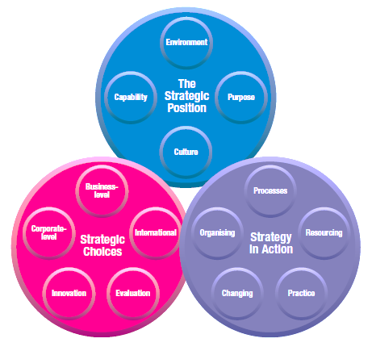
Strategic Management

Slide 27
What is Strategic Management?
Environmental Scanning (Internal & External)
Monitor Strengths & Weaknesses in the light of Opportunities and Threats to generate new strategic direction
Strategy Formulation
(Strategic Planning)
Strategy Implementation / Execution
Evaluation and Control
Source: Hunger, J.D. (2020).
Notes:
In leadership literature, more than 100 different definitions of leadership have been identified (Rost, 1991).
Despite these many definitions, a number of concepts are recognized by most people as accurately reflecting what it is to be a leader.

Slide 28
Business Model
  Profit Formula:
  How does a business earn revenue and make profit?
  Customer Value Proposition: How does a business create value for its customers?
The way or method in which a company makes its money within the business environment is the
business model.
Notes:
Mutual influence process: Concepts essential to leadership: Leadership is a mutual influence process, involving both leaders and followers.
Leadership demands placed on individuals: In every leadership situation, there are expectations and demands placed upon one or more individuals to initiate and take responsibility for a decision, event, or other need. A leader may have a high profile or a low profile, but in every situation there are leadership demands placed on the individual who is the leader.

Slide 29
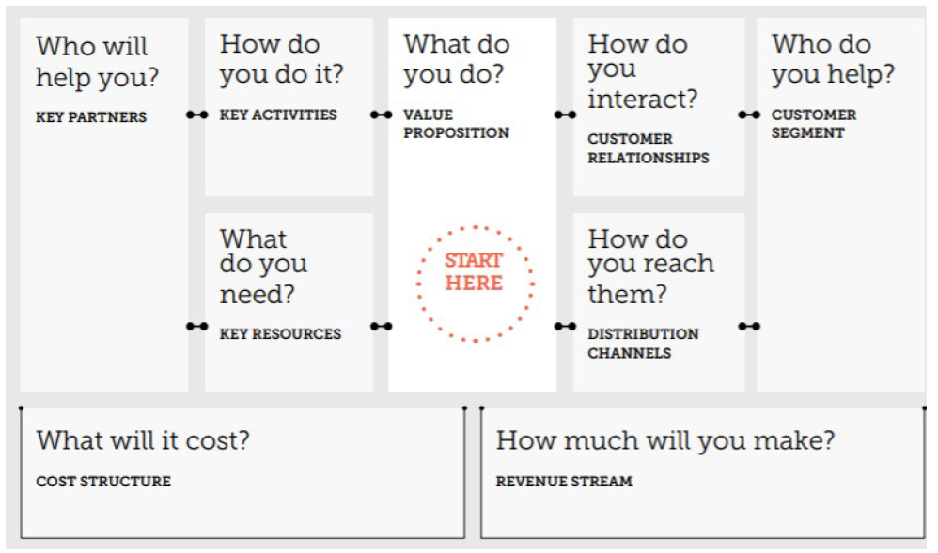
Business Model Canvas
Introduction to the Business Model Canvas – YouTube

Slide 30
Activity
Identify any company of your choice and state its Business Model after developing the business model canvas.

Slide 31
Example of business models
Customer Solutions Model – IBM sells expertise as consultants
Multi-Component System – Gillette sells razors at brake-even in order to sell higher-margin razor blades.
Advertising Model – Google offers free advert to expose users to adverts that pays the bills.
Switchboard Model – Intermediary firm to connect multiple sellers to multiple buyers for a fee. E.g., Mutual Funds, Financial Planners, etc.
Efficiency Model – Waits for a product to become standardised and then enter market with low-prices, low-margin product appealing to the mass market. E.g., Dell, Wallmart.
Time Model – Use R&D to be first in the market. eg., Sony.

Slide 32


Slide 33
Sustainable Competitive Advantage
Competitive Advantage: “Anything that the a firm does especially well compared to rival firms.” (David, Ali, and Al-Aali, 2009).
“A company achieves a Sustainable Competitive Advantage when an attractively large number of buyers develop a durable preference for its products / services over the offerings of competitors, despite the efforts of competitors to overcome or erode its advantage” (Gamble, Thompson, and Peteraf, 2013).
A Sustained Competitive Advantage is achieved by (1) continually adapting to changes in external environment and internal capabilities, and resources, and (2) effectively formulating, executing and evaluating strategies that exploit those factors (David, F.R., Ali, A.J. and Al-Aali, A.Y., 2009).

Slide 34
Sustainable Competitive Advantage
Low-cost provider, e.g. Walmart, Ryanair
Broad differentiation strategy, e.g., Johnson & Johnson in baby products, Apple (innovative products)
Focused low-cost strategy
Focused Differentiation Strategy, e.g., Louis Vuitton and Rolex
Best-cost provider

Slide 35

Charting a Company’s Direction
A Company’s Vision
  First step in strategic planning
  What does the company want to become in the long term?
  Adidas – “to be the leading and most loved sports brand in the world”.
Notes:
Trait: Bringing influencing qualities: Trait is a distinguishing quality of an individual and defining leadership as a trait means that each individual brings to the table certain qualities that influence the way he or she leads.
Belief that traits are innate: Saying that leadership is a trait places a great deal of emphasis on the leader and on the leader’s special gifts. It follows the often-expressed belief “leaders are born, not made,” that leadership traits are innate rather than learned.
All have unique traits: All of us are born with a wide array of unique traits and that many of these traits can have a positive impact on our leadership. It is possible to modify or change these traits to become an effective leader.
Right trait in right situation: Although there are many important leadership traits, what is most important for leaders is having the required traits that a particular situation demands. Effective leadership results when the leader engages the right traits in the right place at the right time.

Slide 36
Examples of Vision Statements
General motors’ vision is to be the world leader in transportation products and related services.
(Author comment: Good statement)
PepsiCo’s responsibility is to continually improve all aspects of the world in which we operate-environment, social, economic—creating a better tomorrow than today.
    (Author comment: Statement is too vague; it should reveal how the firm’s food and beverage business benefits people)
Royal Caribbean’s vision is to empower and enable our employees to deliver the best vacation experience for our guests, thereby generating superior returns for our shareholders and enhancing the well-being of our communities.
(Author comment: Statement is good but could end after the word guests)

Slide 37
Charting a Company’s Direction
A Company’s Mission
  Why does the company exist? Or what is our business?
  Statements of purpose that distinguish the company from other similar firms.
  Defines the scope of a firm’s operations in product and market terms.
Notes:
Trait: Bringing influencing qualities: Trait is a distinguishing quality of an individual and defining leadership as a trait means that each individual brings to the table certain qualities that influence the way he or she leads.
Belief that traits are innate: Saying that leadership is a trait places a great deal of emphasis on the leader and on the leader’s special gifts. It follows the often-expressed belief “leaders are born, not made,” that leadership traits are innate rather than learned.
All have unique traits: All of us are born with a wide array of unique traits and that many of these traits can have a positive impact on our leadership. It is possible to modify or change these traits to become an effective leader.
Right trait in right situation: Although there are many important leadership traits, what is most important for leaders is having the required traits that a particular situation demands. Effective leadership results when the leader engages the right traits in the right place at the right time.

Slide 38
Charting a Company’s Direction … cont’d
Company’s Objectives
  Specific results the company seeks to achieve within a specific timeframe are Objectives.
Long-Term Objectives
Specific results achieved for pursuing its basic mission.
Usually more than 1 year.
Annual Objectives
Milestones that the business must achieve to reach its annual objectives.
Achieved within a year.
Notes:
Trait: Bringing influencing qualities: Trait is a distinguishing quality of an individual and defining leadership as a trait means that each individual brings to the table certain qualities that influence the way he or she leads.
Belief that traits are innate: Saying that leadership is a trait places a great deal of emphasis on the leader and on the leader’s special gifts. It follows the often-expressed belief “leaders are born, not made,” that leadership traits are innate rather than learned.
All have unique traits: All of us are born with a wide array of unique traits and that many of these traits can have a positive impact on our leadership. It is possible to modify or change these traits to become an effective leader.
Right trait in right situation: Although there are many important leadership traits, what is most important for leaders is having the required traits that a particular situation demands. Effective leadership results when the leader engages the right traits in the right place at the right time.

Slide 39
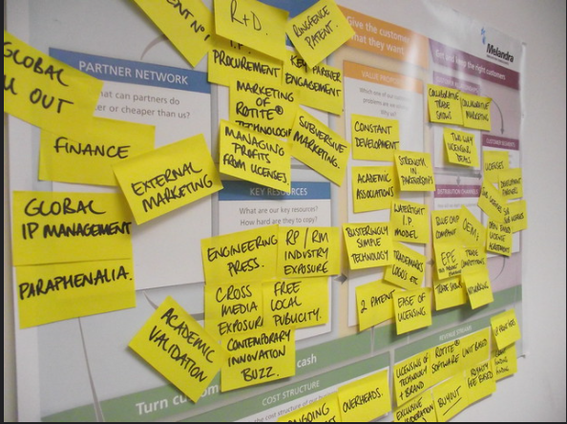
STRATEGIC MANAGEMENT MODEL

Slide 40
Strategic Planning
The Internal Audit
Types of Strategies
Vision, Mission & Objectives
Strategy Formulation
Strategy Implementation / Execution
Strategy Monitoring & Evaluation
The External Audit
Ethics and Corporate Social Responsibility
Source: David, Ali, and Al-Aali (2009 )

Slide 41
Benefits of Strategic Management
Improved Communication
Improved Understanding the organisation
Integrated approach for solving problems
Improved Commitment from staff and other stakeholders.
Expected Outcomes
Exploitation of Opportunities
Encourages forward thinking
Effective allocation and management of Resources
Alignment of behaviour towards company goals
Reduces impact of adverse conditions on business
Framework for coordination of activities and efforts
Source: David, Ali, and Al-Aali (2009 )

Slide 42
Summary of Session
We explored the definition of Strategy
Understanding of the main concepts of Strategic Management
Importance of studying Strategic Management
Strategic Management Model
Notes:
Skill: Competency to accomplish task: Leadership is a skill. Conceptualized as a skill, leadership is a competency developed to accomplish a task effectively.
Know what to do and how to do: Skilled leaders are competent people. They know what they need to do, and they know how to do it.
Can be studied and learned: Even without natural ability, like all skills, people can improve their leadership with practice, instruction, and feedback from others. Viewed as a skill, leadership can be studied and learned. If you are capable of learning from experience, you can acquire leadership.

Slide 43

Next Week
  Exercise for Next Week:
  Give an example of a recent political development that changed the overall strategy of an organisation. Please cite your source.
  Scanning External Environment & Industry Analysis
Using Illustration 1 as an example, show how the elements of strategic management differ in:
(a) a small business (e.g. Marshfield Bakery)
(b) a large multinational business (e.g. AIB)
(c) a non-profit organisation (e.g. NHS Direct or Salvation Army).
Notes:
Behavioral dimension: Behavior is what leaders do when they are in a leadership role. The behavioral dimension is concerned with how leaders act toward others in various situations.
Leadership behaviors are observable: Unlike traits, abilities, and skills, leadership behaviors are observable. When someone leads, we see that person’s behavior, unlike traits, abilities, and skills.
Task behaviors: These are used by leaders to get the job done.
Process behaviors: These are used by leaders to help people feel comfortable with other group members and at ease in the situations in which they find themselves.

Slide 44

Exit Poll
  Please complete the following survey before leaving:
Notes:
Collaboration between leaders and followers: Leadership is centered on the communication between leaders and followers rather than on the unique qualities of the leader. Thought of as a relationship, leadership becomes a process of collaboration that occurs between leaders and followers.
Interactive event: Leadership is not a linear one-way event, but rather an interactive event. In traditional leadership, authority is often top down; in the interactive type of leadership, authority and influence are shared. It is not restricted to the formally designated leader in a group.
Ethical overtone of including followers’ interests: Thinking of leadership as a relationship suggests that leaders must include followers and their interests in the process of leadership. This approach has an ethical overtone because it stresses the need for leaders to work with followers to achieve their mutual purposes. Stressing mutuality lessens the possibility that leaders might act toward followers in ways that are forced or unethical.

Slide 45
References
David, F.R., Ali, A.J. and Al-Aali, A.Y., 2009. Strategic management: Concepts and cases.
Hunger, J.D. (2020). Essentials of strategic management.
Gamble, J.E., Thompson, A.A. and Peteraf, M.A., 2013. Essentials of strategic management: The quest for competitive advantage. McGraw-Hill/Irwin.

