Slide 1
Effective Team Work and Communication
Cod: BMSW4002 LON
Lecturer's name :Soban Sadiq
Alexandra Maria Cozma (2125169)

Slide 2
Introduction – What is Team Work?
When two or more people come together to work toward a common objective, this is known as teamwork.When people recognise that it is more beneficial to work together as a team to achieve a common objective than to go it alone, they engage in teamwork.A group of people working together in a team makes it easier to accomplish a shared objective since it enables people to assign and divide tasks.
(Maxwell, 2009)

Slide 3

History of Team Work
Since the turn of the 20th century, there has been a focus on teamwork.
As businesses experienced a sense of competition, teamwork emerged.
Due to the necessity for invention, joint effort and teamwork eventually developed.(Katzenbach, Smith, 2003)

Slide 4
Benefits of Team Working
By making it simpler to fulfil deadlines due to more manageable workloads, it helps increase productivity within the organisation. This relates to the benefit of team problem solving, as teams frequently include individuals from a variety of backgrounds and skill sets, making the task of solving problems simpler.(Skelton, Pais, 2019)
Helps team members rely on one another and resolve conflicts, which fosters trust.

Slide 5
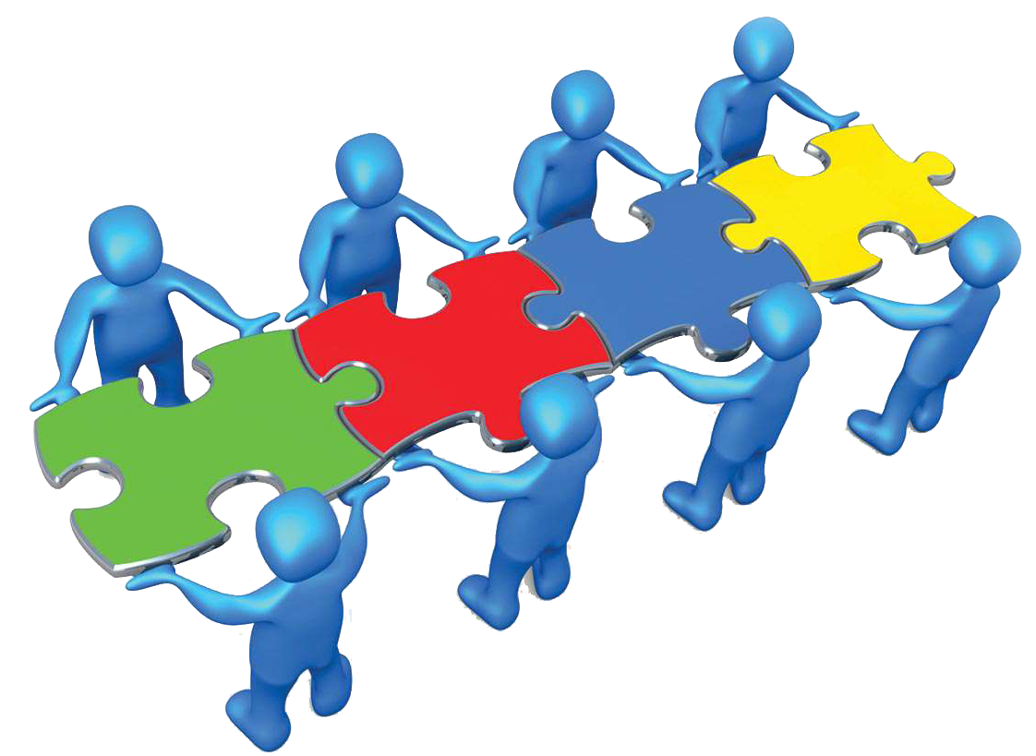
Benefits of Team Working
Encourages creativity by brainstorming and blending each team member’s ideas in order to generate smarter solutions. Team work is usually giving people opportunities to design a plan that usually helps in achieving a goal.
(Dawson, 2021)

Slide 6

Stages of Team Development
Forming
Forming team members are usually excited about working with each other and eager to get started on the project.
Anxiety about how well they will fit in and how well they will perform is common among new members of the team.
This stage focuses on establishing a solid foundation for the team's future success by establishing a defined vision, mission, goals, and responsibilities.
(Egolf, 2013)

Slide 7
Stages of Team Development
Storming
The group members freely discuss ideas during the storming phase in an effort to stand out from the throng and win the approval of their fellow members.
Team leaders may better support their teams during this time by developing a plan to control interteam competition, promote collaboration, and guarantee projects are completed on schedule.(Scully, 2020)

Slide 8
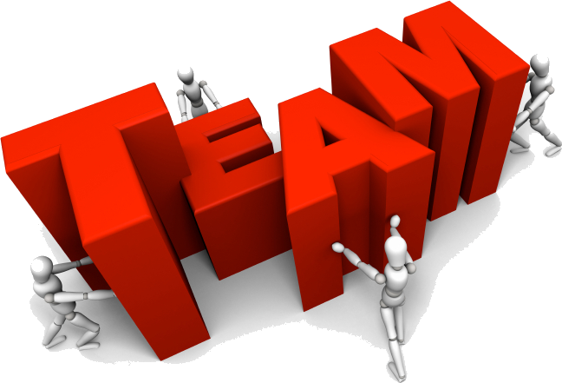
Stages of Team Development
Norming
Teams have mastered the skill of collaborating at this point.
The corporation has eliminated competition, and everyone is aware of their individual roles and duties.
Everyone's productivity levels have grown as a result of everyone being more adept at sharing their ideas with others and actively listening to what others have to say while working toward a common objective.(Llewellyn, 2017)

Slide 9
Stages of Team Development
Performing
. The team's members strongly identify with one another and have complete faith in one another.
Team leaders are no longer required to keep an eye on their subordinates' work in this manner.
Teams now have access to problem-solving techniques even while problems keep popping up that don't jeopardise deadlines or progress.
(Clutterbuck, 2020)

Slide 10
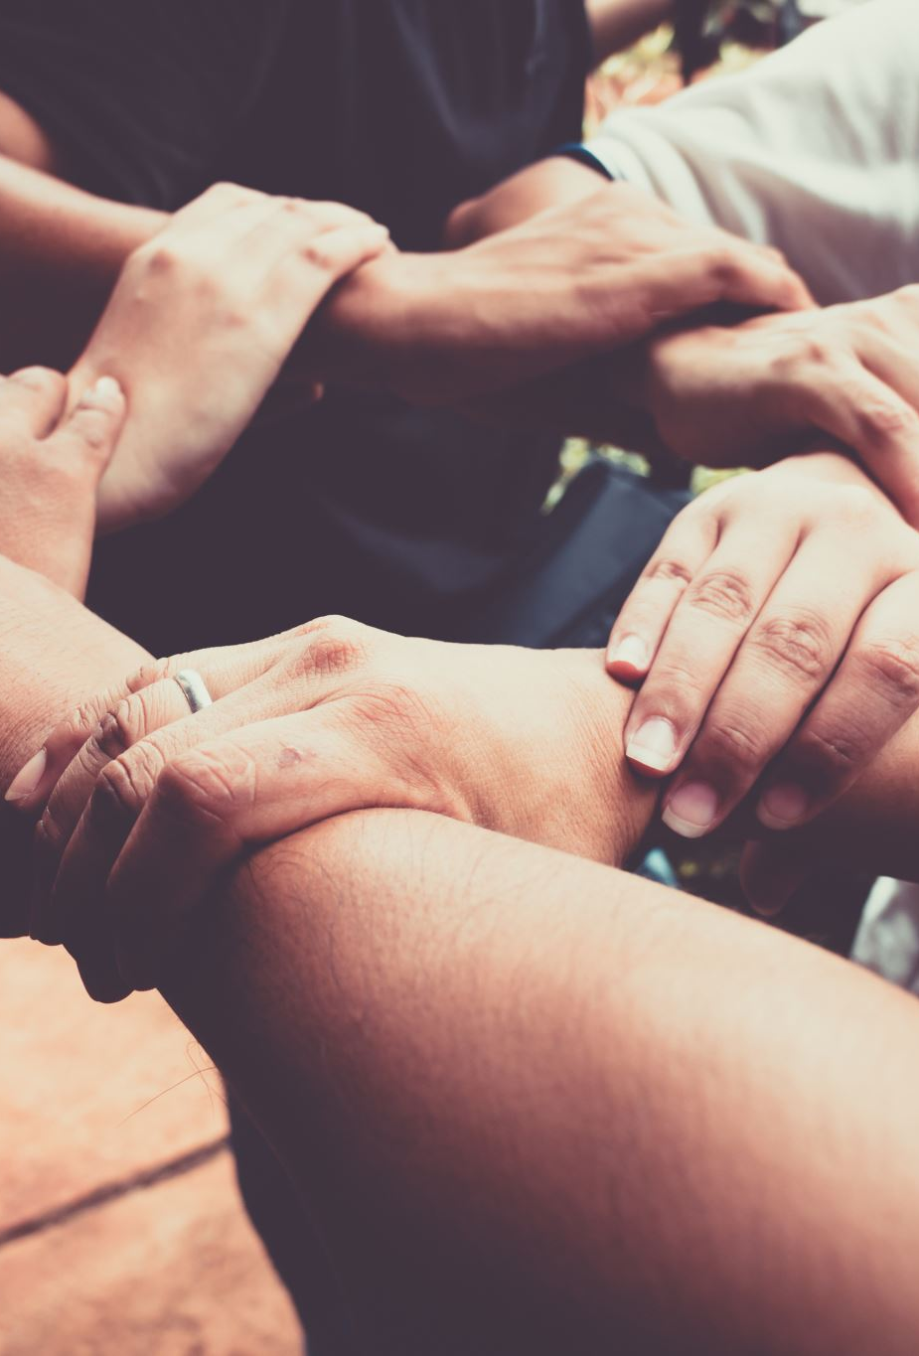
Stages of Team Development
Ending Stage
During the Ending Stage, certain team members may become less focused on the team's tasks and their productivity may decline.
To cope with their grief or loss, some members of the team may prefer to keep their minds on the job at hand.
Some members of the team may be unhappy or experience a loss as a result of the upcoming changes to their team dynamics.
(Lencioni, 2020)

Slide 11
Successful Team Development
Define the roles
The members of the team have complete faith in one another and have a strong sense of identity with one another. It is no longer necessary for team leaders to monitor the work of their subordinates in this way. Teams now have access to problem-solving methods even when new issues arise because they don't compromise timelines or progress. (Young, 2020)

Slide 12
Successful Team Development
(Owen, 2020)
Whether it is the culture of the company they work for or the group they are a part of, the most successful teams share a common culture.
The group's leader should consult with its members when creating a framework for cultural values.

Slide 13
Successful Team Development
Successful communication
The members of a team must be able to communicate effectively with one another in order to have a common purpose and be able to achieve their objectives.
Team communications can be improved by setting clear communication goals.
String Management
The team's leader establishes the group's direction before putting rules and regulations into place to aid the group in achieving its goals.
A leader must engage with the team to develop a strategy for accomplishing the team's goals, understand the nature of the goals, and help the team members carry out their responsibilities.2016's Stowell and Mead

Slide 14
Conclusion
Teamwork fosters a laid-back atmosphere.
Teamwork broadens perspectives
Teamwork frequently emphasises each member's strengths.

Slide 15
References:
Introduction:
Katzenbach, J. R.; Smith, D. K. (2003). The Wisdom of teams: creating the high-perfomance organization. New York: Harper Colins.
Maxwell J. C., (2009), Teamwork 101: What Every Leader Needs to Know., pp. 13-24
Skelton M., Pais M., (2019), Team Topologies, pp. 51-60
Clutterbuck D., (2020), Coaching the Team at Work 2. The definitive guide to team coaching, pp. 55-67
Egolf D., (2013), Forming Storming Norming Performing: Successful Communication in Groups and Teams (Third Edition), pp. 33-60
Scully D., (2020), The 5 Stages of Team Development, Posted on 07/08/2020, [Available Online: https://www.teamwork.com/blog/the-5-stages-of-team-development-what-you-need-to-know/], Accessed on 20/07/2022
on
Belbin R. M., (2010), Team Roles at Work, pp. 111-132
Indeed, (2019), The 9 Belbin Team Roles (With Examples), Posted on 07/10/2019, [Available Online : https://www.indeed.com/career-advice/career-development/belbin-team-roles], Accessed on 20/07/2022
Isaac M., (2016), A Guide to Belbin Team Roles: How to Increase Personal and Team Performance, pp. 23-44

