Slide 1

Political Influence, Policing Priority and Public Engagement
Module BMPO7003D
James Dowler - 2317969
Notes:
Will deliver a presentation based on report
Will touch upon policing governance and tripartite arrangement
Background of political influence on national/local level, policing priorities and public engagement
2. Interplay between police and politics
3. Populist national decisions and how play out locally in policing
4. Diversity in policing and politics
5. National policies vs strategic intent
Policing is political – funding, national direction etc. But shouldn’t be politicised

Slide 2
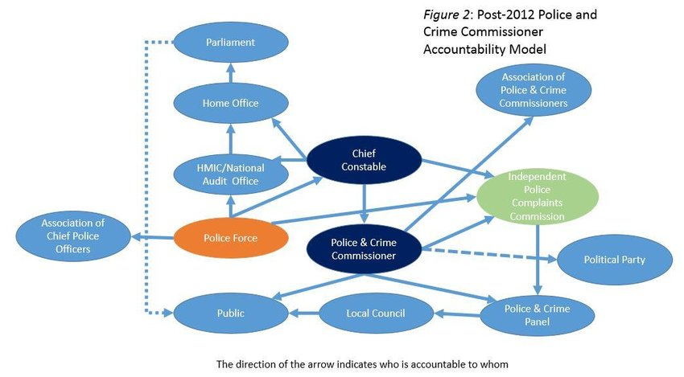
Tripartite Arrangement
Notes:
Confusing structure – tripartite
HO broad strategic priorities
PCC – hold CC to account
CC – operational delibery
Then, influence of public, council, police authotoeos, HMICFS, etc
Policing within the United Kingdom is subject to a tripartite system of governance: locally elected Police and Crime Commissioners (PCC’s) or Mayors set the strategic direction of an individual police force and hold the Chief Constable to account; Chief Constables have responsibility for the day-to-day operation of the police and the central Government, via the Home Secretary, has a broad range of powers on a national level, setting national strategic direction (Joyce & Wain, 2012). The 43 Home Office forces in England and Wales each exist within a set geographical boundary and are therefore subject to the influence of locally elected councillors and councils, potentially leading to conflicting political interest and priority (Mughan & Overstreet, 2023).

Slide 3
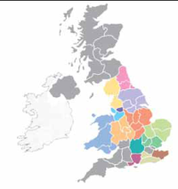
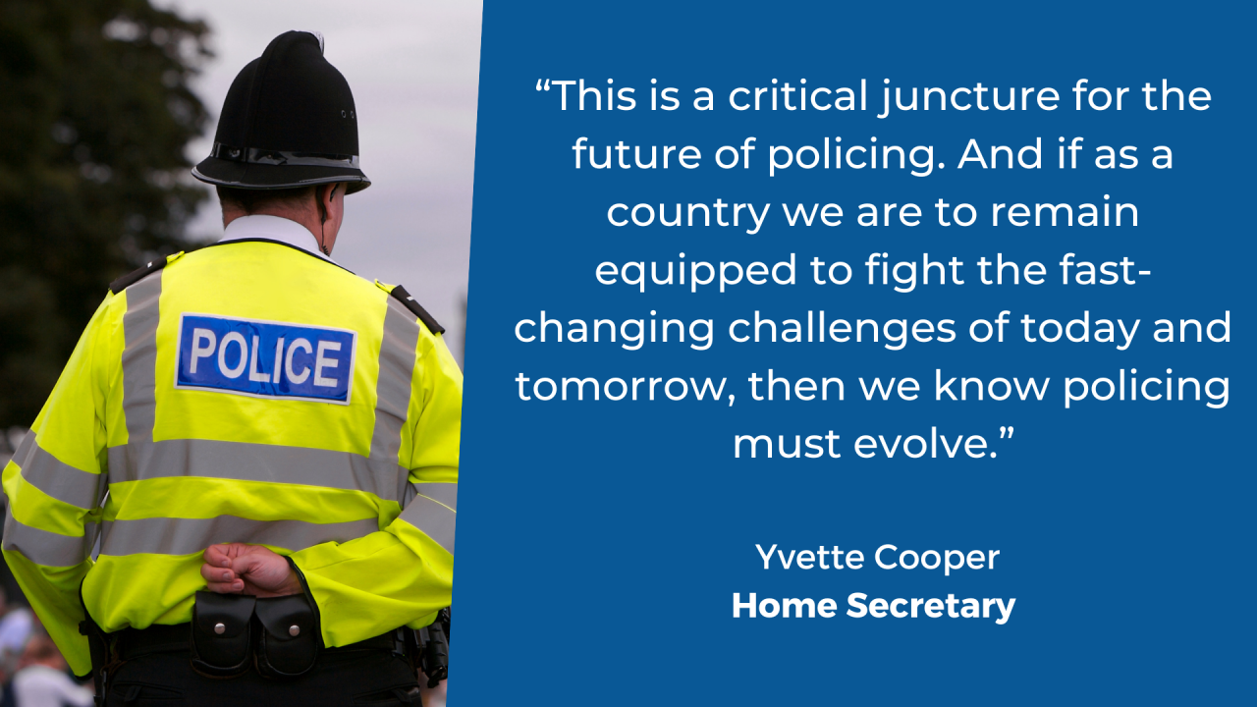
Police Reform
Notes:
Police evolve but do decisions necessarily prioritise this
Police ask for change too – not all one way
His Majesty’s Inspectorate of Constabulary and Fire and Rescue Services (HMICFRS) reported that “most” Chief Constables reported “improper pressure or interference from significant political figures” (HMICFRS, 2024).
One of the more significant changes was the Police Act (1964) which significantly reduced the number of police forces in England and Wales from 117 down to 47 (and down to 20 in Scotland) and gave greater central oversight to the Home Secretary to scrutinise forces (Lexis Nexis, 2025).
The distinction between policing and politics remains blurred and naturally, there is clearly cross over between the two: as an example, the current Metropolitan Police Commissioner has recently advocated for the reduction in the number of police forces in England and Wales from 43 to as few as 12 (The Guardian, 2025).

Slide 4
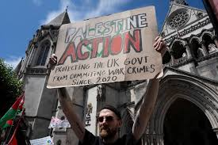
Palestinian Action and populism
Notes:
PA disruption body
Paint on RAF aircraft etc
New dieection by home sec – protest groups as terrorism
Hinges on serious criminal damage – previously not taken this into account (Home sec points to £1million damage and indepdentn review)
UN experts and others point to over policing of this – Just Stop Oil not terrorism
This is important – right wing commentators pushing for greate policing
This then has impact – protets at weekend arrest over 100
Populism – Tony Blair institute “political approach appeasl to ordinary people who feel concerns disregarded by established elite, right wing populism empahises national identitya nd cultural preservation”
Trump, Macron, Farage
The answer could be political and based on taking a strong stance to the public (Haidar, 2025). UK Consititutional Law association

Slide 5
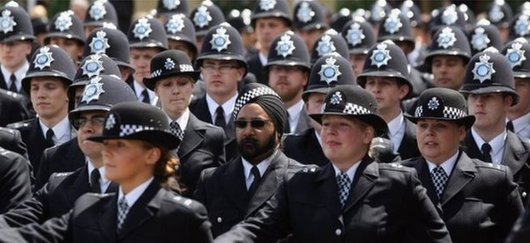
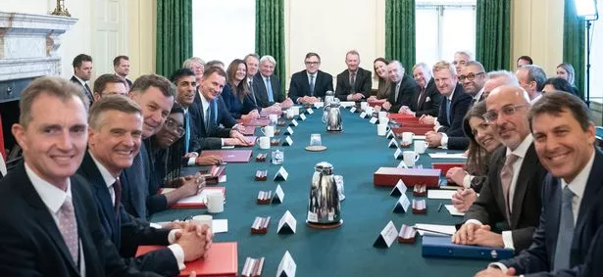
Diversity in politics and policing
Notes:
Police traditionally don’t relfct communities
Stephen Lawrence
\Focus on better justice fro dioverse groups and better representation
But what about diversity of thought?
If most politiians white, male and Oxbridge is persptive enough to ID future threats?
Matthew Sayeed – FBI fail to spot terrorist threat from Osama Bin Laden

Slide 6
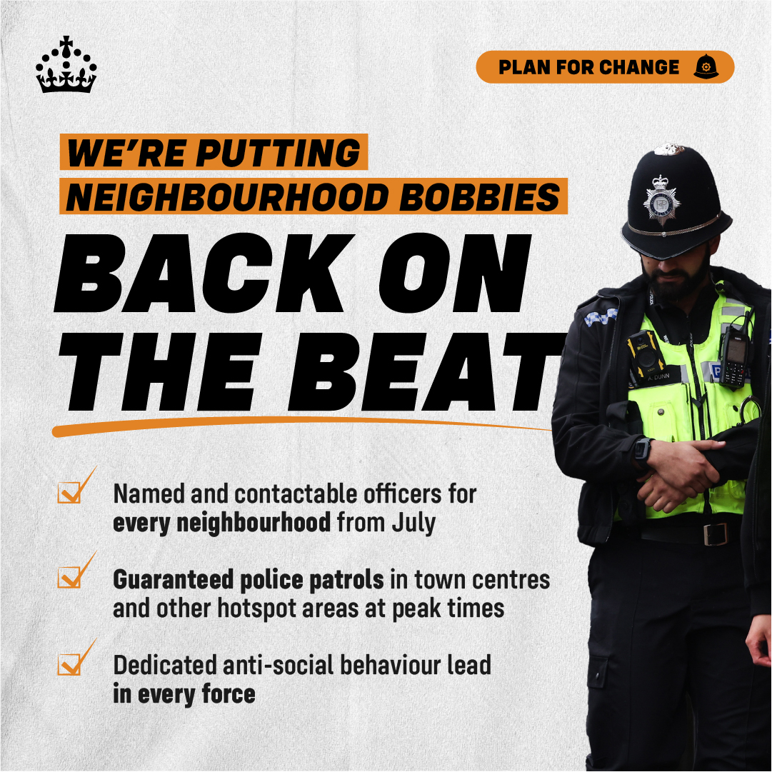
National police vs local delivery
Notes:
Stratgic policing requirement
Vs
Populist policies and looking for votes – tough on crime

Slide 7
References
Tony Blair Institute for Global Change, 2020. High Tide? Populism in Power, 1990-2020. [Online]
Available at: https://institute.global/insights/politics-and-governance/high-tide-populism-power-1990-2020
Slide 2 – Tripartite arrangement diagram
Eckersley, P., Murphy, P. & Ferry , L., 2016. Accountability and transparency: Police forces in England and Wales. [Online]
Available at: https://www.researchgate.net/publication/308898608_Accountability_and_transparency_Police_forces_in_England_and_Wales
[Accessed 17 July 2025].
Slide 3 images
Police Professional, 2006. Map is redrawn. [Online]
Available at: https://policeprofessional.com/news/map-is-redrawn/
[Accessed 17 July 2025].
Public Sector Executive, 2024. Policing reform to drive confidence among public. [Online]
Available at: https://www.publicsectorexecutive.com/articles/policing-reform-drive-confidence-among-public
[Accessed 18 November 2025]
Slide 4 image:
Reuters, 2025. UK's Palestine Action loses bid to pause ban as terrorist group. [Online]
Available at: https://www.reuters.com/world/uk/uks-palestine-action-bids-pause-government-ban-2025-07-04/
[Accessed 7 July 2025].
Slide 4 quote:
Tony Blair Institute for Global Change, 2020. High Tide? Populism in Power, 1990-2020. [Online]
Available at: https://institute.global/insights/politics-and-governance/high-tide-populism-power-1990-2020
Haidar, N., 2025. UK Constitutional Law Association. [Online]
Available at: https://ukconstitutionallaw.org/2025/07/08/nour-haidar-home-secretary-vs-palestine-action-the-constitutional-implications-of-widening-the-legal-understanding-of-terrorism/
[Accessed 14 July 2025].

Slide 8
References
Slide 5 :
BBC, 2016. Police ethnic diversity record 'shocking', MPs warn. [Online]
Available at: https://www.bbc.co.uk/news/uk-36348750
[Accessed 17 July 2025].
The Mirror, 2022. Nearly two-thirds of Rishi Sunak's new Cabinet attended private school, analysis reveals. [Online]
Available at: https://www.mirror.co.uk/news/politics/nearly-two-thirds-rishi-sunaks-28333940
[Accessed 17 July 2025].
Slide 5 quote
Syed, M., 2019. Rebel Ideas - The Power of Diverse Thinking. 1st ed. London: John Murray Press.
Slide 6 image:
UK Prime Minister, 2025. Facebook. [Online]
Available at: https://www.facebook.com/photo.php?fbid=991036019882396&id=100069280206756&set=a.249774874008518
[Accessed 17 July 2025].

