Slide 1
Digital Skills Support Session
Essential Skills Week 5: Digi Focus-Using AI Effectively and Responsibly in Your Studies

Slide 2
Lesson Aims
In this session you will:
Explore and understand UWTSD AI guidance
Consider how AI applies to your assessments
Identify positive and negative uses of AI for responsible study

Slide 3

Discussion Points
Before we begin…
In pairs, discuss:
What comes to mind when you think about using AI in your assessments?
What do you think is allowed?
What do you think might be risky or not allowed?

Slide 4

Why AI matters at university
Why are we talking about AI?
AI tools are widely available and easy to access
AI can support learning if used appropriately
Misuse of AI can lead to academic misconduct
Understanding expectations protects you

Slide 5

What AI is (and isn’t)
Understanding AI in simple terms
What AI is
Artificial Intelligence (AI) refers to computer systems that can generate text, images, or answers based on patterns in existing data
AI tools can help summarise information, explain concepts, or suggest ideas
What AI isn’t
AI does not understand your assessment or marking criteria
AI does not think, reason, or have opinions.
AI can make mistakes, invent information, or sound confident but be wrong
NB: AI is a tool, not a replacement for your thinking

Slide 6
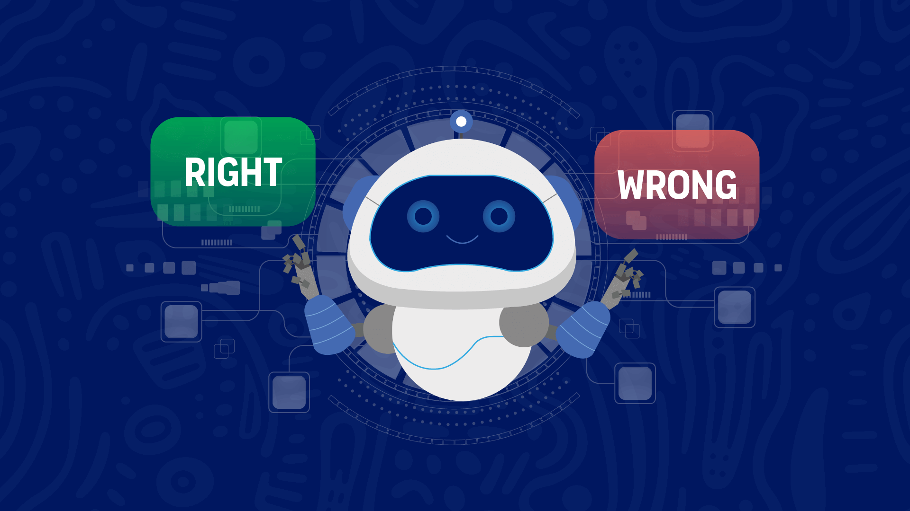
UWTSD AI guidance (overview)
University expectations on AI use
AI use must follow UWTSD academic regulations
You are responsible for the work you submit
AI-generated content must not replace your own work
Misuse may be treated as academic misconduct

Slide 7

Current AI tools and uses
In pairs, discuss:
Which AI tools do you currently use and why ?
What do you mainly use them for?
Share your responses on Padlet.

Slide 8
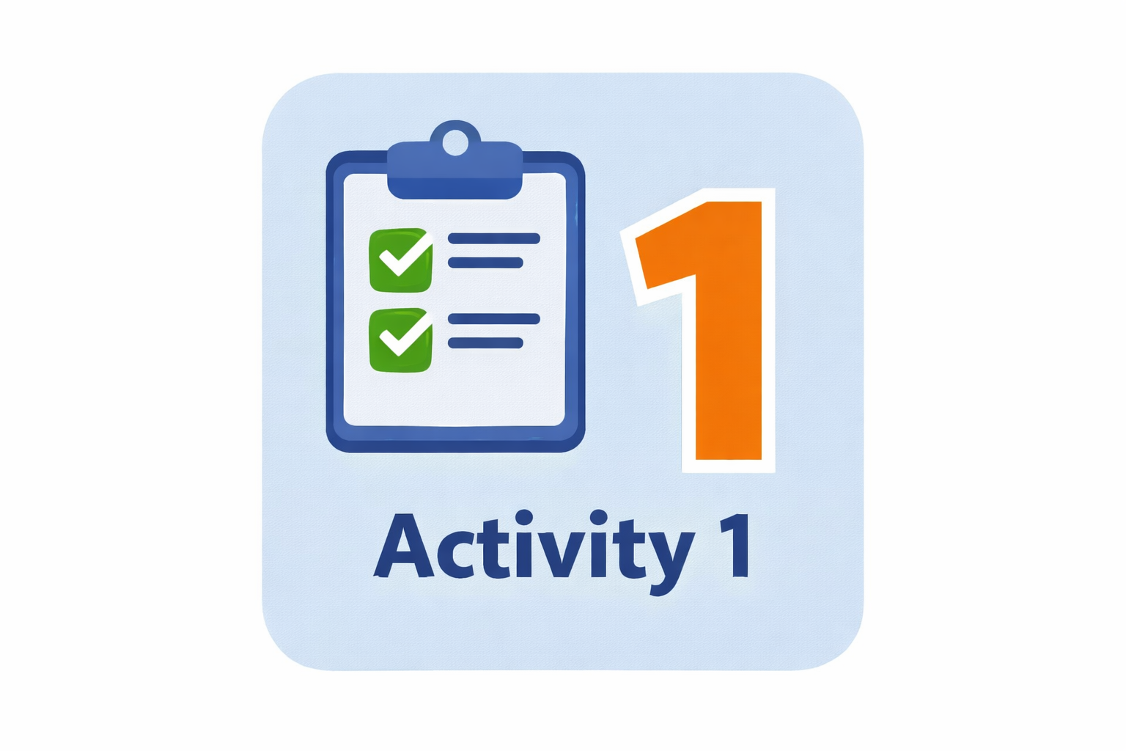
Activity 1: Guidance review
In pairs or small groups:
  Watch / read the UWTSD General / Allowable Use AI Guidance
  provided
Discuss together:
  What is allowed?
  What is not allowed?
  What surprised you?

Slide 9
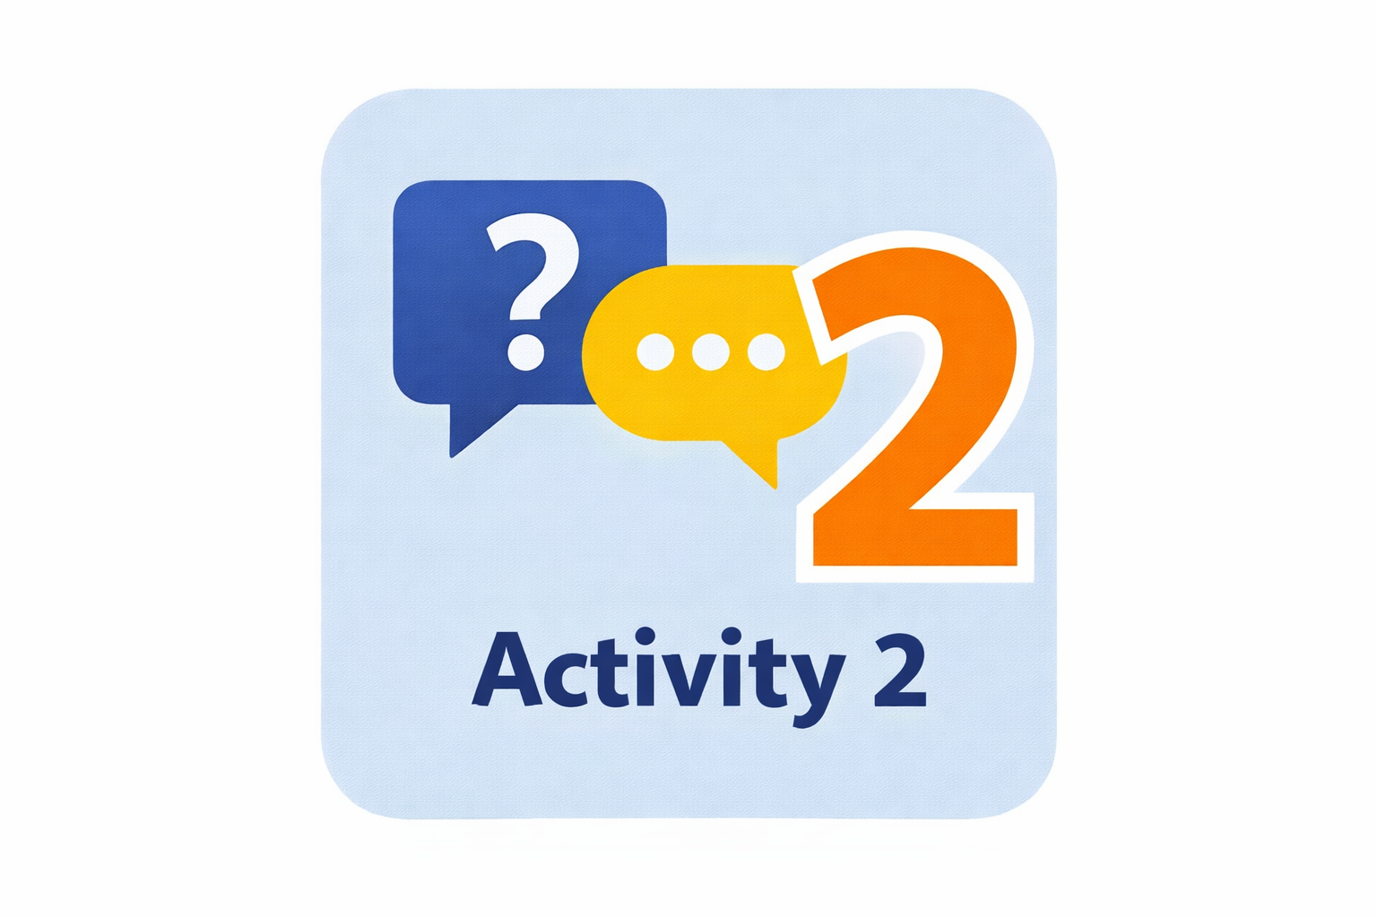
Activity 2: Explaining the UWTSD Allowable Use AI Guidance
Group task
Prepare a 2–3 minute explanation for your peers:
  How would you explain the Allowable Use AI Guidance to a friend?
  What should students be careful about?

Slide 10

Positive uses of AI (safe examples)
Copilot task:
  Use Copilot to explore the UWTSD Allowable Use AI Guidance and generate examples to support your discussion.
In groups, identify:
ways AI can be used appropriately
examples you have seen or used

Slide 11

Negative uses of AI (pitfalls)
Copilot task:
Use Copilot to identify examples of risky or not allowed uses of AI based on the UWTSD Allowable Use AI Guidance.
In groups, identify:
uses that could cause problems
uses that may breach the guidance

Slide 12
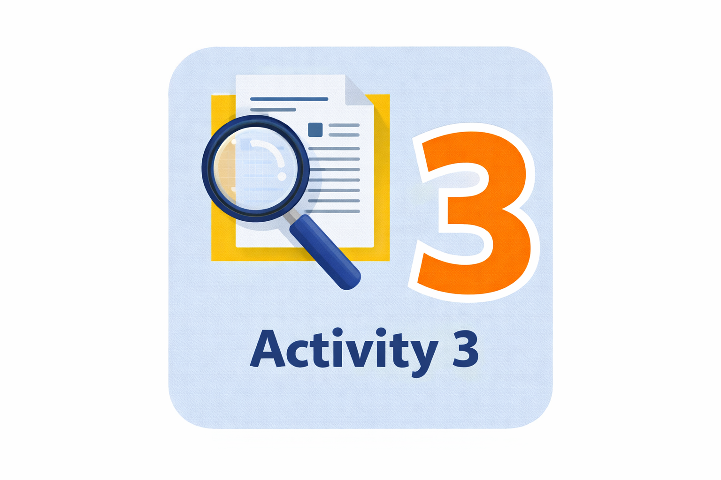
Activity 3: Identifying AI-generated writing
You will be given two short paragraphs:
(Paragraph A and Paragraph B)
One paragraph was written by a student, and one was generated using AI. In pairs or small groups, read both paragraphs carefully.
Which paragraph do you think was generated using AI?
What features or clues influenced your decision?
What risks might there be in submitting AI-generated writing?

Slide 13

Applying AI guidance to your assignment
How does this apply to your work?
AI should not write your assignment for you
You must understand and check anything AI helps with
Your ideas, structure, and argument must be your own

Slide 14
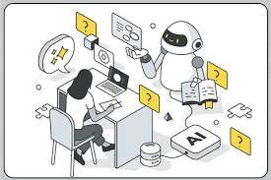
Using AI to support your studies
In pairs or small groups, discuss how AI can be used for:
Note-taking and summarising your own notes
Time management and study planning
Understanding difficult concepts
Supporting research (e.g. explaining key terms or theories)

Slide 15
Activity 4: Is this acceptable AI use?
In groups, discuss each scenario and decide:
Is this acceptable, risky, or not allowed?
Why?
Scenario 1 – Language Polishing
A student writes their essay themselves and uses AI to correct grammar and improve clarity.
Debate prompt:
Is this different from using academic writing support?
Scenario 2 – Practice Questions
A student uses AI to create example exam questions to practise before a test.
Debate prompt:
Is this a valid revision strategy?

Slide 16
Activity 4: Is this acceptable AI use?(cont’d)
In groups, discuss each scenario and decide:
Is this acceptable, risky, or not allowed?
Why?
Scenario 3 – Paraphrasing Tool Overuse
A student writes their assignment, then uses AI to rewrite every sentence to sound more academic.
Debate prompt:
Is this still the student’s own voice?
Scenario 4 – Submitting AI Writing
A student submits AI-generated writing as their own work.
Debate prompt:
Is minimal editing enough to claim authorship?

Slide 17

Remember
You are responsible for your work
AI is a tool, not a shortcut
Understanding university guidance protects you
When unsure, ask for advice

Slide 18
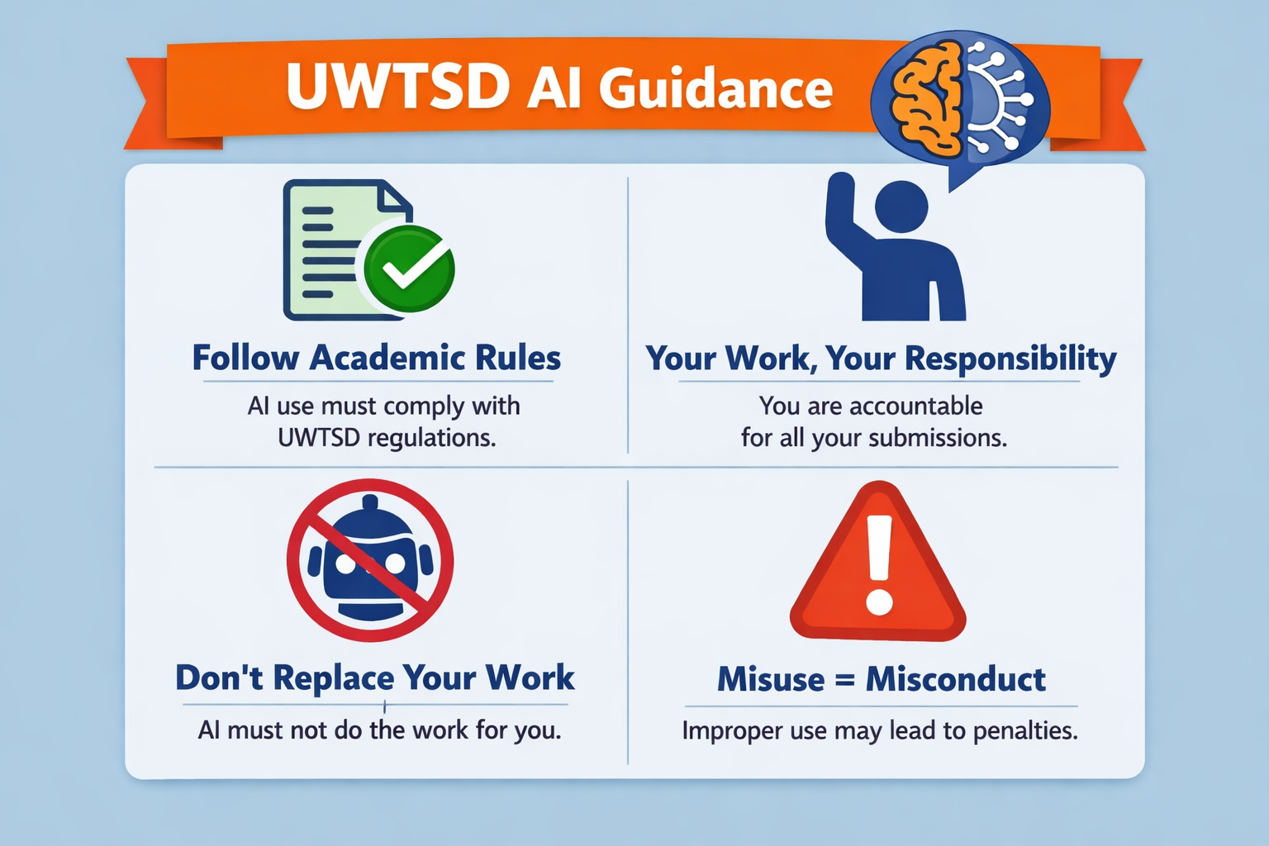

Slide 19

Any Questions?

