Slide 1
Skills for Life:
Employability and Entrepreneurship
ECYW5008
6th November 2025
Notes:
1

Slide 2
Module Aim
To foster a range of behaviours, attitudes and competencies which develop enterprising thinking and an employability mindset and enhance students’ ability to critically reflect on their own development needs.

Slide 3
Learning Outcomes
Upon the successful completion of this module, the student should be able to:
evaluate personal employability skills and their congruence with the skills required for professional practice;
reflect on the importance of continual learning and future thinking for own personal development and employability;
research and demonstrate a critical analysis of the principles of effective employability skills and good practice with links to entrepreneurship and innovation.

Slide 4
Indicative Content
A comprehensive examination of methods of developing management skills and implementing effective methods of marketing, risk assessments, financial forecasts, feasibility, profitability, sustainability, business and operational plans, capacity building and change management.
An overview of the entrepreneurial leader: a study of the social entrepreneur as a continual learner and the importance of coaching and the identification of staff development needs in order to support professional development to ensure a high-quality workforce and the need to focus on employability.

Slide 5
Indicative Content
Creating a professional profile e.g. CV writing, LinkedIn, appropriate use of social media, AI and professional networking. Effective interview and presentation techniques, job-searching and application processes.
Personal development planning, mentorship, and continuing professional development.
Behaviours, attributes and characteristics associated with developing an enterprising mind-set and fostering dynamic and innovative thinking e.g., initiative, creativity, self-discipline, flexibility.
Interpersonal skills for the workplace e.g., teamwork, leadership, conflict resolution, negotiation.

Slide 6
Assessment
Written Assessment
4000 words
Portfolio of 3 elements
Submission date:
11th December 2025 (full-time student)
13th January 2026 (part-time student)

Slide 7
Written Task 1: 1000 words
Task 1: Personal Employability Skills CV (1,000 words)
Task Description: Students will be required to create a CV that highlights their academic achievements, work experience, volunteering, extracurricular activities, and transferable skills. The CV should be tailored to a specific career or sector, using evidence-based bullet points to demonstrate responsibilities, achievements, and teamwork. Students should reflect on how their experiences align with the skills required for their chosen profession, using the STAR (Situation, Task, Activity, Result) or CAR (Context, Action, Result) frameworks to structure their entries.​

Slide 8
Written Task 2: 1500 words
Task 2: Reflective Essay on Personal Development and Employability (1,500 words)
Task Description: Students will be required to write a reflective essay using a structured model (such as Gibbs’ Reflective Cycle) to critically analyse a significant experience (academic, work-based, or voluntary). The essay should identify strengths, weaknesses, and areas for improvement, and discuss how continual learning and adaptability have shaped their employability mindset. Students should also consider how future thinking, and lifelong learning will support their career progression and personal growth.​

Slide 9
Written Task 3: 1500 words
Task 3: Critical Analysis of Employability Skills and Entrepreneurial Principles (1,500 words)
Task Description: Students will be required to conduct a literature review of current theories and best practices in employability, entrepreneurship, and innovation. The assignment should include a critical analysis of how these principles are applied in real-world contexts, drawing on academic literature and case studies. Students should evaluate the relevance of these principles to their own career aspirations and discuss how enterprising thinking can enhance employability in a rapidly changing job market.

Slide 10

Any Questions?

Slide 11
Module Engagement Expectations
Attend all scheduled lectures to deepen your understanding and actively contribute to class discussions.
Complete every weekly self-directed task. These are essential for developing your skills and knowledge outside the lecture room.
Treat self-directed tasks as a core part of your learning journey, not optional extras.
Regular engagement in both lectures and self-study will help you achieve the module's learning outcomes.

Slide 12
Module Engagement Expectations
Your commitment to these activities will be closely monitored and plays a key role in your overall development.
Make use of feedback to support your academic and personal growth.
Consistent engagement shows your professionalism and readiness for further learning – which connect to the focus of this module.
Engaging fully with lectures and weekly self-directed tasks will not only strengthen your academic performance but also build the professional habits, initiative, and self-management skills that are highly valued by employers.

Slide 13
Unlocking the Learning Journey
In your small group, discuss and list key employability skills needed in your chosen professional field
Each group member briefly evaluates their own strengths and areas for development related to these skills
Feedback

Slide 14
Unlocking the Learning Journey
In your group, discuss and share ideas on how ongoing learning and forward thinking can support career growth
Discuss practical ways to stay flexible and take charge of your own development
Feedback

Slide 15

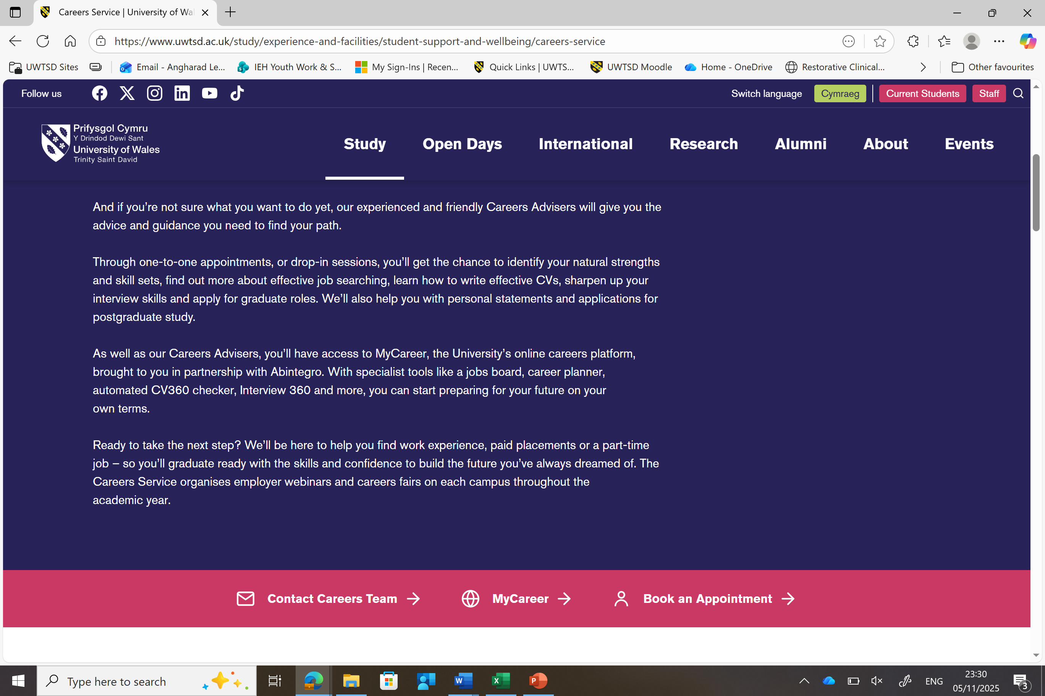
Your weekly self-directed tasks
The self-directed tasks you will engage in on a weekly basis can be located on the MyCareer platform on the UWTSD website.
There are a few ways to access this platform.
One option is to head to the website and access the Careers Service section, then scroll down until you see the pink banner and select ‘MyCareer’.

Slide 16
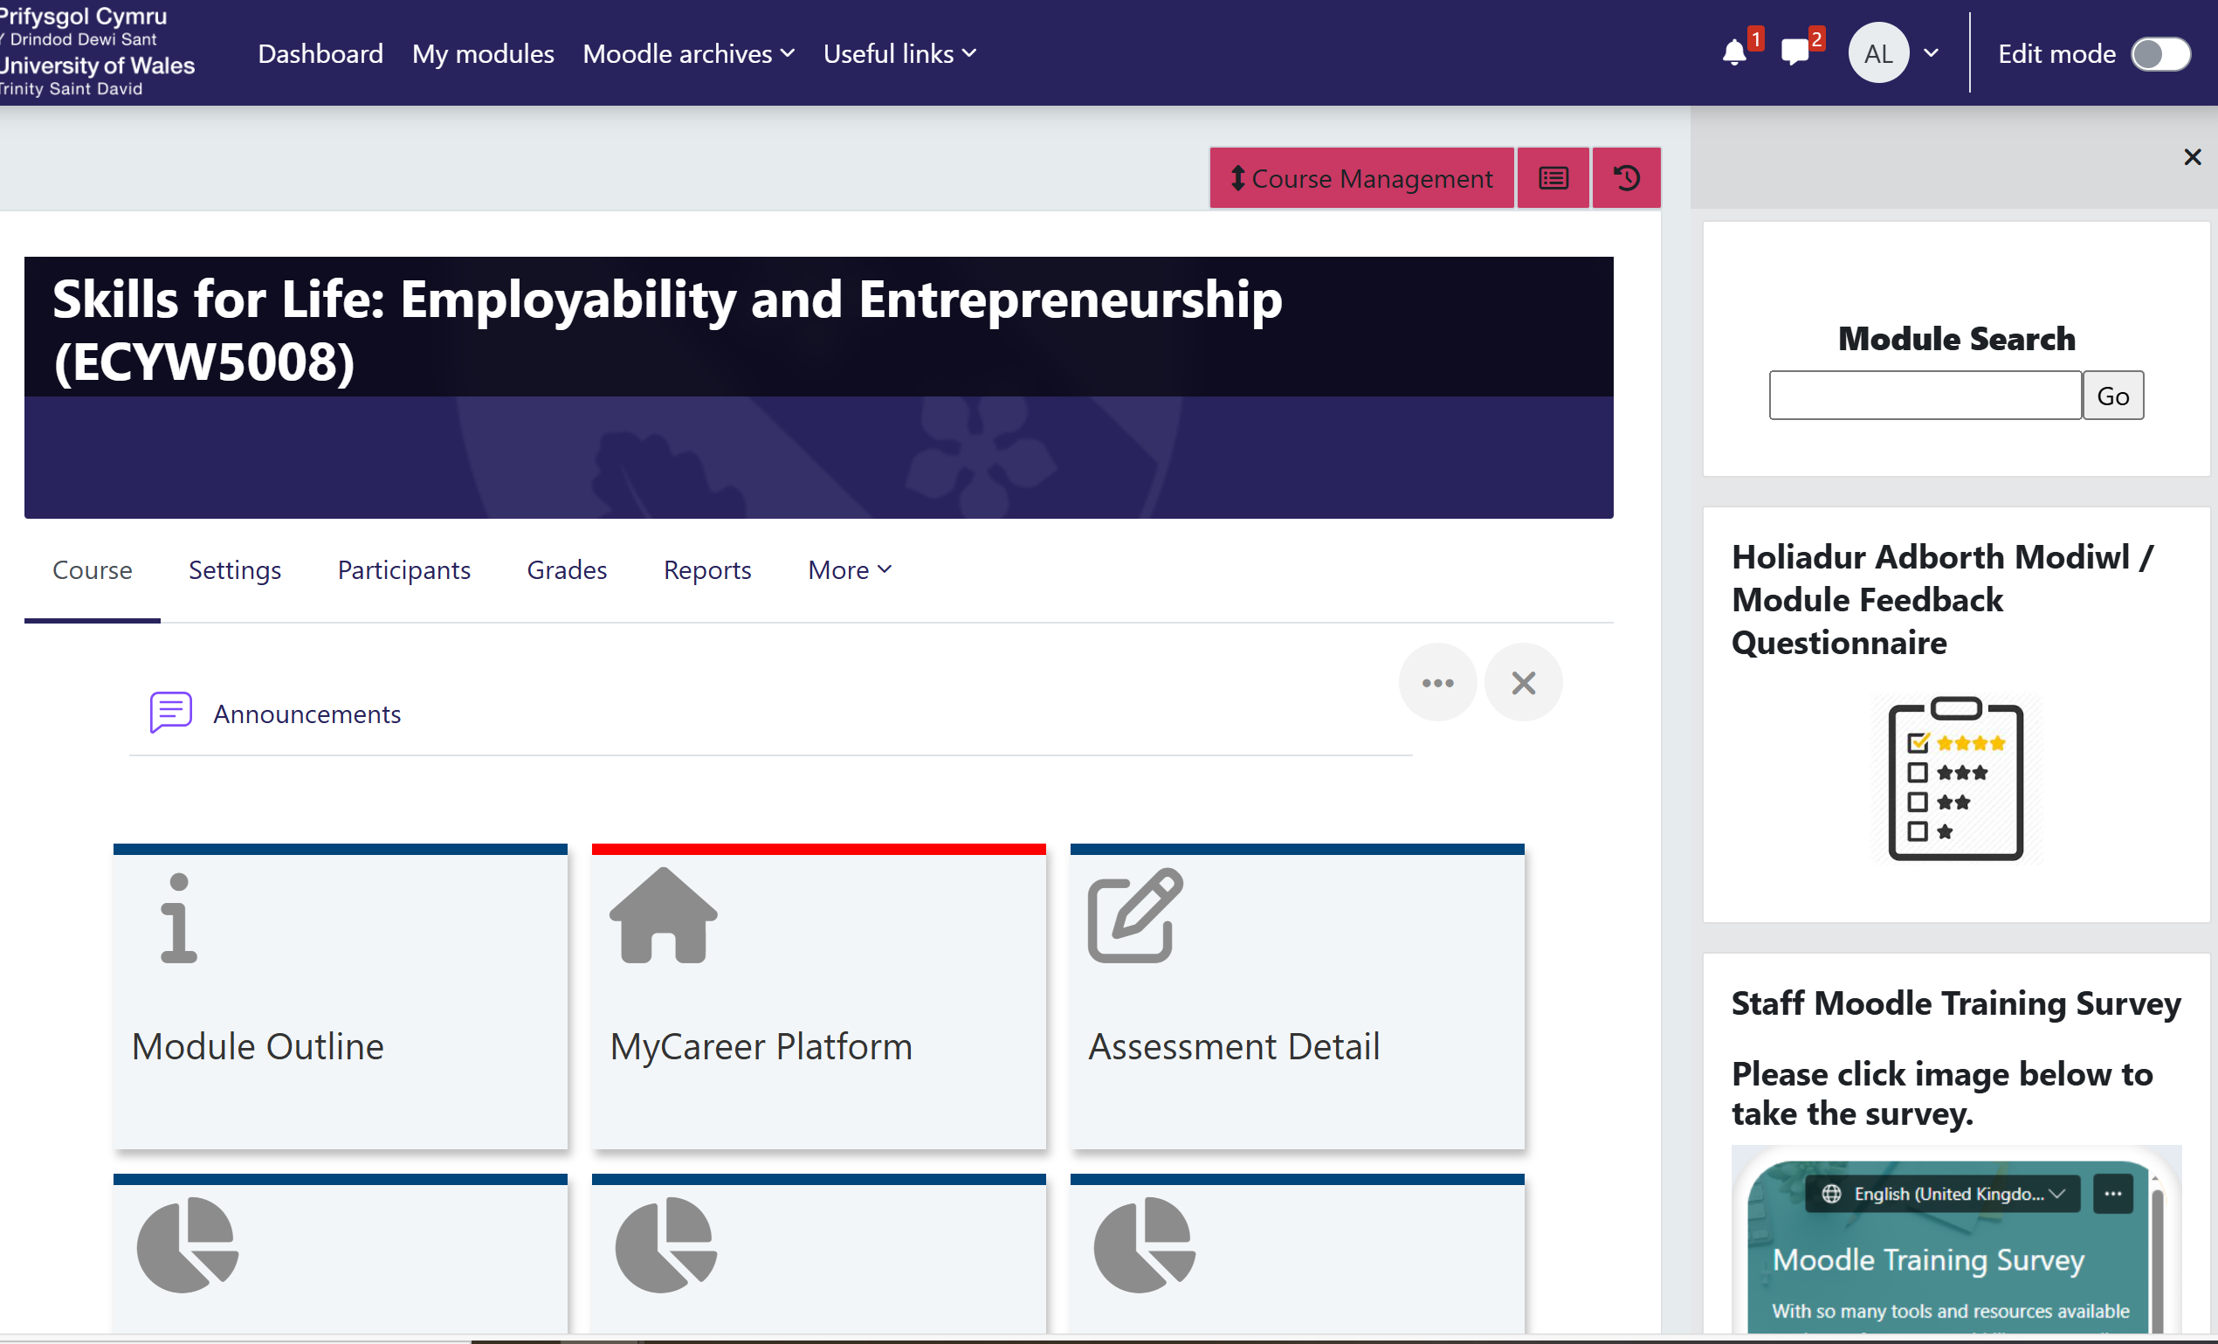
Or, access the link on Moodle

Slide 17
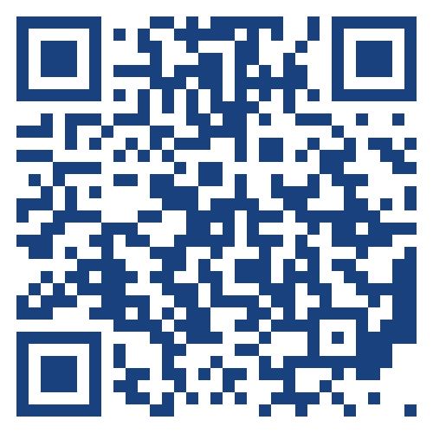
Or, scan this QR code!
Let’s put this to the test!
Please scan the QR Code
Once you are on the platform you will need to select ‘Student/Staff’
Now, sign in with your University log in
You are now on your personalised dashboard!
Don’t close this down yet on your phone…

Slide 18
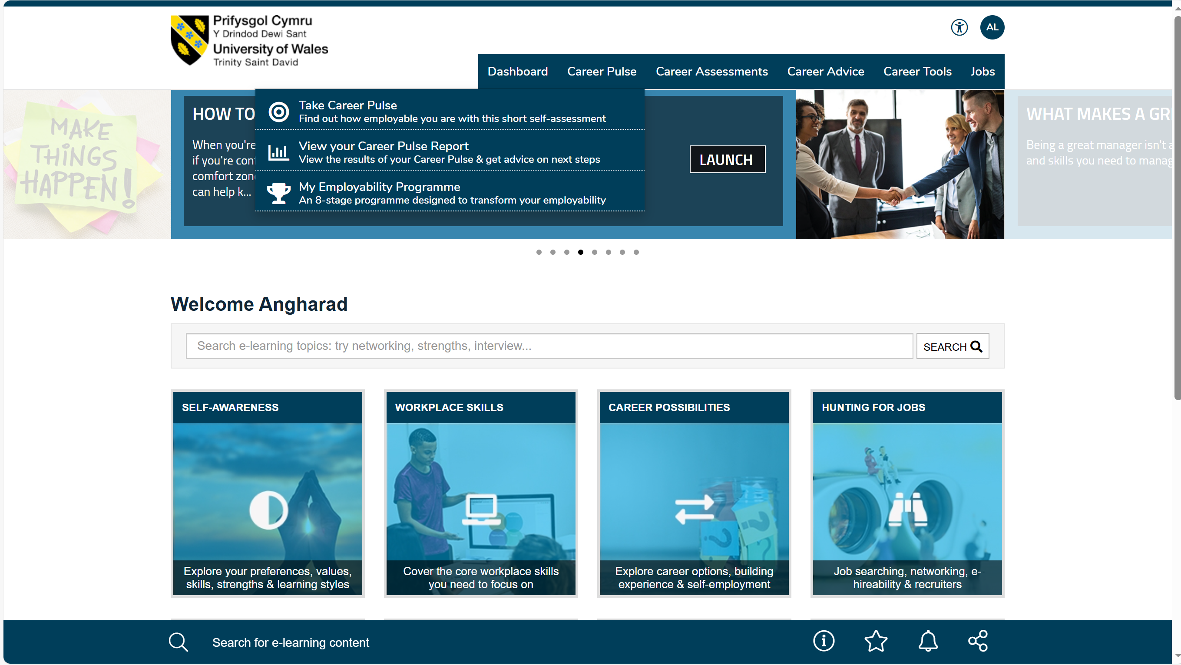
Take ‘Career Pulse’ Self-Assessment
This individual task will take a couple of minutes!
First select ‘Career Pulse’ on the top banner
Then select the first option, which is ‘Take Career Pulse’
Answer each question
You will then be provided with a personalised Employability Self-assessment Report with tips on what you can do to work on/develop/improve in the different areas

Slide 19
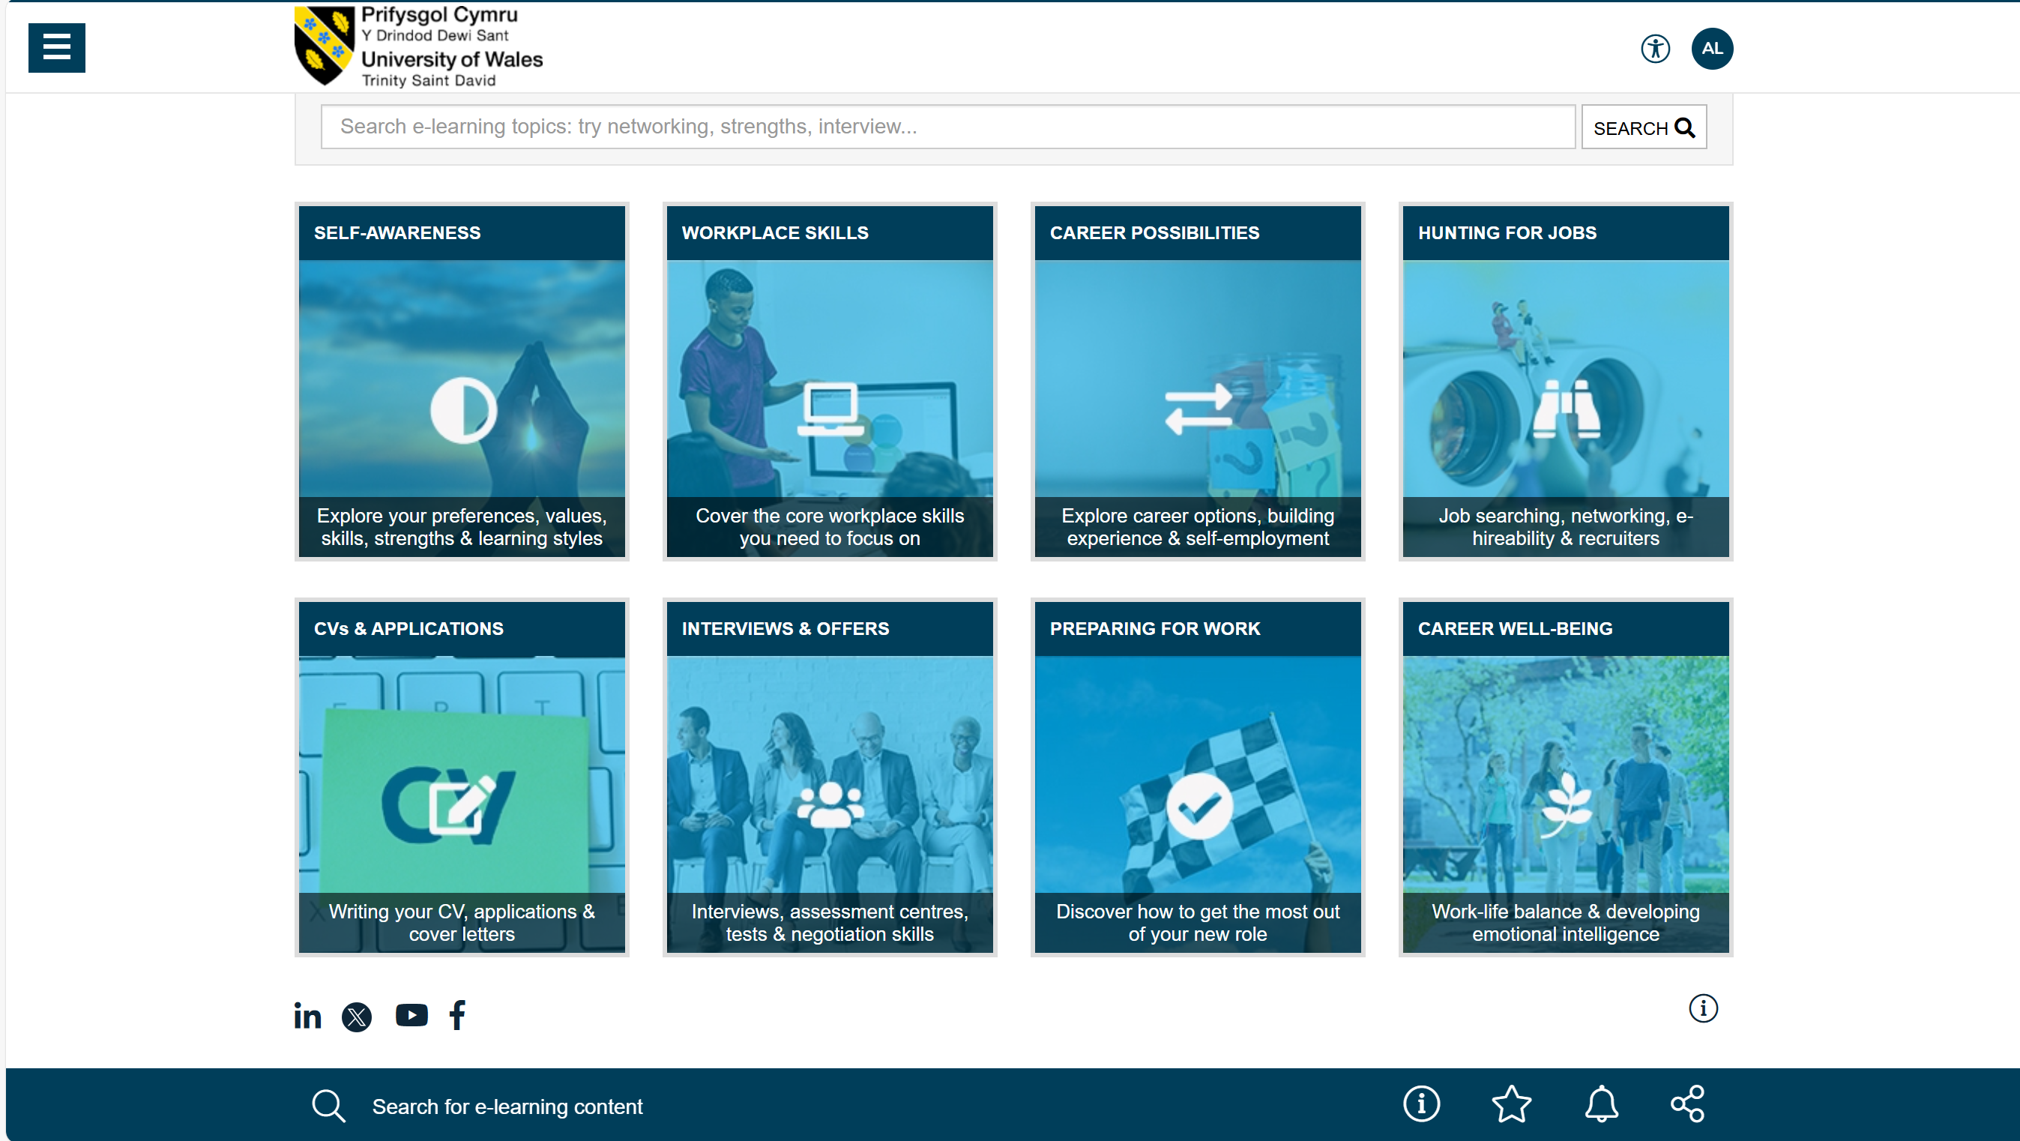
Self-Directed Task to be completed by your next lecture: Thursday 13th November…
Go to ‘MyCareer’ and complete all tasks located within the first two tiles:
Self-Awareness
Workplace Skills

Slide 20
Any Questions?

